Slide 2
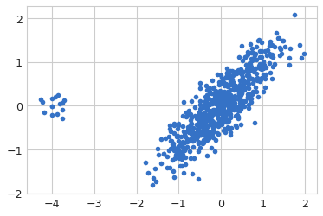
Dimensionality Reduction
Initial Dataset= [625,2] R^2

Slide 3
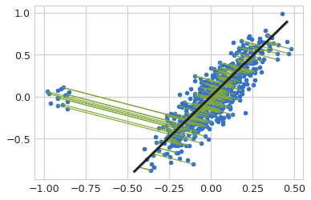
Dimensionality Reduction
Using Direction -1
Maximum Variance
Eigen vec of Co-Variance
Green segments show
Reconstruction Error
Reduced Dataset= [625,1] R^1

Slide 4
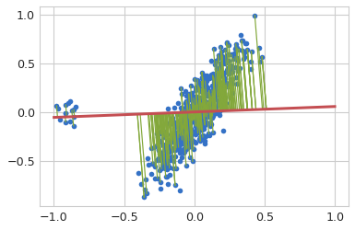
Dimensionality Reduction
using Direction-2
co-Kurtosis
Comulant tensor of
Fourth Moment
Reduced Dataset= [625,1] R^1

Slide 5
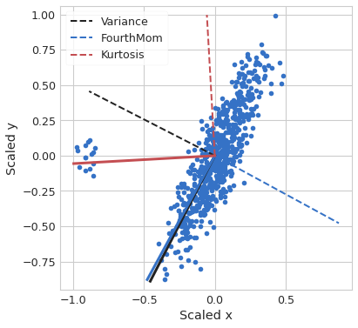
- Priciple Vectors for
Second Moment
Fourth Moment
- Optimal Direction
For anomalous cluster

Slide 6
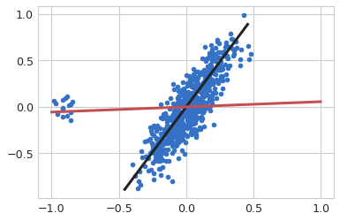
Optimal Reconstruction
1. Anomalous Cluster
Using Red Vector
2. Normal Datapoints
Using Black Vector

Slide 7
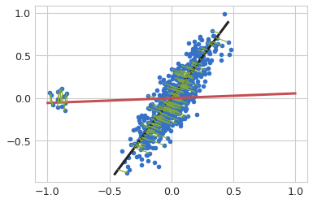
Optimal Reconstruction
1. Anomalous Cluster
Using Red Vector
2. Normal Datapoints
Using Black Vector
Minimum
Total Reconstruction Error

Slide 8
Optimal Reconstruction
1. Anomalous Cluster
Using Red Vector
2. Normal Datapoints
Using Black Vector
Minimum
Total Reconstruction Error
Requirement:
Prior Identification of Anomalies

Slide 10
The Process is reproducible for different datasets.

Slide 11
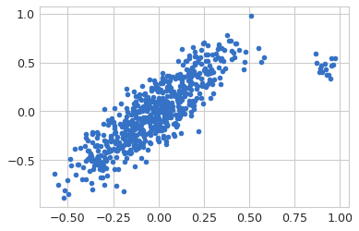
Original Dataset, {625,2}

Slide 12
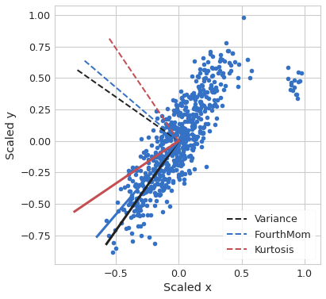
Original Dataset, {625,2}
Principle Vectors

Slide 13
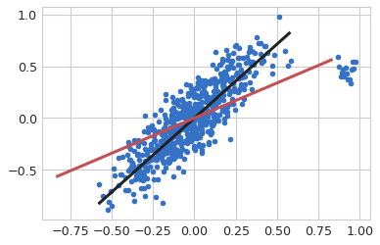
Adoptive Dim Reduction
Principle Vectors

Slide 14
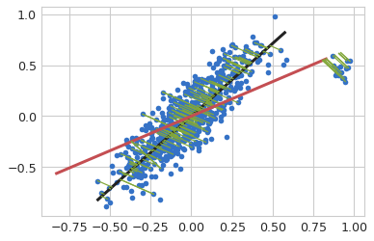
Reduced Data at [625,1], R^1
Principle Vectors

Slide 15
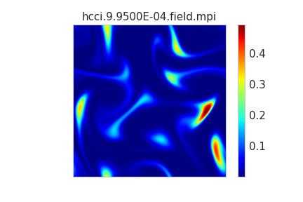
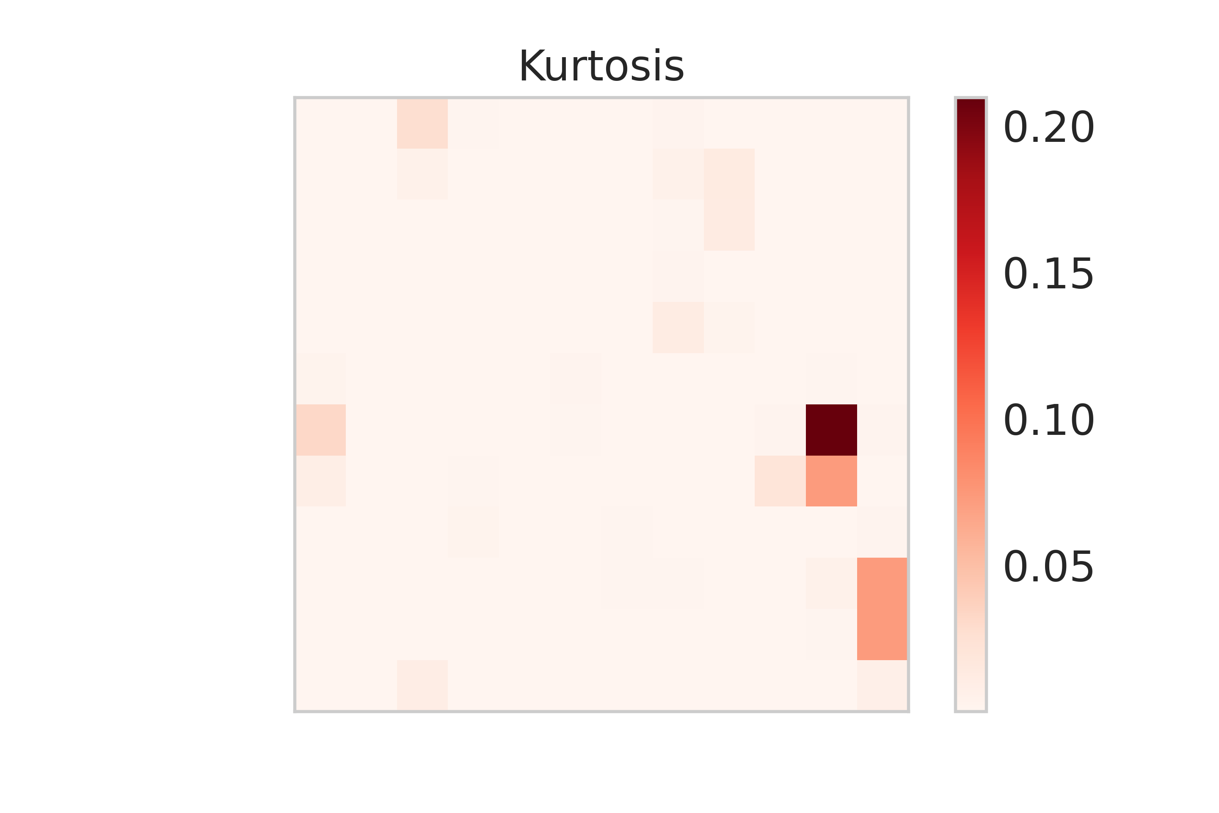
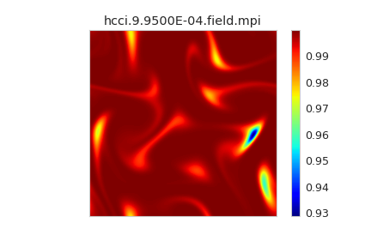
Conclusion:
Tests on HCCI Datasets
Accuracy on Reconstructed Data
Accuracy on Chemical Computations

Slide 16
Conclusion:
Tests on HCCI Datasets
Accuracy on Reconstructed Data
Accuracy on Chemical Computations

Slide 17
