Slide 2
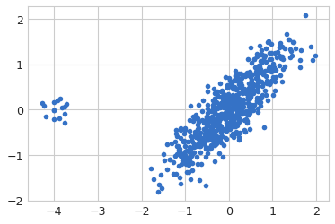
Dimensionality Reduction
Initial Dataset= [625,2] R^2

Slide 3
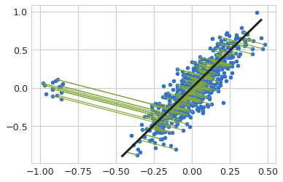
Dimensionality Reduction – 2D Gaussian
Using Direction -1
Direction of maximum Variance
Eigen vector of
Co-variance matrix
Green segments show
Reconstruction Error
Reduced Dataset= [625,1] R^1

Slide 4
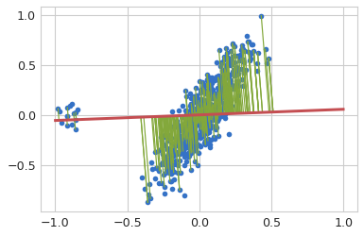
Dimensionality Reduction – 2D Gaussian
using Direction-2
Singular vectors of co-kurtosis
Cumulant tensor of fourth order moment
Notice shorter error segments for outlier cluster
Reduced Dataset= [625,1] R^1

Slide 5
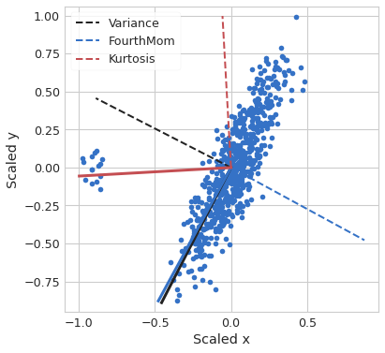
Dimensionality Reduction – 2D Gaussian
- Two possible directions are principle Vectors for
Second Moment
Fourth Moment
- Choose optimal direction for
Anomalous cluster
Majority cluster

Slide 6
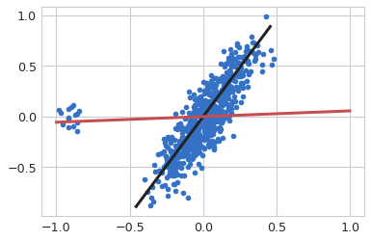
Optimal Reconstruction
1. Normal Datapoints
Using Black Vector
Minimise:
Total reconstruction error

Slide 7
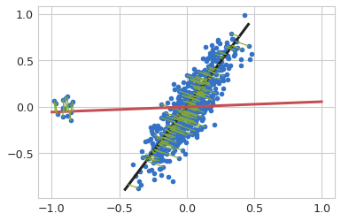
Optimal Reconstruction
1. Normal Datapoints
Using Black Vector
2. Anomalous Cluster
Using Red Vector
Minimise:-
Reconstruction error of outlier cluster

Slide 8
Optimal Reconstruction
1. Anomalous Cluster
Using Red Vector
2. Normal Datapoints
Using Black Vector
Combined problem statement:-
Minimise:-
Reconstruction error of function z(x,y)
s.t.
The source function z(.) assigns
Constrained weights to normal and outlier points

Slide 9
Combined problem statement:-
Minimise:-
Reconstruction error of function z(x,y)
s.t.
The source function z(.) assigns
Constrained weights to normal and outlier points

Slide 10
The process is reproducible for different datasets with varying orientation of kurtosis and variance vectors:-

Slide 11
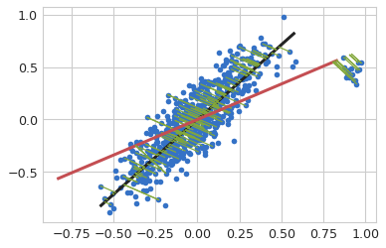
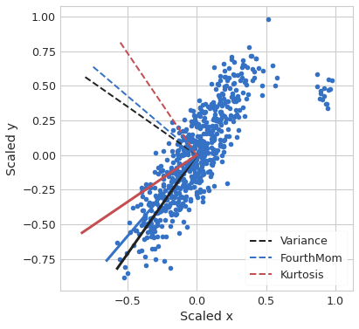
Dimensionality Reduction – 2D Gaussian
Dimensionality Reduction – 2D Gaussian
Reduced Data at [625,1], R^1
Principle Vectors

Slide 12
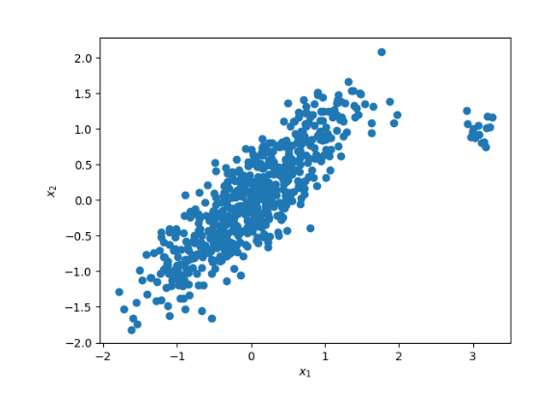
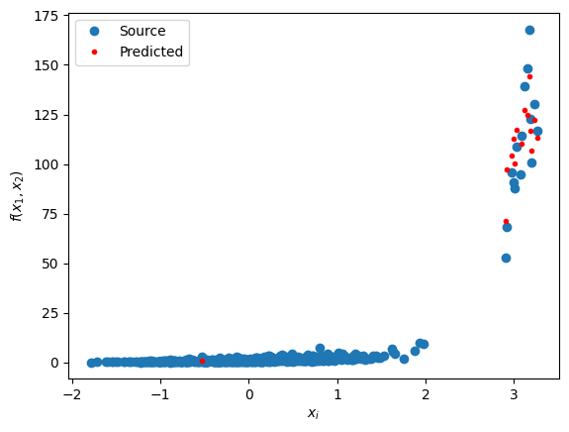
Dimensionality Reduction – 2D Gaussian
X: Given 2D dataset
z: Generate a sourcing term z=f(x1,x2)
Xp: Project 2D dataset to one dimension*
(Compressed representation)
(can be covariance/cokurtosis)
Learn mapping from projection space Xp
to source term : g(xp) ---> z
Predict z^ using regression models
(shown in red colour points)

Slide 13
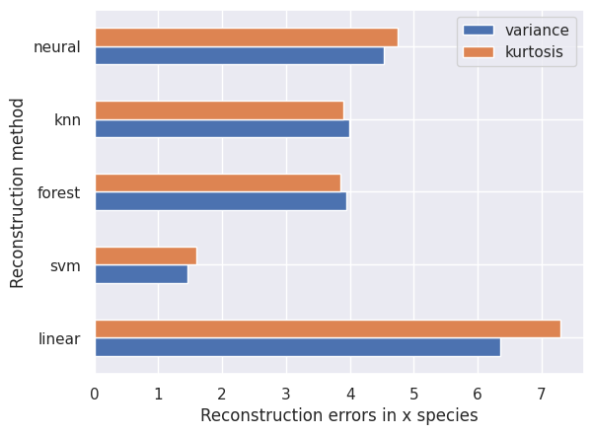
Dimensionality Reduction – 2D Gaussian
Error comparison of different regression models for covariance and cokurtosis projections:
Error in x-coordinate reconstruction

Slide 14
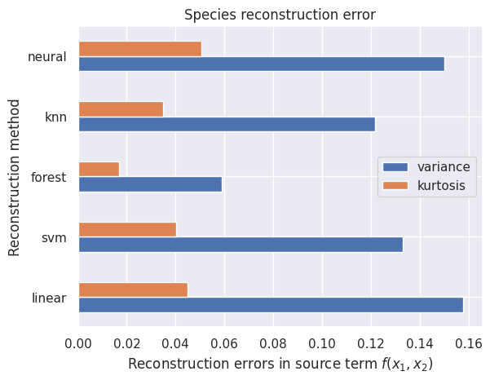
Dimensionality Reduction – 2D Gaussian
Error comparison of different regression models for covariance and cokurtosis projections:-
Error in source term f(x1,x2)

Slide 15
Dimensionality Reduction – 2D Gaussian
Error comparison of different regression models for covariance and cokurtosis projections:-
Error in source term f(x1,x2):
Kurtosis performs better than covariance
As the value of source term depends strongly on outlier cluster

Slide 16
Dimensionality Reduction – 2D Gaussian
Error comparison of different regression models for covariance and cokurtosis projections:-
Error in source term f(x1,x2)

Slide 17
Dimensionality Reduction – Syngas combustion

Slide 18
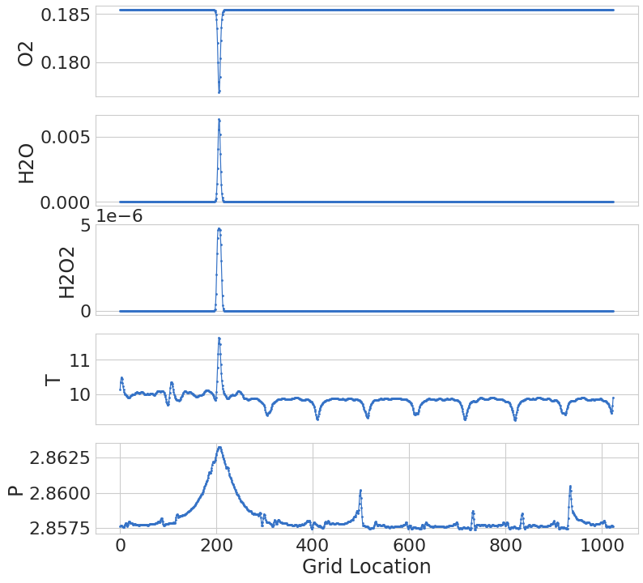
Dimensionality Reduction – Syngas combustion

Slide 19
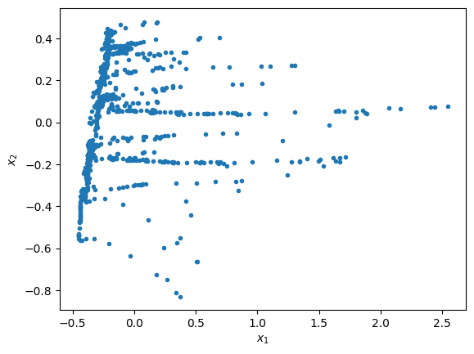
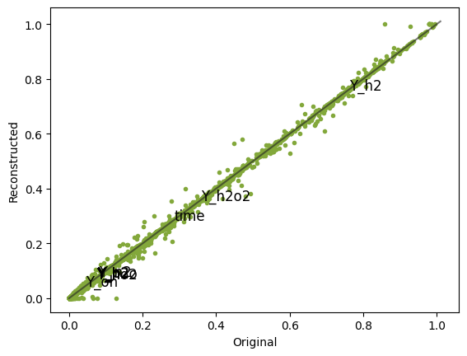
Dimensionality Reduction – Syngas combustion
Representation in 2D plane
Reconstruction error

Slide 20
Dimensionality Reduction – Syngas combustion

Slide 21
The Process is reproducible for different datasets.

Slide 22
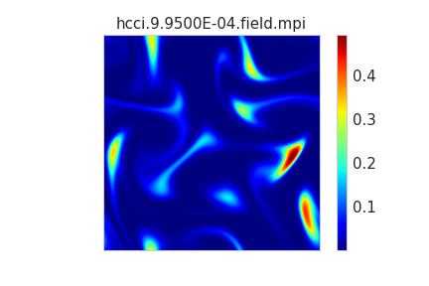
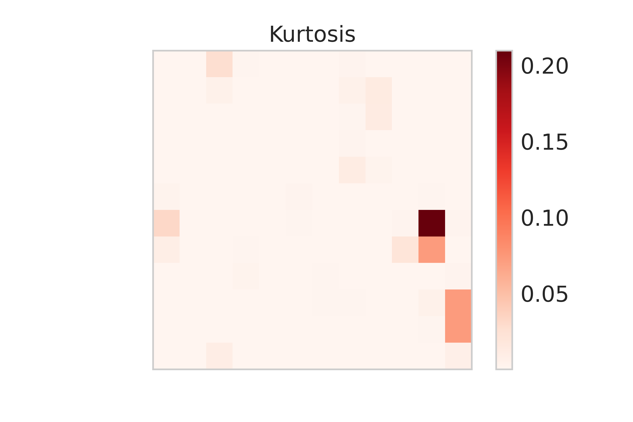
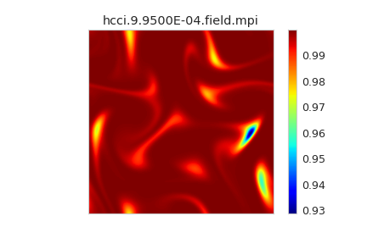
Further:-
Tests on HCCI Datasets
Accuracy on Reconstructed Data
Accuracy on Chemical Computations

