Slide 1
ECG
1)We considered other ECG-database, where we have person wise records.
2)Segmented one person’s records.

Slide 2
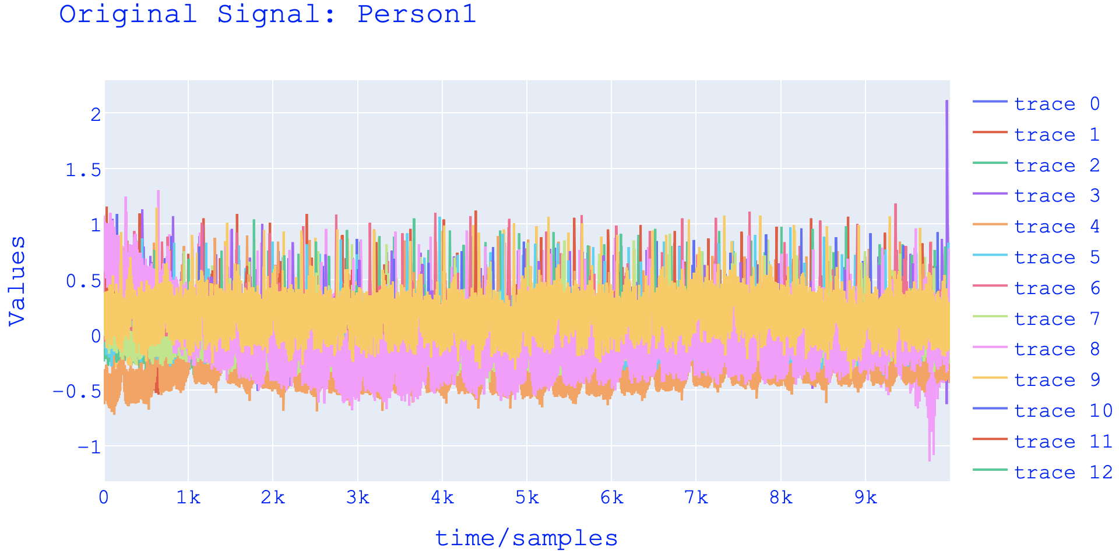

Slide 3
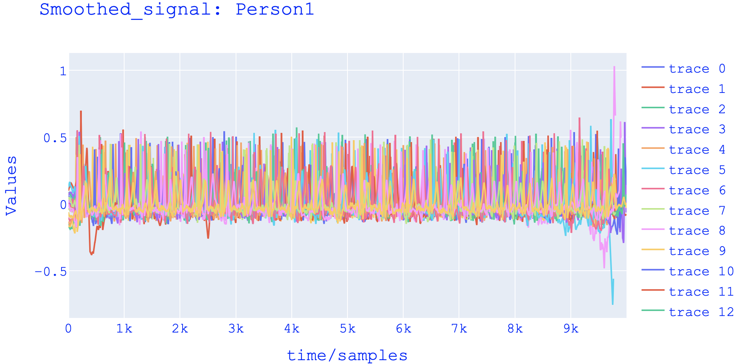

Slide 4
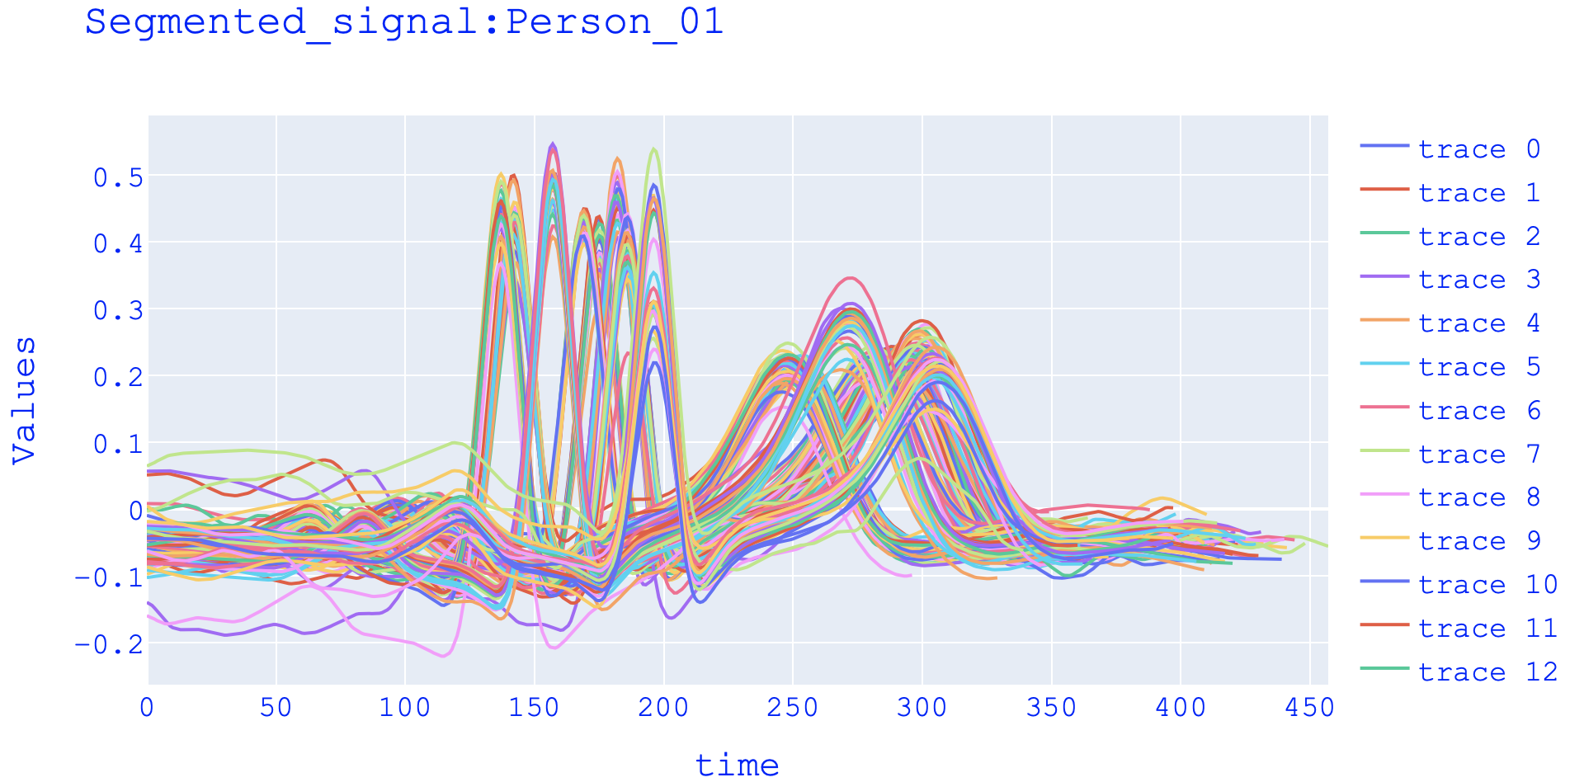

Slide 5
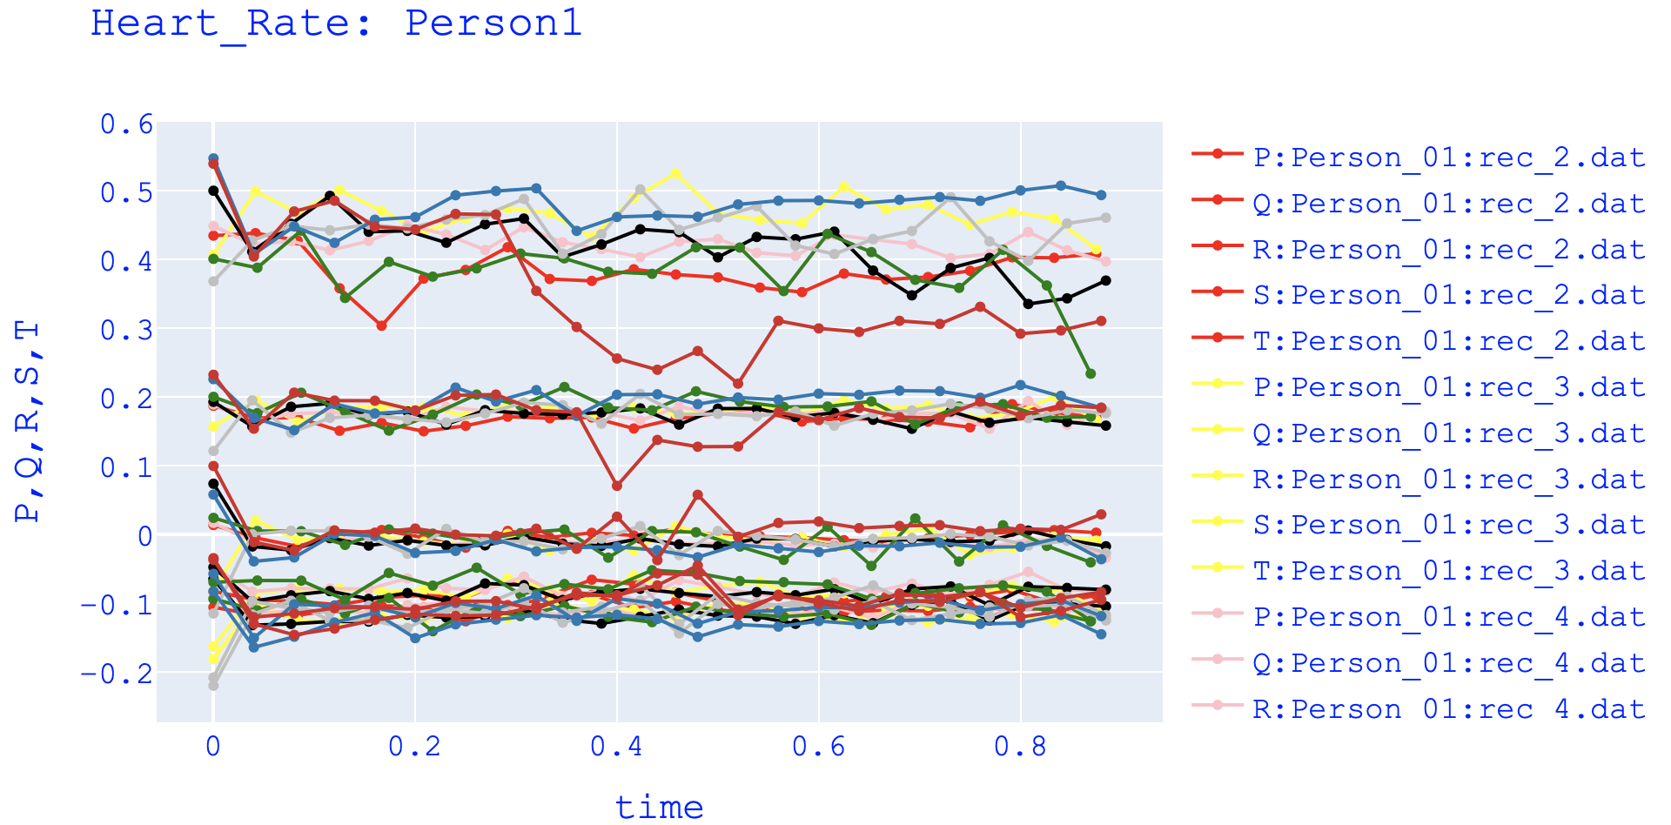

Slide 6
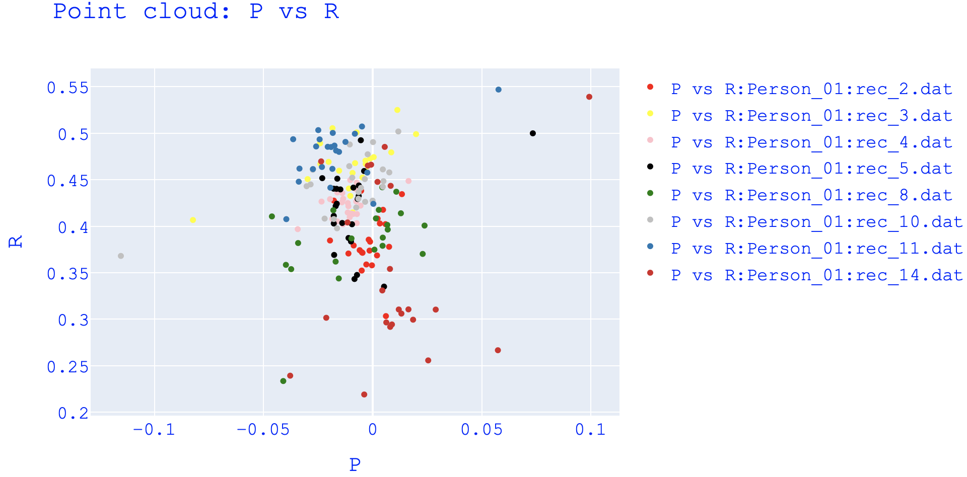

Slide 7
REGENT
1)I am trying to convert the 1D code to Regent.

