Slide 1
Analyzing normal signal and abnormal signal
Segmented each records into individual signals.
Determined P,Q,R,S,T of each individual signals of each records.
Plotted P vs R for each individual signals of each records.

Slide 2
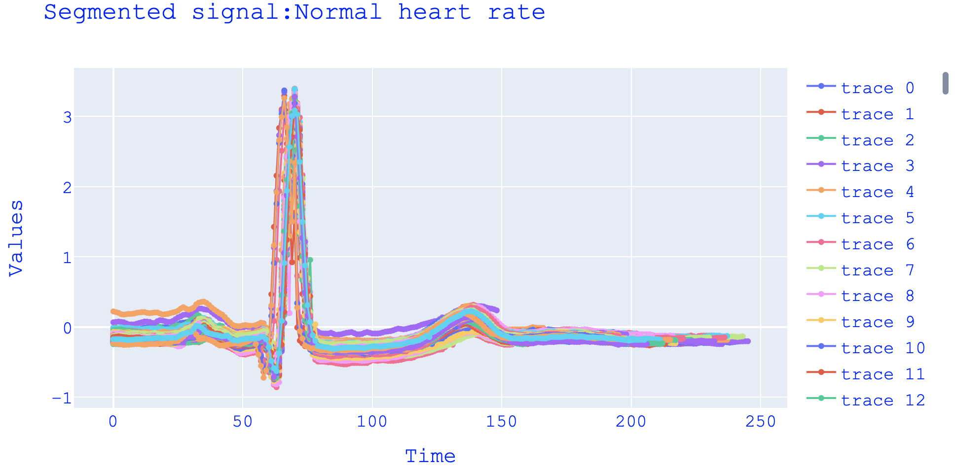

Slide 3
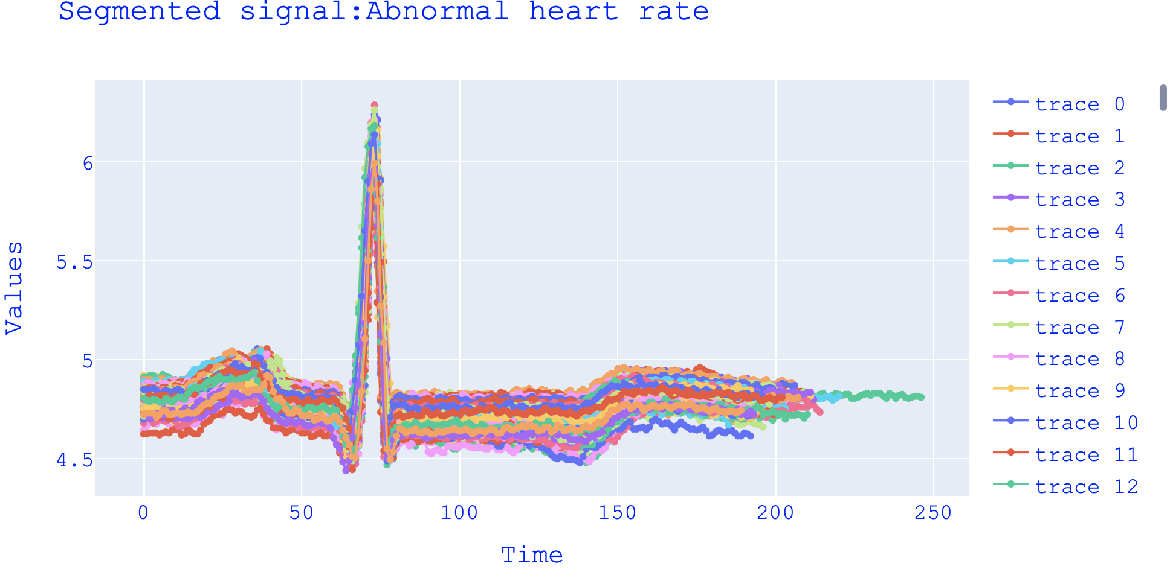

Slide 4
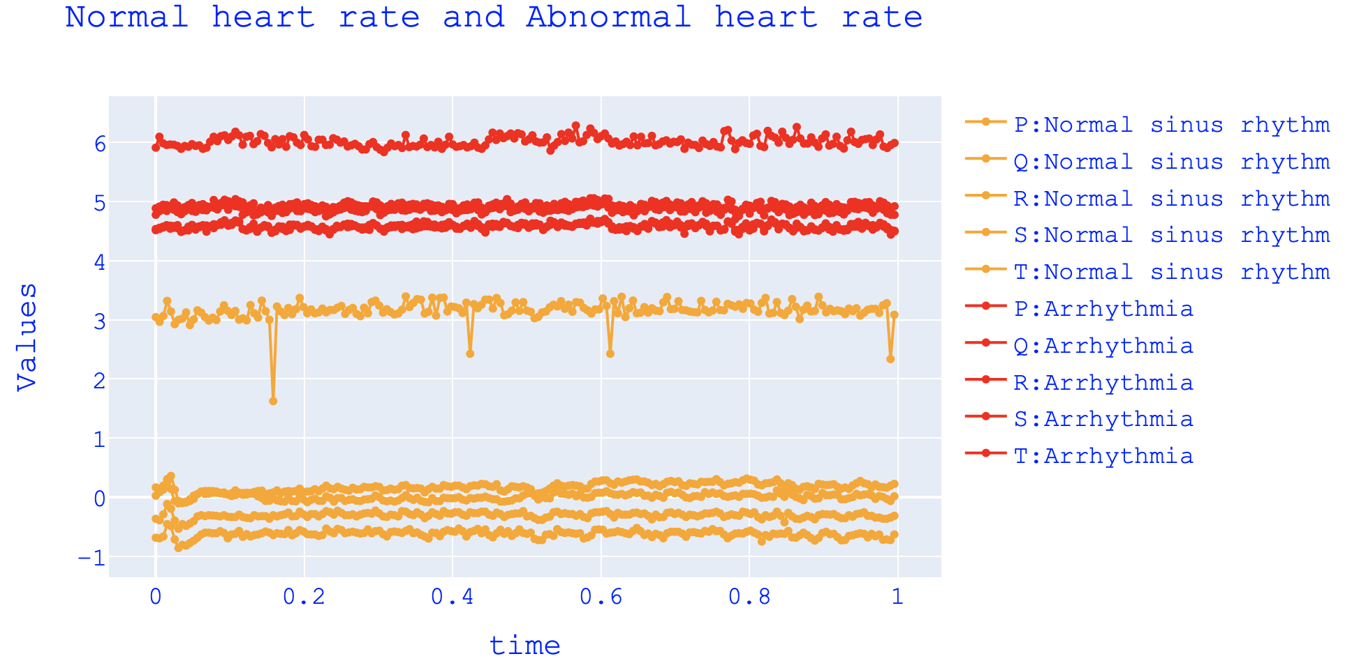

Slide 5
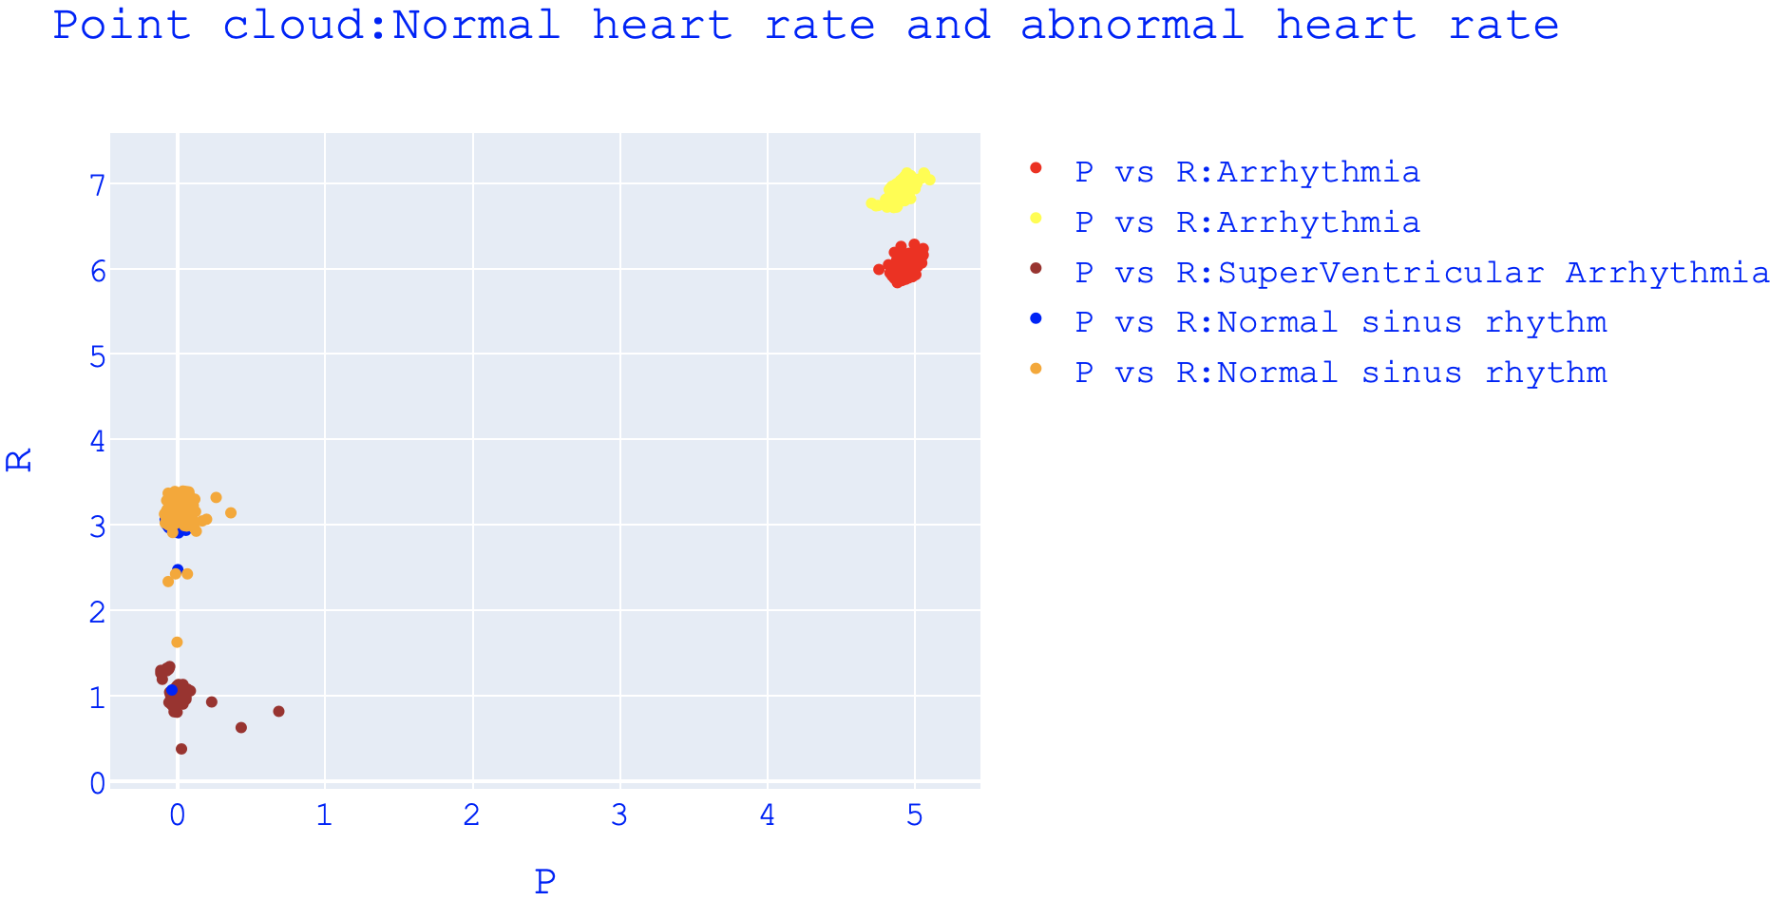

Slide 6
REGENT
Executed some of simple programs and went through some of the topics under tutorial section.

