Slide 1
Group Meeting
15/06/2020

Slide 2
Outline :
ECG-Anomaly Detection :
RMSE Approach
LSTM Approach

Slide 3
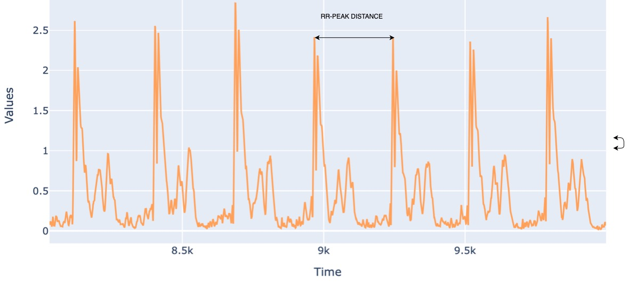
Slicing with RR-Distance :

Slide 4
RMSE Approach :
Using Pan-tomkins algorithm we detect the R-Peaks
Then slice the signal
Find the RMSE of 1 signal slice with all the other signal slices
Then pick the signals having maximum RMSE error.

Slide 5
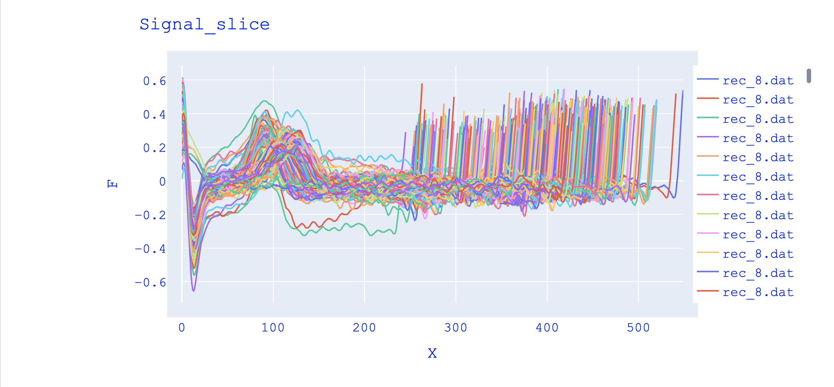
Signal_slices :

Slide 6
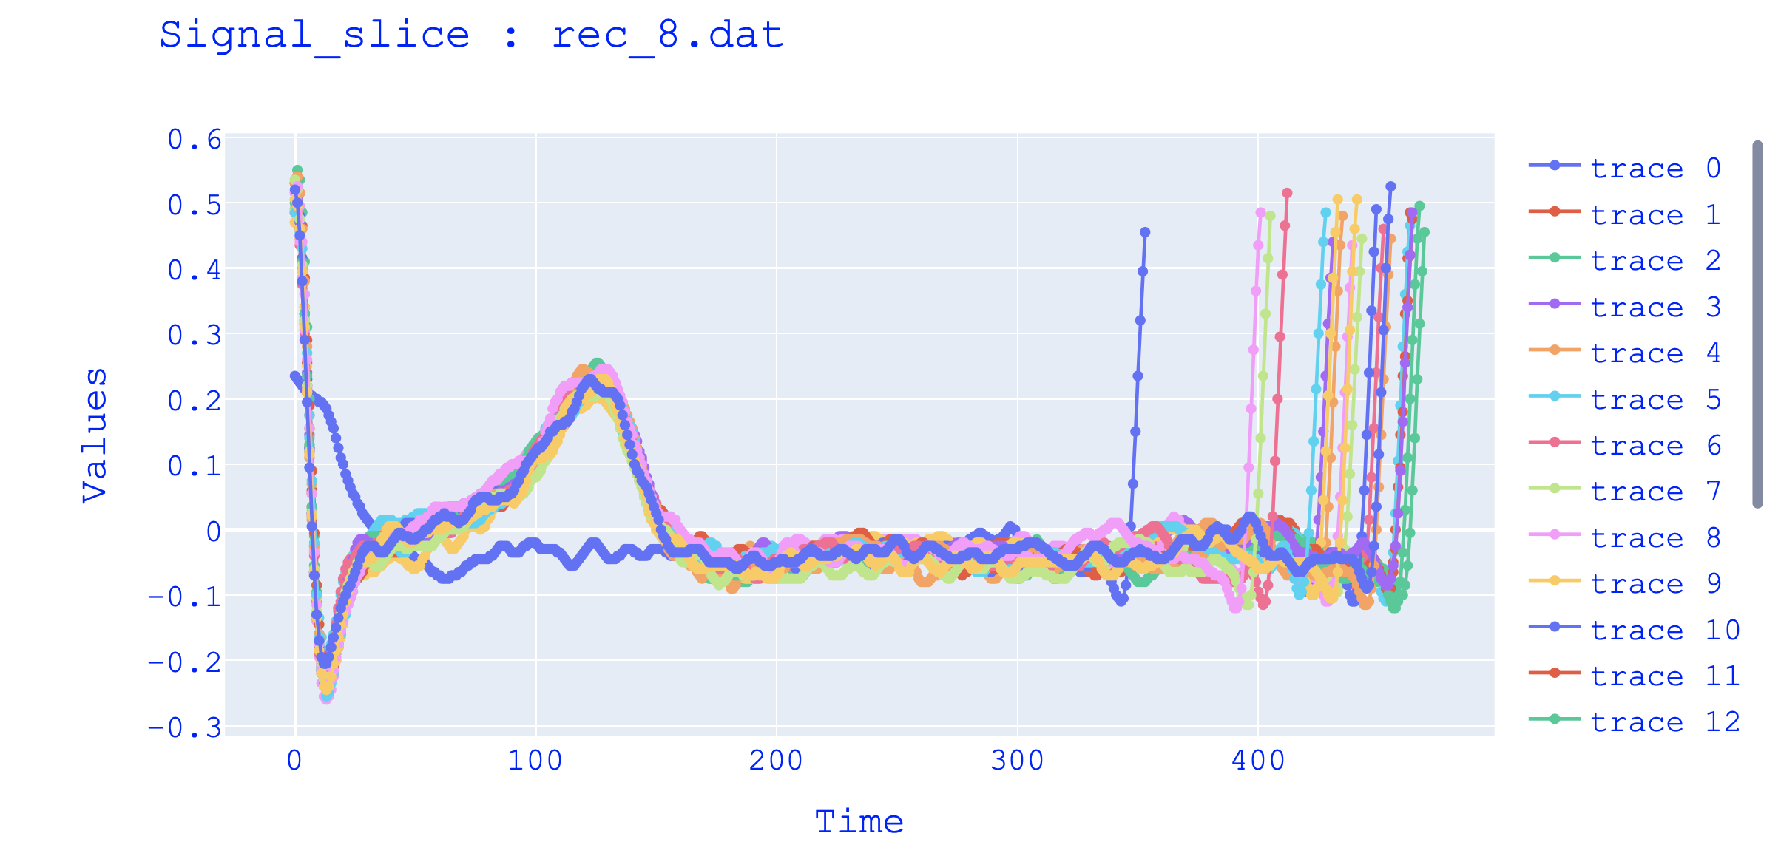
Signal_slice : rec_8

Slide 7
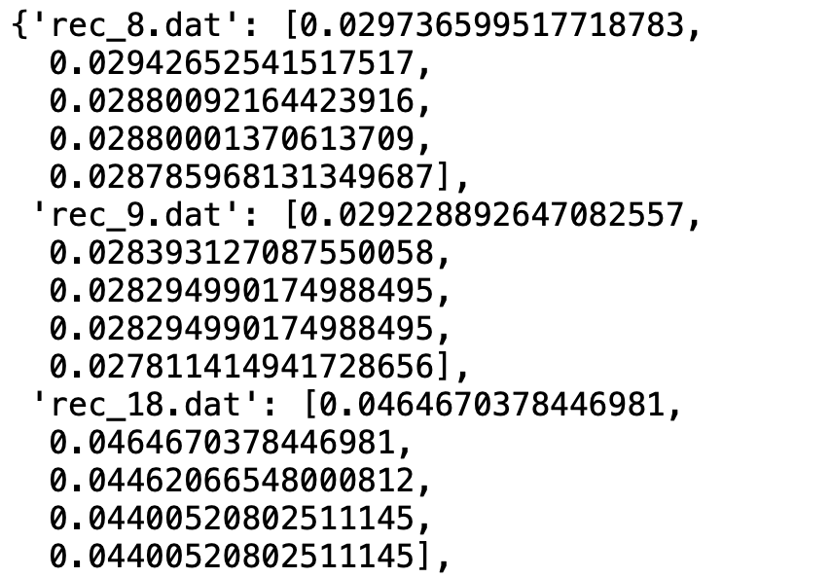
Pick the anomalies

Slide 8
LSTM Approach: Keras
Signals are split as Train_data and Test_data.
Training the model using Train_data.
Computing Mean-Absolute-Error(MAE) for training the model.
Plotting the distance plot of MAE calculated during Training.
Setting the threshold value from MAE plot.
Evaluating test_data using the threshold calculated.
Getting the anomalous peaks.

Slide 9
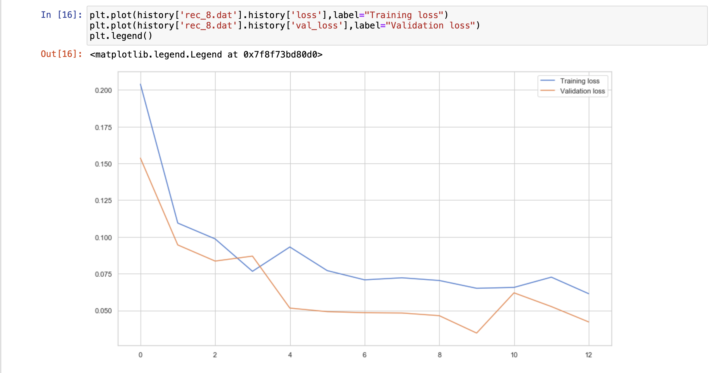
Loss values: Training

Slide 10
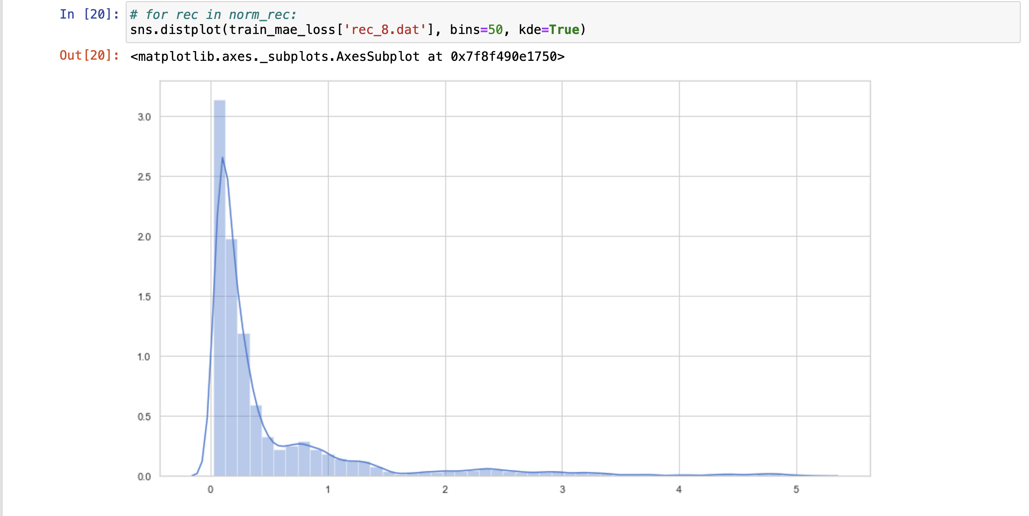
MAE Loss : rec_8

Slide 11
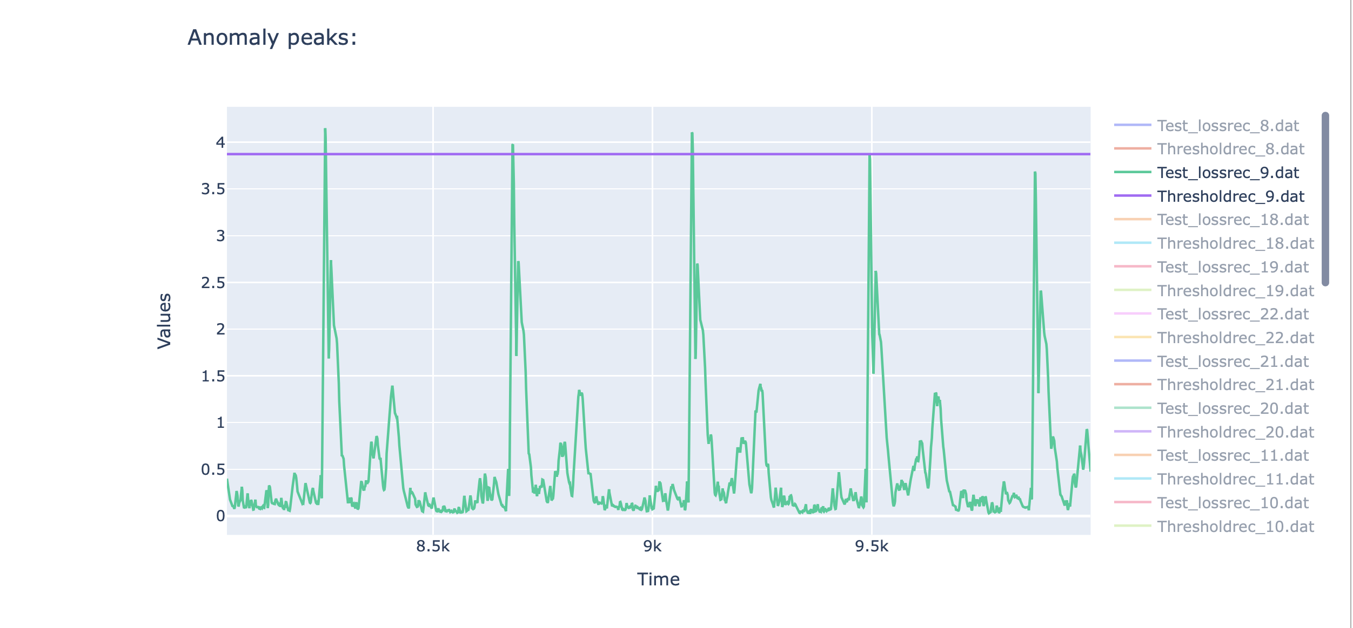
Anomalous peaks :

