Slide 1



Portal Engineering Ltd.
Investor Presentation
Vishal Kulkarni

Slide 2

MARKET EXPANSION STRATEGIES
Agenda
Key Points for Market Expansion in India's Elevator Industry
#1
Vision
#4
Target Market
Define the long-term vision and strategic goals for market expansion in India's elevator industry.
Define the specific target market segments and consumer demographics for market expansion strategies.
#2
Problem Statement
#5
Competitive Landscape
Identify and analyze the current challenges and market gaps within the Indian elevator industry.
Analyze the competitive landscape in the elevator industry in India, including key players and market positioning.
#3
Solution
#6
Financials
Propose innovative solutions to address the identified challenges and improve market positioning.
Present financial projections and estimations for market expansion initiatives in the Indian elevator sector.

Slide 3
WHY PORTAL ENGINEERING
Key Investment Highlights
A profitable, fast-growing import-substitution play in India's elevator & parking systems market
15+ Yrs
~52%
100%+
Proven Track Record
Revenue CAGR
PAT Growth
Established maker of automatic lift doors, hydraulic systems & multi-level parking
Y-o-Y revenue growth sustained over FY22–FY25
Profit after tax more than doubled over the last two years
3 Geographies
New Plant
25% Stake
Live Export Traction
Capacity Scale-Up
Secondary on Offer
Recurring orders from Kuwait, Canada & Australia
Ambernath facility + advanced machinery driving margin gains
Promoter stake sale at ~₹95 Cr equity value
All projections are indicative and subject to availability of funds at the right time.

Slide 4

INNOVATIVE VISION
Vision
To be the Leading Innovator and solutions provider in the Global Elevator & Parking Systems Industry

Slide 5


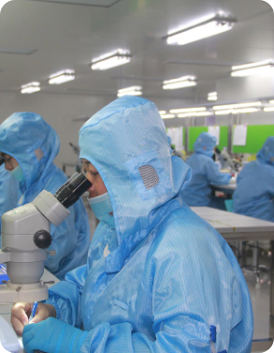

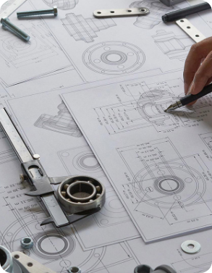
Strong Market Presence for 15 Years
Formidable Competition from Multinational Corporations
Leveraging Skilled Technical Team and Design Capabilities
Our company has established a robust market presence over 15 years, specializing in top-tier automatic doors for lifts, hydraulic power packs, cylinders, and multi-level car parking systems.
Facing tough competition from multinational corporations and traders importing elevator components from Europe and China, posing a significant threat to our market share.
We aim to leverage our highly skilled technical team, robust design capabilities, and advanced manufacturing facility to outpace competition and drive innovation in a saturated market dominated by imports.
INDUSTRY CHALLENGES AND COMPETITIVE LANDSCAPE
Problem Statement
Challenges Faced by Our Manufacturing Company in the Elevator Industry
#1
#2
#3

Slide 6








ELEVATOR COMPONENTS AND OFFERINGS
Products – 2021-2025
Essential Components and Offerings in the Elevator Industry
Hydraulic Cylinders and Power Packs
Automatic Doors for Elevators
Vertical Telescopic Doors
Car Parking Systems
Hydraulic Cylinders
Key components for elevators providing necessary force and control for efficient vertical movement.
Enhancing safety and convenience, these doors offer seamless automatic operation for both residential and commercial buildings.
Maximizing space efficiency, these doors are ideal for car and goods elevators, ensuring safe loading and unloading.
Crafted for safety, durability and reliability, these multi-level parking systems are budget friendly
Structural backbone for any hydraulic lift, these are sold to other integrators. Has a very high potential for global markets as well

Slide 7
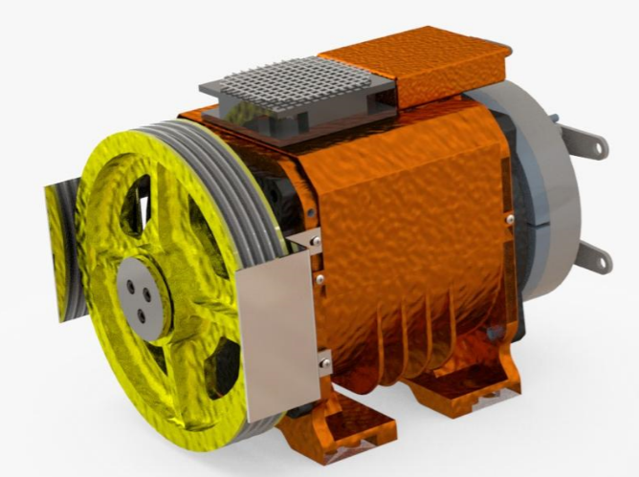
ELEVATOR COMPONENTS AND OFFERINGS
Products – 2025-2026-2027
Premium Home Lifts
Essential Components and Offerings in the Elevator Industry
Premium Home Lifts in minimum space fully compliant with European Standards
Hydraulic Cylinders and Power Packs
Automatic Doors for Elevators
Vertical Telescopic Doors
Car Parking Systems
Dumb Waiter Lifts
Key components for elevators providing necessary force and control for efficient vertical movement.
Enhancing safety and convenience, these doors offer seamless automatic operation for both residential and commercial buildings.
Maximizing space efficiency, these doors are ideal for car and goods elevators, ensuring safe loading and unloading.
Crafted for safety, durability and reliability, these multi-level parking systems are budget friendly
Urbanization brings new opportunities, these lifts are used for movement of food from one floor to another in Hotels/Restaurants, similarly can be used in Hospitals for Medicines and accessories movement

Slide 8
ELEVATOR COMPONENTS AND OFFERINGS
Revenue Contributors- 2022-2023-2024
Essential Components and Offerings in the Elevator Industry

Slide 9
ELEVATOR COMPONENTS AND OFFERINGS
Products- 2027-2028-2029
Essential Components and Offerings in the Elevator Industry

Slide 10


Customization
#1
Offer tailored solutions to meet specific customer requirements, a unique advantage over mass-produced imports.
STRATEGY
Solution
Strategies for Market Expansion and Competitive Positioning in India's Elevator Industry
Local expertise
#2
Leverage knowledge of local regulations, standards, and customer preferences to build trust and cater effectively to the Indian market.

Slide 11


After-sales service
#3
Provide superior customer support, including maintenance and repairs, addressing a common challenge faced by imported products in the market.
STRATEGY
Solution
Strategies for Market Expansion and Competitive Positioning in India's Elevator Industry
Quick turnaround
#4
Leverage proximity to the market to ensure faster delivery times compared to overseas suppliers, enhancing customer satisfaction.

Slide 12


Sustainability
#5
Highlight eco-friendly materials and processes to attract environmentally conscious consumers and align with sustainable trends in the industry.
STRATEGY
Solution
Strategies for Market Expansion and Competitive Positioning in India's Elevator Industry
Technology integration
#6
Incorporate smart technologies into products for improved functionality and a modern appeal, meeting the evolving demands of the Indian market.

Slide 13
Construction Companies
#1
Engaged in the construction of various properties such as residential, commercial, and industrial buildings that require elevators.
MARKET SEGMENTS
Target Market
Key Market Segments for Elevator Industry Expansion in India
Real Estate Developers
#2
Require elevators for new property developments or to enhance existing structures, driving demand for elevator solutions.

Slide 14
Elevator Installation Companies
#3
Specialized firms focusing on the installation of elevators, necessitating high-quality elevator components and accessories.
MARKET SEGMENTS
Target Market
Maintenance and Repair Services
Key Market Segments for Elevator Industry Expansion in India
#4
Offer ongoing maintenance and repair services for elevators, requiring reliable elevator parts and components for efficient operations.
Architects and Designers
#5
Specify elevator components in their building designs, influencing the choice of elevator solutions used in construction projects.

Slide 15

Government and Public Infrastructure
#6
Public buildings, transportation hubs, and social housing projects require elevators, creating opportunities for elevator industry growth.
MARKET SEGMENTS
Target Market
Key Market Segments for Elevator Industry Expansion in India
Export Markets
#7
Countries with expanding construction sectors and increasing demand for elevator components present potential export opportunities for elevator industry players.

Slide 16



Product Roadmap
Strategies for Market Expansion and Competitive Positioning in India's Elevator Industry
#1
#2
#3
Market Analysis
Product Development
Brand Building
Continuously analyze market trends and customer feedback to adapt product offerings to meet evolving consumer demands in the Indian elevator industry.

Slide 17

Product Roadmap
Strategies for Market Expansion and Competitive Positioning in India's Elevator Industry
#1
#2
#3
#4
Market Analysis
Product Development
Brand Building
Distribution Network
Invest in R&D to innovate and enhance product quality by focusing on unique features that differentiate your offerings from competitors in the elevator industry.

Slide 18

Product Roadmap
Strategies for Market Expansion and Competitive Positioning in India's Elevator Industry
#2
#3
#4
#5
Market Analysis
Product Development
Brand Building
Distribution Network
Customer Service
Strengthen brand presence through targeted marketing campaigns showcasing superior product quality and industry expertise to increase market share in India's elevator industry.

Slide 19
Product Roadmap
Strategies for Market Expansion and Competitive Positioning in India's Elevator Industry
#3
#4
#5
#6
Product Development
Brand Building
Distribution Network
Customer Service
Certifications
Expand distribution channels nationwide to ensure widespread product availability, enabling customers to access your elevator solutions across India.

Slide 20

Product Roadmap
Strategies for Market Expansion and Competitive Positioning in India's Elevator Industry
#4
#5
#6
Brand Building
Distribution Network
Customer Service
Certifications
Establish a reputation for exceptional customer service, including comprehensive after-sales support and maintenance services to enhance customer satisfaction and loyalty within the elevator industry.

Slide 21
Product Roadmap
Strategies for Market Expansion and Competitive Positioning in India's Elevator Industry
#5
#6
Distribution Network
Customer Service
Certifications
Acquire relevant certifications to demonstrate compliance with safety and quality standards, assuring customers of the reliability and credibility of your elevator products in the Indian market.

Slide 22


KEY PLAYERS IN THE ELEVATOR AND PARKING SOLUTIONS INDUSTRY
Competitive Landscape
Key Players in India's Elevator and Parking Solutions Industry
Category
Company
Premium Priced
Fermator India (Techno Doors Pvt. Ltd.)
Premium Priced
GMV India Pvt. Ltd
Premium Priced
Klaus Multi Parking India
Economical
Suzhou Genesis Elevator Sys. Co.
Economical
Wohr Parking Systems
Contenders
Aaron Industries Limited
Contenders
A.V.Cam Corp. Ltd.
Contenders
Sieger Spintech Equipment Pvt. Ltd.

Slide 23















MARKET EXPANSION STRATEGIES
Business Model
Strategies for Market Expansion and Competitive Positioning in India's Elevator Industry
Installing High-End Machines with Latest Technologies
Maintaining Ready Stock at Various Locations
Bulk Purchases for Customized Raw Materials
Obtaining Certifications from European/American Agencies
Investing in R&D and Training
This will increase productivity significantly, leading to reduced product costs and making it challenging for competitors to match our prices and quality.
Having fast-moving products readily available at multiple locations will enhance customer attractiveness by saving on inventory and transit time.
Procuring raw materials in bulk from mills for customized sizes will decrease scrap costs and provide better pricing advantages over competitors.
Allocating resources towards research and development along with training programs will enable the creation of high-value products not currently offered.
Securing certifications from reputable agencies will lower input costs and help penetrate the market with a cost-effective and robust indigenous brand.

Slide 24





STRATEGY
Summary
Strategies for Dominance in India's Elevator and Parking Solutions Market
Striving to lead India's elevator and parking solutions sector through innovation.
Providing customized solutions, local expertise, and exceptional after-sales services.
Leading Innovator Vision
Key Solutions Offered
Competitive Market Presence
Facing challenges from global competitors while maintaining a strong market foothold.

Slide 25



STRATEGY
Summary
Strategies for Dominance in India's Elevator and Parking Solutions Market
Targeting construction firms, real estate developers, and government infrastructure projects.
Target Market Segments
Strategic Product Focus
Financial Stability and Growth
Emphasizing quality, reliability, and user safety in a diverse product portfolio.
Demonstrating steady financial growth with a robust business model.

Slide 26










FINANCIAL PERFORMANCE OVERVIEW
Financials / P&L Statement
Summary of Financial Performance (Amount in Crores)
Financial Year
Sales
Purchase
Head Count
PAT
EBITDA
NPM
Revenue/Employee
2021-2022
₹ 12.39
₹ 0.43
₹ 1.39
3.5%
2022-2023
₹ 18.40
₹ 0.92
₹ 2.31
5.0%
2023-2024
₹ 28.70
₹ 2.12
₹ 4.50
7.2%
2024-2025
₹ 35.30
₹ 2.07
₹ 4.50
5.2%

Slide 27
THE PROPOSAL
Transaction Structure
A secondary stake sale — funded straight back into the business as interest-free promoter capital
1
2
3
4
Secondary Sale
Proceeds to Promoter
Re-Infused as Loan
Repaid from Cash Flow
PE investor acquires 25% equity by buying existing shares from the promoter. No new shares are issued — zero primary dilution.
Promoter receives ₹23.75 Cr. The company's share capital and balance sheet are unchanged at this step.
Promoter infuses the entire ₹23.75 Cr back into Portal as an interest-free, unsecured loan (quasi-equity).
Company deploys the capital for growth; the loan is drawn down from internal free cash flows over 3–5 years.
PE acquires
for consideration of
Implied 100% equity value
Capital available to business
25% stake
₹23.75 Cr
~₹95 Cr
₹23.75 Cr
All projections are indicative and subject to availability of funds at the right time.

Slide 28
DEAL SNAPSHOT
Indicative Transaction Terms
Key commercial terms of the proposed 25% secondary
Transaction Type
Secondary sale of existing shares — no primary dilution
Stake on Offer
25%
Consideration
₹23.75 Crores
Implied Equity Value (100%)
~₹95 Crores
Implied Valuation Multiple
~17.6x FY26-27E PAT | ~9.3x FY27-28E PAT
Re-Investment Instrument
Interest-free, unsecured promoter loan (quasi-equity)
Loan Repayment
Drawn from internal accruals over 3–5 years
Use of Capital
Growth capex, capacity, inventory, certifications & branding
Governance
1 board seat + customary information & minority rights (indicative)
All projections are indicative and subject to availability of funds at the right time.

Slide 29
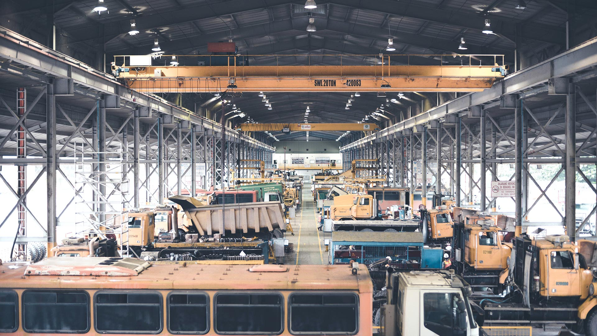






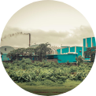
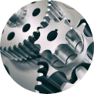







USE OF FUNDS — TOTAL ₹23.75 CRORES
Use of Funds
Deployment of the ₹23.75 Cr promoter loan into growth capex & working capital
Factory Land & Building in Ambernath (8.9 Crores)
Investment in Machinery (7.8 Crores)
Procure key equipment: Material Handling Cranes/Forklifts (INR 0.5 Crores), Amada Make Turret Punching Machine (INR 2.3 Crores), DMG-Mori Make 5 Axis VMC (1.5 Crores), Powder Coating Plant (1 Crore), Shot Blasting & Hard Chrome Plating Plant (1 Crore), Tool Room Machines (1.5 Crores)
Construction + Debt Reduction
* Potential impact on bottom-line – 2 Crores / Year.
Inventory & Certifications (5.55 Crores)
Branding & Promotions (1.5 Crores)
Allocate funds for Inventory (INR 5 Crores) and Certifications (INR 0.55 Crores)
Invest INR 1.5 Crores for branding and promotional activities in the first year

Slide 30



Supporting Evidence 2022-2025
Financial Years 2024- 2025-2026 was a capex heavy year due to land acquisition and construction along with product developments. We don’t use it for benchmarking as we had already factored in the flat to a negative year in terms of revenue as well as profit margins. This period was utilised for capacity addition and product development.
52%
100%
78%
Revenue Growth
Profit Growth
EBITDA Growth
Strong Revenue Growth of ~52% Y-O-Y for past 3 Years
100% plus growth in past 2 years
Consistent 78%+ growth in EBITDA Y-o-Y over the past 3 years

Slide 31

The Team
With over 35 years of experience in mechanical design and manufacturing, Mr. Ravishankar is a seasoned mechanical engineer. His expertise lies in creating complex machines that push the boundaries of innovation. His passion for precision and attention to detail have been instrumental in our success.
Also a qualified mechanical engineer with 22 years of experience in Design, manufacturing, process planning & operations, Vishal brings a wealth of knowledge to our team. His 15-year long business partnership with Mr. Ravishankar has been the cornerstone of our achievements. Together, they’ve navigated challenges, celebrated victories, and built a legacy of excellence.
Looking after administration, Mrs. Pushpa has a keen interest in the growth of the business.
K. Ravishankar
Vishal Kulkarni
Pushpa Ravishankar
Founder Director
Director
Director

Slide 32















Quarterly Projections for FY 26-27
Amount in Crores
Quarter
Revenue
Expenses
Profit-PAT
PAT Margin (%)
Q1
₹ 10.0
₹ 2.20
₹ 1.00
10%
Q2
₹ 12.00
₹ 2.80
₹ 1.64
14%
Q3
₹ 17.00
₹ 3.50
₹ 2.04
12%
Q4
₹ 19.00
₹ 4.00
₹ 2.30
12%
All projections are indicative and subject to availability of funds at the right time.

Slide 33












Annual Projections
Amount in Crores
Metric
Mar-2027 (FY 26-27)
Mar-2028 (FY 27-28)
Mar-2029 (FY 28-29)
Mar-2030 (FY 29-30)
Revenue
₹ 53.0
₹ 89.0
₹ 160.0
₹ 280.0
PAT
₹ 5.4
₹ 10.2
₹ 22.75
₹ 39.2
NET Margin (%)
10.20%
11.40%
14.20%
14.0%
Operating Expenses
₹ 12.80
₹ 19.50
₹ 32.00
₹ 49.00
All projections are indicative and subject to availability of funds at the right time.

Slide 34
Near-Term Impact: First Tranche
What an immediate ₹5 Cr first tranche unlocks in H1 FY 26-27 | Subject to timely infusion
₹22 Cr
12%
₹5 Cr
Target Sales
PAT Margin
First Tranche
April – September 2026
PAT = ₹2.64 Crores
First draw of the ₹23.75 Cr promoter loan
✓ Immediate capital enables bulk raw material procurement — boosting margins significantly
✓ Premium Home Lifts and new products launched — driving higher revenue mix from H1 itself
✓ Export pipeline (Kuwait, Canada, Australia) activated — delivering incremental revenue from Q1

Slide 35
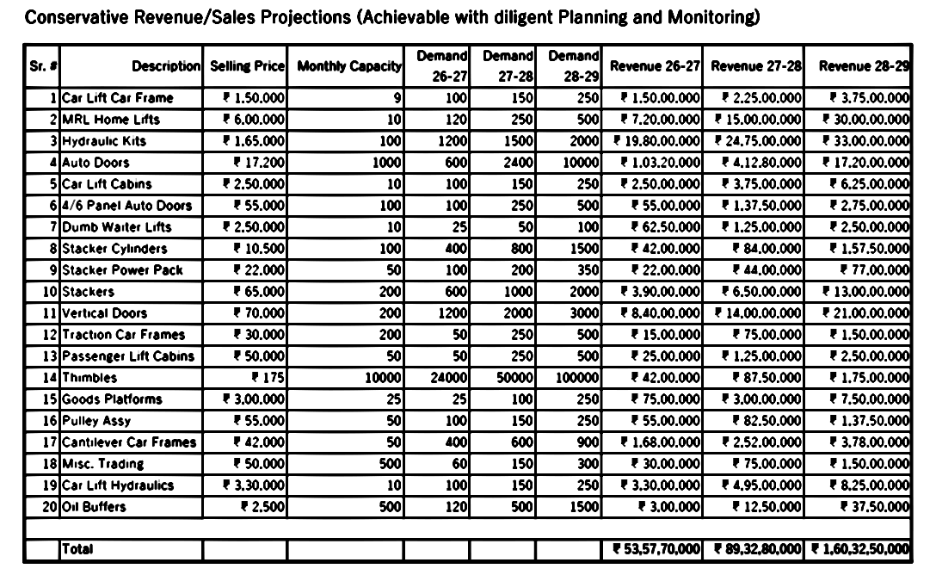

Slide 36





EFFICIENCY DRIVES PROFITABILITY
TRANSPORT
MATERIAL HANDLING
Save material transportation costs by optimizing MOQ’s and efficiently manage dispatches to avoid multiple trips to same site.
Eliminate the expense of material handling by implementing efficient equipment and a well-planned plant layout.
#2
#1
PRODUCTIVITY
Raw Material
Control the labor cost by installing advanced machinery with best in class features as well as speed.
#3
#4
Leveraging the advantages of capital by buying material in bulk and getting better bargain

Slide 37


Impact of Cost Saving measures on Bottomline
Material Handling
Transport
FY 23-24 transport cost of 45 Lacs is due to lack of space forcing us to carry-out partial dispatches.
50 Lacs worth labor cost in FY 23-24 for Loading & Unloading expense should come down by 80% once operations at new plant are commenced. .
Productivity
Raw Material
40 Lacs from the heading Wages is due to overtime because of speed limitation of existing machines which should get completely eliminated.
Currently Raw material worth 18 Crores being bought thru Dealers, when bulk purchases start from direct mills there would be potential saving of 10% in the input costs.

Slide 38
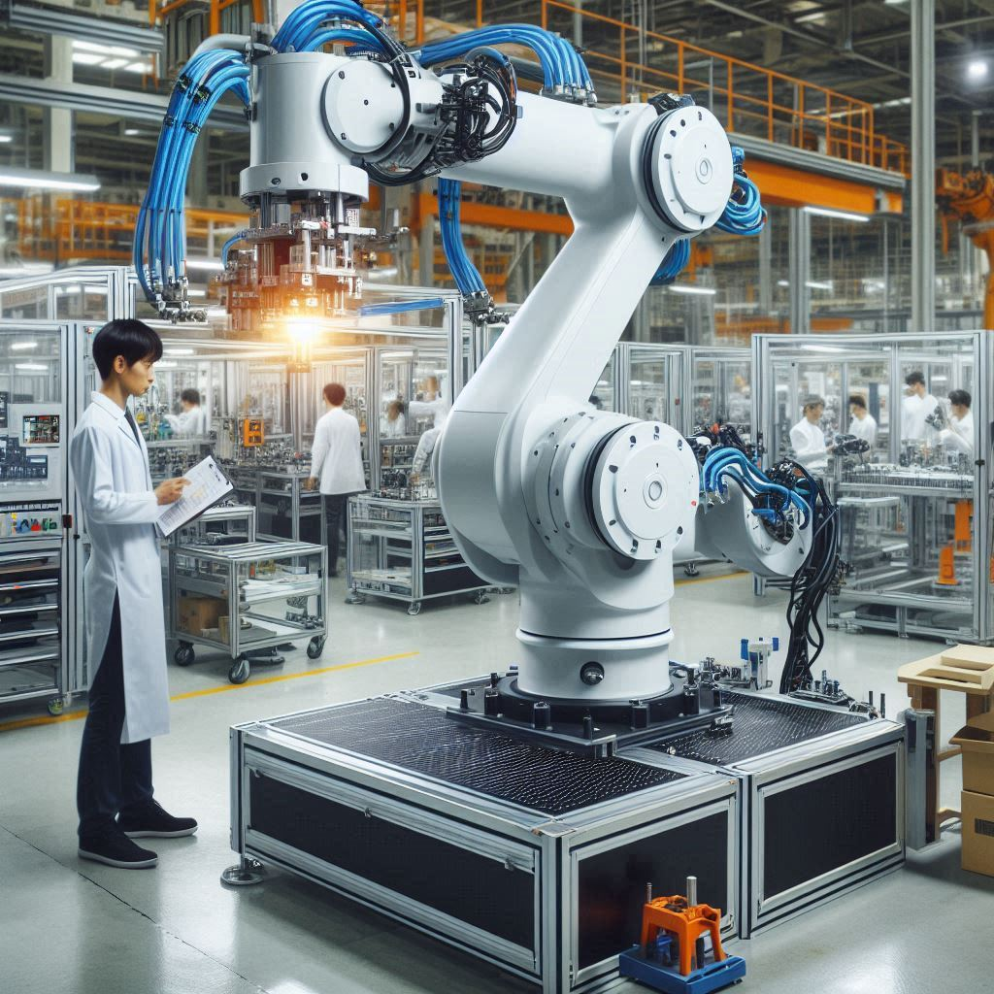
Fueling Growth: Impactful Factors
#1
Larger Floor Space
Allows better material storage and movement enhances productivity and helps cater to additional orders
#2
Automation
Inducting Semi-Robotic Lines to reduce labor costs and produce consistent quality products helping in increasing profitability
#3
Capital
Availability of adequate capital allows competitive advantage in terms of keeping statistically derived inventory and giving clients material just in time.
Better negotiated rates from suppliers by giving attractive payment terms and quantum
#4
New Products
Attracting better talent to manage new product launches which would allow sales team to upsell to the same customers
#5
Expanding geographically
Certifying products to comply with native regulations and expanding the base by becoming a global solutions provider.

Slide 39

Revenue Drivers for FY 2025-2026
#1
Capital
Infusing capital by availing CC Limit
#2
Commencement of Export Orders
1st Shipment to Kuwait has been dispatched,
Repeat order from Kuwait getting dispatched in 4th week of June
1st Order from Canada getting dispatched in last week of June
Regular Sales to Australia Started since 1 year
#3
Extending Product Offerings
Actively pursuing orders for Car Parking Products which were not in focus for past year due to space constraints
Overcoming capital & Capacity constraints and delivering already developed products
Vertical Auto Doors with a slight variation are one of the most in-demand product in Australian market, currently Chamberlin is the only company dominating the market due to lack of competition. We have already secured expressions of interest from few of the dealers of Chamberlin, we expect to launch the product in first quarter of Fisc. Year 2025

Slide 40

Thank You
Vishal Kulkarni vishal@portalengg.com

