Slide 1
ECE510 Project Proposal
Rohit Kulkarni Anuja Vaidya

Slide 2
Modules in Design
Clkgen_driver
Instr_decode
Instr_exec
Memory_pdp

Slide 3
IFD Unit
Fetches instruction
Decodes fetched instruction
Supports decoding of
6 memory reference instructions
Opcode 0 to 5
22 microinstructions
Opcode 7 : Group 1 and Group 2

Slide 4
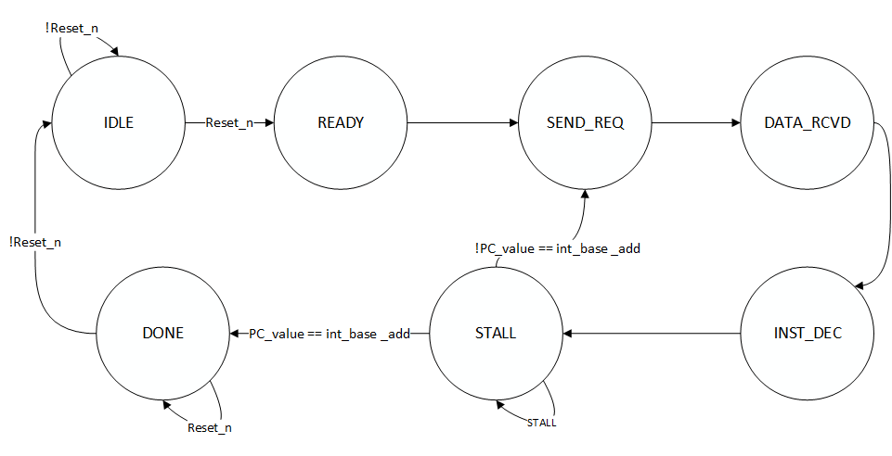
IFD FSM

Slide 5
EXEC Unit
Executes instruction decoded by IFD unit.
Accesses memory if instruction among opcodes 0 to 5.
Reads operand from memory
Writes result into memory
Stalls IFD unit until current instruction completes execution

Slide 6
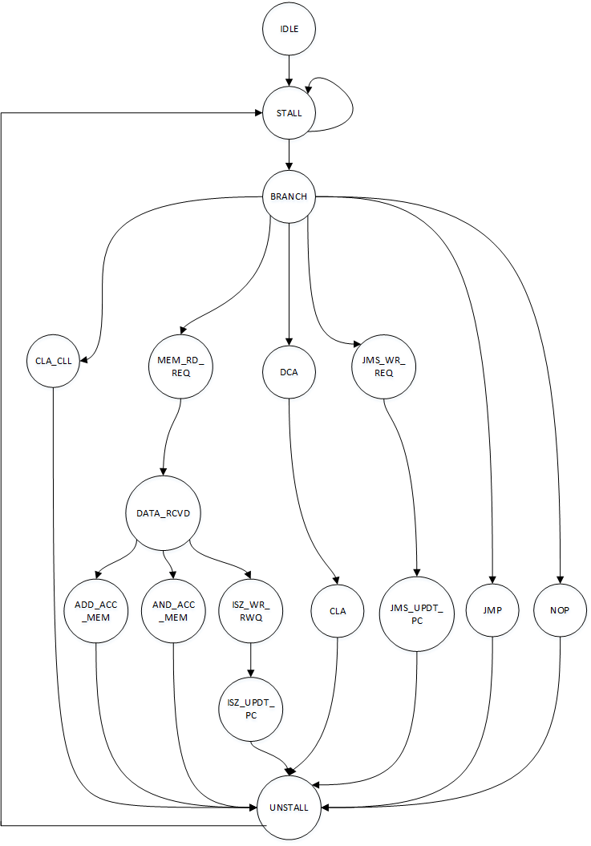
EXEC Unit FSM

Slide 7
Verification Strategy
Unit Level Testbenches for
IFD Unit
EXEC Unit
Full chip validation for entire design

Slide 8
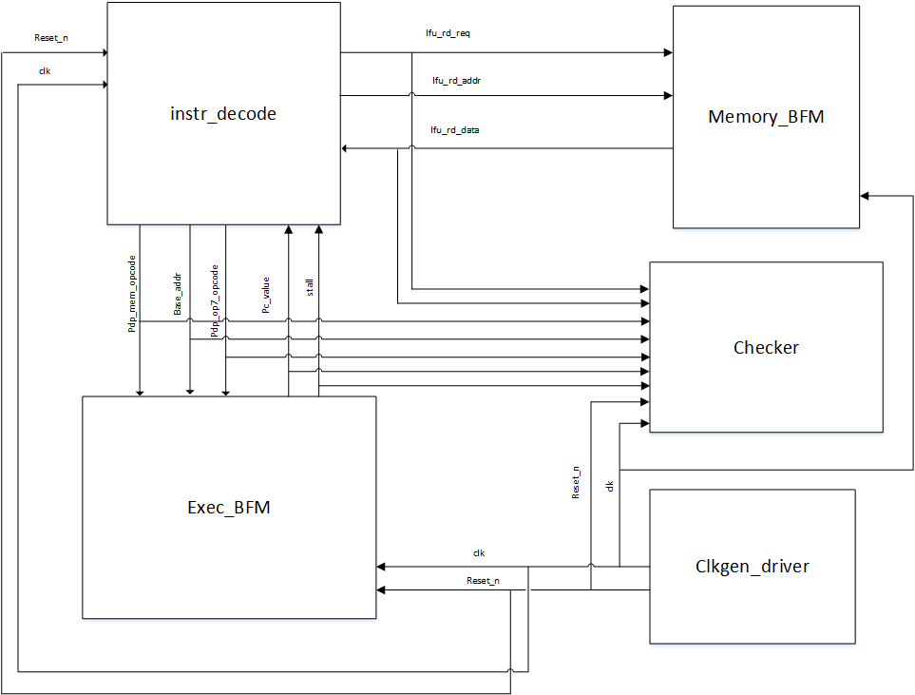
Unit Level TB: IFD

Slide 9
Unit Level TB: IFD
Components needed:
Instr_decode (DUT)
Exec_BFM
Memory_BFM
Clk_gen_driver
Checker

Slide 10
Validation Strategy for IFD
Stimulus:
IFU_RD_DATA from MEMORY_BFM
STALL from EXEC_BFM
PC_VALUE from EXEC_BFM
RESET_N from CLK_GEN
Checks to perform:
Check if opcode sent to EXEC is correctly decoded
Check if address sent to EXEC is correctly decoded
When STALL is asserted, IFD should not fetch the next instruction and no new requests sent to EXEC unit
If reset_n asserted at any point, then all outputs are cleared within 1 clock cycle
On asserting reset, next instruction should be fetched from o200
If current state = STALL and PC = 0200, then next state = DONE
No instructions are fetched after going into DONE state
Coverage:
State coverage, Arc coverage, Path Coverage

Slide 11
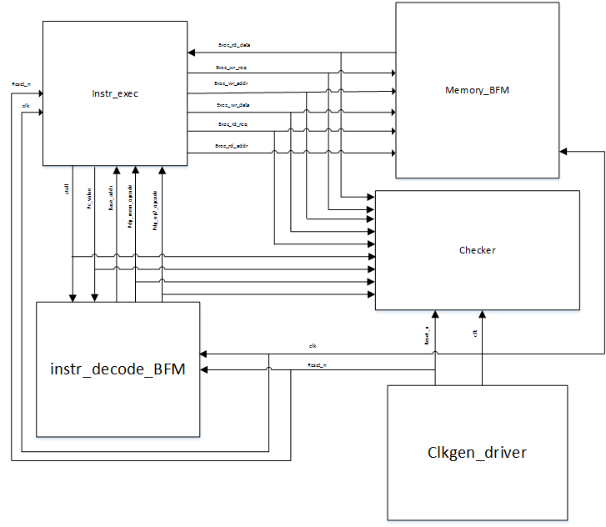
Unit Level TB: EXEC

Slide 12
Unit Level TB: EXEC
Components needed:
Instr_exec (DUT)
Instr_decode_BFM
Memory_BFM
Clk_gen_driver
Checker

Slide 13
Validation Strategy for EXEC
Stimulus:
PDP_OPCODE from INSTR_DECODE_BFM
EXEC_RD_DATA from MEMORY_BFM
RESET_N from CLK_GEN
Checks to perform:
Check if result is corrected correctly
Check if result computed is written to memory for certain instructions
Check if LINK bit is correctly computed
Check if STALL is asserted after beginning to execute each opcode
Check if STALL is deasserted after completion of execution of each opcode
Check if illegal opcodes are executed as NOP
Coverage:
State coverage, Arc coverage, Path Coverage

Slide 14
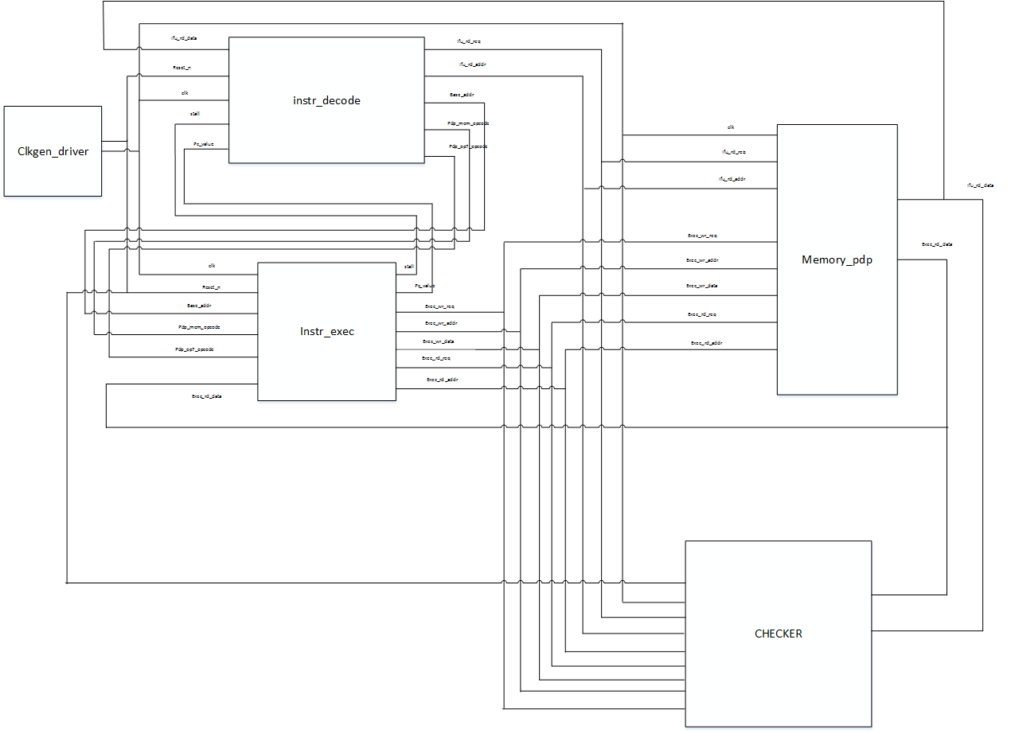
Full chip TB

Slide 15
Validation Strategy for Full-Chip
Stimulus: Assembly code loaded in memory
Stimulus should write result to memory after each operation so that checker checks the result
Checks to perform:
Tap memory interface with IFD/EXEC for
Instruction fetched
Operand fetched
Compute Golden Result and check if Actual Result matches Golden Result

Slide 16
Questions?

