Slide 1

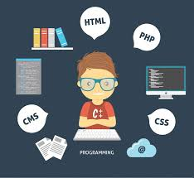
Course Name: Open Source Programming Faculty Name: JayaKumar Sadhasivam Project Topic: Online Streaming Service
1 /
Notes:
1

Slide 2

OPEN-SOURCE-PROGRAMMING(J-COMPONENT):
Group Members:
19BIT0323 : Aadi Manchekar (Front-end, DBMS dev) 19BIT0319 : Roshan Mishra (Front-end, Back-end dev) 19BIT0309 : Mrigank Batra (Back-end dev)
2 /
Notes:
2

Slide 3
Topic: Online Streaming Service
Our aim is to create a streaming service that offers a wide variety of award-winning TV shows, movies, anime, documentaries, and more on thousands of internet-connected devices. You can Watch on your smartphone, tablet,laptop.
A media stream can be streamed either "live" or "on demand". Live streams are generally provided by a means called "true streaming". True streaming sends the information straight to the computer or device without saving the file to a hard disk. On-demand streaming is provided by a means called progressive streaming or progressive download.
The quality of the interaction between servers and users is based on the workload of the streaming service; as more users attempt to access a service, the more quality is affected unless there is enough bandwidth or the host is using enough proxy networks.
3 /
Notes:
3

Slide 4

Technologies used
4 /
Notes:
4

Slide 5


Technologies used(contd.)
5 /
Notes:
5

Slide 6


Slide 7
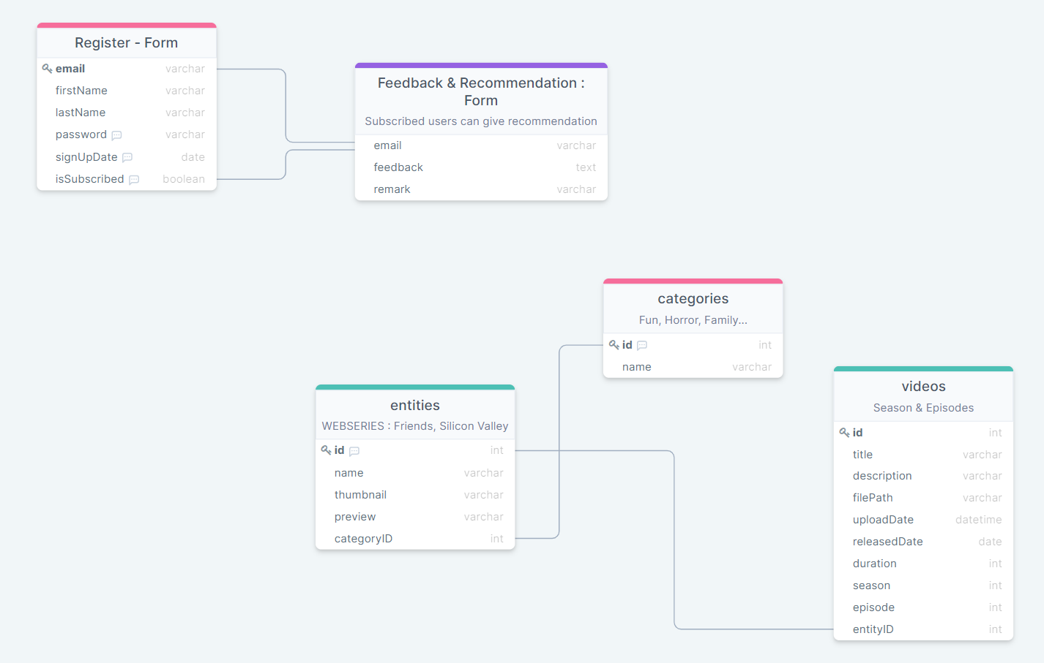
Relationship Diagram:
7 /
Notes:
7

Slide 8
Creating the online movie experience:
Most people don’t know it, but streaming services only uses its own IP address and hostname service.com for two key functions.
Registration of new user accounts and capture of payment information (credit card or PayPal Account
Redirection of users to movies.streaming.com or signup.com based on whether the user is logged in or not respectively.
8 /
Notes:
8

Slide 9
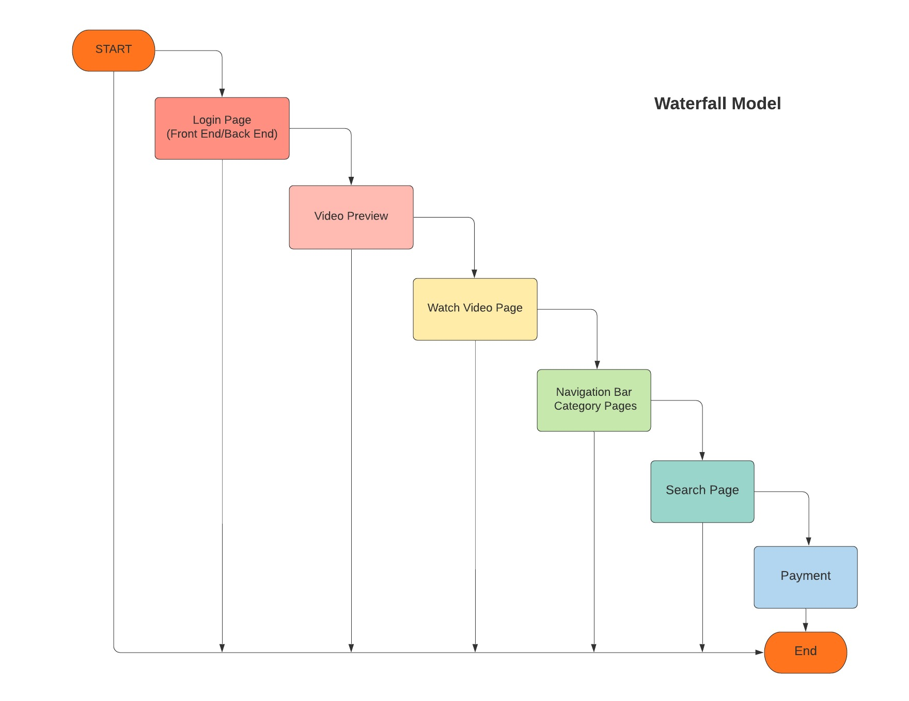
Flow-chart
9 /
Notes:
9

Slide 10
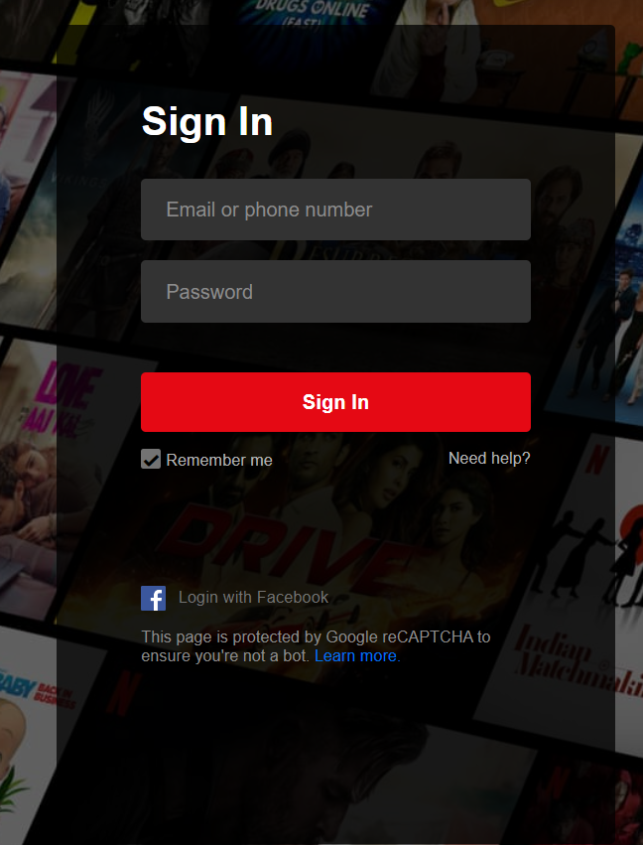
10 /
Notes:
10

Slide 11
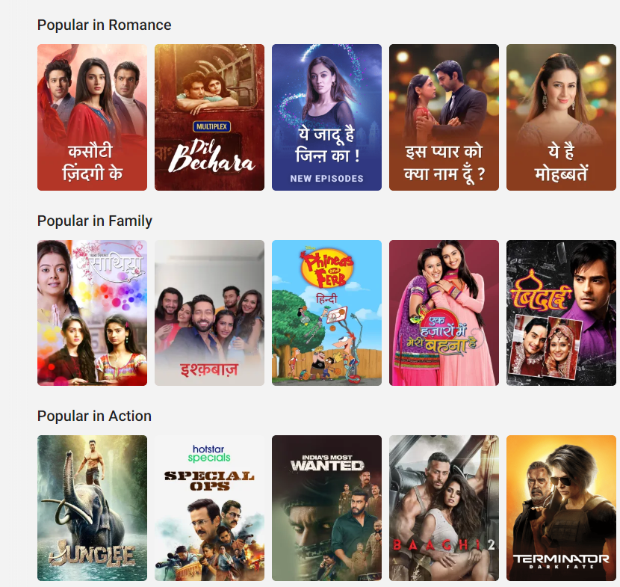
11 /
Notes:
11

Slide 12
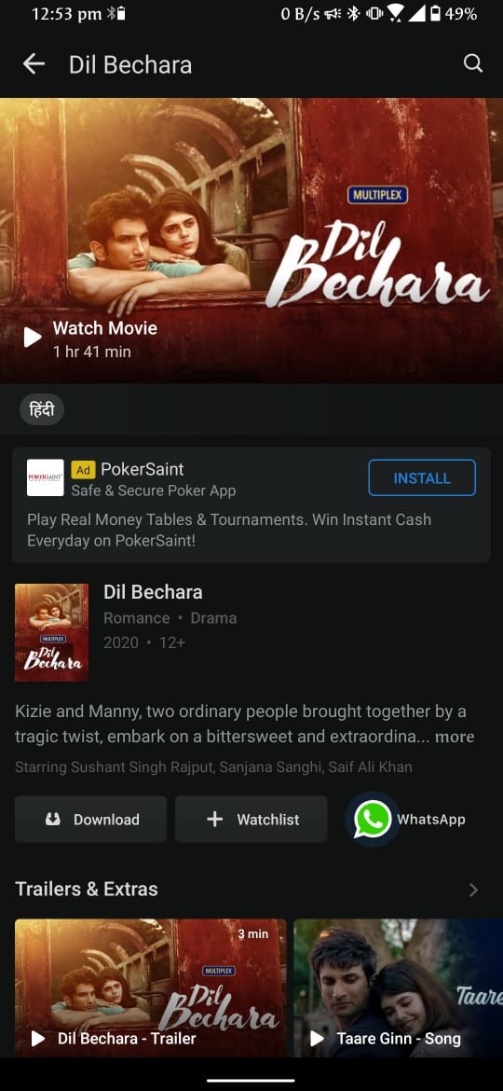
12 /
Notes:
12

Slide 13
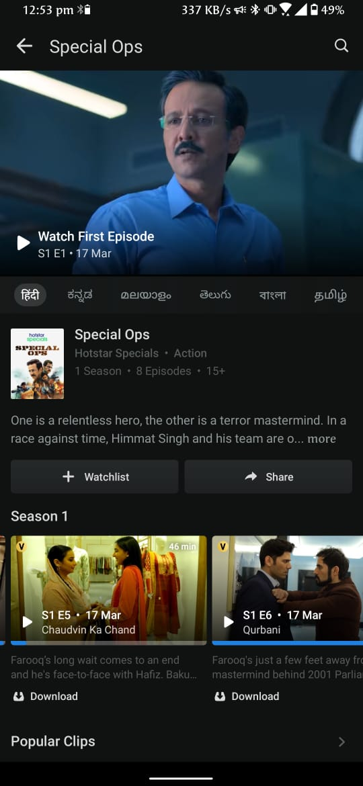
13 /
Notes:
13

Slide 14
Thank you.
19BIT0323
19BIT0319
19BIT0309

