Slide 1


AI-Powered Resume Screening & Employee Engagement Analysis
Presenting our HR-Tech Innovation Challenge project focused on AI-driven HR solutions. Our goal is to improve hiring and engagement.
by KULLAYI REDDY

Slide 2
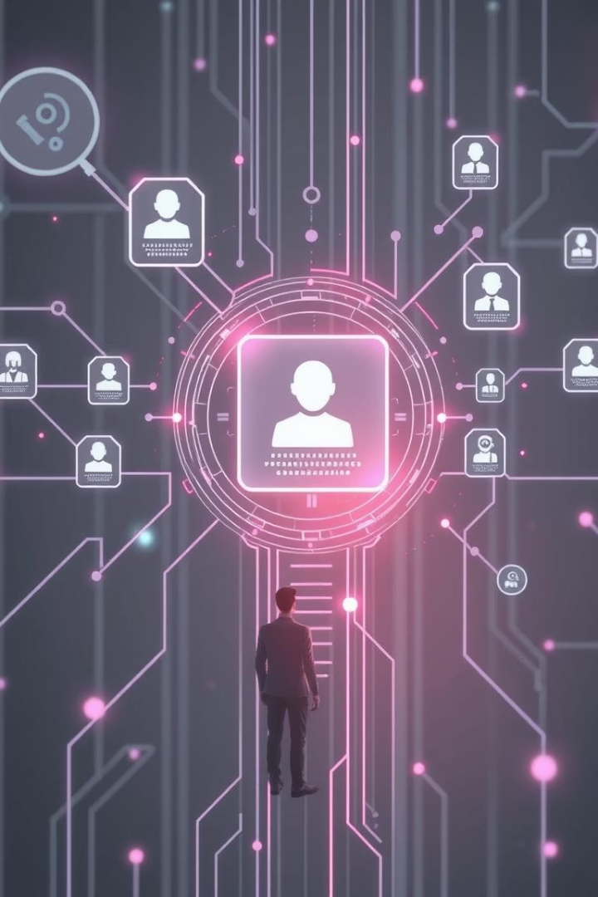
Objective: Automate Key HR Processes
Resume Screening
Sentiment Analysis
Automate selection for software engineer roles with AI accuracy.
Analyze employee feedback to boost morale and engagement.
Enhanced Efficiency
Save time and gain actionable HR insights rapidly.

Slide 3
AI-Powered Resume Screening
Key Features
Benefits
Uses Transformer-based models (e.g., BERT)
Identifies top candidates quickly
Trained on 1,000+ resumes
Reduces screening time by 75%
Achieves 90% precision
Supports faster, smarter hiring

Slide 4
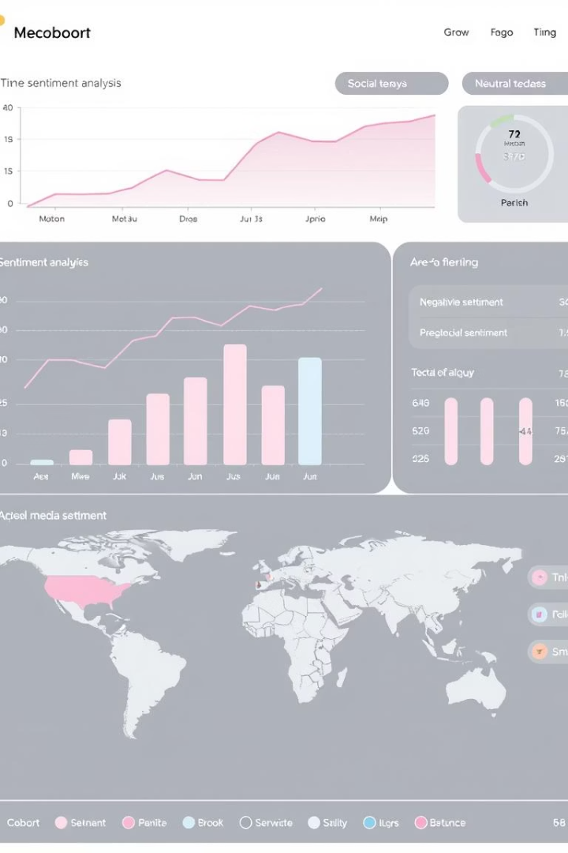
Employee Sentiment Analysis
Data Sources
Technology
Surveys, performance reviews, employee emails
Leverages Azure Cognitive Services or Google Cloud NLP
Outcomes
Real-time sentiment dashboards to flag at-risk teams early

Slide 5
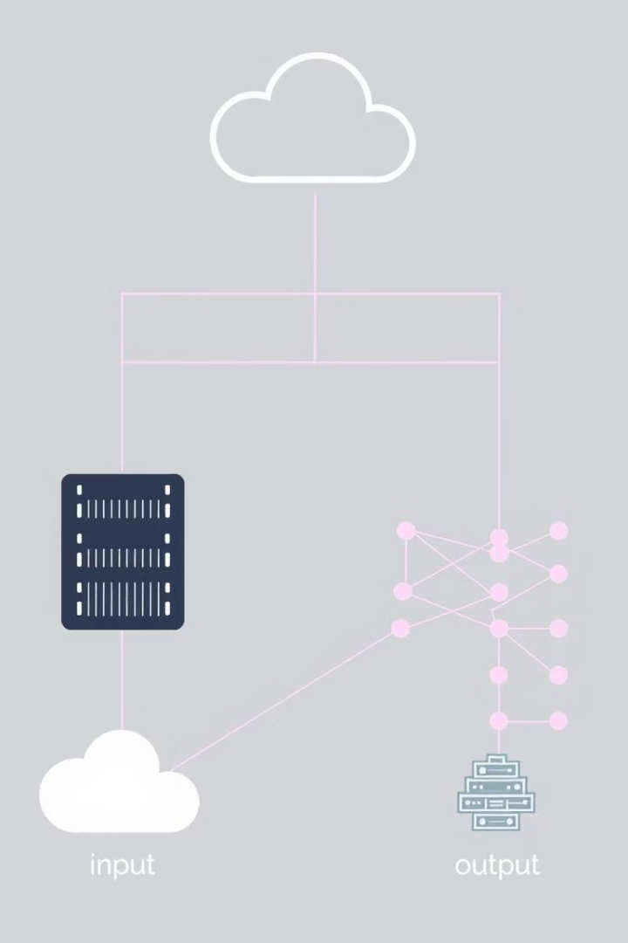




Technical Architecture
Data Ingestion
Azure Data Lake Storage / Google Cloud Storage
Model Deployment
Azure AI Studio / Google AI Platform
API Integration
Seamless with existing HR systems
Scalability
Designed to support 10,000+ employees

Slide 6
Impact & Future Directions
Current Benefits
Future Plans
Faster, more accurate hiring processes
Expand AI tools to other roles and departments
Improved employee engagement and happiness
Integrate predictive analytics for retention
Commit to continual HR-Tech innovation

