Slide 1

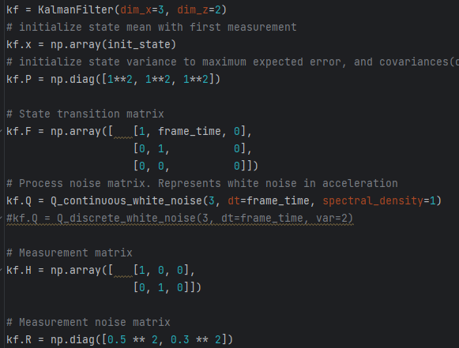

Evaluation of Linear Kalman
On Laptop ~3FPS
Gate
Point pick
Measurements made inside long corridor. Not much echos.
Tried fast movements and going far, which were not picked up
Remember: These are the RF radar
Maximums. They WERE
Broken during testing to see
What happens

Slide 2


Kalman_results.npy

Slide 3


Kalman_results1.npy

Slide 4


Kalman_results2.npy

Slide 5


Kalman_results3.npy

Slide 6


Kalman_results4.npy

Slide 7


Kalman_results5.npy

Slide 8


Kalman_results6.npy

Slide 9


Kalman_results7.npy

Slide 10


Kalman_results8.npy

Slide 11


Kalman_results9.npy

Slide 12


Kalman_results10.npy

Slide 13


Kalman_results11.npy

Slide 14


Kalman_results12.npy

