Slide 1

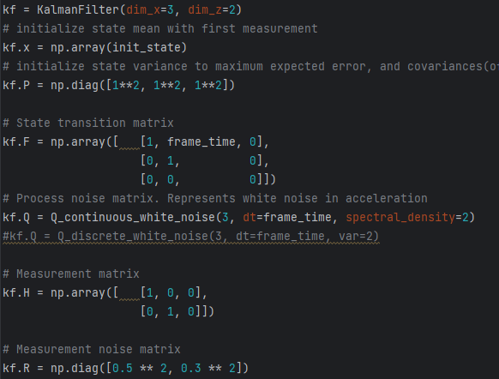
Linear Kalman with averaging
On Laptop ~3FPS
Measurements made inside small room. Lots of echos

Slide 2
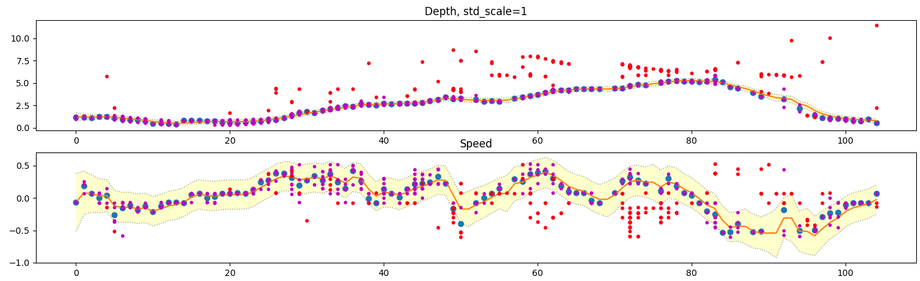
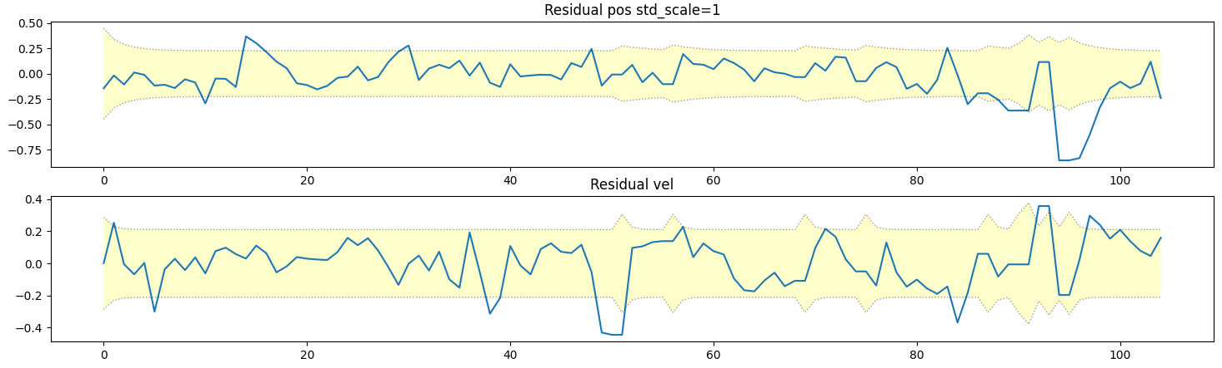
Linear
kalman_results_new1.npy

Slide 3
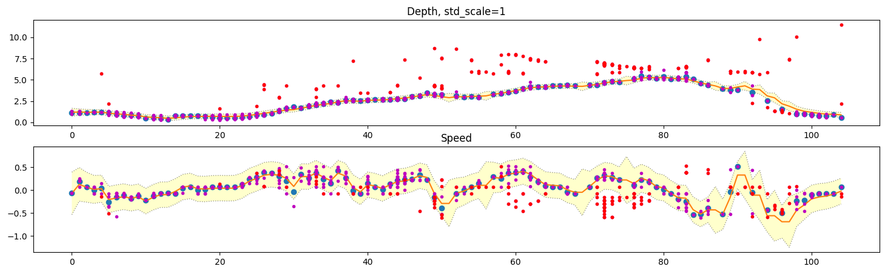
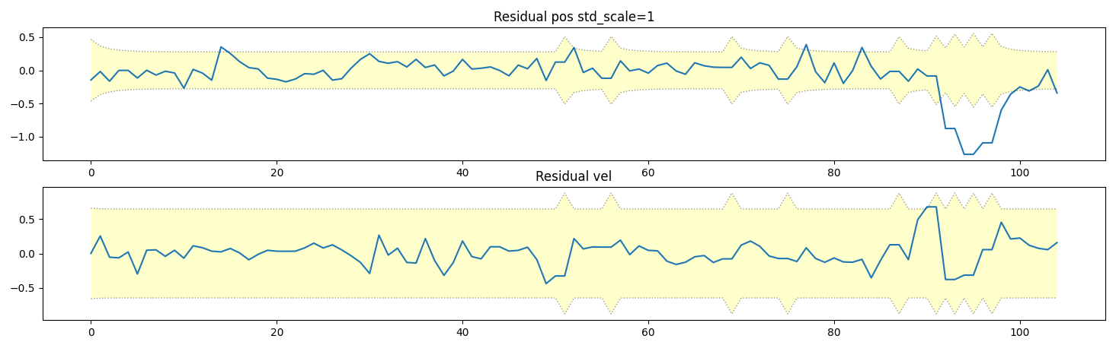
Unscented

Slide 4
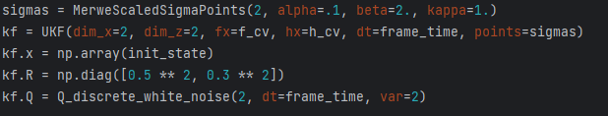
Same Model were given to Unscented Kalman Filter to see if results are better
We see that variances and the predictions are actually WORSE with UKF
Residual however says that velocity was predicted better
Maybe the UKF can be tuned better? This was with the same values as in Linear approach
Lets start tuning the UKF using the followin process model:
If our process or measurements are
Nonlinear or non gaussian we should
be able to achieve better results.
Since radar depth is cut off at 0 and
Cant go negative, it IS non gaussian
Uses average

Slide 5
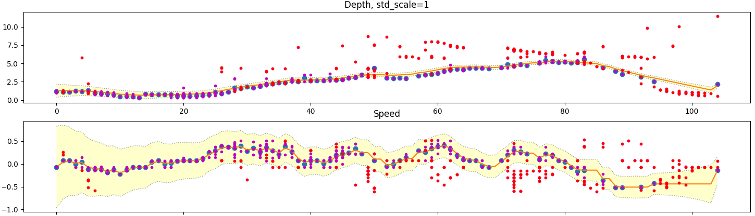
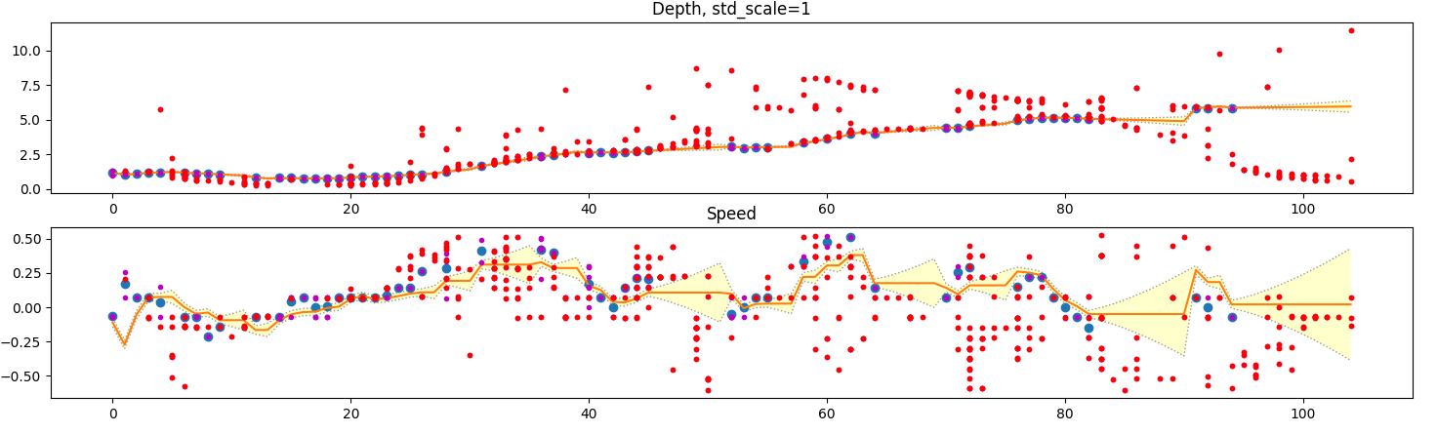
Test: Which sensor to trust more
Look at end where it might diverge

Slide 6
What we learned:
Its better to trust the speed instead of velocity
The filter WILL quicly converge to P = Q hoods. So the process noise it the lowest possible noise. And it is reached failrly fast.
Low process noise gives problems to gating
Gate must be expanded because the detections are not within the believed standard deviations but outside them. Our undestanding of variance is BAD.

Slide 7
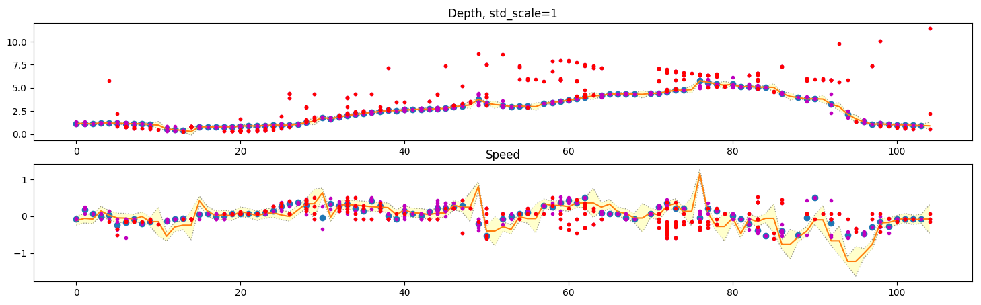
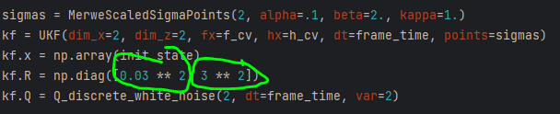
Curiosity: Use depth to calculate speed (more trust in depth)
The standard deviations are VERY wrong. 10std wont even allow us to include OK measurements<

Slide 8
OK! Since we have two variables, we have to decide which one is going to be the smoother one and which
The more responsive one
I say we make depth smoother as it is used in further calculations to ”cut the ray”. The velocity is also
-just like in nature- a parameter that changes faster. By definition it IS a derivative. This is why i sould allow more jumpy velocity measurement

Slide 9
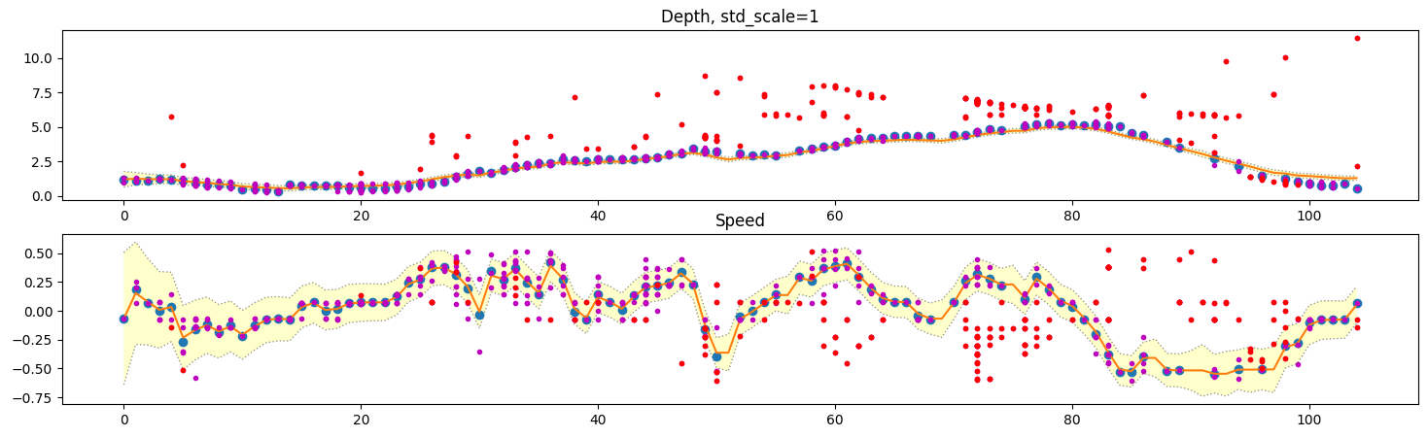
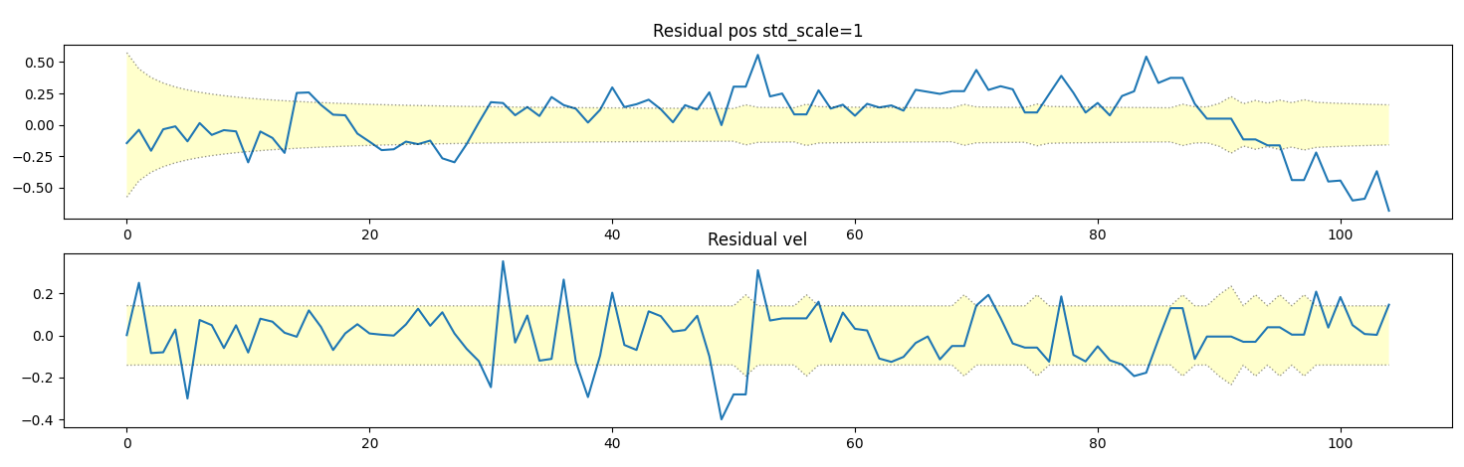
1/2

Slide 10
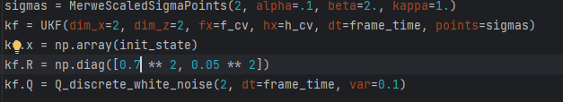
2/2
Tried fitting by using residual. The depth is now really smooth but lags behind. Speed measurement is trusted outright. This is not really good either
We can say with good accuray that a liner filter would have sufficed. The UKF is not really
Giving us much better results

