Slide 1
GPU machine
FPS~20
The Kalman filter does NOT work on GPU machine. It does not converge. We have to look at fitting Kalman for this system on its own.

Slide 2
Lets measure from visually selected correct ”perfect” samples (the dots that are for sure THIS object and also not reflections), the variance of the sensors
Then this can funtion as the absolute lowest confidence level. This will give us some idea into what the numbers ought to be for measurement noise
MaxDepth=12
MaxSpeed=0.6
../measurements/kalman_results_gpu0.npy
STD_depth = 0.4
STD_speed = 0.6
../measurements/kalman_results_gpu5.npy
STD_depth = 0.2
STD_speed = 0.4
../measurements/kalman_results_gpu1.npy
STD_depth = 0.6
STD_speed = 0.7
../measurements/kalman_results_gpu6.npy
STD_depth = 0.5
STD_speed = 0.5
../measurements/kalman_results_gpu2.npy
STD_depth = 0.3
STD_speed = 0.6
../measurements/kalman_results_gpu7.npy
STD_depth = 0.3
STD_speed = 0.9
../measurements/kalman_results_gpu3.npy
STD_depth = 1
STD_speed = 0.3
../measurements/kalman_results_gpu8.npy
STD_depth = 1.5
STD_speed = 1
../measurements/kalman_results_gpu4.npy
STD_depth = 0.4
STD_speed = 0.4
../measurements/kalman_results_gpu9.npy
STD_depth = 0.3
STD_speed = 0.6

Slide 3
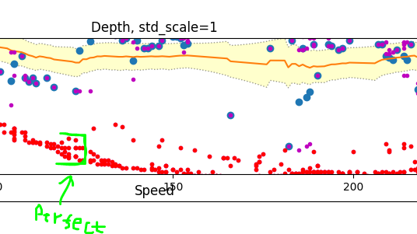
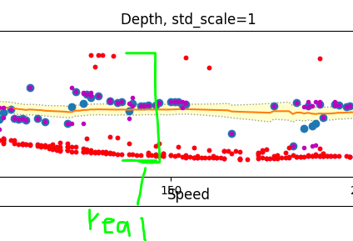
The above PERFECT measurements have a HUGE problem
They do not take into account
Longer propagation paths
Reflections
Wrong fusion
We got reflection from object
that is not THIS object, even though
It was inside of the person as viewed in camera

Slide 4

Note:
As we do not have a ground truth, we can not measure real standard deviation. The above results are all measured by eye.
Eye measurement of STD is possible for small deviations…not large ones
We COULD measure STD if we knew the ground truth. Possible experiment: Stay still in front of the radar. How much do the measurements sway?
Other way: Take the STD formula:
Now track the ground truth by hand
Ground truth = median -> You can now calculate STD
Bad way: Trust std from Kalman

Slide 5
Other ways to measure ”goodness”
Maximum errors are easy to interpret by eye. Measurement vs actual place. However it is very hard to average them out in ones head.
In order to calculate averages one would need to plot out ground truth again. I do not want to do this, as it takes a lot of hand selecting data.

Slide 6
Average max error of ALL points
MaxDepth=12
MaxSpeed=0.6
As defined above as ”real”
../measurements/kalman_results_gpu0.npy
Avg_max_error_in_depth =
Avg_max_error_in _speed =
../measurements/kalman_results_gpu5.npy
Avg_max_error_in_depth =
Avg_max_error_in _speed =
../measurements/kalman_results_gpu1.npy
Avg_max_error_in_depth =
Avg_max_error_in _speed =
../measurements/kalman_results_gpu6.npy
Avg_max_error_in_depth =
Avg_max_error_in _speed =
../measurements/kalman_results_gpu2.npy
Avg_max_error_in_depth =
Avg_max_error_in _speed =
../measurements/kalman_results_gpu7.npy
Avg_max_error_in_depth =
Avg_max_error_in _speed =
../measurements/kalman_results_gpu3.npy
Avg_max_error_in_depth =
Avg_max_error_in _speed =
../measurements/kalman_results_gpu8.npy
Avg_max_error_in_depth =
Avg_max_error_in _speed =
../measurements/kalman_results_gpu4.npy
Avg_max_error_in_depth =
Avg_max_error_in _speed =
../measurements/kalman_results_gpu9.npy
Avg_max_error_in_depth =
Avg_max_error_in _speed =

