Slide 1
Implemented minimum point
No more need for gating
Maybe use some percentile filter before minimum?
Or extend point picking to have time dimension in addition to this strictly ”vertical” point picking within the same delta-time

Slide 2
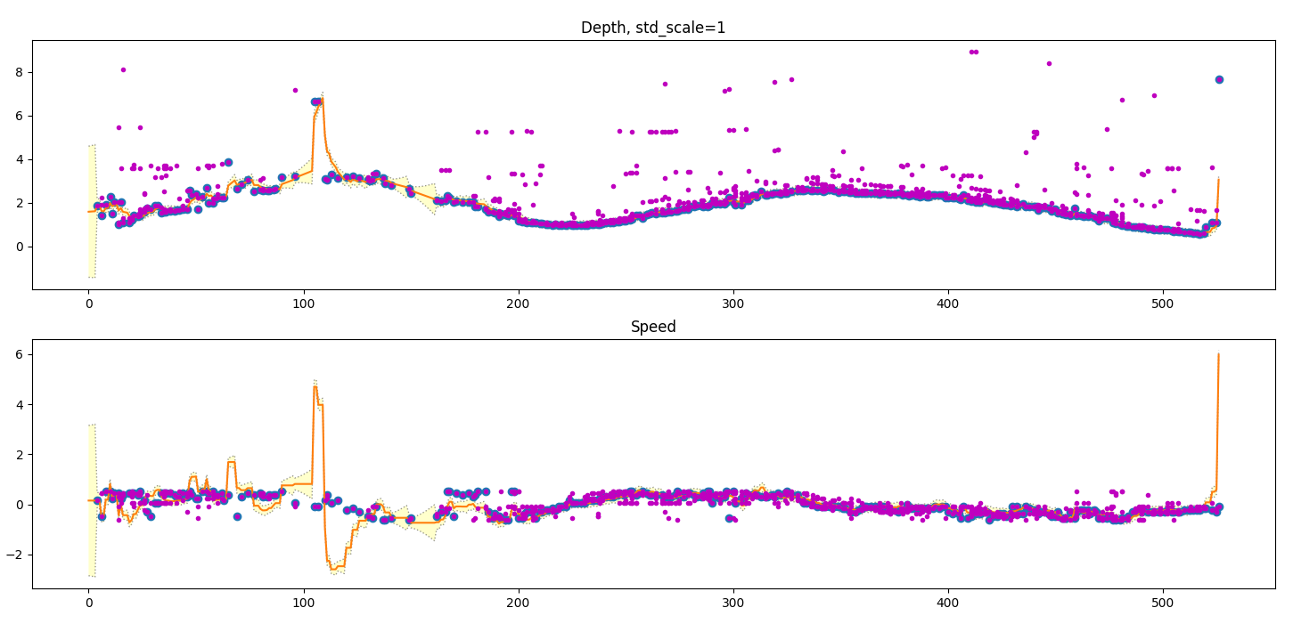
Do not trust depth estimate too much
Even if ALL
else is fine, a single rogue depth can flip the whole speed

Slide 3
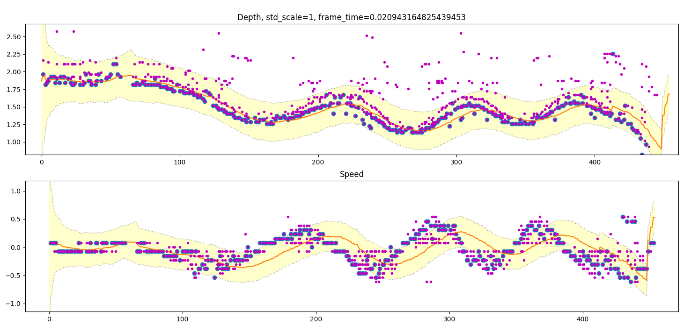

Too much trust in prediction perhaps. We see the filter responds slowly. This dataset also is hard because it has acceleration that
We do not predict. Process noise needs to be higher

Slide 4
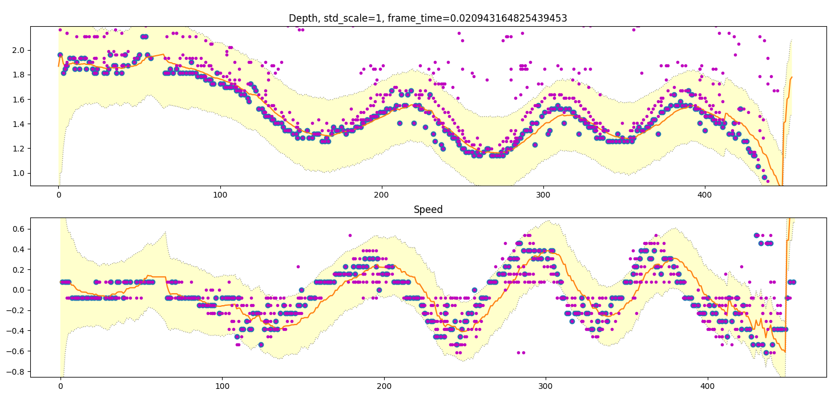

Process noise increase makes it more ”real time”

Slide 5
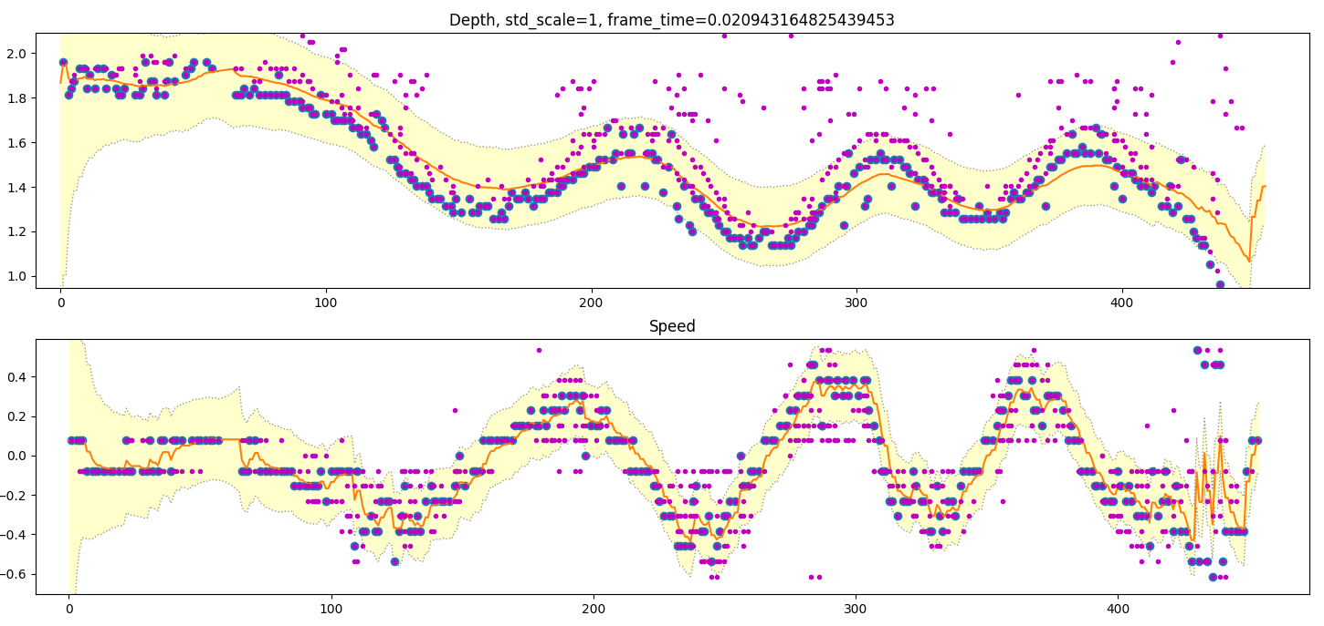

How about we change to trust speed more now?
- The position estimate suffers

Slide 6
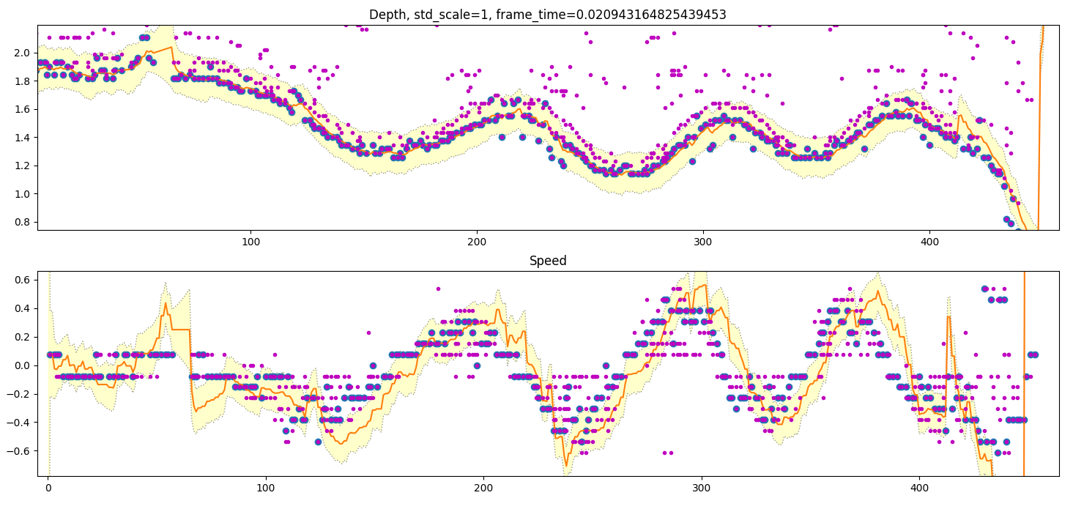

How about: position = 10x as accurate as speed
This works very well in this case
However:

Slide 7
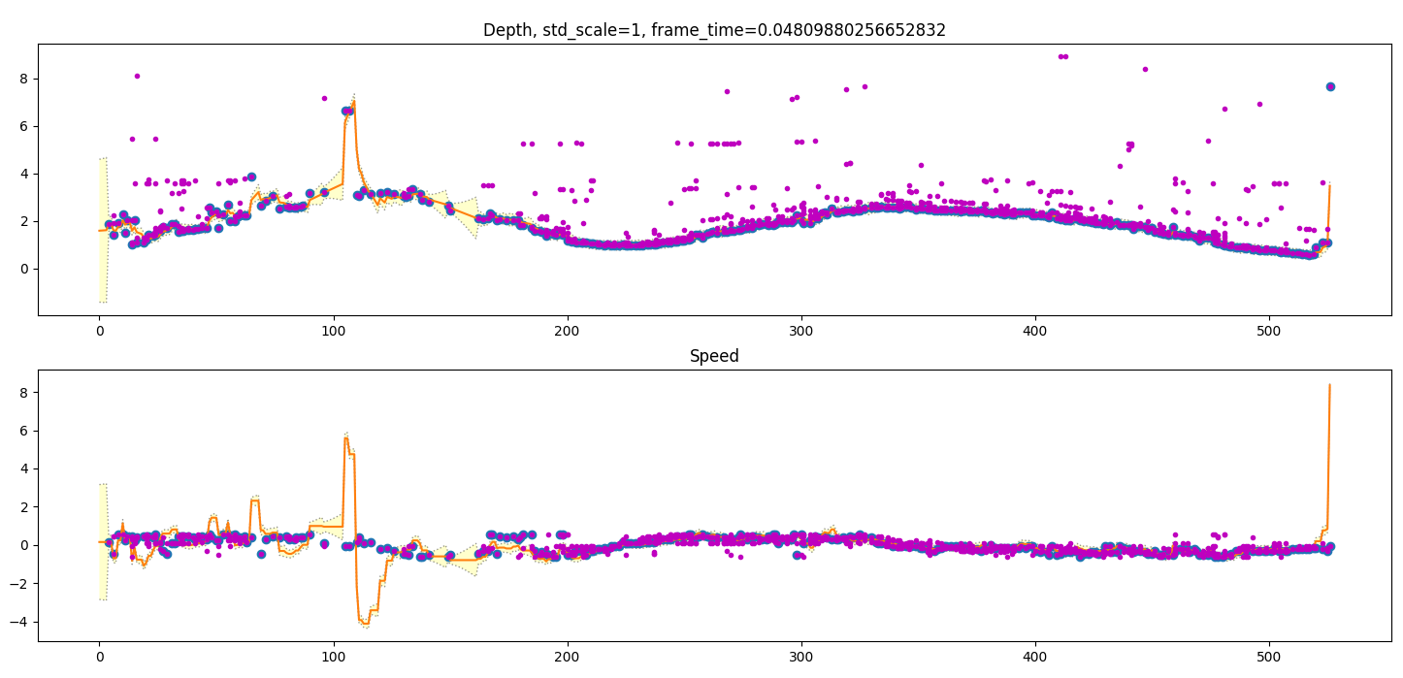
For different dataset we see that trusting position a lot will make sudden jerks in acceleration when measurement of real object fails and we only have a far away shadow.
We can see that this does not happen very often however. AND. When we filter speed in the post processing,
This spike will probably be relieved a little.
The outputs are however a little edgy/jagged. We could trust the prediction a little more

Slide 8
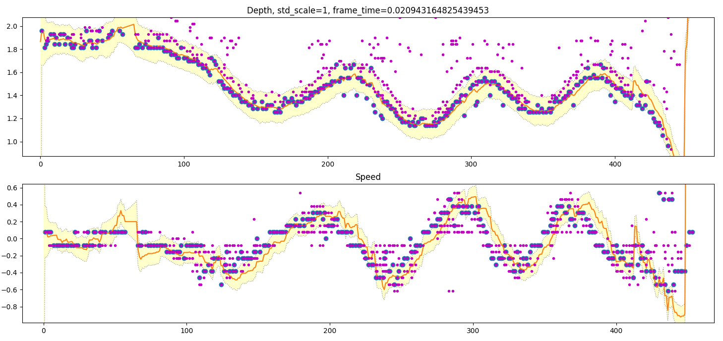
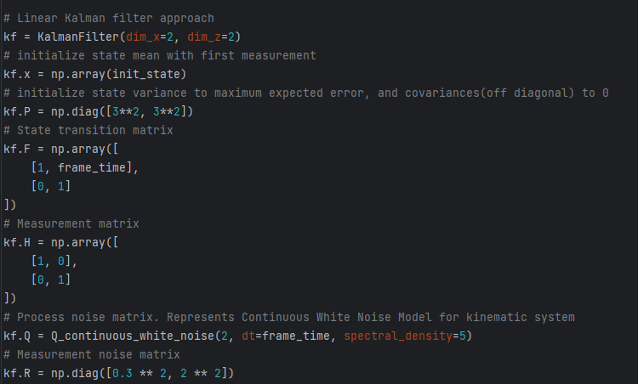

This model gives very good estimation for both distance and speed
Lets test this for all datasets

Slide 9
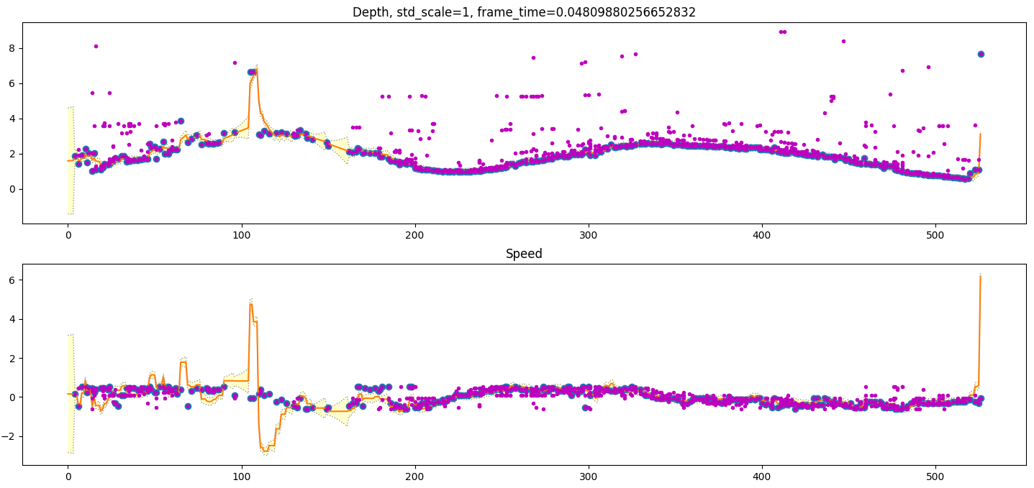
../measurements/kalman_results_gpukone0.npy

Slide 10
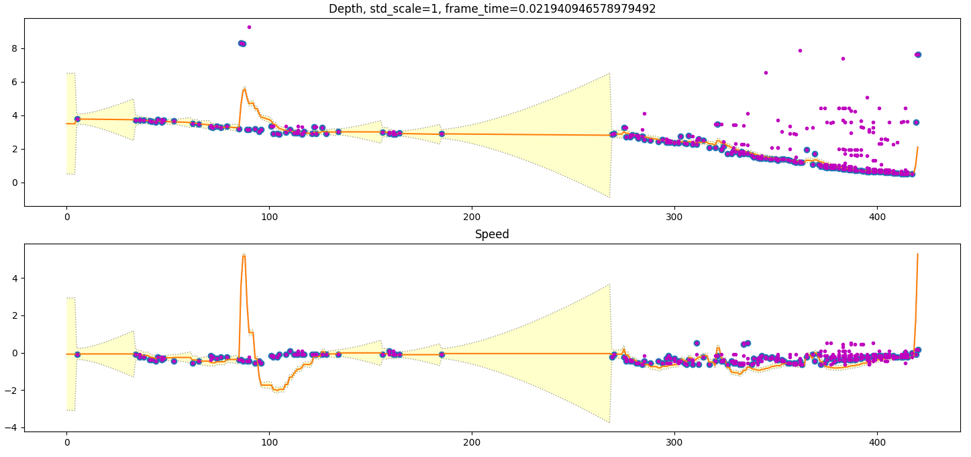
../measurements/kalman_results_gpukone1.npy

Slide 11
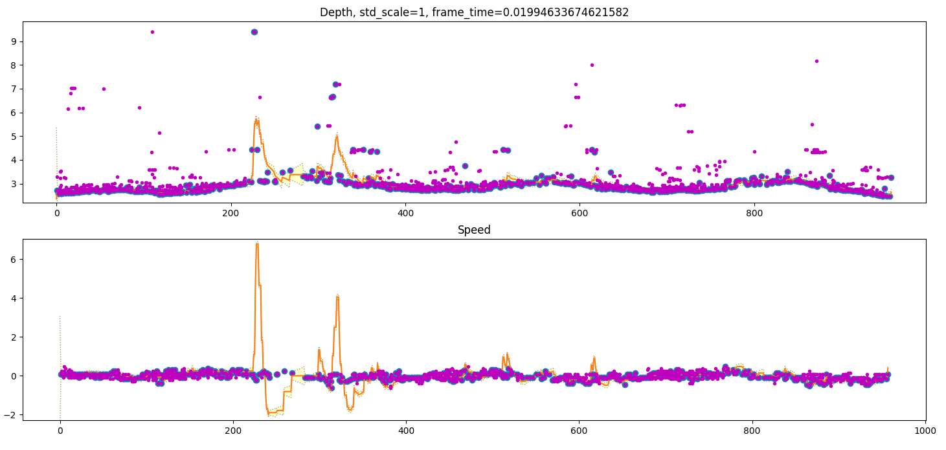
../measurements/kalman_results_gpukone2.npy

Slide 12
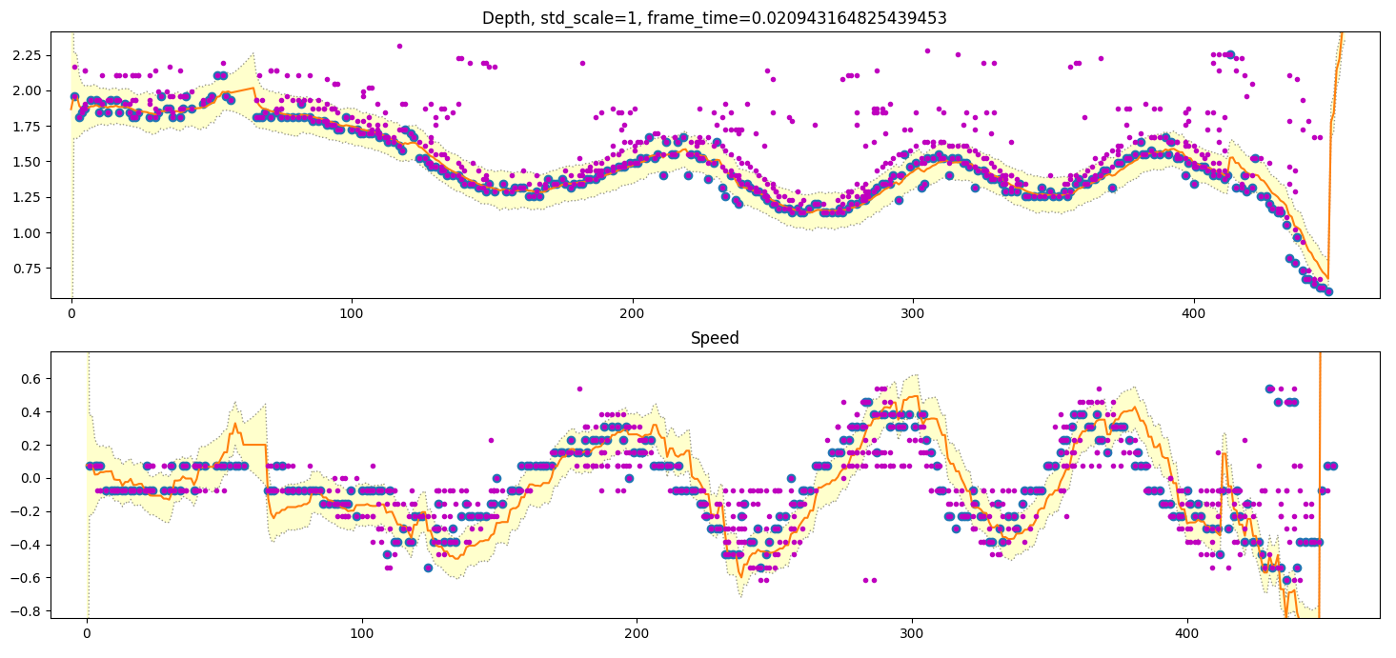
../measurements/kalman_results_gpukone3.npy

Slide 13
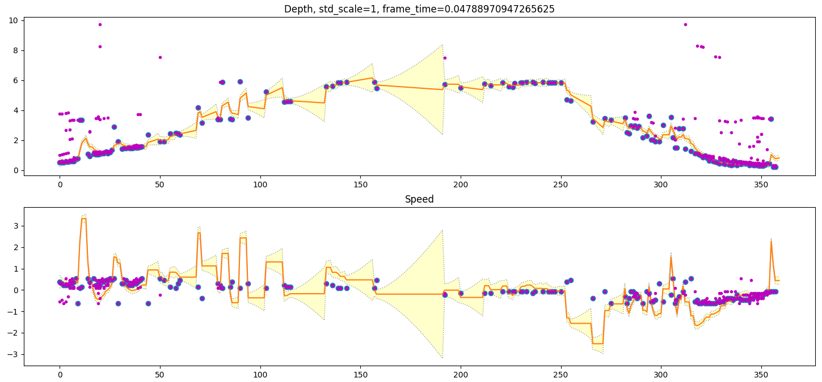
../measurements/kalman_results_gpukone4.npy

Slide 14
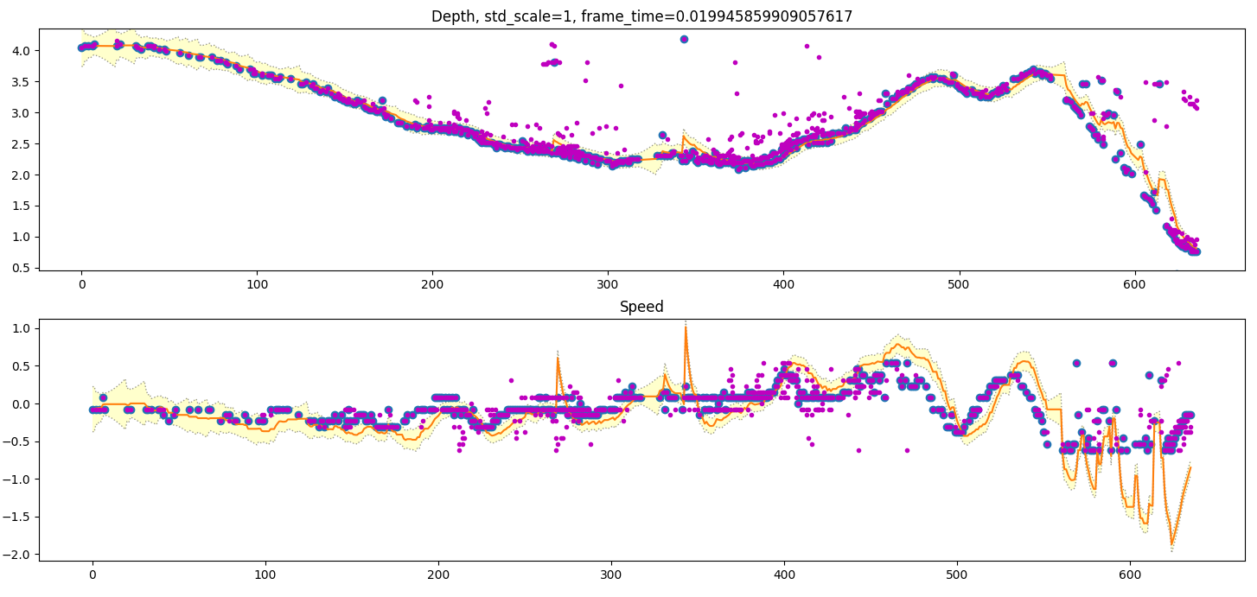
Dont worry about the end. My speed exceeded radar top speed so the speed is cut off. Kalman is right to predict faster speed than what was measured
../measurements/kalman_results_gpukone5.npy

Slide 15
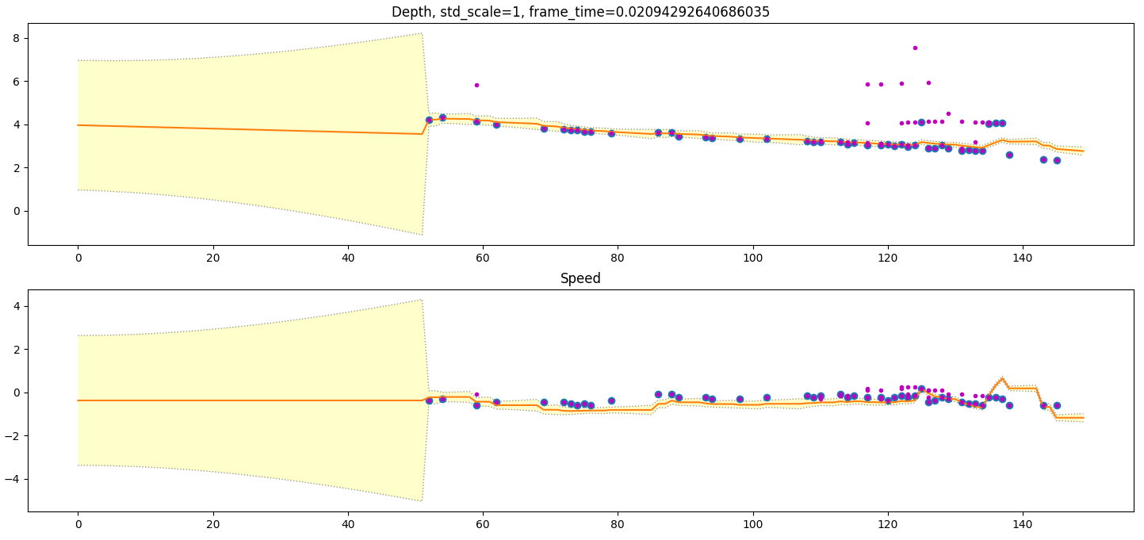
../measurements/kalman_results_gpukone6.npy

Slide 16
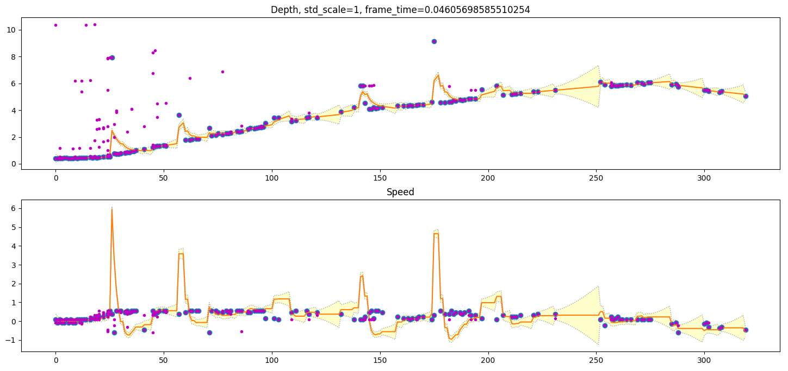
../measurements/kalman_results_gpukone7.npy

Slide 17
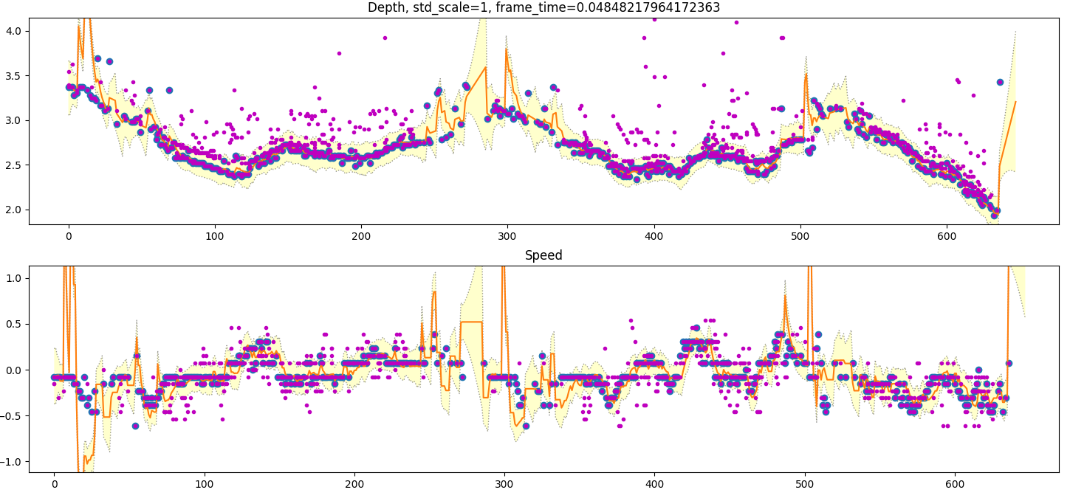
../measurements/kalman_results_gpukone8.npy

Slide 18
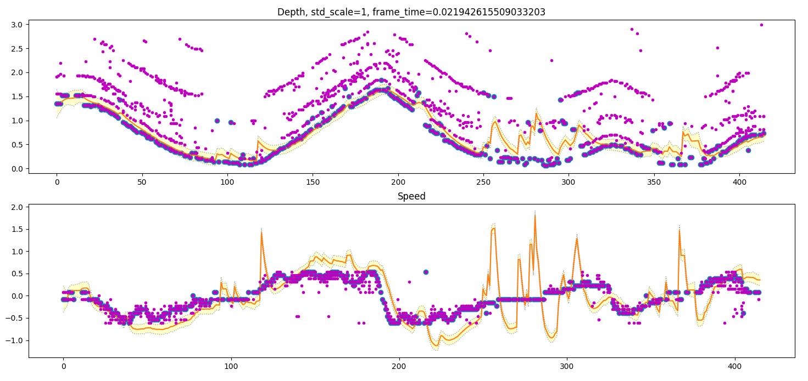
WHOA! You can CLEARLY see the different length propagation paths
This data9 is also VERY good for training
../measurements/kalman_results_gpukone9.npy

Slide 19
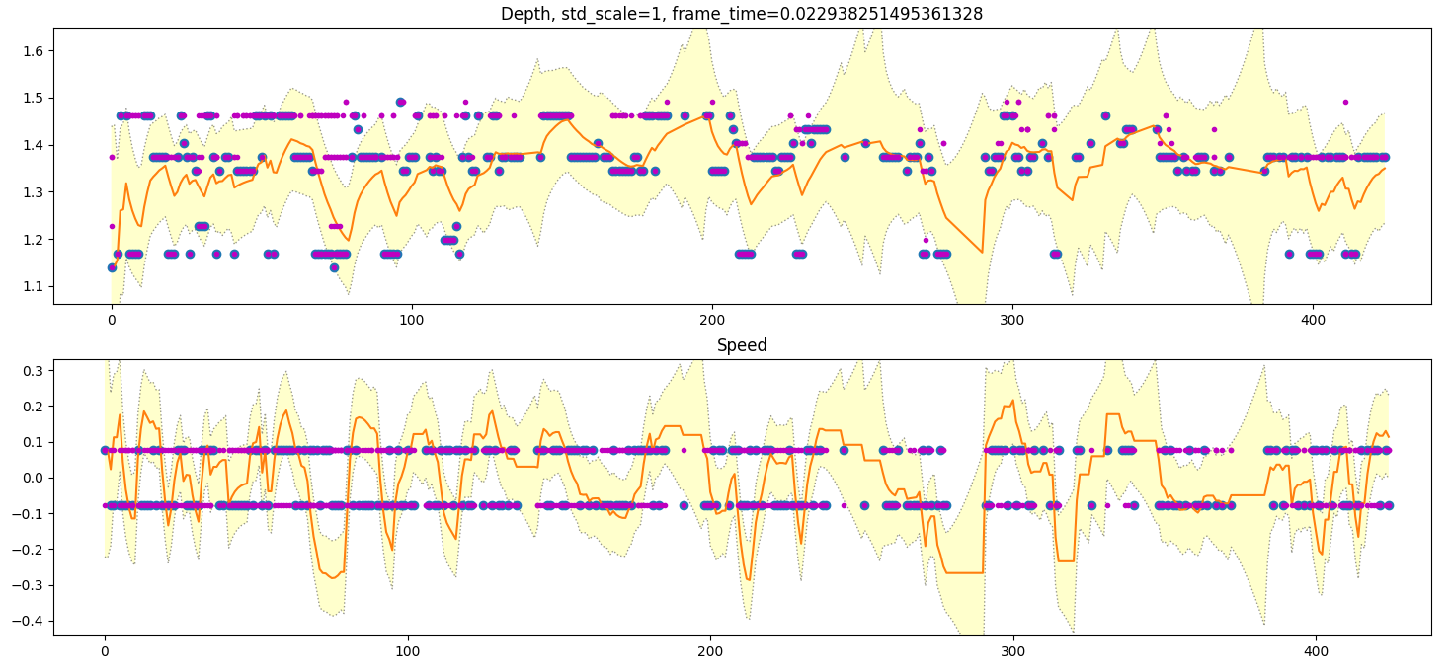
In this example i try to still in front of the radar, moving just millimeters to trigger the radar into measurement.
My actual depth changed by 5cm max, but this predicts 40cm confidence
../measurements/kalman_results_gpukone10.npy

Slide 20
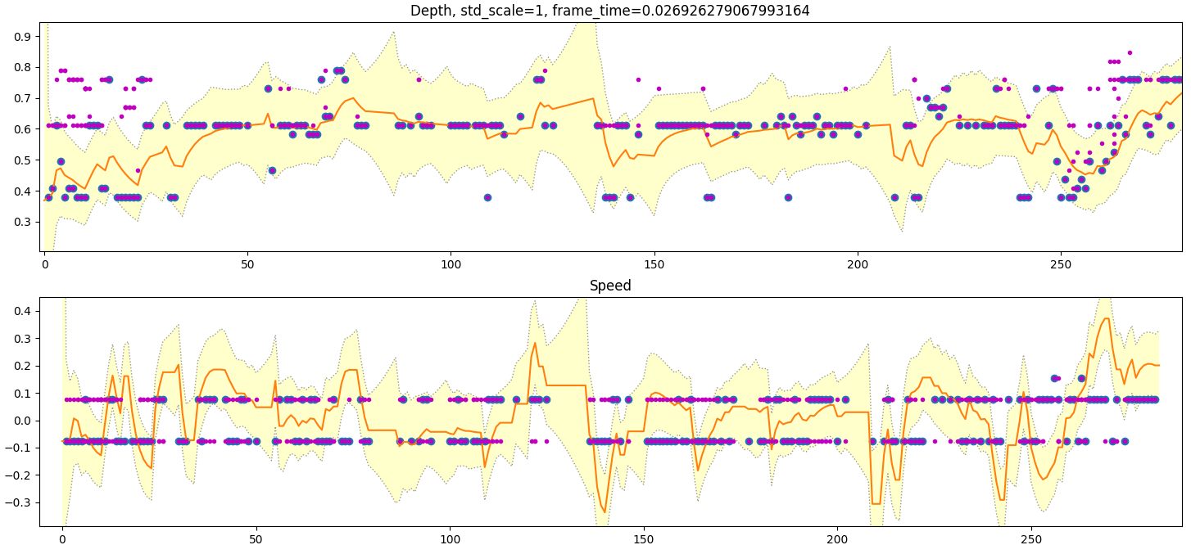
Another ”not moving” test
../measurements/kalman_results_gpukone11.npy

Slide 21
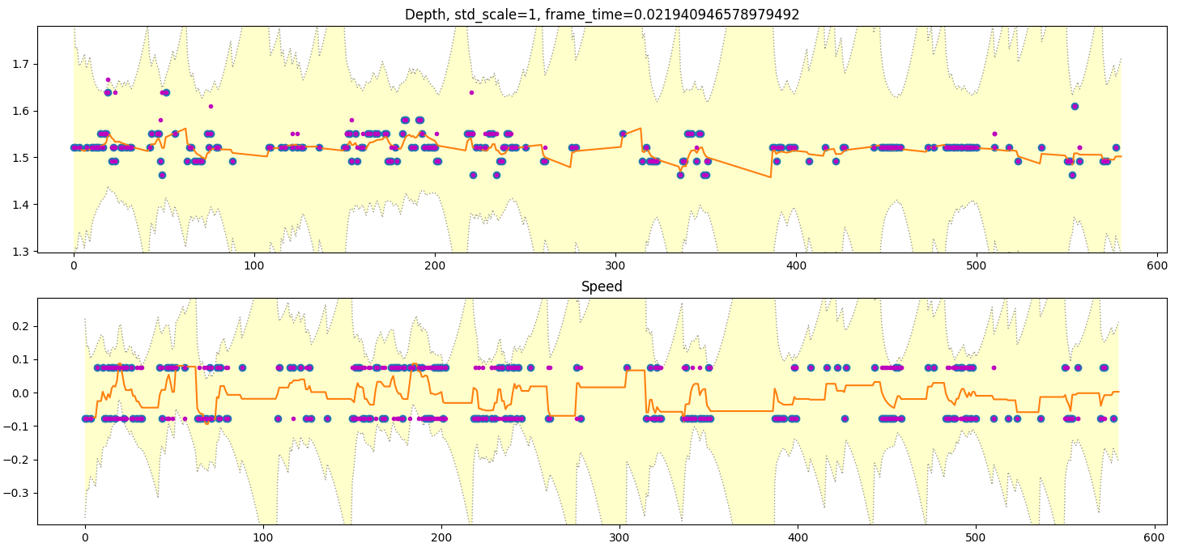
../measurements/kalman_results_gpukone12.npy

Slide 22
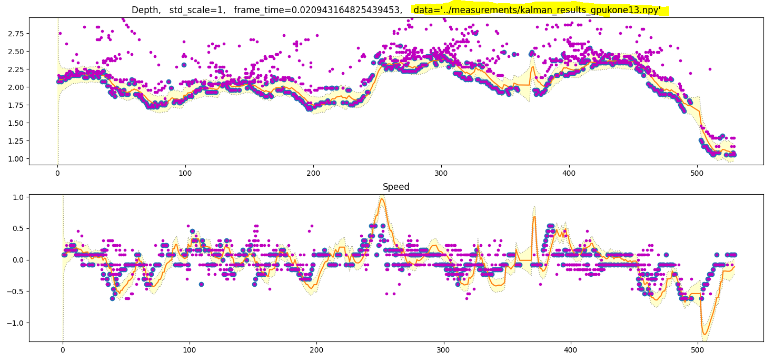

Slide 23
Ok. What we learned:
Sometimes theres just not a single right measurement.
Combined with high trust in place measurement this will make a huge spike. Recovery is fast as we trust
Place a lot and more measurements will put it back into place. However, it would be better not to make spikes at all.
In visualization and in general, because of post calculations with the kalman results:
Depth must NOT have spikes. That would lead us to cut ray at wrong place and therefore also calculate
Camera speed wrong. Thus EVERYTHING will be wrong
Speed can have spikes. We dont really care. They can be filtered. And in any case speed is a lot faster of a variable.
Depth is actually accurate in range of 40cm for human. If a human stays still, the depths vary 40cm. This maybe due to sensor, but most of it is because a human has depth. Depth of the body is about 30cm and a radar reflection can come from any point of the body
Ghost targets (multipath propagation) is present even in fused data. This is VERY evident in
where ghosts appear 10cm, 50cm and 150cm behind the subject and mimic the subject movement
This is interesting because we would think that multipath would not end up within the mask of the subject. The longer paths are by definition not line of sight to subject. Camera only sees line of sight from which it finds out the mask…
Unless! The Segmentation is not perfect and the mask is larger than the subject. Too large mask allows echoes coming from a little next to the subject
../measurements/kalman_results_gpukone9.npy

Slide 24
Kalman SHOULD know that a measurement is way out of line and not trust it
Or… not? Kalman actually just takes my word for ”how good” the measurement is
When it gets a measurement it calculates || of P and R. (Same as parallel resistors formula).
It will think that the measurement is good because i told it so. This leads to requirement for
Input filtering. This is because
Garbage in – Garbage out
We need input filter. In particular – time based input filter
This is because in a single dt we might not have a single right measurement. But looking at multiple dt there most probably is a real measurement.
How long should the window be?
Looking at the data above: The longest amount of dt:s without real measurement = 3
Mostly the dt without real measurement are just 1 dt in length.
Window of 3 might be enough. As we will be taking minimums, we do not want too long window
Or.. We could accept that trusting predicted state is OK, it just produces results that are delayed.

