Slide 1
Taking TIME into consideration in picking points
Windowing

Slide 2
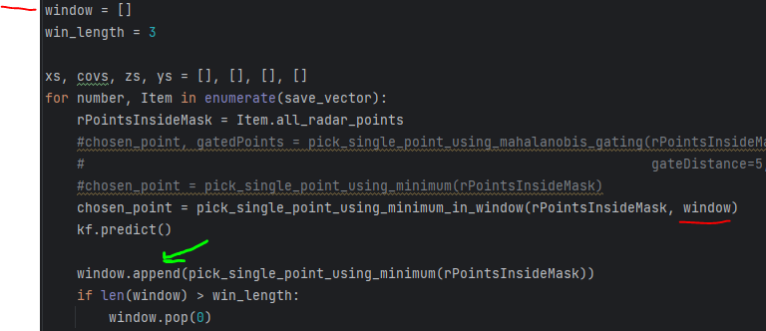
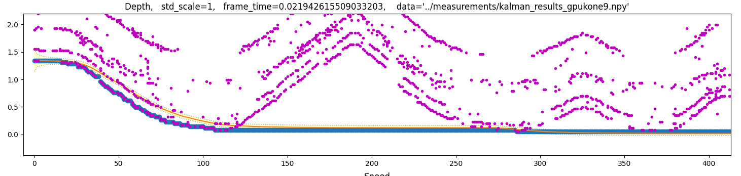
Green: You MUST not put the chosen point, but the measurement into the window. Otherwise the algorithm will converge
What i mean by converge is the
Minimum will be remembered as in:

Slide 3
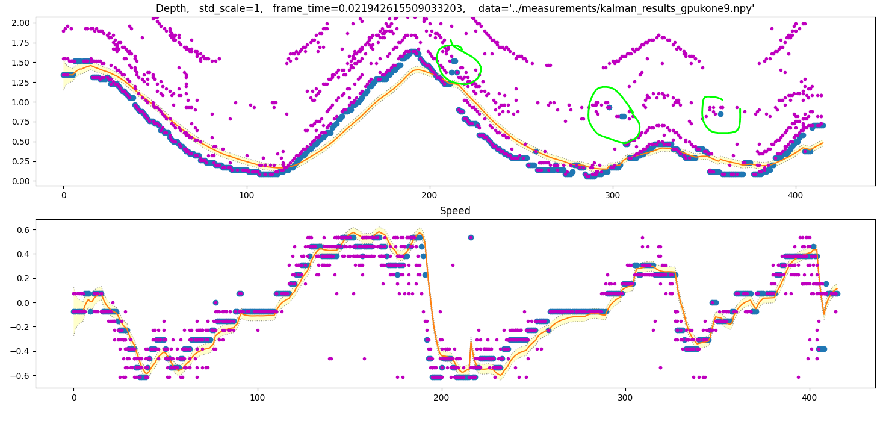
Window size 3 will have some outliers left and be delayed by 3 dT

Slide 4
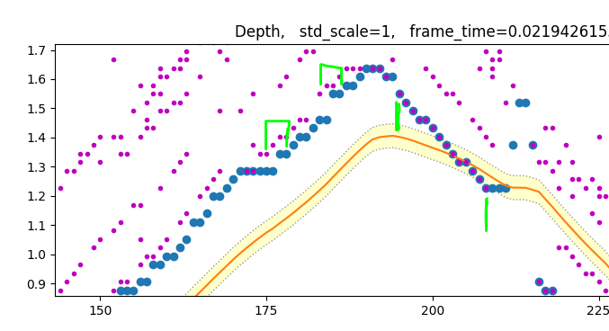
With minimum inside window, rising depth will be delayed. Falling depth wont.
Delay is approximately the window size. Here window size = 3

Slide 5
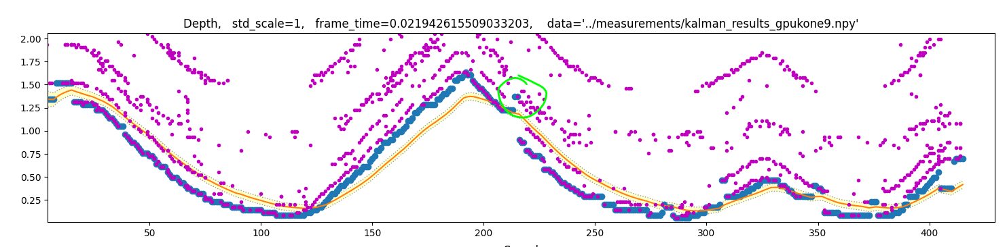
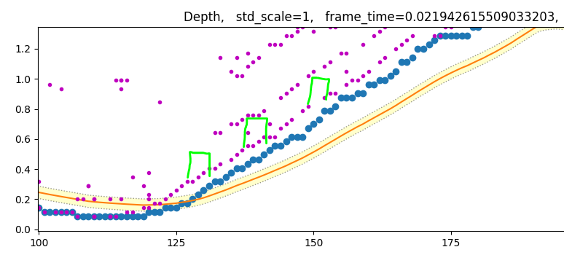
Just single outlier remaining
Delay is long. In GPU this 5 dT = 0.1 seconds
(Delay = frametime*window size)
On laptop this is 1.5 seconds….
For laptop, we want to limit ourselves to a second of delay.
Window size 2-3 is the only choise in minimum filtering
window size = 5 (larger)

Slide 6
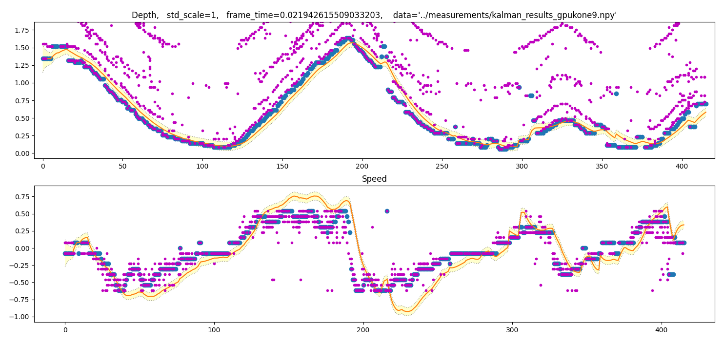


Fitting on Kalman

Slide 7
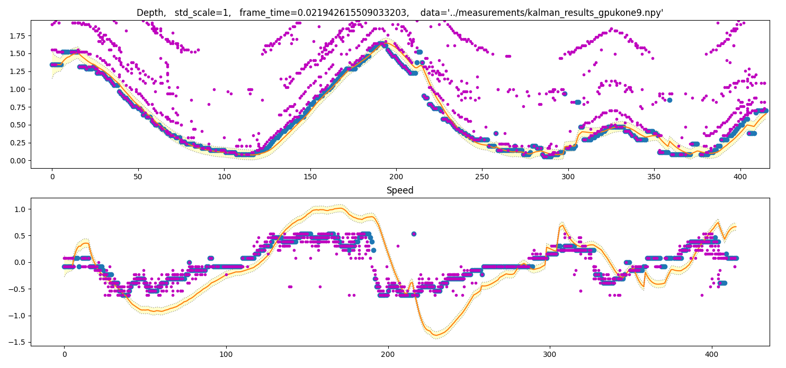


With this configuration we can estimate speed even when it
Is larger than maxVelocity of radar

