Slide 1
Laptop results
The driver was fixed, AoA of radar was limited, sideinfo was suppressed
This lead to us being able to use higher radar frame rate
This file is measured with laptop 25fps radar inside small apartment with echoes
Taken with f=600

Slide 2

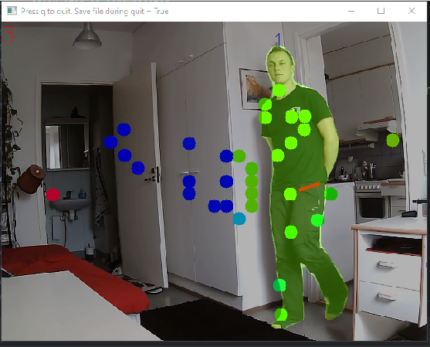
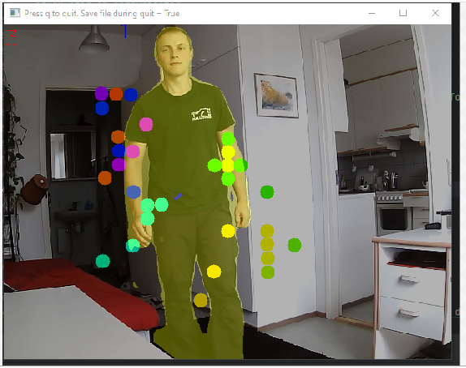


Linear Kalman
Multipath propagation
BUT it doesnt hit the
Segmentation mask so
It is discarded by fusion
Here multipath gets included

Slide 3
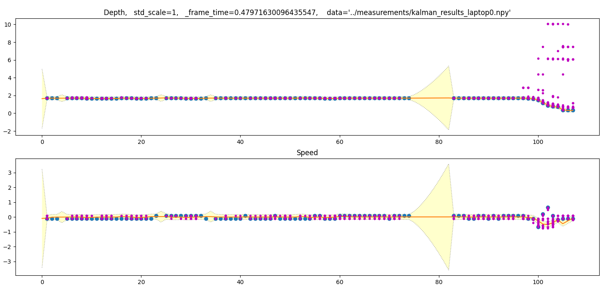
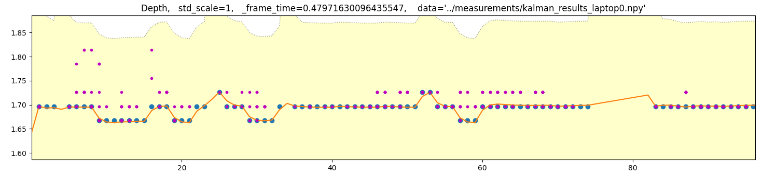
Standing still
Range noise
is very small

Slide 4
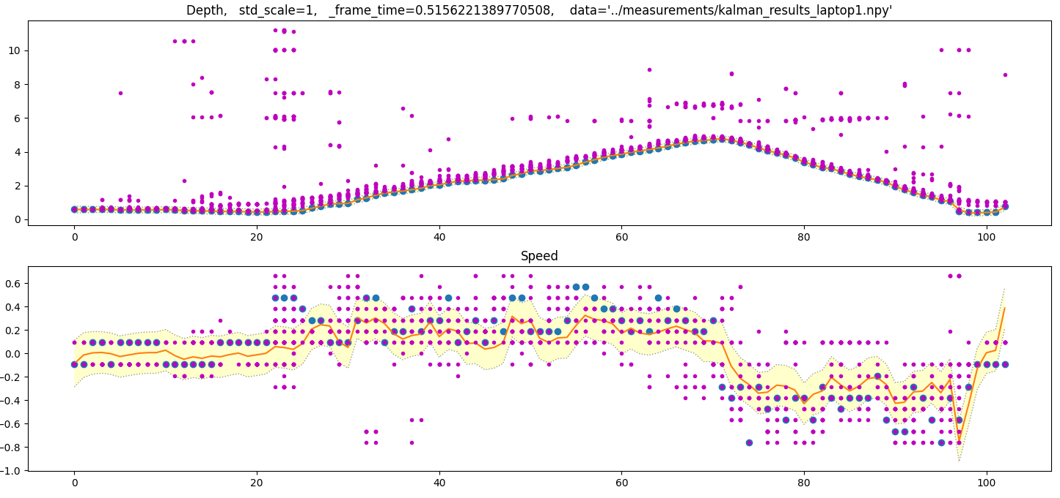

Slide 5
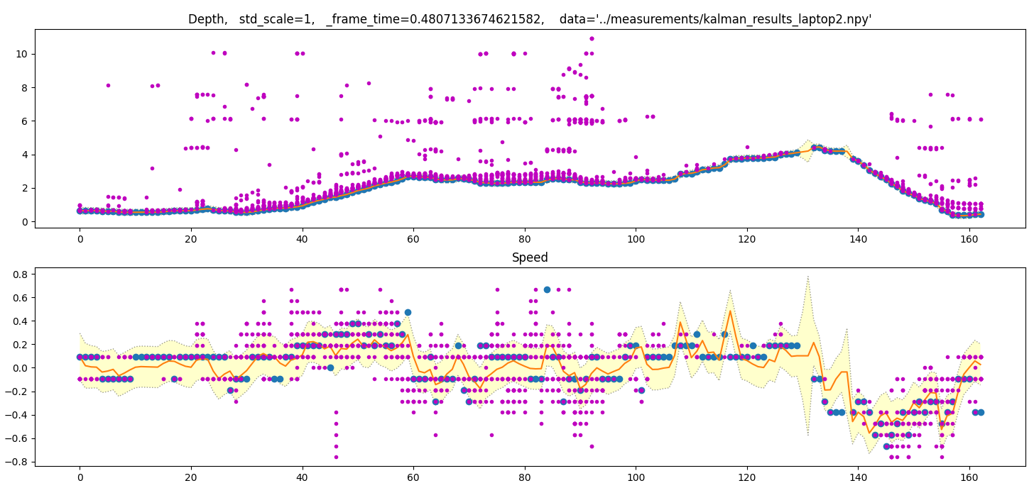

Slide 6
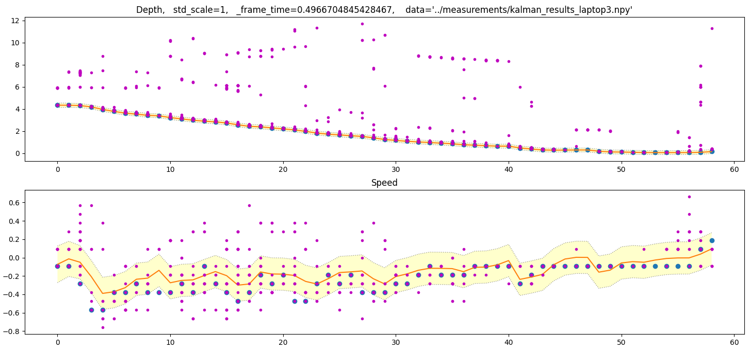

Slide 7
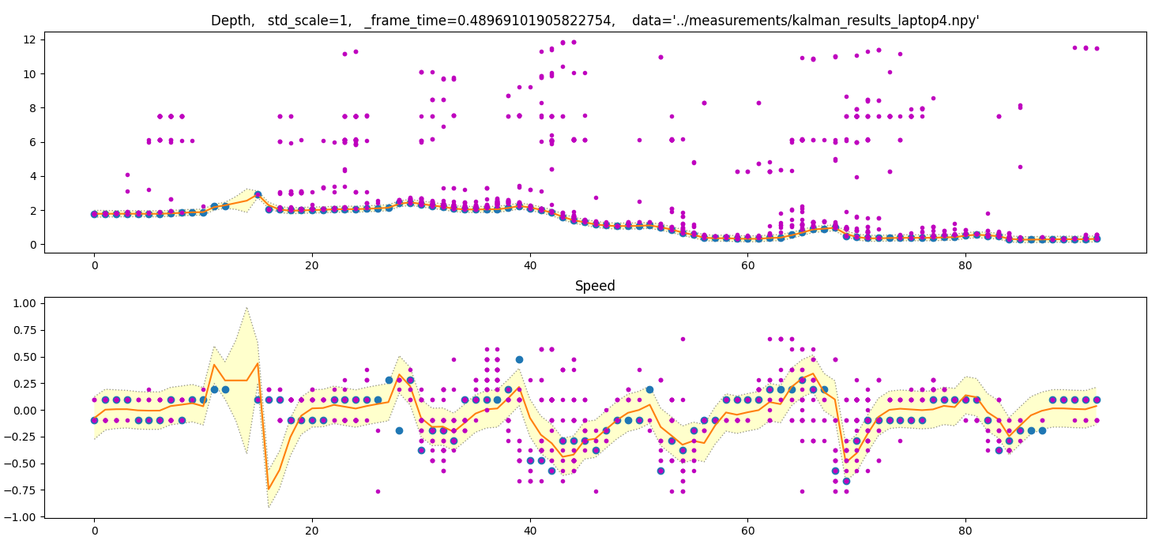

Slide 8
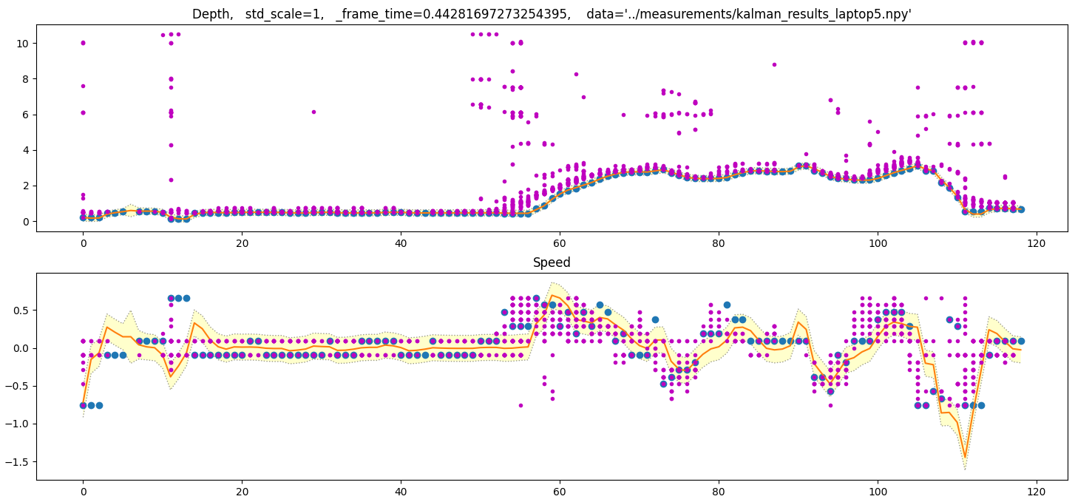

Slide 9
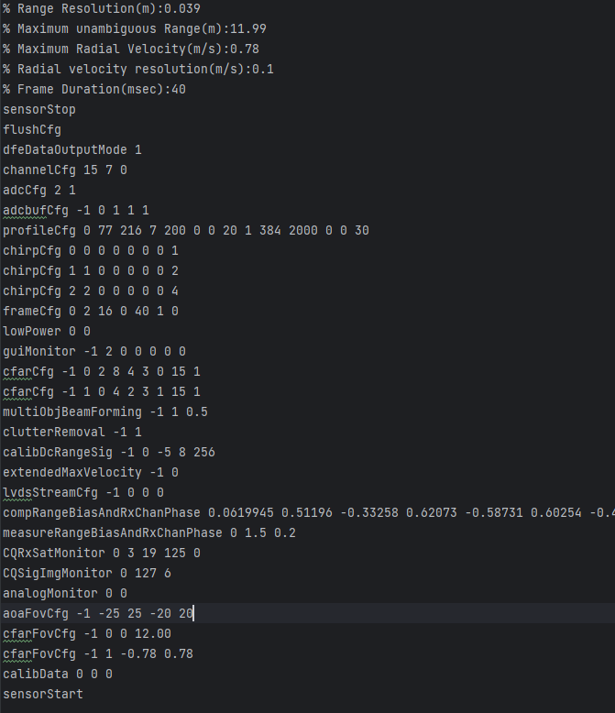
Config file of 25fps

