Slide 1
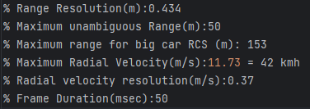
Measurements of cars
'radar_configurations/scatter_20fps_car_40kmh.cfg'
_focal_length = 600
model = YOLO("yolov8n-seg.pt")

Slide 2
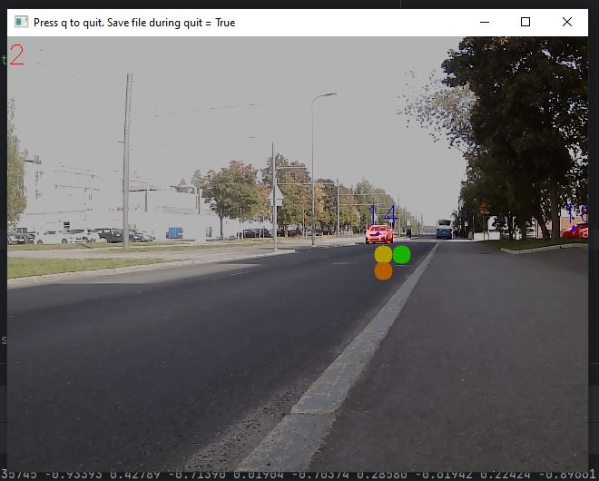
Biggest problem is that radar dots do not align with the segmentation masks. Thus no input is given into the Kalman
Bigger mask or use of bounding box could ease this problem, BUT it would negate the idea that only line of sight radar paths are counted
The real solution is to have different data association technique than just bare projection.

Slide 3
Problem 2
Radar velocity measurement can be outright wrong
Does not correlate to the distance change over time
Check
This can be because frame rate has changed. Our system assumes constant frame rate which is measured with the first couple frames
Calculate (pos_end – pos_start)/((end_frame – start_frame)*frame_time)
Because x-axis is in frames, not time

Slide 4
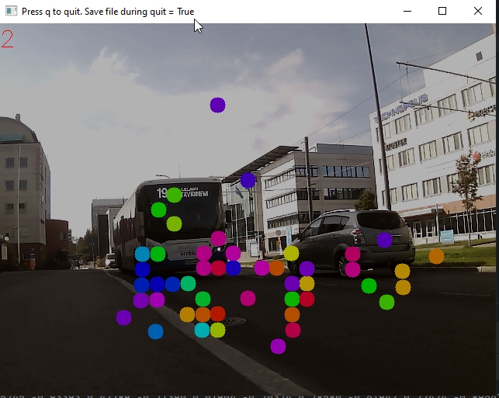
Yolo does not count busses as cars
Cars coming into picture need about 5 frames in frame in order to be recognised as cars and segmented
Another segmentation network or faster fps could help in this

Slide 5
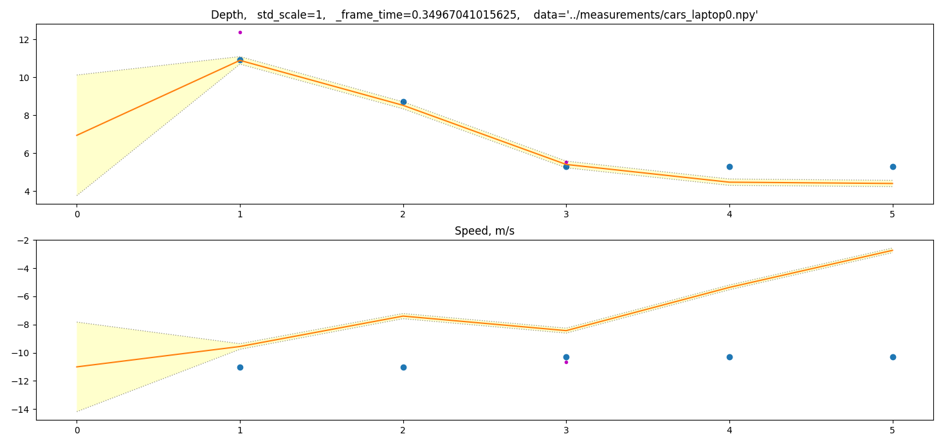
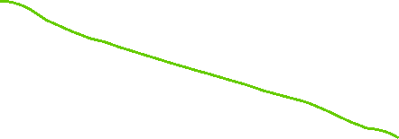
6.47 m/s
0 m/s
11 m/s

Slide 6
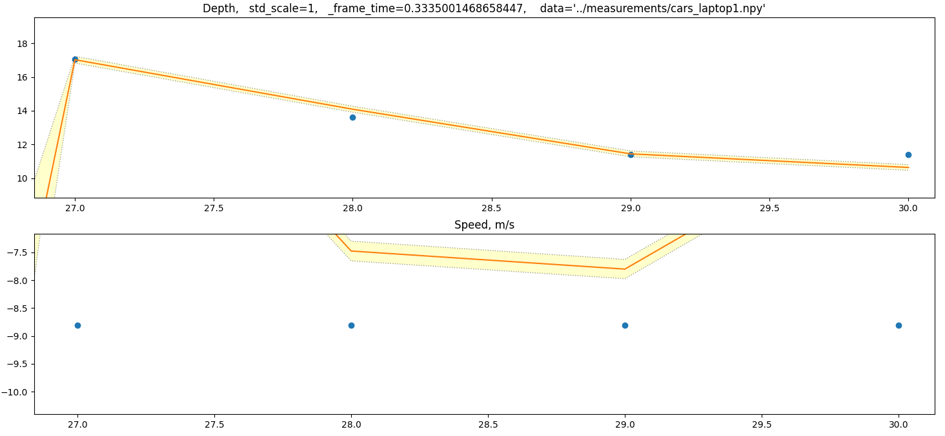
4.8 m/s
8.8 m/s

Slide 7
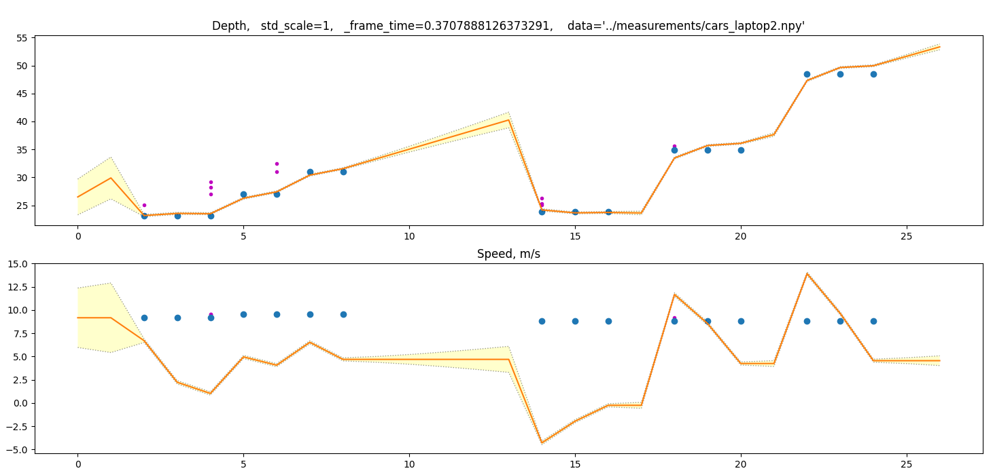
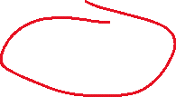
7.0 m/s
3.46 m/s
This is furthest measurement
With data-association!
10 m/s
This was probably two cars after one another. 10m/s = 36 km/h

Slide 8
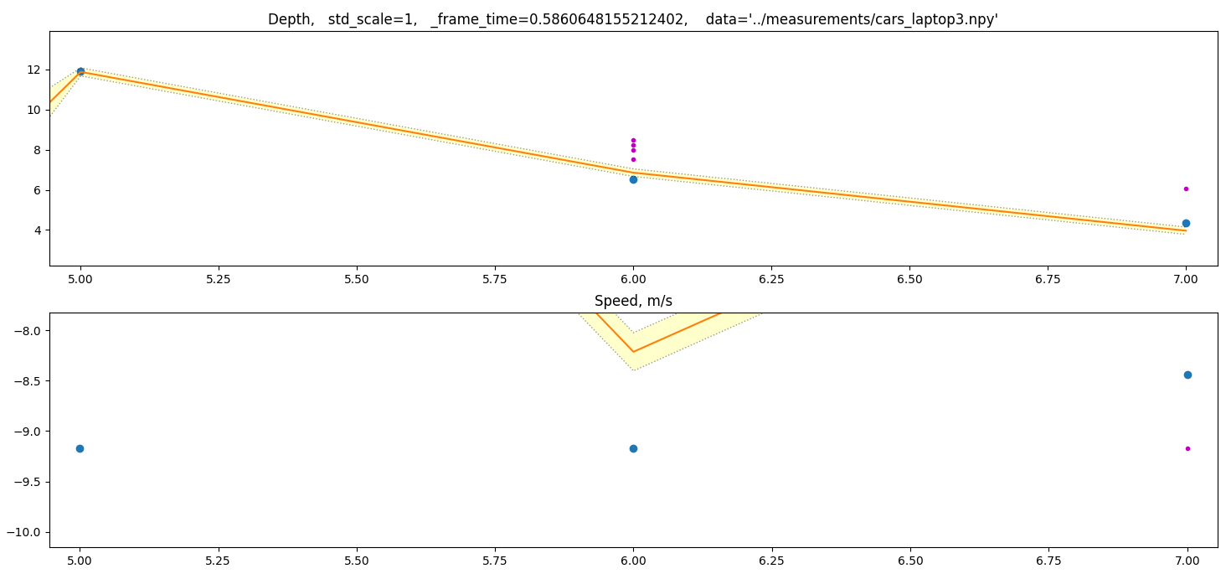
-6.4 m/s
-9.1m/s

Slide 9
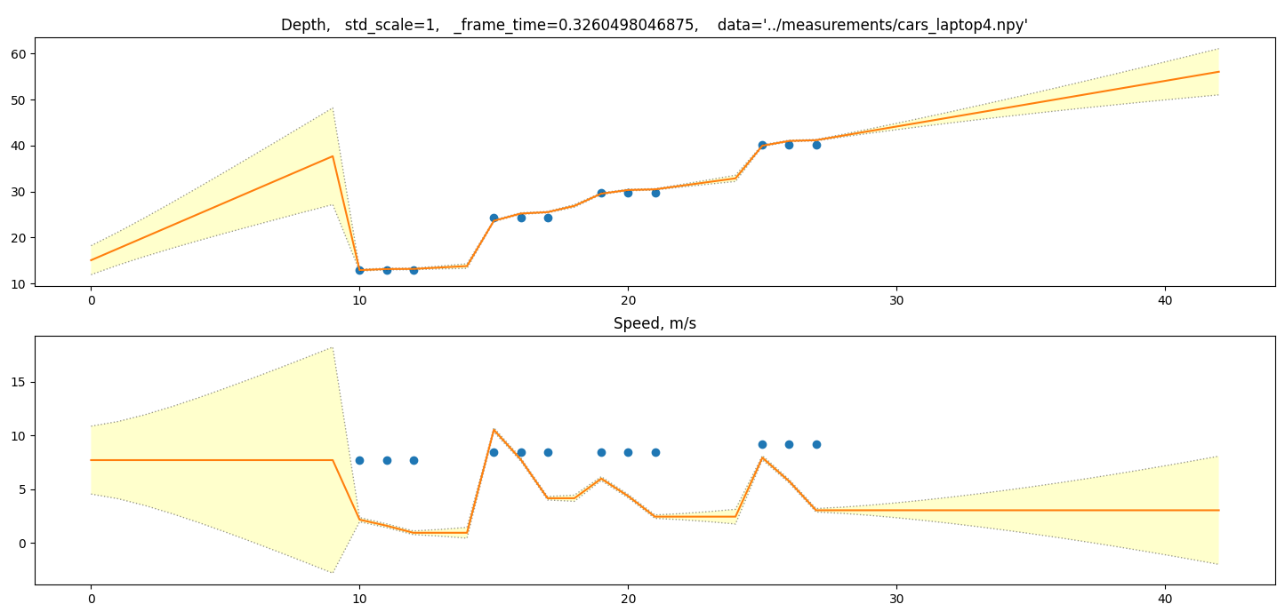
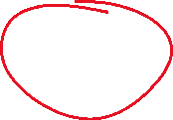
Whoa! We got data association from 40 meters away!

Slide 10
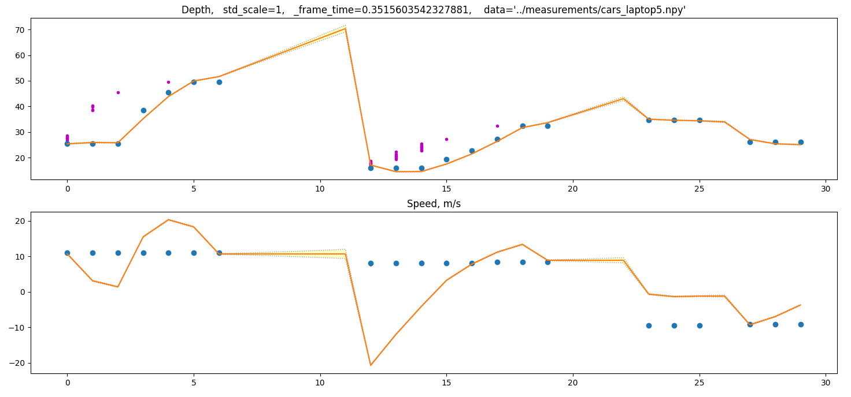
3 cars

Slide 11
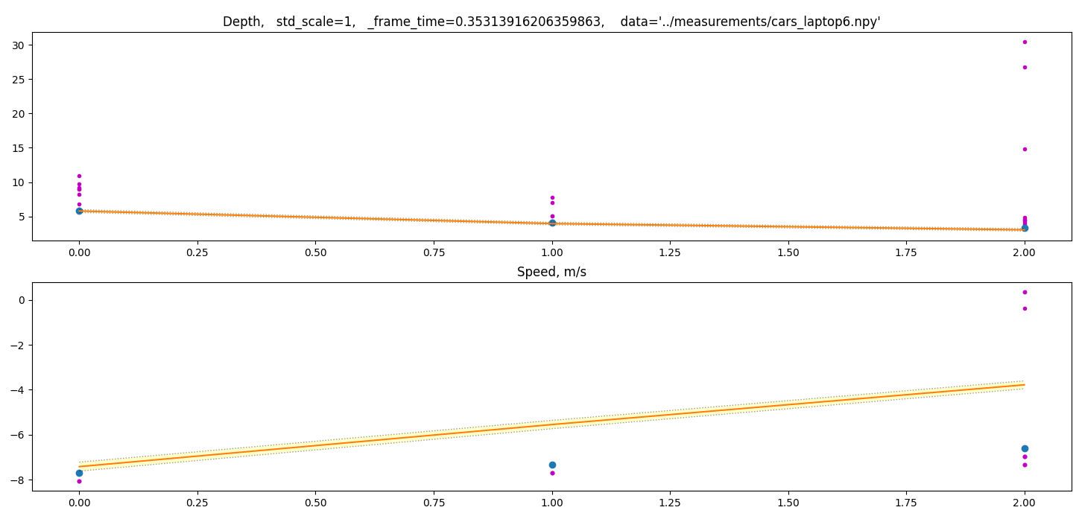

What in heavens is this??? How did we get radar reflections that were associated with a camera segmentation mask from
5 to 30 meters for one obect. The object is probably an accidental bus track. The object reflects from very long area of length

Slide 12
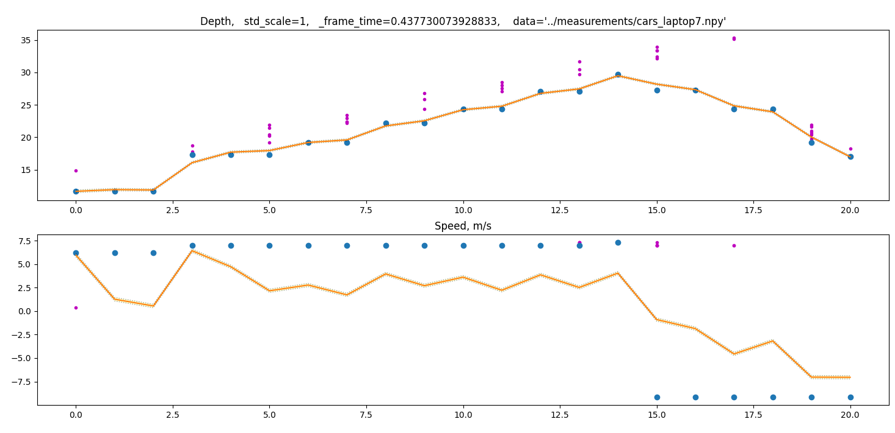
3.0 m/s
-4.5 m/s
6.0 m/s
Velocity measurement lies.
Radar v is outright wrong.
Kalman calculates more correct speed.
-9.5 m/s
Data-association worked MUCH better for this car traveling at lower speed (21 kmh). It was traveling away from us. At 15s
Track is of another car coming toward us

Slide 13
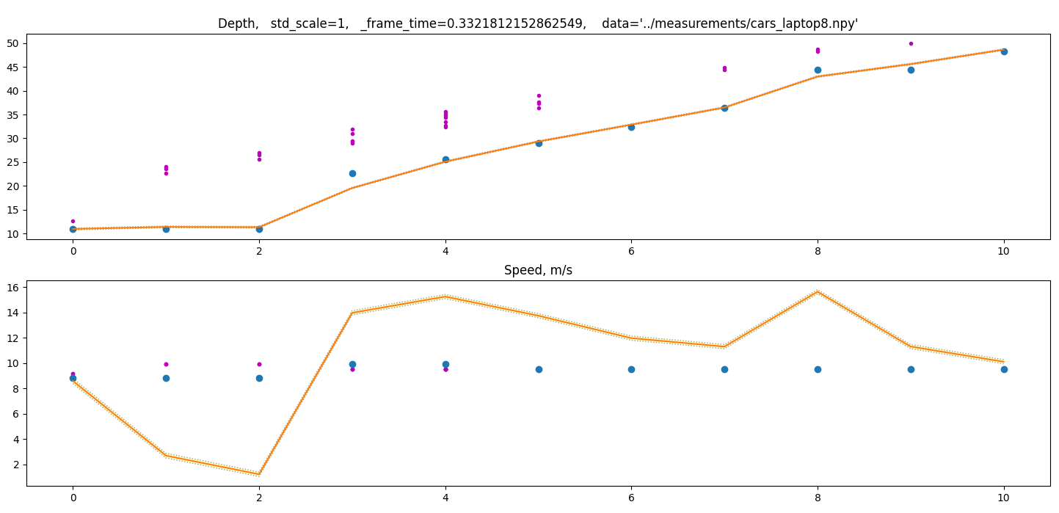

Slide 14
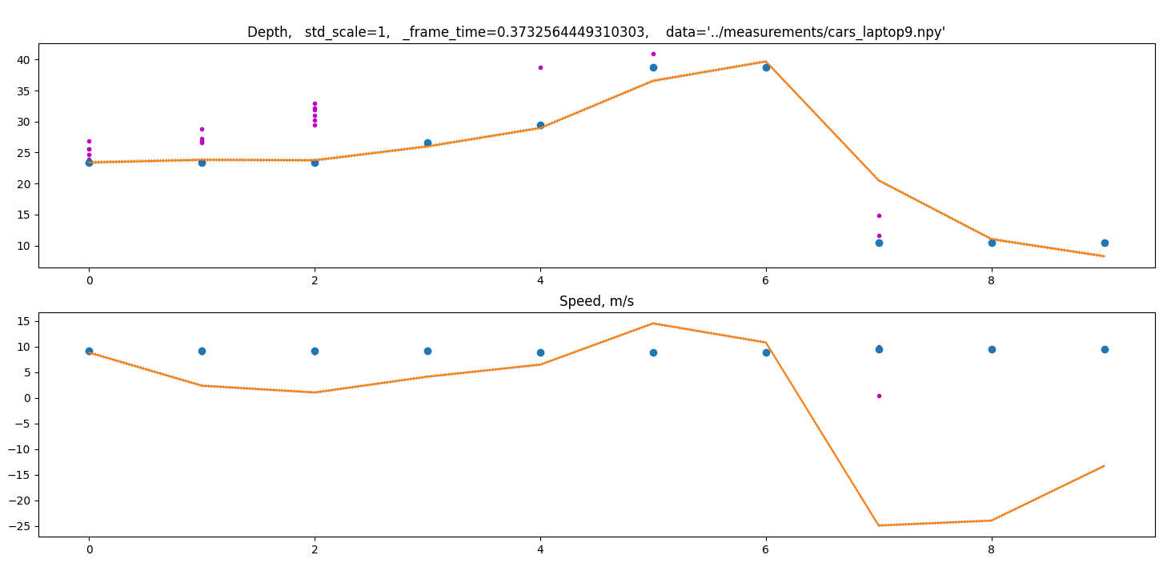

Slide 15
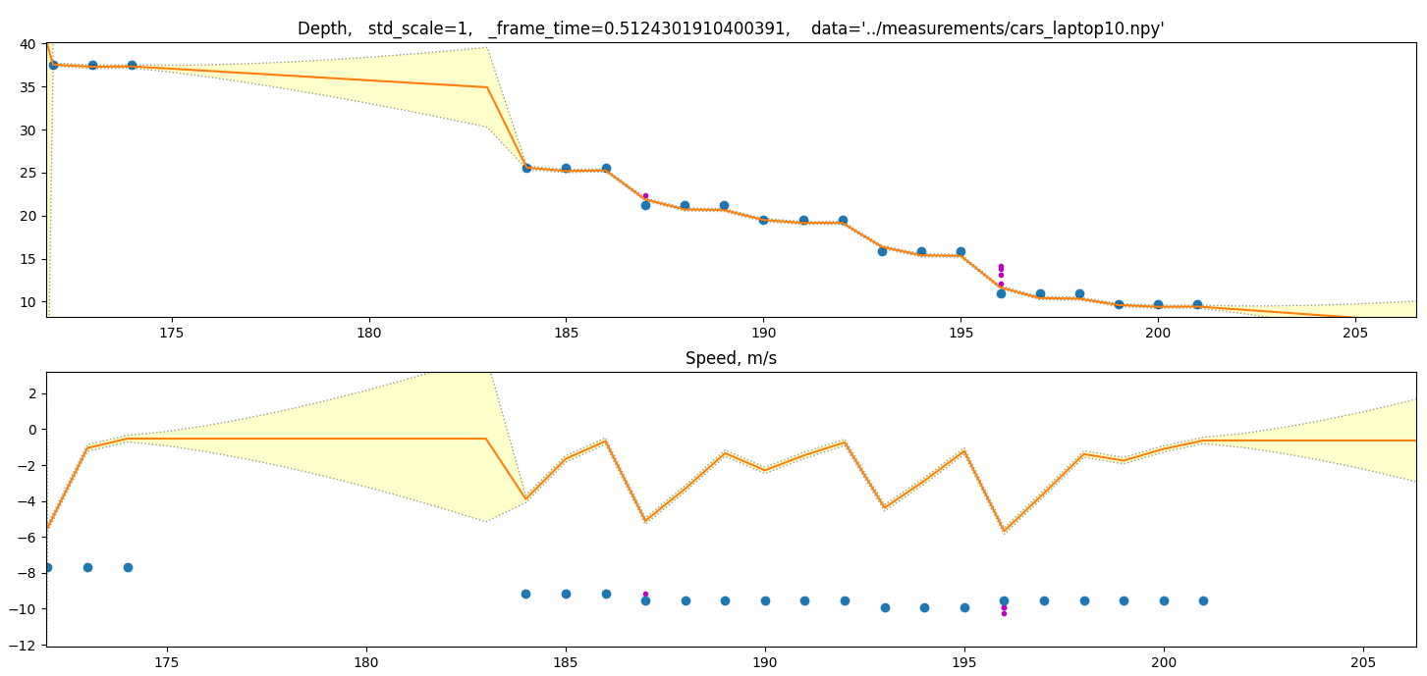

Slide 16
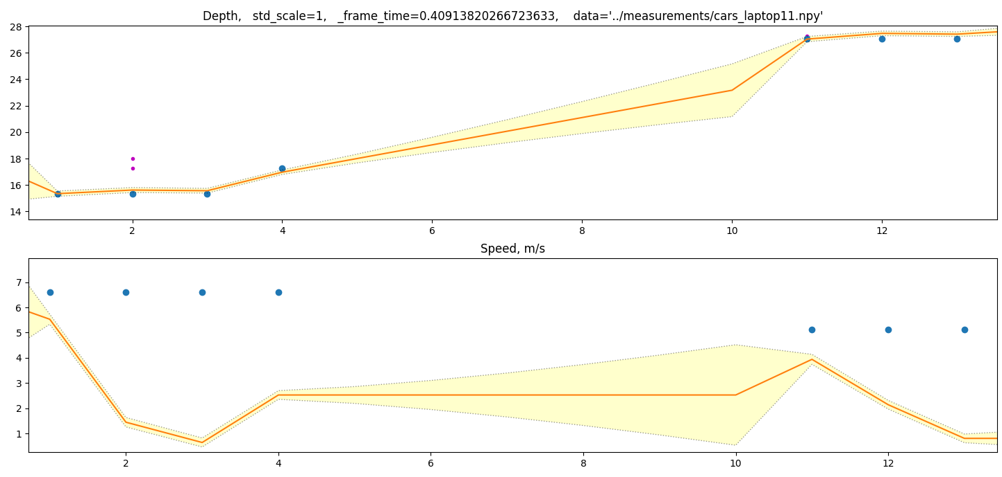

Slide 17
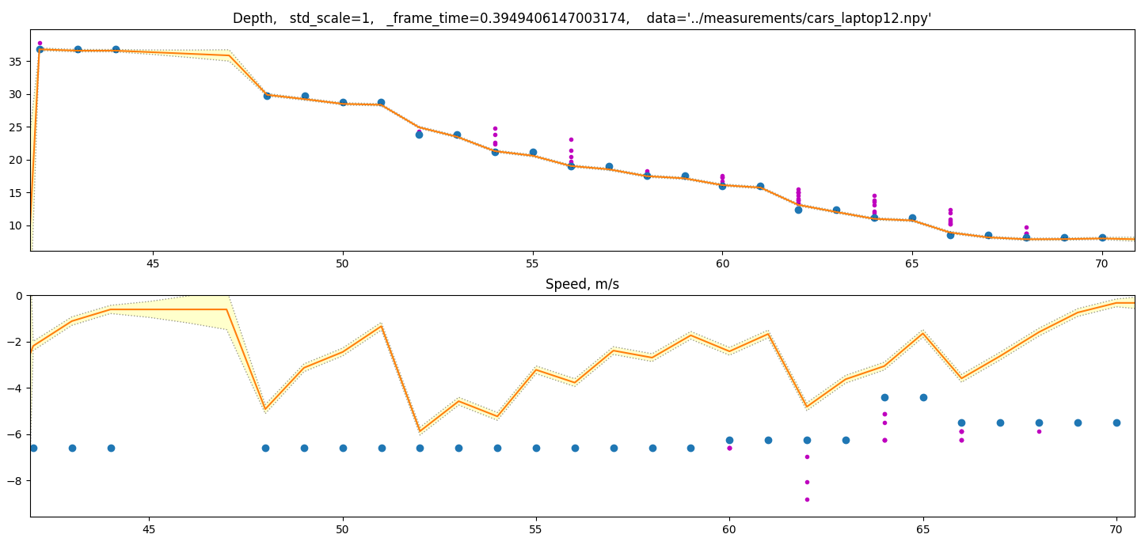

Slide 18
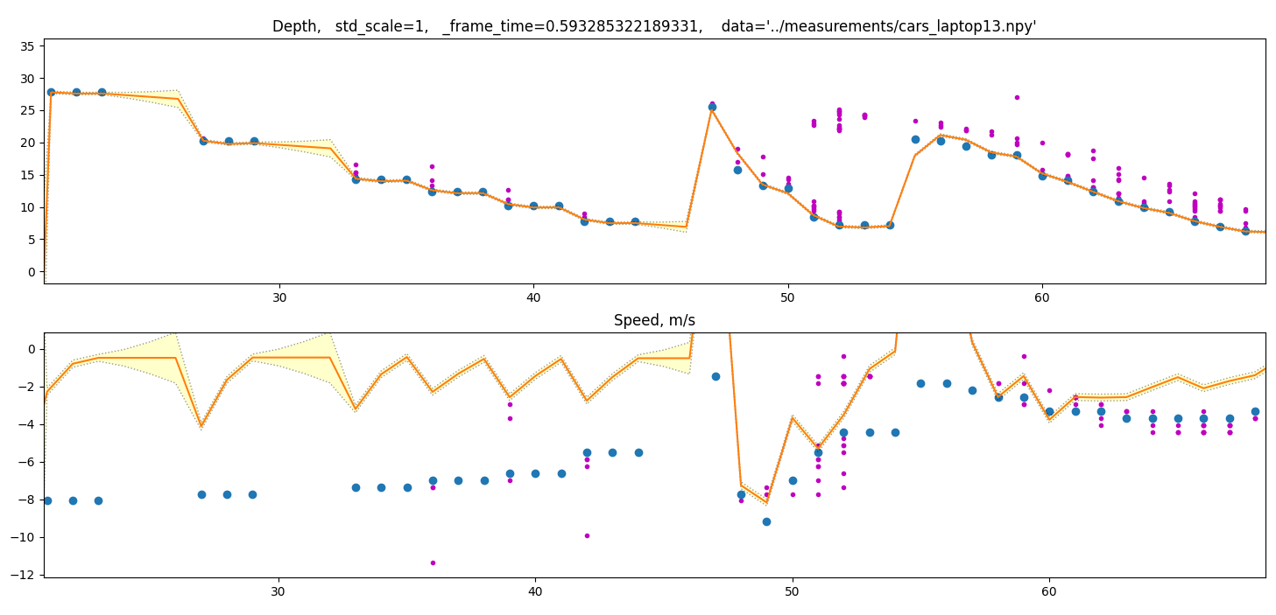
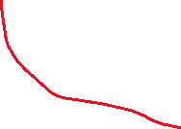
3 cars

Slide 19
Excel with the speed measurements was made: carMeas0_calc.xlsx
In it we see that the depth measurement + delta time version of speed calculation that goes to the Kalman does not agree with the radar measurement.
This gives us a dillema: Varying fps will cause Kalman filter to do wrong assumptions.
How should we place trust?
Kalman has added uncertainty from deltaT
Measurement might not be right
Often we would want to trust a speed measurement from radar. However even if we trust the radar speed more the predictions of Kalman will still be wrong as the deltaT is wrong. Maybe we should check the deltaT sometimes?
Why is the DeltaT problem so bad? – We use as our data the Kalman filter output. Not the measurement. If dT is wrong then the prediction from distance to speed is wrong. Thus we have faulty output.
We need some kind of synchronization. OR to make kalman dT adaptive. That just means re calculation of Kalman matrices for every time instance.

Slide 20
From excel
Average error between calc and measured = 3.4 m/s = 12 kmh
Radar claims to have resolution on 0.37m/s = 1.3 kmh
We have 10x fault in our predictions with dT
Average frame time = 0.42s

