Slide 1

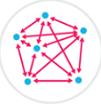
Blockchain application and outlook in the banking industry Ye Guo* and Chen Liang
By
Radhnandani Prasad
Kulpreet kour

Slide 2
How It All Started ?
Blockchain technology has become a new of this 21st century. But much before this technology came into existence there was a system of Digital Cash which was conceptualized by Chaum in 1983 to handle the concept of double spending, even though advanced cryptography existed at the time too, but it failed to be compatible with centralization, the anonymity of the transaction and double spending.
So three decades later in 2009 Satoshi Nakamoto came up with Bitcoin, a world’s first decentralized currency, which replaced the digital cash centralized server signature mechanism, with a consensus based proof of work. It solved the issue of double spending and improvised the concept of Chaum’s by introducing the decentralized payment system using revolutionary Blockchain technology.

Slide 3
What is a blockchain?
A blockchain is a decentralized, distributed and public digital ledger that is used to record transactions across many computers so that the record cannot be altered retroactively without altering the subsequent blocks and the collusion of the network.
Each block contains three things in it:
A cryptographic hash for previous block
A timestamp
Transaction data
.

Slide 4
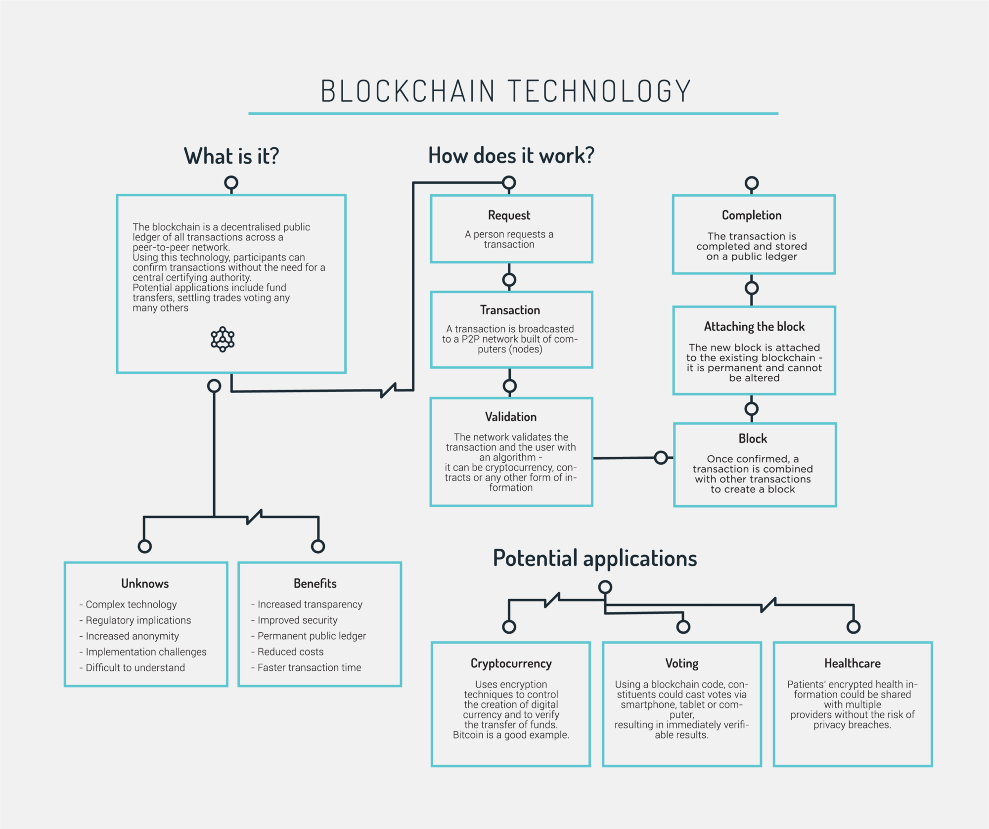

Slide 5
Blockchains makes use of security methods such as public key cryptography. It is considered to the most secure technology of the recent times. Blockchains are also secure by design.
Blockchains arguably represent a new sort of shared distributed database. Similar to systems based on the Dynamo model, the data in the block chain is distributed redundantly across a large number of hosts. However, the Blockchain represents a complete paradigm shift in how permissions are managed within the database. In an existing database system, the database owner has absolute control over the data held in the database. However, in a Blockchain system, ownership is maintained by the creator of the data
Consider a database that maintains a social network such as Facebook: Although the application is programmed to allow only you to modify your own posts or personal details, the reality is that the Facebook company actually has total control over your online data. They can – if they wish – remove your posts, censor your posts, or even modify your posts if they really wanted to. In a Blockchain-based database, you would retain total ownership of your posts and it would be impossible for any other entity to modify them.

Slide 6
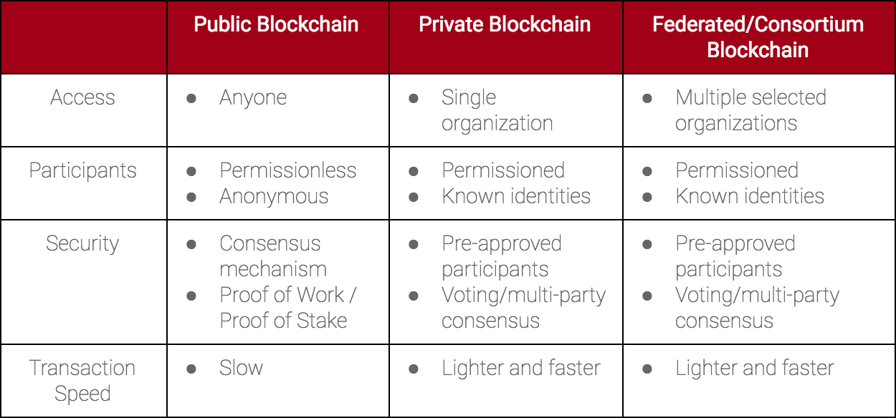
TYPE OF BLOCKCHAIN

Slide 7
ADVANTAGES OF BLOCKCHAIN
Decentralization
Openness
Permissionless
Secured
Blockchain technology is used for various things, such as:
Smart Contracts
Land registration
Decentralized networks
Cryptocurrencies
Apart from its use in the world of cryptocurrency, it is also used for non-cryptocurrency designs such as

Slide 8
Steemit- A blogging/social networking website and a cryptocurrency.
Hyperledger- A cross-industry collaborative effort from the Linux Foundation to support blockchain-based distributed ledgers, with projects under this initiative including Hyperledger Burrow and Hyperledger Fabric.
Counterparty- An open source financial platform for creating peer-to-peer financial applications on the bitcoin blockchain.
Quorum- A permissionable private blockchain by JPMorgan Chase with private storage, used for contract applications.
Bitnation- A decentralized borderless “voluntary nation” establishing a jurisdiction of contracts and rules, based on Ethereum
Factom- A distributed registry.

Slide 9
Many Companies are involved in the improvement process of blockchain technology and its further implementation.
Microsoft Visual Studio is making the Ethereum Solidity language available to application developers.
IBM offers a cloud blockchain service based on the open source Hyperledger Fabric project.
Oracle Cloud offers Blockchain Cloud Service based on Hyperledger Fabric. Oracle has joined the Hyperledger consortium.
MasterCard has added three blockchain-based APIs for programmers to use in developing both person-to-person (P2P) and business-to-business (B2B) payment systems.
CLS Group is using blockchain technology to expand the number of currency trade deals it can settle.
Deloitte and ConsenSys announced plans in 2016 to create a digital bank called Project ConsenSys.

Slide 10
WHAT IS CRYPTOCURRENCY?
So, what is a cryptocurrency and how it makes use of blockchain?
A cryptocurrency is an encrypted data string that denotes a unit of currency. It is monitored and organized by a peer-to-peer network called a blockchain, which also serves as a secure ledger of transactions. Unlike physical money, cryptocurrencies are decentralized, which means they are not issued by governments or other financial institutions. The validity of each cryptocurrency’s coins is provided by a blockchain. A blockchain is a continuously growing list of records, called blocks, which are linked and secured using cryptography.
Cryptocurrencies makes use of different algorithms named as hashing algorithms. By the way, Hash is a “message digest” -a number generated from a string of text, the hash itself is smaller than the text, it’s almost impossible to generate another string of text with the same hash value.

Slide 11
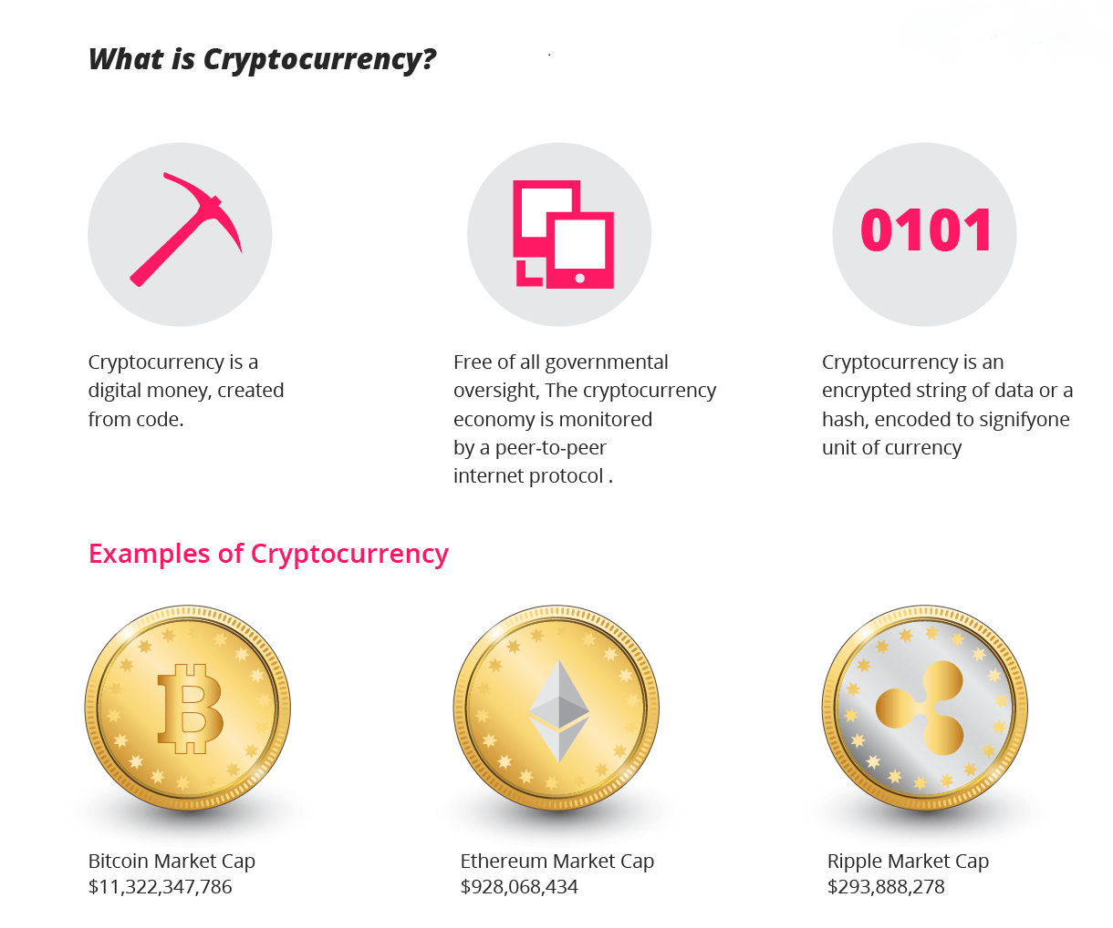

Slide 12
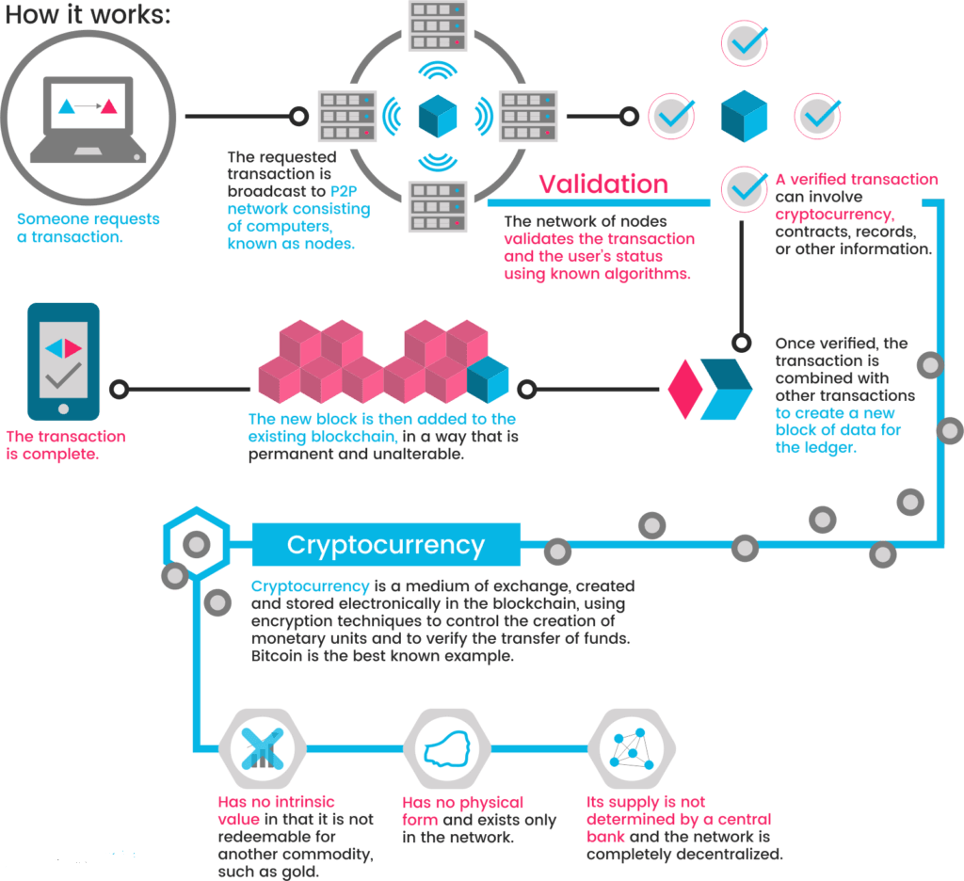
CRYPTOCURRENCY IN TRANSACTION

Slide 13
There are different hashing algorithms used for various cryptocurrencies
SHA-256
Ethash
Scrypt
Equihash
Cryptonight
X11
SHA-256
SHA-256 stands for “Secure Hash Algorithm” that belongs to SHA-2 family. It generates 256 bit(32 byte) signature for a text string. It’s block processing time is generally around seven minutes and requires hash rates at giga hashes per second. This mining algorithm was used by bitcoin, the most popular cyrptocurrency. Some of the other cryptocurrencies that are mined using this algorithm are:
Bytecoin
Joulecoin
Devcoin
Ixcoin
Terracoin
Battlecoin
21Coin
Peercoin
Namecoin
Unobtanium
Betacoin

Slide 14
ETHASH
Ethash is Ethereum’s Proof of Work hashing algorithm. The algorithm is GPU memory intensive to discourage CPU mining and future development of ASIC’s. It uses Keccak, a hash function eventually standardized to SHA-3. The cryptocurrencies that are mined using this algorithm are:
Ethereum
Ethereum Classic
KodakCoin
Ubiq
SCRYPT
Scrypt is used in many cryptocurrencies as a proof-of-work algorithm. It was first implemented for Tenebrix (released in September 2011) and served as the basis for Litecoin and Dogecoin, which also adopted its scrypt algorithm. The Scrypt algorithm is more simple and quicker than the SHA-256 algorithm. Scrypt’s hash rate is measured by Kilohashes per second, or one thousand hash computations per second. The cryptocurrencies that are mined using this algorithm are:
Dogecoin
Gulden
Litecoin
PotCoin
FeatherCoin
Bitmark
TagCoin
Ekrona
MidasCoin

Slide 15
EQUIHASH
Equihash is a proof of work mining algorithm that allows people to mine cryptocurrency on standard computers. Equihash has proof-of-work schemes with three parameters n, k, and d, which determine the scheme Equihash-n/k/d and the time and memory complexity of the puzzle solver for it, and seed S, which makes every puzzle unique and solutions incompatible.The cryptocurrencies that are mined using this algorithm are:
Zcash
Zcoin
Zclassic
Bitcoin Gold
Komodo
ZenCash
CRYPTONIGHT
CryptoNight is a proof-of-work algorithm. It is designed to be suitable for ordinary computer’s CPU, but currently there are no special purpose devices available for mining . CryptoNight was originally implemented in the CryptoNote code base. CryptoNight can only be CPU-mined for the time being. The cryptocurrencies that are mined using this algorithm are:
Bytecoin
Monero
Dashcoin
DigitalNote
X11

Slide 16
X11 algorithm was developed by Dash developers and its called a Proof-of-Work. The algorithm was based on multiple rounds of different hashes (blake, bmw, groestl, jh, keccak, skein, luffa, cubehash, shavite, simd, echo) by making it one of the safest cryptocurrency in existence.The cryptocurrencies that are mined using this algorithm are:
MonetaryUnit
Karmacoin
StartCoin
Dash
XCurrency
POPULAR CRYPTOCURRENCIES:
Bitcoin
Ethereum
LiteCoin
Ripple
Stellar
Tron
Monero
Dash
Zcash
Cardano

Slide 17
Blockchain principles
1. Decentralization : Blockchain is a p2p network where no single participant(user) controls the transaction, the power is distributed among all the participants in this network, that means no single stakeholder can hack,manipulate or close the chain of blocks or can shut it down. this blockchain network due to its distributed(decentralized) mechanism is free from any hacks or fraud.
2. Integrity:
In the blockchain powered network all the participants have got the rights to make decisions, here the trust in the system is not forced but is totally guided by user intuition. The tight integrity is observed in the way every user gets incentivized for their effort and also in the way this entire P2P network function.

Slide 18
3. Cryptograpy : Fair To All
Blockchain has been designed with this core principle to provide high levelof security and authenticity to the user. To ensure tightly knit security & data integrity it uses the power of cryptography. The Blockchain transaction mechanism is favorable & rewarding for an authentic user at the same time it is very harsh on reckless user. That means the blockchain system is fair for all who behave as a good user and reward them appropriately. But if you go about using it with wrong intent you are not spared and penalized.
4. Security:
Blockchain being distributed network, there is no one central point of failure and also no single person can behave recklessly to damage the entire chain of network. The damage because of any individual hack of password will limit to that single person itself. With blockchain PKI(Public Key Infrastructure) encryption mechanism your transaction over the network is highly secured until you are a fool to share your private key for which no technology has a solution. So, largely you can trust on Blockahin technology to ensure your transactions gets completed without being hacked .

Slide 19
5. Inclusive:
The Blockchain is inclusive in its approach where everyone is independent to participate without any discrimination in the global economy. The bitcoin allows all the richest, the poorest, to invest in their capacity and become part of this global economy, as the need to have a bank account was totally removed . They can directly decide to transact to whomsoever they want without third party intervention that too paying zero to very little transaction fee.
6. Blockchain Respects Your Privacy:
In a digital world, where consumers and businesses transact online for shopping, transferring payments & to verify information for a myriad of purposes, ensuring data privacy has become paramount. It’s Strong Hash Key encryption is quite secure and helps you exchange data over the internet without disclosing your true identity.
With Blockchain your identity is never revealed while you transact using the blokchain P2P network.Your Rights and freedom is clear and enforceable, as you become part of the blockchain ecosystem. The Blockchain’s Smart Contract is an awesome way to execute any agreement between two parties, which basically allow for transactions to go through only when certain predefined benchmarks have been reached and agreed upon both parties involved

Slide 20
Blockchain Technology Use Case:
Major use case can be classified in two major categories
Financial Sector
Non-Financial Sector
Lets get into the details of few of the important one’s quickly:
1. Financial Sector
1.1 BFSI:
The most apt use case of blockchain based technology is seen in banking & financial sectors which has been disrupting services ranging from operations to retail.
Financial service industry is witnessing multiple experiments with blockchain tech to ease cross-border remittances, Post trade settlements and trade finance.
Power of AI in collaboration with blockchain has been shaping various financial services landscape creating not just opportunities, but also challenges for customers, service providers, and regulators. With Blockchain as an economic model, Fintech services providers will create new innovative solutions that will respond to consumer needs for security, trust, better services, privacy and transform the competitive landscape.

Slide 21
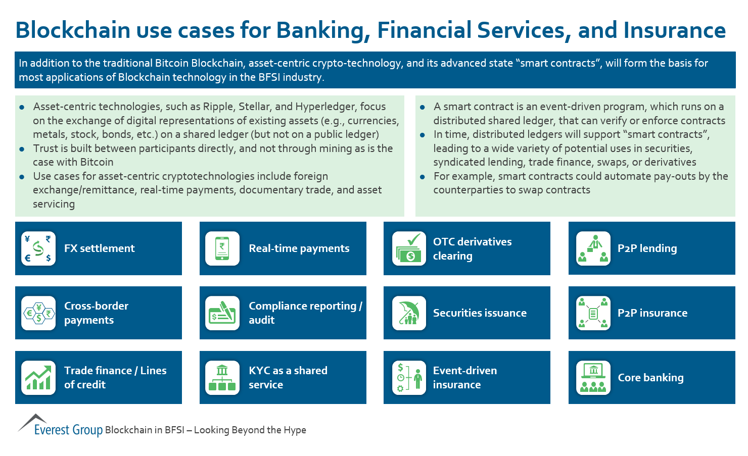

Slide 22
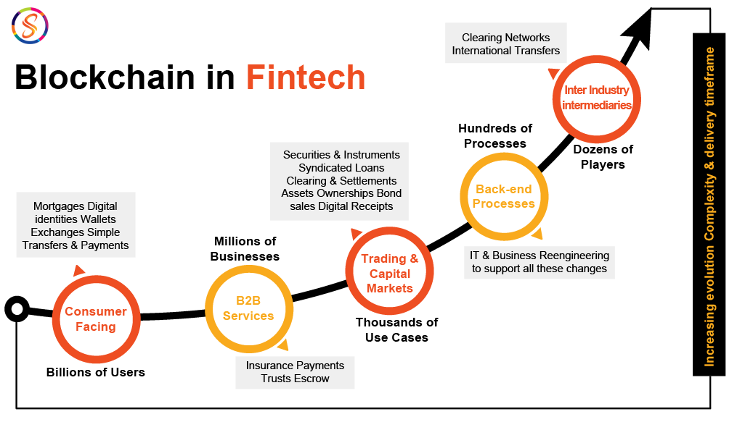

Slide 23
2. Non-Financial Sector
2.1. Healthcare:
Healthcare sector has been most progressive sector after BFSI sector in adopting blockchain to build a tech of the future where all the stakeholders like doctors, patient, hospitals, pharmacist, Testing labs all will be communicating through this decentralized mechanism to maintain the healthcare records which will be more secure, reliable and authentic.
Blockchain in heathcare can be used to :
Maintain secure medical records of patients
Will create a robust network of communication between all healthcare beneficiaries
Reliable & authentic records keeping of pharma companies supply chain
Precise and accurate patient information will be accessible to doctors to help them serve patients better.
Simplify claim settlement process by including insurance companies in the blockchain powered healthcare network.

Slide 24
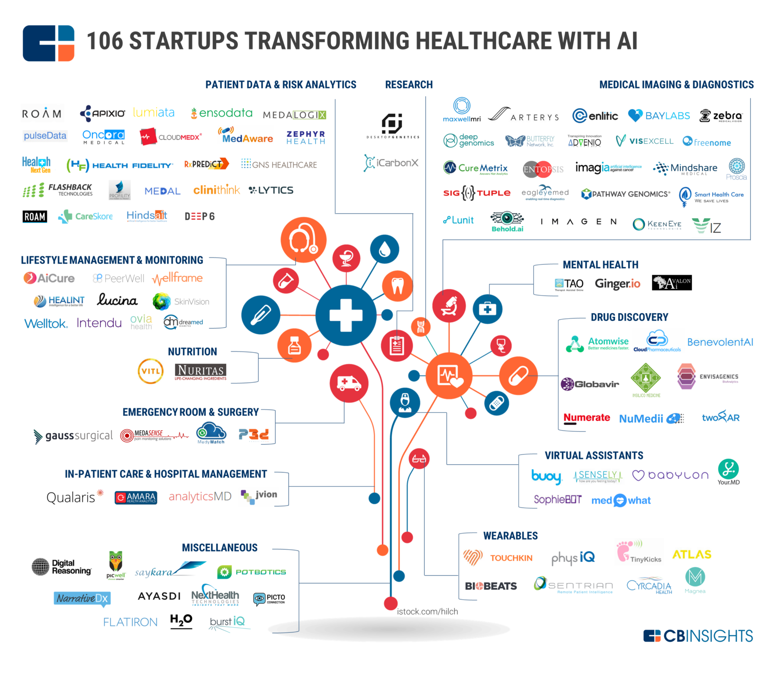

Slide 25
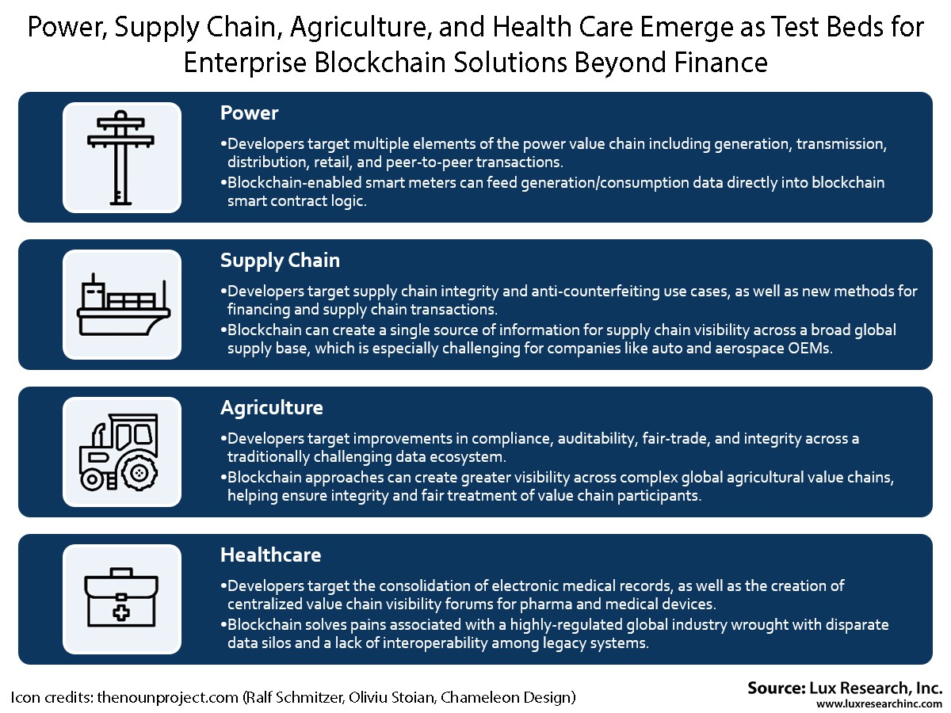
Some other use cases In Non-Financial Sectors: Like Power , Supply Chain , Agriculture etc has been compiled by lux research, Inc

Slide 26
HOW BLOCKCHAIN IS USED IN FINANCE SECTOR
Richard Bradley: In one of his article sums up the blockchain as:
You (a “node”) have a file of transactions on your computer (a “ledger”). Two government accountants (let’s call them “miners”) have the same file on theirs (so it’s “distributed”). As you make a transaction, your computer sends an e-mail to each accountant to inform them.
Each accountant rushes to be the first to check whether you can afford it (and be paid their salary “Bitcoins”). The first to check and validate hits “REPLY ALL”, attaching their logic for verifying the transaction (“Proof of Work”). If the other accountant agrees, everyone updates their file…
This concept is enabled by “Blockchain” technology.

Slide 27
Abstract
Blockchain technology is a core, underlying technology with promising application
prospects in the banking industry. On one hand, the banking industry in China is
facing the impact of interest rate liberalization and profit decline caused by the
narrowing interest-rate spread. On the other hand, it is also affected by economic
transformation, Internet development, and financial innovations. Hence, the banking
industry requires urgent transformation and is seeking new growth avenues. As such,
blockchains could revolutionize the underlying technology of the payment clearing
and credit information systems in banks, thus upgrading and transforming them.
Blockchain applications also promote the formation of “multi-center, weakly intermediated”
scenarios, which will enhance the efficiency of the banking industry. However, despite the
permissionless and self-governing nature of blockchains, the regulation and actual
implementation of a decentralized system are problems that remain to be resolved.
Keywords: Blockchain, Decentralization, Banking industry transformation

Slide 28
Review
It has also been identified as a disruptive innovation of the Internet era. However, as blockchain is a major breakthrough in data storage and information transmission, it might fundamentally transform the existing operating models of finance and economy, which might lead to a new round of technological innovations and industrial transformation within the FinTech industry
(Mu Qi-Guo 2016).
Recently, international institutions, including the United Nations and the International
Monetary Fund, (The First Digital Currency Report of the International Monetary Fund
[EB/OL]) as well as developed nations, such as the US, the UK, and Japan, have paid close
attention to the development of blockchains and explored their application in various
fields. Furthermore, China, Russia, India, South Africa, and other countries have also successively initiated research on blockchain technology.

Slide 29
Different types of blockchain industrial consortiums have emerged in order to promote the development of blockchain technology and its applications, the R3 blockchain consortium being the most influential among them. It has brought together over 40 of the world’s leading financial institution, including Bank of America, Citigroup, Morgan Stanley, Deutsche Bank,and Barclays Bank. As of May 2016, Ping An Bank and China Merchants Bank (CMB) have also joined the R3 blockchain consortium, thus strengthening the exchange and cooperation of top financial institutions in the blockchain technology
As such, an increasing number of banks have begun to be pay greater attention
and place emphasis on blockchains. Therefore, why is the current banking industry focusing on the deployment of blockchain strategies? Which specific scenarios can blockchains be applied to? What are the existing problems in the implementation process of blockchain technology? This paper discusses these questions in turn in the following sections.

Slide 30
Blockchain technology is expected to transform the banking industry
The banking industry in China is currently facing multiple pressures, including a
decline in profits and an increase in risk, and has entered a new state of change and
development. The sudden Internet finance boom has also led to numerous challenges in the traditional banking business. Consequently, commercial banks need to rely on new technological growth to accelerate product and service innovations, thereby adapting to new customer demands and competitive environments.
Blockchain technology can revolutionize the underlying technology of banking businesses
Blockchain technology is a type of underlying technology that can connect with a variety of scenarios. It can achieve asset digitization and point-to-point value transfer, thereby reconstructing the financial infrastructure. This sharply increases the process efficiency of the clearing and settlement of financial assets after transactions, while
reducing costs. Hence, it resolves several existing problems in the banking industry to a
large extent, which can be easily seen in Table 2.

Slide 31
