Slide 1
Displaying Data from Multiple Tables

Slide 2
Objectives
After completing this lesson, you should be able to do the following:
  Write SELECT statements to access data from more than one table using equijoins and non-equijoins
  Join a table to itself by using a self-join
  View data that generally does not meet a join condition by using outer joins
  Generate a Cartesian product of all rows from two or more tables
Notes:
Objectives
This lesson explains how to obtain data from more than one table. A join is used to view information from multiple tables. Hence, you can join tables together to view information from more than one table.
Note: Information on joins is found in “SQL Queries and Subqueries: Joins” in
Oracle SQL Reference.

Slide 3
Types of Joins
Joins that are compliant with the SQL:1999 standard include the following:
  Cross joins
  Natural joins
  USING clause
  Full (or two-sided) outer joins
  Arbitrary join conditions for outer joins
Notes:
Types of Joins
To join tables, you can use join syntax that is compliant with the SQL:1999 standard.
Note: Prior to the Oracle9i release, the join syntax was different from the ANSI standards. The SQL:1999–compliant join syntax does not offer any performance benefits over the Oracle-proprietary join syntax that existed in prior releases. For detailed information about the proprietary join syntax, see Appendix C.

Slide 4
Joining Tables Using SQL:1999 Syntax
Use a join to query data from more than one table:
SELECT table1.column, table2.column
FROM table1
[NATURAL JOIN table2] |
[JOIN table2 USING (column_name)] |
[JOIN table2
ON (table1.column_name = table2.column_name)]|
[LEFT|RIGHT OUTER JOIN table2
ON (table1.column_name = table2.column_name)]|
[CROSS JOIN table2];
Notes:
Defining Joins
In the syntax:
table1.column denotes the table and column from which data is retrieved
NATURAL JOIN joins two tables based on the same column name
JOIN table USING column_name performs an equijoin based on the column name
JOIN table ON table1.column_name performs an equijoin based on the condition in the ON clause, = table2.column_name
LEFT/RIGHT/FULL OUTER is used to perform outer joins
CROSS JOIN returns a Cartesian product from the two tables
For more information, see “SELECT” in Oracle SQL Reference.

Slide 5
Creating Natural Joins
  The NATURAL JOIN clause is based on all columns in the two tables that have the same name.
  It selects rows from the two tables that have equal values in all matched columns.
  If the columns having the same names have different data types, an error is returned.
Notes:
Creating Natural Joins
You can join tables automatically based on columns in the two tables that have matching data types and names. You do this by using the keywords NATURAL JOIN.
Note: The join can happen on only those columns that have the same names and data types in both tables. If the columns have the same name but different data types, then the NATURAL JOIN syntax causes an error.

Slide 6
Creating Joins with the USING Clause
  If several columns have the same names but the data types do not match, the NATURAL JOIN clause can be modified with the USING clause to specify the columns that should be used for an equijoin.
  Use the USING clause to match only one column when more than one column matches.
  Do not use a table name or alias in the referenced columns.
  The NATURAL JOIN and USING clauses are mutually exclusive.
Notes:
USING Clause
Natural joins use all columns with matching names and data types to join the tables. The USING clause can be used to specify only those columns that should be used for an equijoin. The columns that are referenced in the USING clause should not have a qualifier (table name or alias) anywhere in the SQL statement.
For example, the following statement is valid:
SELECT l.city, d.department_name
FROM locations l JOIN departments d USING (location_id)
WHERE location_id = 1400;
The following statement is invalid because the LOCATION_ID is qualified in the WHERE clause:
SELECT l.city, d.department_name
FROM locations l JOIN departments d USING (location_id)
WHERE d.location_id = 1400;
ORA-25154: column part of USING clause cannot have qualifier
The same restriction also applies to NATURAL joins. Therefore, columns that have the same name in both tables must be used without any qualifiers.

Slide 7
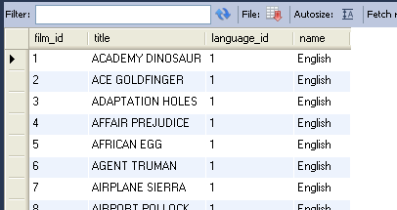
Retrieving Records with the USING Clause
select film_id, title, language_id, name
from language
join film
using (language_id)
Notes:
Retrieving Records with the USING Clause
The slide example joins the DEPARTMENT_ID column in the EMPLOYEES and DEPARTMENTS tables, and thus shows the location where an employee works.

Slide 8
Qualifying Ambiguous
Column Names
  Use table prefixes to qualify column names that are in multiple tables.
  Use table prefixes to improve performance.
  Use column aliases to distinguish columns that have identical names but reside in different tables.
  Do not use aliases on columns that are identified in the USING clause and listed elsewhere in the SQL statement.
Notes:
Qualifying Ambiguous Column Names
You need to qualify the names of the columns with the table name to avoid ambiguity. Without the table prefixes, the DEPARTMENT_ID column in the SELECT list could be from either the DEPARTMENTS table or the EMPLOYEES table. It is necessary to add the table prefix to execute your query:
SELECT employees.employee_id, employees.last_name,
departments.department_id, departments.location_id
FROM employees JOIN departments
ON employees.department_id = departments.department_id;
If there are no common column names between the two tables, there is no need to qualify the columns. However, using the table prefix improves performance, because you tell the Oracle server exactly where to find the columns.
Note: When joining with the USING clause, you cannot qualify a column that is used in the USING clause itself. Furthermore, if that column is used anywhere in the SQL statement, you cannot alias it.

Slide 9
Using Table Aliases
  Use table aliases to simplify queries.
  Use table aliases to improve performance.
select f.film_id, f.title,
language_id, l.name
from film f join language l
using (language_id)
Notes:
Using Table Aliases
Qualifying column names with table names can be very time consuming, particularly if table names are lengthy. You can use table aliases instead of table names. Just as a column alias gives a column another name, a table alias gives a table another name. Table aliases help to keep SQL code smaller, therefore using less memory.
Notice how table aliases are identified in the FROM clause in the example. The table name is specified in full, followed by a space and then the table alias. The EMPLOYEES table has been given an alias of e, and the DEPARTMENTS table has an alias of d.
Guidelines
Table aliases can be up to 30 characters in length, but shorter aliases are better than longer ones.
If a table alias is used for a particular table name in the FROM clause, then that table alias must be substituted for the table name throughout the SELECT statement.
Table aliases should be meaningful.
The table alias is valid for only the current SELECT statement.

Slide 10
Creating Joins with the ON Clause
  The join condition for the natural join is basically an equijoin of all columns with the same name.
  Use the ON clause to specify arbitrary conditions or specify columns to join.
  The join condition is separated from other search conditions.
  The ON clause makes code easy to understand.
Notes:
ON Clause
Use the ON clause to specify a join condition. This lets you specify join conditions separate from any search or filter conditions in the WHERE clause.

Slide 11
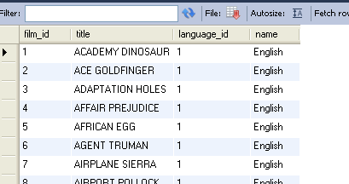
Retrieving Records with the ON Clause
select f.film_id, f.title, f.language_id, l.name
from film f join language l
on (f.language_id = l.language_id)
Notes:
Creating Joins with the ON Clause
In this example, the DEPARTMENT_ID columns in the EMPLOYEES and DEPARTMENTS table are joined using the ON clause. Wherever a department ID in the EMPLOYEES table equals a department ID in the DEPARTMENTS table, the row is returned.
You can also use the ON clause to join columns that have different names.

Slide 12
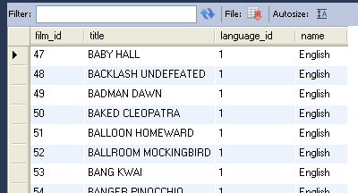
Applying Additional Conditions to a Join
select f.film_id, f.title, f.language_id, l.name
from film f
join language l
on (f.language_id = l.language_id)
and title like 'B%'
Notes:
Applying Additional Conditions to a Join
You can apply additional conditions to the join.
The example shown performs a join on the EMPLOYEES and DEPARTMENTS tables and, in addition, displays only employees who have a manager ID of 149. To add additional conditions to the ON clause, you can add AND clauses. Alternatively, you can use a WHERE clause to apply additional conditions:
SELECT e.employee_id, e.last_name, e.department_id,
d.department_id, d.location_id
FROM employees e JOIN departments d
ON (e.department_id = d.department_id)
WHERE e.manager_id = 149;

Slide 13
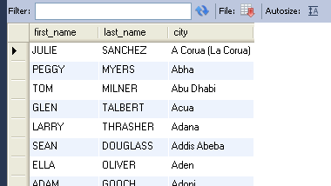
Creating Three-Way Joins with the
ON Clause
select first_name, last_name , city
from customer c
join address a
on c.address_id = a.address_id
join city ct
on a.city_id = ct.city_id
Notes:
Three-Way Joins
A three-way join is a join of three tables. In SQL:1999–compliant syntax, joins are performed from left to right. So the first join to be performed is EMPLOYEES JOIN DEPARTMENTS. The first join condition can reference columns in EMPLOYEES and DEPARTMENTS but cannot reference columns in LOCATIONS. The second join condition can reference columns from all three tables.

Slide 14
INNER Versus OUTER Joins
  In SQL:1999, the join of two tables returning only matched rows is called an inner join.
  A join between two tables that returns the results of the inner join as well as the unmatched rows from the left (or right) tables is called a left (or right) outer join.
  A join between two tables that returns the results of an inner join as well as the results of a left and right join is a full outer join.
Notes:
INNER Versus OUTER Joins
Joining tables with the NATURAL JOIN, USING, or ON clauses results in an inner join. Any unmatched rows are not displayed in the output. To return the unmatched rows, you can use an outer join. An outer join returns all rows that satisfy the join condition and also returns some or all of those rows from one table for which no rows from the other table satisfy the join condition.
There are three types of outer joins:
LEFT OUTER
RIGHT OUTER
FULL OUTER

Slide 15
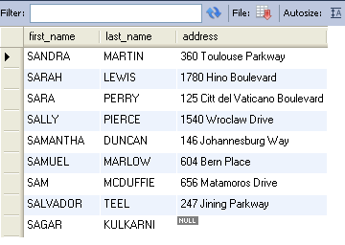
LEFT OUTER JOIN
select c.first_name, c.last_name, a.address from customer c
left outer join address a on a.address_id=c.address_id
where first_name like 'sa%'
Notes:
Example of LEFT OUTER JOIN
This query retrieves all rows in the EMPLOYEES table, which is the left table even if there is no match in the DEPARTMENTS table.

Slide 16
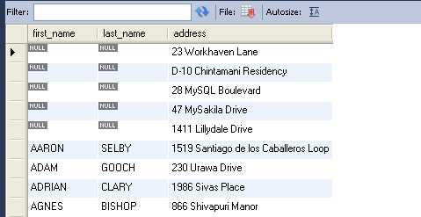
RIGHT OUTER JOIN
select c.first_name, c.last_name, a.address
from customer c right outer join address a
on a.address_id=c.address_id order by first_name
Notes:
Example of RIGHT OUTER JOIN
This query retrieves all rows in the DEPARTMENTS table, which is the right table even if there is no match in the EMPLOYEES table.

Slide 17
Summary
In this lesson, you should have learned how to use joins to display data from multiple tables by using:
  Equijoins
  Non-equijoins
  Outer joins
  Self-joins
  Cross joins
  Natural joins
Notes:
Summary
There are multiple ways to join tables.
Types of Joins
Equijoins
Non-equijoins
Outer joins
Self-joins
Cross joins
Natural joins
Full (or two-sided) outer joins
Cartesian Products
A Cartesian product results in a display of all combinations of rows. This is done by either omitting the WHERE clause or specifying the CROSS JOIN clause.
Table Aliases
Table aliases speed up database access.
Table aliases can help to keep SQL code smaller by conserving memory.

