Slide 1
Using Subqueries to Solve Queries

Slide 2
Objectives
After completing this lesson, you should be able to do the following:
  Define subqueries
  Describe the types of problems that subqueries can solve
  List the types of subqueries
  Write single-row and multiple-row subqueries
Notes:
Objectives
In this lesson, you learn about more-advanced features of the SELECT statement. You can write subqueries in the WHERE clause of another SQL statement to obtain values based on an unknown conditional value. This lesson covers single-row subqueries and multiple-row subqueries.

Slide 3
Subquery Syntax
  The subquery (inner query) executes once before the main query (outer query).
  The result of the subquery is used by the main query.
SELECT select_list
FROM table
WHERE expr operator
(SELECT select_list
FROM table);
Notes:
Subquery Syntax
A subquery is a SELECT statement that is embedded in a clause of another SELECT statement. You can build powerful statements out of simple ones by using subqueries. They can be very useful when you need to select rows from a table with a condition that depends on the data in the table itself.
You can place the subquery in a number of SQL clauses, including the following:
WHERE clause
HAVING clause
FROM clause
In the syntax:
operator includes a comparison condition such as >, =, or IN
Note: Comparison conditions fall into two classes: single-row operators
(>, =, >=, <, <>, <=) and multiple-row operators (IN, ANY, ALL).
The subquery is often referred to as a nested SELECT, sub-SELECT, or inner SELECT statement. The subquery generally executes first, and its output is used to complete the query condition for the main (or outer) query.

Slide 4
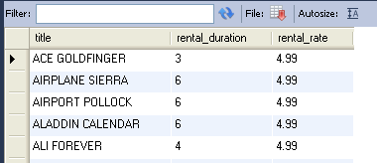
Using a Subquery
select title, rental_duration, rental_rate
from film
where rental_rate =
(select rental_rate from film
where title='Apache Divine');
Notes:
Using a Subquery
In the slide, the inner query determines the salary of employee Abel. The outer query takes the result of the inner query and uses this result to display all the employees who earn more than this amount.

Slide 5
Guidelines for Using Subqueries
  Enclose subqueries in parentheses.
  Place subqueries on the right side of the comparison condition.
  The ORDER BY clause in the subquery is not needed unless you are performing Top-N analysis.
  Use single-row operators with single-row subqueries, and use multiple-row operators with
  multiple-row subqueries.
Notes:
Guidelines for Using Subqueries
A subquery must be enclosed in parentheses.
Place the subquery on the right side of the comparison condition for readability.
With Oracle8i and later releases, an ORDER BY clause can be used and is required in the subquery to perform Top-N analysis.
Prior to Oracle8i, however, subqueries could not contain an ORDER BY clause. Only one ORDER BY clause could be used for a SELECT statement; if specified, it had to be the last clause in the main SELECT statement.
Two classes of comparison conditions are used in subqueries: single-row operators and
multiple-row operators.

Slide 6
Types of Subqueries
  Single-row subquery
  Multiple-row subquery
Main query
Subquery
returns
One row
Main query
Subquery
returns
Multiple rows
Notes:
Types of Subqueries
Single-row subqueries: Queries that return only one row from the inner SELECT statement
Multiple-row subqueries: Queries that return more than one row from the inner SELECT statement
Note: There are also multiple-column subqueries, which are queries that return more than one column from the inner SELECT statement. These are covered in the Oracle Database 10g: SQL Fundamentals II course.

Slide 7
Single-Row Subqueries
  Return only one row
  Use single-row comparison operators
Operator | Meaning
= | Equal to
> | Greater than
>= | Greater than or equal to
< | Less than
<= | Less than or equal to
<> | Not equal to
Notes:
Single-Row Subqueries
A single-row subquery is one that returns one row from the inner SELECT statement. This type of subquery uses a single-row operator. The slide gives a list of single-row operators.
Example
Display the employees whose job ID is the same as that of employee 141:
SELECT last_name, job_id
FROM employees
WHERE job_id =
(SELECT job_id
FROM employees
WHERE employee_id = 141);

Slide 8
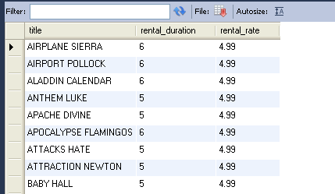
Executing Single-Row Subqueries
select title, rental_duration, rental_rate
from film
where rental_rate =
(select rental_rate
from film
where title='Apache Divine')
and rental_duration >
(select rental_duration
from film
where title='Ali Forever');
Notes:
Executing Single-Row Subqueries
A SELECT statement can be considered as a query block. The example in the slide displays employees whose job ID is the same as that of employee 141 and whose salary is greater than that of employee 143.
The example consists of three query blocks: the outer query and two inner queries. The inner query blocks are executed first, producing the query results ST_CLERK and 2600, respectively. The outer query block is then processed and uses the values that were returned by the inner queries to complete its search conditions.
Both inner queries return single values (ST_CLERK and 2600, respectively), so this SQL statement is called a single-row subquery.
Note: The outer and inner queries can get data from different tables.

Slide 9
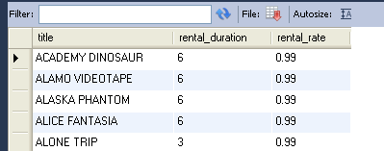
Using Group Functions in a Subquery
select title, rental_duration, rental_rate
from film
where rental_rate =
(select min(rental_rate)
from film);
Notes:
Using Group Functions in a Subquery
You can display data from a main query by using a group function in a subquery to return a single row. The subquery is in parentheses and is placed after the comparison condition.
The example in the slide displays the employee last name, job ID, and salary of all employees whose salary is equal to the minimum salary. The MIN group function returns a single value (2500) to the outer query.

Slide 10
The HAVING Clause with Subqueries
  The MySQL server executes subqueries first.
  The MySQL server returns results into the HAVING clause of the main query.
select rating, max(rental_rate)
from film
group by rating
having avg(rental_rate) >
(select avg(rental_rate)
from film)
2500
Notes:
The HAVING Clause with Subqueries
You can use subqueries not only in the WHERE clause but also in the HAVING clause. The Oracle server executes the subquery, and the results are returned into the HAVING clause of the main query.
The SQL statement in the slide displays all the departments that have a minimum salary greater than that of department 50.
Example
Find the job with the lowest average salary.
SELECT job_id, AVG(salary)
FROM employees
GROUP BY job_id
HAVING AVG(salary) = (SELECT MIN(AVG(salary))
FROM employees
GROUP BY job_id);
…

Slide 11
Multiple-Row Subqueries
  Return more than one row
  Use multiple-row comparison operators
Operator | Meaning
IN | Equal to any member in the list
ANY | Compare value to each value returned by the subquery
ALL | Compare value to every value returned by the subquery
Notes:
Multiple-Row Subqueries
Subqueries that return more than one row are called multiple-row subqueries. You use a multiple-row operator, instead of a single-row operator, with a multiple-row subquery. The multiple-row operator expects one or more values:
SELECT last_name, salary, department_id
FROM employees
WHERE salary IN (SELECT MIN(salary)
FROM employees
GROUP BY department_id);
Example
Find the employees who earn the same salary as the minimum salary for each department.
The inner query is executed first, producing a query result. The main query block is then processed and uses the values that were returned by the inner query to complete its search condition. In fact, the main query appears to the Oracle server as follows:
SELECT last_name, salary, department_id
FROM employees
WHERE salary IN (2500, 4200, 4400, 6000, 7000, 8300, 8600, 17000);

Slide 12
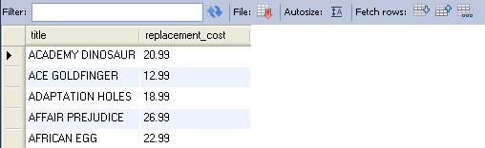
Using the ANY Operator in Multiple-Row Subqueries
select title, replacement_cost
from film
where replacement_cost <= any
(select replacement_cost
from film
where rating='NC-17')
Notes:
Multiple-Row Subqueries (continued)
The ANY operator (and its synonym, the SOME operator) compares a value to each value returned by a subquery. The slide example displays employees who are not IT programmers and whose salary is less than that of any IT programmer. The maximum salary that a programmer earns is $9,000.
<ANY means less than the maximum. >ANY means more than the minimum. =ANY is equivalent to IN.

Slide 13
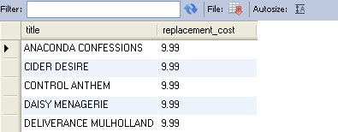
Using the ALL Operator in Multiple-Row Subqueries
select title, replacement_cost
from film
where replacement_cost <= all
(select replacement_cost
from film
where rating='NC-17')
Notes:
Multiple-Row Subqueries (continued)
The ALL operator compares a value to every value returned by a subquery. The slide example displays employees whose salary is less than the salary of all employees with a job ID of IT_PROG and whose job is not IT_PROG.
>ALL means more than the maximum, and <ALL means less than the minimum.
The NOT operator can be used with IN, ANY, and ALL operators.

Slide 14
Summary
In this lesson, you should have learned how to:
  Identify when a subquery can help solve a question
  Write subqueries when a query is based on unknown values
SELECT select_list
FROM table
WHERE expr operator
(SELECT select_list
FROM table);
Notes:
Summary
In this lesson, you should have learned how to use subqueries. A subquery is a SELECT statement that is embedded in a clause of another SQL statement. Subqueries are useful when a query is based on a search criterion with unknown intermediate values.
Subqueries have the following characteristics:
Can pass one row of data to a main statement that contains a single-row operator, such as =, <>, >, >=, <, or <=
Can pass multiple rows of data to a main statement that contains a multiple-row operator, such as IN
Are processed first by the Oracle server, after which the WHERE or HAVING clause uses the results
Can contain group functions

