Slide 1

AI ASSISTANTS

Slide 2
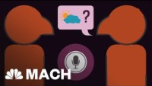
AI Assistants
AI Assistants are used commercially all over these days, Apples Siri is an example of AI an assistant used in a mobile phone, it uses speech recognition to first record what you are saying and convert it to text. It also uses a deep learning technology called natural language processing (NLP) to greatly increase speech recognition capabilities. The purpose of an AI assistant like Siri or Alexa is to make a users experience better by performing basic tasks such as answering questions or setting reminders.

