Slide 1
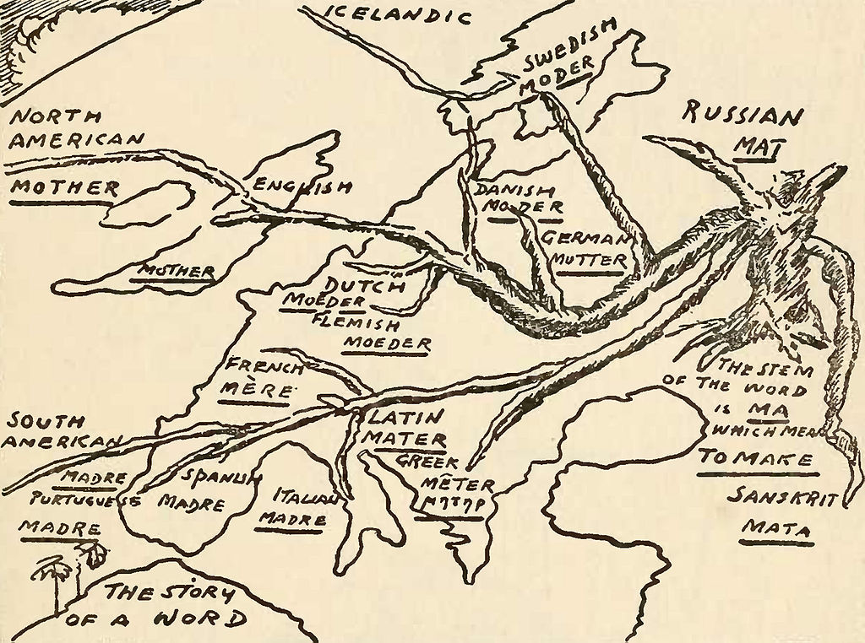


e t y m o l o g y
ε τ υ μ ο λ ο γ ί α
Modern Greek (GRE1001) | Jacopo Mosesso | VIT University, July 2022

Slide 2
mathematics μάθημα
kinematics κίνημα
electronics ήλεκτρον
physics φυσική
μαθηματικά
τεχνολογία
tribology τρίβω
technology τέχνη
Modern Greek (GRE1001) | Jacopo Mosesso | VIT University, July 2022

Slide 3
Geometry γη / μέτρον
Trigonometry τρίγωνο
γεωμετρία
γεωγραφία
Choreography χορός
Geography γη / γραφή
Modern Greek (GRE1001) | Jacopo Mosesso | VIT University, July 2022

Slide 4
Sociology λόγος
Television τήλε-
τηλεόραση
πανόραμα
Telescope σκοπός
Telephone φωνή
τηλέφωνο
Ecology οίκος
οικολογία
Modern Greek (GRE1001) | Jacopo Mosesso | VIT University, July 2022

Slide 5
Odometer οδός
Photography φως
Geography γη / γραφή
Geometry γη / μέτρον
φωτογραφία
Modern Greek (GRE1001) | Jacopo Mosesso | VIT University, July 2022

Slide 6
LOANWORDS,
THE OTHER WAY ROUND
corona corona (Latin | «crown»)
virus virus (Latin | «poison»)
pharmacy φάρμακον (Greek | «poison»)
ιός (Greek | another word for «poison»)
κορωνοϊός
quarantine quaranta (Italian | «fourty»)
vaccine vacca (Latin | «cow»)
Modern Greek (GRE1001) | Jacopo Mosesso | VIT University, July 2022

Slide 7
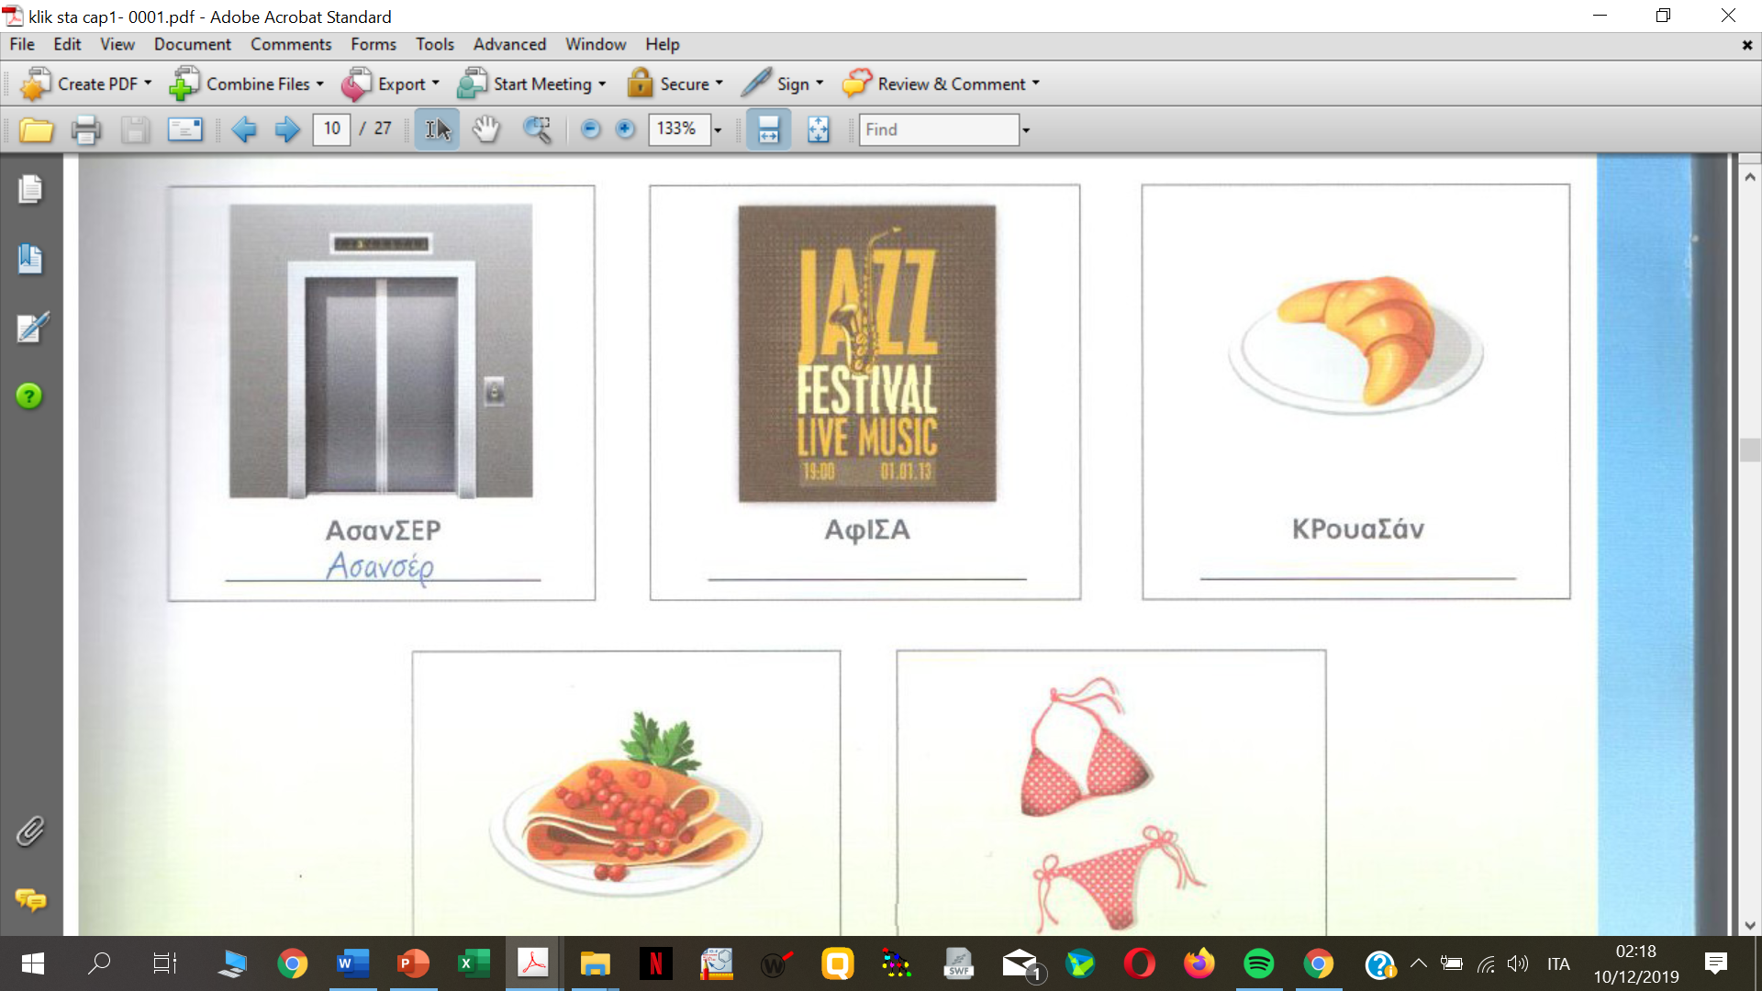
ΤΟ ΑΛΦΑΒΗΤΟ
ΚΕΦΑΛΑΙΑ / μικρά
ΑΣΑΝΣΕΡ
ΑΦΙΣΑ
ΚΡΟΥΑΣΑΝ
ασανσέρ
ascenseur [asɑ̃sɶr]
αφίσα
affiche [afiʃ]
κρουασάν
croissant [krwasɑ̃]
What is a loanword?
गिलास (एक गिलास पानी) /ɡɪʹlɑːs/
glass (UK): /ˈɡlɑːs/
Modern Greek (GRE1001) | Jacopo Mosesso | VIT University, July 2022

Slide 8
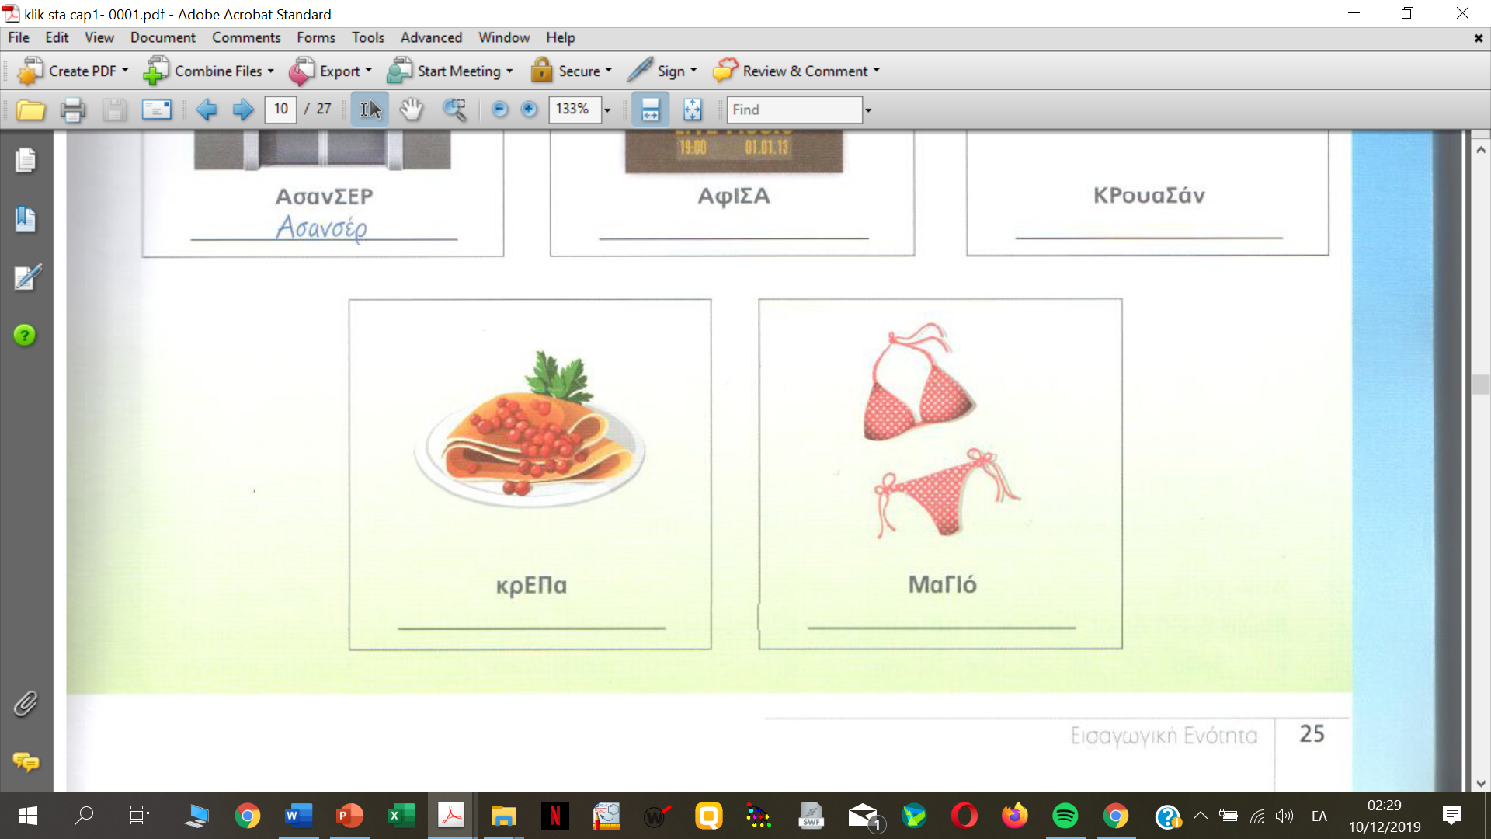
ΤΟ ΑΛΦΑΒΗΤΟ
ΚΕΦΑΛΑΙΑ / μικρά
ΚΡΕΠΑ
ΜΑΓΙΟ
κρέπα
μαγιό
In French: crêpe
[krεp]
In French: maillot
[majo]
Transliteration or Orthographic transcription?
Modern Greek (GRE1001) | Jacopo Mosesso | VIT University, July 2022

Slide 9
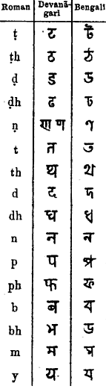
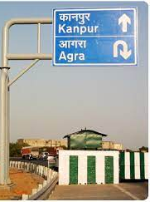
Example:
“Ελληνική Δημοκρατία”: the usual transliteration to Latin script is ⟨Ellēnikḗ Dēmokratía⟩.
The equivalence ⟨η⟩ = ⟨ē⟩ is not accurate in terms of pronunciation: the grapheme ⟨ē⟩ is associated to a long [ē] sound (in English we can find this sound in the word bared, pronounced as [beːd]).
In fact, the vowel ⟨η⟩ is pronounced as [i] (in English we can find this sound in the word fatigue, pronounced as [fəˈtiːg]).
A phonetic transcription (based on how we pronounce the various symbols) is instead: [elinikí ðimokratía].
Transliteration: conversion from one script to another (swapping letters). The phonetical aspect is secondary (matching is based on written symbols and not on the corresponding sounds).
Modern Greek (GRE1001) | Jacopo Mosesso | VIT University, July 2022

Slide 10
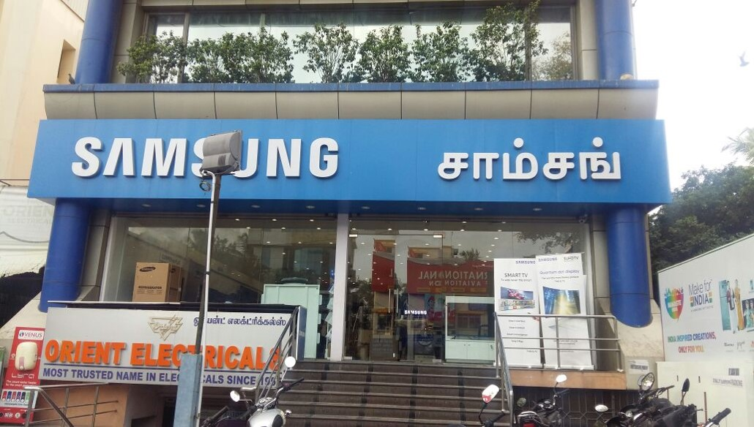
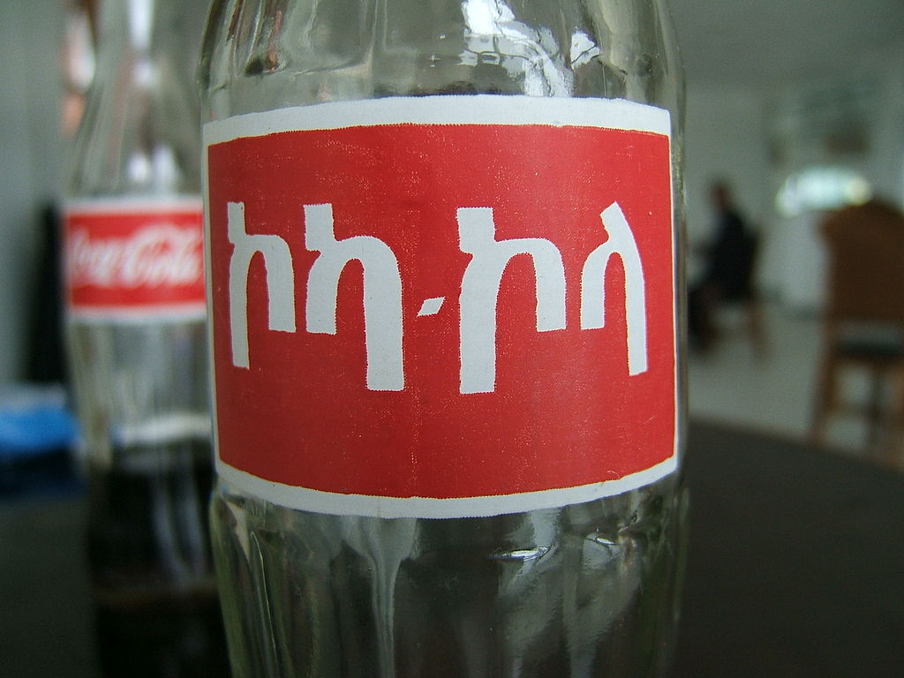
Orthographic transcription: mapping from sound to script, adapting to the standard system of the target language.
Examples: glass → गिलास ; Samsung → सैमसंग; Samsung → சேம்சங் maillot → μαγιό
ΤΟ ΑΛΦΑΒΗΤΟ
Modern Greek (GRE1001) | Jacopo Mosesso | VIT University, July 2022

Slide 11
ΤΟ ΑΛΦΑΒΗΤΟ
Phonetic transcription: mapping from sound to script, mostly using IPA (see https://tophonetics.com/).
Example: /ˈtaɪtl/ (broad transcription, uses slashes); [ˈtaɪɾɫ̩] (narrow, allophonic transcription, uses square brackets) → title and tidal are allophones in American English.
Modern Greek (GRE1001) | Jacopo Mosesso | VIT University, July 2022

Slide 12
ΤΟ ΑΛΦΑΒΗΤΟ
ኮካ-ኮላ
koka – kola?
ኮ = ko
ካ = ka
ko «sounds like co»
ላ = la
in coca-cola
The orthographic transcription is based on how a word is pronounced
Modern Greek (GRE1001) | Jacopo Mosesso | VIT University, July 2022

Slide 13
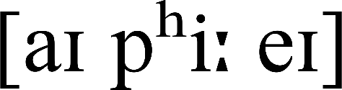
Απλά φωνήεντα
Simple vowels
Pronunciation
Προφορά
α | [a] | a as in father | πάλι | pali
η, ι, υ | [i] | i as in fatigue | Μήλο Τι Πολύ | milo, ti, poli
ε | [e] | e as in pen | πατέρας, Μαίρη | pateras, Meri
ο, ω | [o] | o as in lot | Ιταλός, μένω | italos, meno
Modern Greek (GRE1001) | Jacopo Mosesso | VIT University, July 2022

Slide 14
δίψηφα φωνήεντα
vowel digraphs
i.e., two letters (vowels) which represent a single sound (vowel)
αι | ει | οι | ου
/e/ | /i/ | /i/ | /u/
Writing | Pronunciation | Example | Translation | Pronunciation | Similar pronunciation
αι | /e/ | αίμα | Blood | /ema/ | Aesthetic, ever
 |  | αισθητική | Aesthetics | /esθitici/
οι | /i/ | οικονομία | Economicy | /ikonomia/ | Police
 |  | οικογένεια | Family | /ikoʝenia/
ει | /i/ | είμαι | I am | /ime/
 |  | κλειδί | Key | /kliði/
ου | /u/ | ουρανός | Sky | /uranos/ | Zoo
 |  | λουλούδι | flower | /luluði/
Modern Greek (GRE1001) | Jacopo Mosesso | VIT University, July 2022

Slide 15
συνδιασμοί αυ & ευ
combinations: α+υ & ε+υ
i.e., two letters (vowels) which represent two sounds (vowel+consonant)
αυ | [av] | αυλή
αυ | [af] | αυτή
ευ | [ev] | Εύα
ευ | [ef] | Ευτυχία
Modern Greek (GRE1001) | Jacopo Mosesso | VIT University, July 2022

Slide 16
 | κ
 | π
 | τ
 | φ
αυ/ευ + | θ = [af] [ef]
 | χ
 | σ
 | ξ
 | ψ
 | α, ε, η, ει, οι, ου, ω, ο
 | β
 | γ
 | δ
αυ/ευ + | ζ = [av] [ev]
 | λ
 | ρ
 | μ
 | ν
VOICELESS
SONORANT
Modern Greek (GRE1001) | Jacopo Mosesso | VIT University, July 2022

Slide 17
καταχρηστικοί δίφθογγοι
spurious diphthongs
Two (or exceptionally three) vowels that are pronounced as a single syllable.
The spurious diphthongs are (pay attention to the position of the stress mark!) :
όι
όη
άι
αη
ια
υα
εια (3 vowels)
οια (3 vowels)
Example | Translation | Pronunciation
κορόιδο | Fool | /ko.roi.ðo/
αηδόνι | nightingale | /ai.ðo.ni/
γάιδαρος | donkey | /ɣai.ða.ros/
Modern Greek (GRE1001) | Jacopo Mosesso | VIT University, July 2022

Slide 18
Pronunciation
Προφορά
Απλά σύμφωνα
(Simple consonants)
Β β | [v] | v as in voice | βάζω | vazo
Δ δ | [ð] | dh as in then | εδώ | edho
Ζ ζ | [z] | z as in zebra | ζείτε | zite
Θ θ | [θ] | th as in thick | θέλω | thelo
Λ λ | [l] | l as in leave | λέξη | lexi
Modern Greek (GRE1001) | Jacopo Mosesso | VIT University, July 2022

Slide 19
Pronunciation
Προφορά
Απλά σύμφωνα
(Simple consonants)
Μ μ | [m] | m as in meet | μήνας | minas
Ν ν | [n] | n as in nun | νέος | neos
Π π | [p] | p as in peep | πρέπει | prepi
Ρ ρ | [r] | r as in pretty | νερό | nero
Σ σ/ς | [s] | s as in soft | ίσως | isos
Modern Greek (GRE1001) | Jacopo Mosesso | VIT University, July 2022

Slide 20
Pronunciation
Προφορά
Απλά σύμφωνα
(Simple consonants)
Τ τ | [t] | t as in tea | Τώρα | tora
Φ φ | [f] | f as in fox | φάρμακο | farmako
Γ γ | [ɣ, ʝ] | 1) gh (voiced velar) 2) y as in year (voiced palatal, when followed by [e] or [i]) | μεγάλη γέρος | meghali yeros
Χ χ | [x, ç] | 1) kh as in Scottish loch 2) ch as in German ich (when followed by [e] or [i]) | έχω όχι | ekho ochi
Κ κ | [k, c] | 1) ck as in lock 2) k as in key (when followed by [e] or [i]) | εκατό εκεί | ekato eki
Modern Greek (GRE1001) | Jacopo Mosesso | VIT University, July 2022

Slide 21
Pronunciation
Προφορά
Διπλά σύμφωνα
(Double consonants)
Ξ ξ | [ks] | ks as in beaks | έξυπνος | eksipnos
Ψ ψ | [ps] | ps as in shops | ψωμί | psomi
Modern Greek (GRE1001) | Jacopo Mosesso | VIT University, July 2022

Slide 22
δίψηφα σύμφωνα
consonant digraphs
i.e., two letters (consonants) which represent a single sound (consonant)
μπ | ντ | τζ | τσ | γκ | γγ
/b/ | /d/ | /d͡ʒ/; /dz/ | /t͡ʃ/; /ts/ | /g/ | /g/
Writing | Pronunciation | Example | Translation | Pronunciation | Similar pronunciation
μπ | /b/ | μπίρα | beer | /bira/ | beer
ντ | /d/ | ντομάτα | tomato | /domata/ | domino
τζ | /d͡ʒ/; /dz/ | τζίπ | Jeep | /d͡ʒip/; /dzip/ | Jeep; loads
τσ | /t͡ʃ/; /ts/ | τσέπι | pocket | /t͡ʃepi/; /tsepi/ | cheap; cats
γκ | /g/ | γκαρσόνι | waiter | /garsoni/ | good
γγ | /g/ | φεγγάρι | moon | /fegari/ | ugly
Modern Greek (GRE1001) | Jacopo Mosesso | VIT University, July 2022

Slide 23
ΤΟ ΑΛΦΑΒΗΤΟ
Phonetic transcription: mapping from sound to script, mostly using IPA (see https://tophonetics.com/).
Example: /ˈtaɪtl/ (broad transcription, uses slashes); [ˈtaɪɾɫ̩] (narrow, allophonic transcription, uses square brackets) → title and tidal are allophones in American English.
Modern Greek (GRE1001) | Jacopo Mosesso | VIT University, July 2022

