Slide 1



Pronunciation
Προφορά
Απλά σύμφωνα
(Simple consonants)
Β β | [v] | v as in voice | βάζω | vazo
Δ δ | [ð] | dh as in then | εδώ | edho
Ζ ζ | [z] | z as in zebra | ζείτε | zite
Θ θ | [θ] | th as in thick | θέλω | thelo
Λ λ | [l] | l as in leave | λέξη | lexi
Modern Greek (GRE1001) | Jacopo Mosesso | VIT University, July 2022

Slide 2
Pronunciation
Προφορά
Απλά σύμφωνα
(Simple consonants)
Μ μ | [m] | m as in meet | μήνας | minas
Ν ν | [n] | n as in nun | νέος | neos
Π π | [p] | p as in peep | πρέπει | prepi
Ρ ρ | [r] | r as in pretty | νερό | nero
Σ σ/ς | [s] | s as in soft | ίσως | isos
Modern Greek (GRE1001) | Jacopo Mosesso | VIT University, July 2022

Slide 3
Pronunciation
Προφορά
Απλά σύμφωνα
(Simple consonants)
Τ τ | [t] | t as in tea | Τώρα | tora
Φ φ | [f] | f as in fox | φάρμακο | farmako
Γ γ | [ɣ, ʝ] | 1) gh (voiced velar) 2) y as in year (voiced palatal, when followed by [e] or [i]) | μεγάλη γέρος | meghali yeros
Χ χ | [x, ç] | 1) kh as in Scottish loch 2) ch as in German ich (when followed by [e] or [i]) | έχω όχι | ekho ochi
Κ κ | [k, c] | 1) ck as in lock 2) k as in key (when followed by [e] or [i]) | εκατό εκεί | ekato eki
Modern Greek (GRE1001) | Jacopo Mosesso | VIT University, July 2022

Slide 4
Pronunciation
Προφορά
Διπλά σύμφωνα
(Double consonants)
Ξ ξ | [ks] | ks as in beaks | έξυπνος | eksipnos
Ψ ψ | [ps] | ps as in shops | ψωμί | psomi
Modern Greek (GRE1001) | Jacopo Mosesso | VIT University, July 2022

Slide 5
δίψηφα σύμφωνα
consonant digraphs
i.e., two letters (consonants) which represent a single sound (consonant)
μπ | ντ | τζ | τσ | γκ | γγ
/b/ | /d/ | /d͡ʒ/; /dz/ | /t͡ʃ/; /ts/ | /g/ | /g/
Writing | Pronunciation | Example | Translation | Pronunciation | Similar pronunciation
μπ | /b/ | μπίρα | beer | /bira/ | beer
ντ | /d/ | ντομάτα | tomato | /domata/ | domino
τζ | /d͡ʒ/; /dz/ | τζίπ | Jeep | /d͡ʒip/; /dzip/ | Jeep; loads
τσ | /t͡ʃ/; /ts/ | τσέπι | pocket | /t͡ʃepi/; /tsepi/ | cheap; cats
γκ | /g/ | γκαρσόνι | waiter | /garsoni/ | good
γγ | /g/ | φεγγάρι | moon | /fegari/ | ugly
Modern Greek (GRE1001) | Jacopo Mosesso | VIT University, July 2022

Slide 6
ΤΟ ΑΛΦΑΒΗΤΟ
Phonetic transcription: mapping from sound to script, mostly using IPA (see https://tophonetics.com/).
Example: /ˈtaɪtl/ (broad transcription, uses slashes); [ˈtaɪɾɫ̩] (narrow, allophonic transcription, uses square brackets) → title and tidal are allophones in American English.
Modern Greek (GRE1001) | Jacopo Mosesso | VIT University, July 2022

Slide 7
WORD STRESS
com-pu-ter /kəmˈpjuːtər/
/ˈɪnsaɪt/ /ɪnˈsaɪt/
insight (noun)
incite (verb, t.)
Modern Greek (GRE1001) | Jacopo Mosesso | VIT University, July 2022

Slide 8
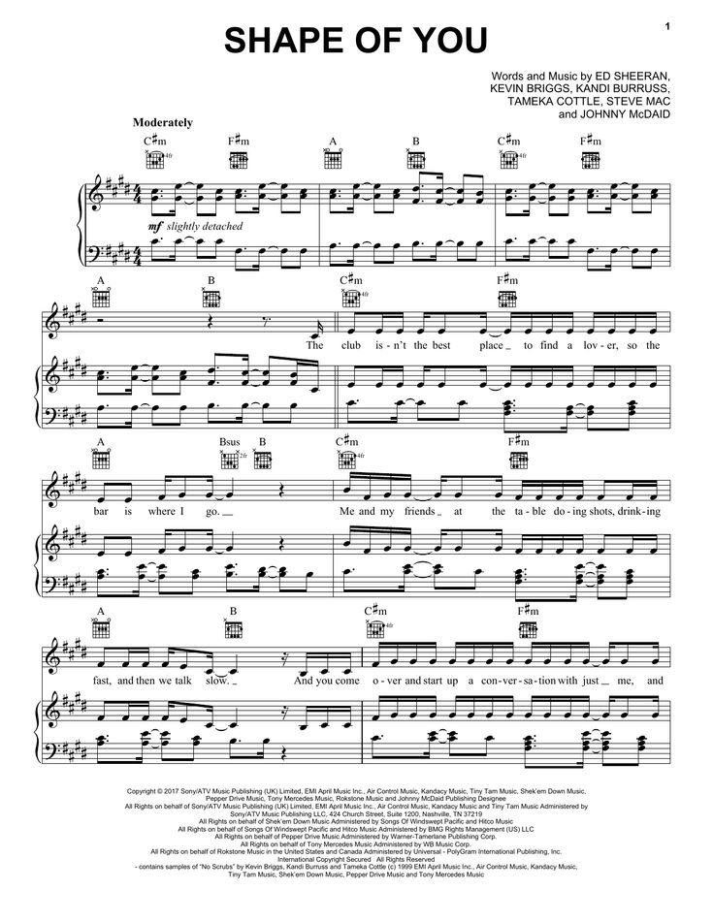
WORD STRESS
Modern Greek (GRE1001) | Jacopo Mosesso | VIT University, July 2022

Slide 9
Modern Greek (GRE1001) | Jacopo Mosesso | VIT University, July 2022

Slide 10
WORD STRESS
If we shadows have offended,
Think but this, and all is mended—
That you have but slumbered here
While these visions did appear.
And this weak and idle theme,
No more yielding but a dream,
Gentles, do not reprehend.
If you pardon, we will mend.
And, as I am an honest Puck,
If we have unearned luck
Now to ’scape the serpent’s tongue,
We will make amends ere long.
Else the Puck a liar call.
So good night unto you all.
Give me your hands if we be friends,
And Robin shall restore amends.
¯˘ ¯˘ ¯˘ ¯˘
¯˘ ¯˘ ¯˘ ¯
[catalectic trochaic tetrameter]
Modern Greek (GRE1001) | Jacopo Mosesso | VIT University, July 2022

Slide 11
WORD STRESS
diacritics διακριτικά → «to distinguish»
acute accent → ◌́ τόνος
diaeresis → ◌̈ διαλυτικά
diaeresis with accent → ◌̈́ διαλυτικά με τόνο
Modern Greek (GRE1001) | Jacopo Mosesso | VIT University, July 2022

Slide 12
WORD STRESS
diaeresis διαίρεσις → «to divide»
αι
αϊ
οι
οϊ
→ /e/
→ /ai/
→ /i/
→ /oi/
Modern Greek (GRE1001) | Jacopo Mosesso | VIT University, July 2022

Slide 13
ΐ (ιώτα με τόνο και διαλυτικά):
Windows: Shift + W I
Mac: ⌥ + ; I
Linux, BSD, Unix: Shift + ; ; I
ι ί ϊ ΐ υ ύ ϋ ΰ
ΰ (ύψιλον με τόνο και διαλυτικά):
Windows: Shift + W Υ
Mac: ⌥ + ; Υ
Linux, BSD, Unix: Shift + ; ; Υ
Modern Greek (GRE1001) | Jacopo Mosesso | VIT University, July 2022

Slide 14

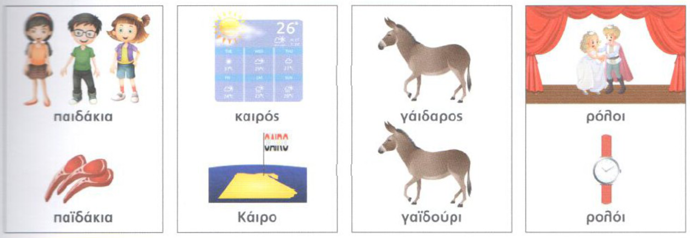
[e] αι, [ai] άι αϋ αϊ αΐ, [i] οι, [oi] όι οϊ ωί, [ei] έι εϊ
Modern Greek (GRE1001) | Jacopo Mosesso | VIT University, July 2022

Slide 15
WORD STRESS
diaeresis διαίρεσις → «to divide»
αι
αϊ
οι
οϊ
→ /e/
→ /ai/
→ /i/
→ /oi/
Spurious diphthongs:
όι
όη
άι
αη
ια
υα
εια
οια
→ /oi/
→ /oi/
→ /ai/
→ /ai/
→ /ia/
→ /ia/
→ /ia/
→ /ia/
Modern Greek (GRE1001) | Jacopo Mosesso | VIT University, July 2022

Slide 16
WORD STRESS
counting syllables
●●● | ●●● | ●●●
3rd to last Antepenult Proparoxytone | 2nd to last Penultimate Paroxytone | last Ultima Oxytone
Modern Greek (GRE1001) | Jacopo Mosesso | VIT University, July 2022

Slide 17
Remember:
Spurious diphthongs: όι; όη; άι; αη; ια; υα; εια (3 vowels); οια (3 vowels)
WORD STRESS
●● | ●● | ●●● | ●●● | ●●● | ●●●● | ●●●●
γάλα | ελιά | μπρόκολο | αλάτι | πιπεριά | γαρίφαλο | καλημέρα
παιδάκια
Κάιρο
γάιδαρος
ρόλοι
παϊδάκια
καιρός
γαϊδούρι
ρολόι
Modern Greek (GRE1001) | Jacopo Mosesso | VIT University, July 2022

Slide 18
WORD STRESS
●●●● | ●●●●● | ●●●●● | ●●●●●● | ●●●●●●
εφημερίδα
κατακόρυφα
Αλεξανδρούπολη
οικοδομή
πολυκατοικία
Modern Greek (GRE1001) | Jacopo Mosesso | VIT University, July 2022

Slide 19
SYLLABLES AND WORD STRESS
Single vowels can constitute a syllable by itself: e.g. α-έ-ρας, Ι-ω-α-κείμ
On the other hand, one or more consonants cannot constitute a syllable without a vowel
Vowel digraphs (αι, οι, υι, ει, ου), spurious diphthongs (όι, όη, άι, αη, ια, υα, εια, οια) and combinations (αυ, ευ) are counted as a single vowel and are never taken separately: e.g. αί-μα, αη-δό-νι, πά-πια
A single consonant positioned between two vowels (or at the beginning of a word, followed by a vowel), forms a syllable with the second vowel (the one that follows): e.g. έ-λα, κα-πέ-λο
Two consonants positioned between two vowels (or at the beginning of a word, followed by a vowel) form a syllable with the second vowel (the one that follows) only if there are existing Greek words that start with that combination of consonants: e.g. κά-στα-νο (there are Greek words starting with στ, like for instance the word στάση, therefore the syllable στα can be formed without separating σ and τ)
Modern Greek (GRE1001) | Jacopo Mosesso | VIT University, July 2022

Slide 20
SYLLABLES AND WORD STRESS
Three or more consonants positioned between two vowels (or at the beginning of a word, followed by a vowel) form a syllable all together with the second vowel (the one that follows) only if there are existing Greek words that start with that combination of consonants (or at least with the first two of them):
e.g. κά-στρο (there are Greek words starting with στρ, like for instance the word στροφή, therefore the syllable στρο can be formed without separating σ, τ and ρ);
e.g. ε-χθρός (there are Greek words starting with χθ, like for instance the word χθες, therefore the syllable χθρός can be formed without separating χ and θ).
Otherwise, the consonant cluster is broken down, and the first consonant of the consonant cluster is included in the previous syllable:
e.g. άν-θρω-πος (there is no Greek word that starts with the combination of νθρ, therefore ν is separated from θρ: ν is included in the previous syllable άν, while θρ are forming the syllable that follows, i.e. θρω)
Modern Greek (GRE1001) | Jacopo Mosesso | VIT University, July 2022

Slide 21
SYLLABLES AND WORD STRESS
Same-consonant couples (γγ, λλ, ρρ, σσ etc.) are always split in two different syllables (e.g.: άλ-λος, θάρ-ρος,φεγ-γά-ρι)
Consonant digraphs, with the exception of γγ (μπ, ντ, γκ, τσ, τζ) are never split (e.g.: κα-μπά-να, πα-γκά-κι, πά-ντο-τε)
As a general rule, the lateral λ, trill ρ, nasal μ and ν are always separate from the consonant that follows (except, of course, the combination of μ and π and the combination of ν and τ). E.g.: άρ-μα, άμ-βω-νας, έν-ση-μο.
Modern Greek (GRE1001) | Jacopo Mosesso | VIT University, July 2022

Slide 22

Modern Greek (GRE1001) | Jacopo Mosesso | VIT University, July 2022

