Slide 1
ABI CI Review & Beyond
Nick Kirwan

Slide 2
The challenges for CI…
Sustainability issues
  Advances in medical science
  Reinsurance capacity for guaranteed premiums?
  Reviewable premiums
Reputational issues
  £1.7 bn claims paid since 2000 – but…
  1 in 5 claims declined?
  League tables
FSA issues
  Declined claims – “high”
  FinProms update – “scaremongering”/”exclusions”
  FSA themed work – disclosure, linked sales etc
  TCF – complexity brings “considerable challenge”

Slide 3
What are we doing?
Sustainability
FSA
Reputation
CI Review
More sustainable definitions
Reviewability
Guidance
CI Review
Improved clarity
Consumer research
CI Review
What’s covered and what’s not
Application Forms
Non-disclosure
Claims Handling
Unrelated Non-disclosure
Guidance
TPD

Slide 4
Statement of Best Practice for CI
Published 1999 following OFT Review…
  Clarity, Comparability & Security
  Model definitions & presentation format
Full Review 2002 – Cancer + Heart Attack
Intermediate Review 2004 – Regulation example
Current Full Review…
  Further improve clarity for consumers
  Help ensure CI is sustainable and continues to meet consumer needs at an affordable price

Slide 5
Clarity – Product Level
  A standard description of CI…
  Life and critical illness cover pays out a lump sum if you either die or are diagnosed with a critical illness that meets our policy definition. We only cover the critical illnesses we define in our policy and no others.

Slide 6
Clarity – Definitions
More descriptive headings…
Cancer – excluding less advanced cases
Extend model definitions to 23…
Alzheimer’s disease before age X – resulting in permanent symptoms
HIV infection – caught in the UK from a blood transfusion, a physical assault or at work in an eligible occupation
Traumatic head injury – resulting in permanent symptoms

Slide 7
Clarity – Exclusions
Exclusions…
Regulations require significant or unusual exclusions (SUEs) to be disclosed up front
Consumers want ALL exclusions disclosed up front
Requirement goes beyond FSA

Slide 8
Help make CI more sustainable
Objectives…
Consider future medical advances
Retain cover today and into the future

Slide 9
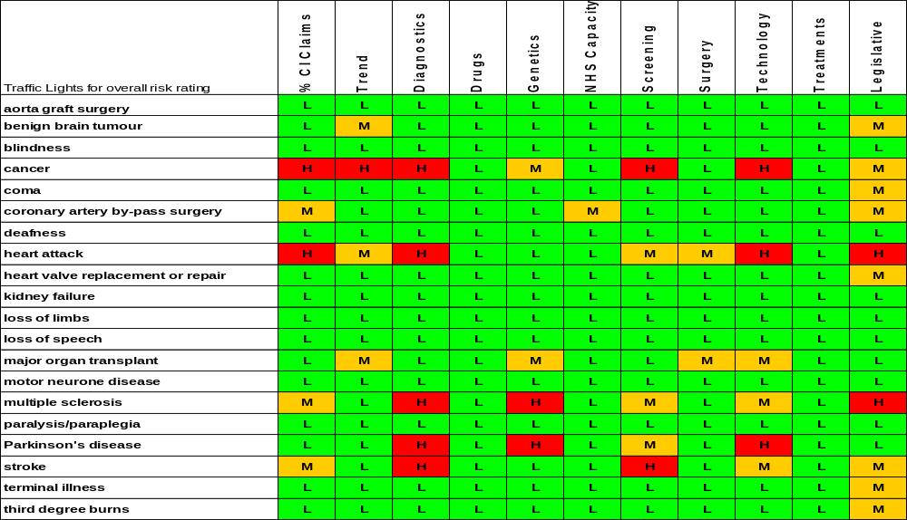
Trend Map

Slide 10
Help make CI more sustainable
Approach…
Cancer
Heart Attack
Stroke & progressive illnesses (Alzheimer’s, Parkinson’s etc)

Slide 11
“Scaremongering” Vs “Informing”
Providing helpful information…
  Scary is not the same as scaremongering
  Statistics – helpful if relevant, up to date and from a reliable, quoted source
  Care re personalising

Slide 12
Implementation
Implementation…
  As soon as practical
  Must be before end of April 2007

Slide 13
And Now For Something Completely Different
Protection Committee objectives…
  To improve consumer’ financial security
  To improve consumer confidence
Next steps…
  Update the CI Definitions Guide
  Work on Total Permanent Disability (TPD)
  Unrelated non-disclosure
  Work with HCF on claims handling
  Simplify IP – 17 November 2006

Slide 14
The Need for Protection
Changes in society…
  £27 billion savings gap
  £1.2 trillion debt mountain
Consumers need protection…
  Healthy, thriving, competitive market
  Trust
  Clear information

