Slide 1
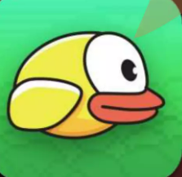
FLAPPY
BIRD

Slide 2
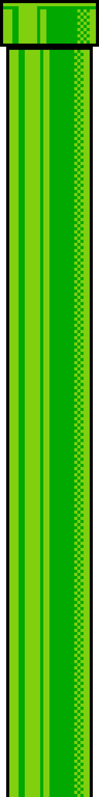
TABLE OF CONTENTS
About the Project
Objective
Scope
Tools and Technologies
Implementation Overview
Conclusion

Slide 3
The Flappy Bird game is a classic side-scrolling game where the player controls a bird, attempting to fly between sets of pipes without hitting them. The objective is to score points by successfully navigating through the gaps between the pipes. This project is implemented using Java's Swing framework, which provides a graphical user interface (GUI) for the game.
About the Project

Slide 4
OBJECTIVE
The primary objective of this project is to create a functional clone of the Flappy Bird game.
Demonstrate proficiency in Java programming.
Focus on event-driven programming.
Incorporate game development concepts.
Design GUI using Swing in Java.

Slide 5
SCOPE
This project covers:
Basic game mechanics including gravity, bird movement, and collision detection.
Randomized pipe generation to create an endless scrolling effect.
Score tracking and game-over conditions.
Handling user inputs to control the game using keyboard events.
Game restart functionality after the game-over condition.

Slide 6
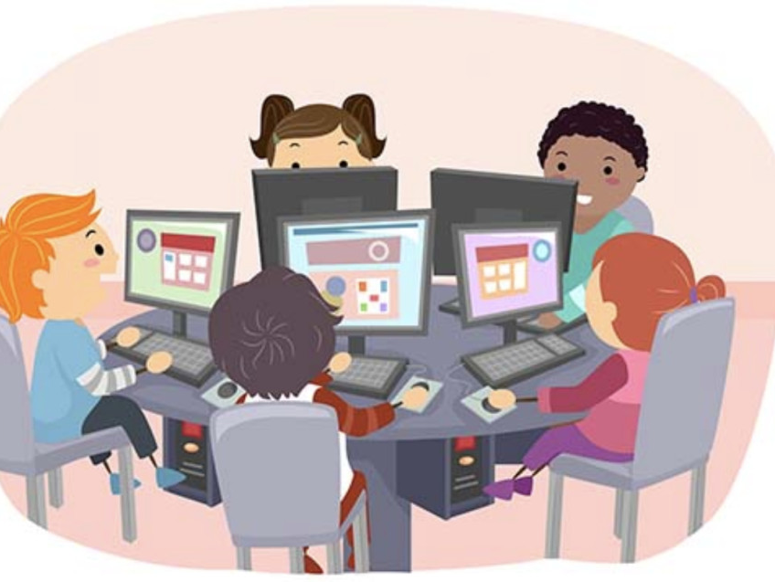
TOOLS & TECHNOLOGY
Programming Language: Java
Framework: Java Swing for GUI
IDE: Any Java-supported IDE (e.g., IntelliJ IDEA, Eclipse, NetBeans)
Resources: Image resources for the background, bird, and pipes.

Slide 7
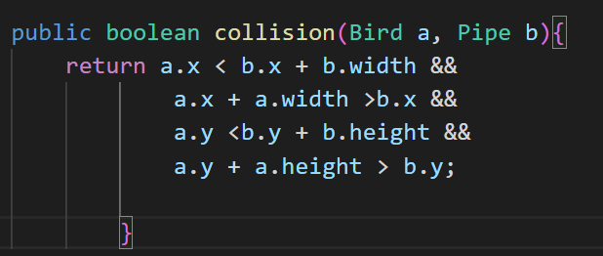
IMPLEMENTATION OVERVIEW
The game is implemented by extending the JPanel class.
Implements the ActionListener and KeyListener interfaces.
The core game loop is driven by a timer, updating the game state 60 times per second.
Pipes are generated at random vertical positions and move leftward, simulating the bird's forward motion.
Collision detection is implemented to end the game when the bird hits a pipe or the ground.
Code of Collision
1st line : a's top left corner doesn't reach b's top right corner
2nd line : a's top right corner passes b's top left corner
3rd line :a's top left corner doesn't reach b's bottom left corner
4th line: a's bottom left corner passes b's top left corner

Slide 8
FUTURE ENHANCEMENT
Sound Effects: Adding sound effects for actions such as jumping, passing through pipes, and game over.
High Score System: Implementing a high-score feature to record the highest score achieved in a session.
Multiple Levels: Introducing multiple levels with varying difficulties, such as increased pipe speed or narrower gaps.
Improved Graphics: Enhancing the visual quality of the game with better graphics and animations.

Slide 9
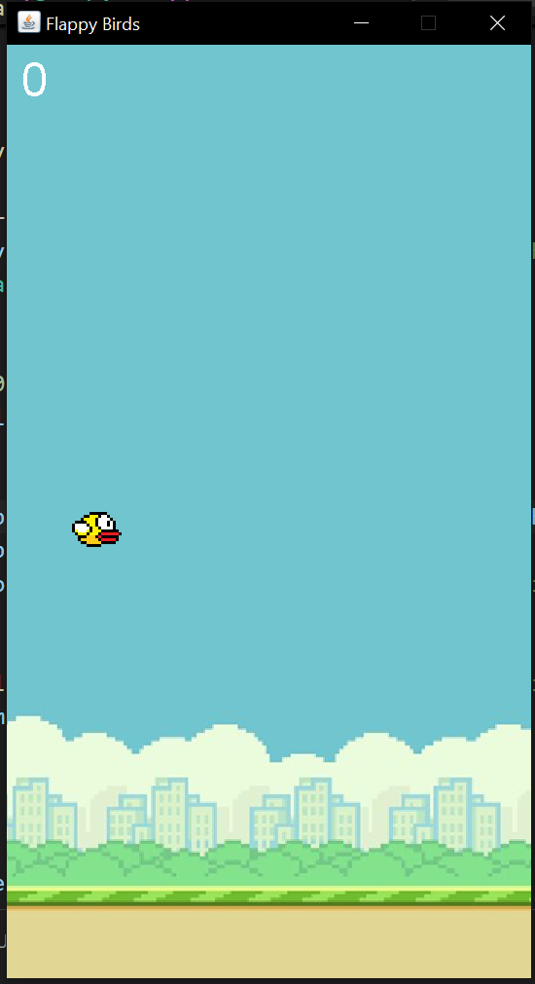
GAME START

Slide 10
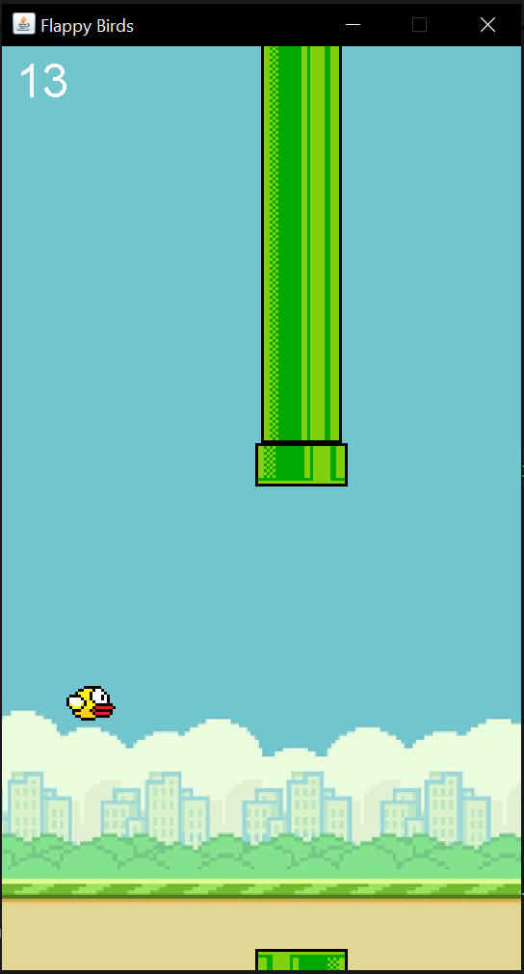
GAME PLAY
TOTAL SCORE

Slide 11
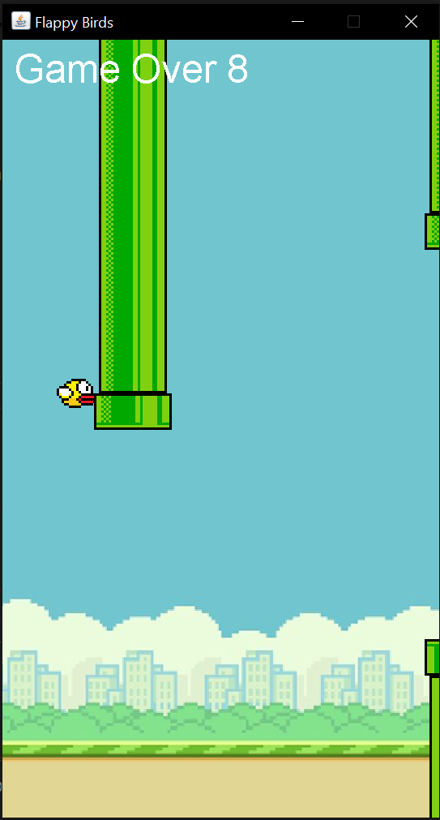
GAME OVER

Slide 12


THANK YOU
SUBMITTED TO:
PROF. DR. VAISHALI R KULKARNI
SUBMITTED BY :
NAME : HEMLATA KUMARI
REG ID : 231382027
COURSE : MCA ODL (2ND)

