Slide 1



GBHEALTH
Introduction
Functions
Demo
17309003 : CHO MAN KI
17309004 : KIM SEON GHYEON
17309005 : KUM SEUNG WON
17309006 : MIS SI WAN

Slide 2

Intro
For those who want to work out alone at home,
We created an application with various functions such as:
-Log-In ( including Register) -Push up count -Exercise Tip -My exercise record -Listen music

Slide 3
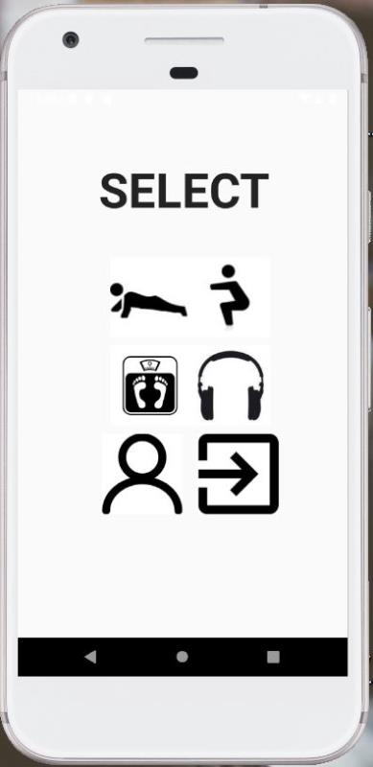
Key technologies
Push up counting, Time check
Show various positions
Record Daily Weight
Listening to music
Log-In
Terminate App

Slide 4
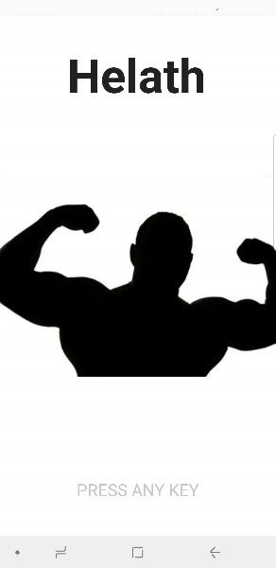
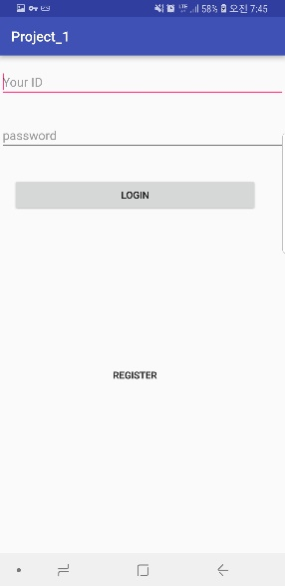
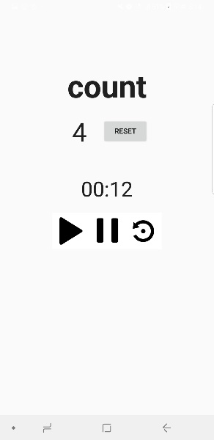
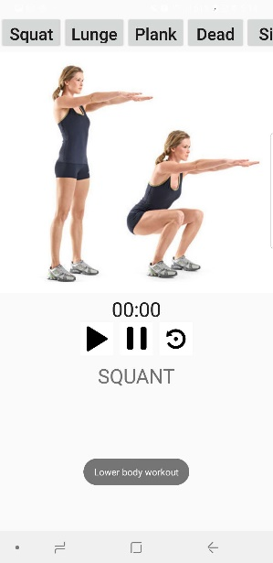
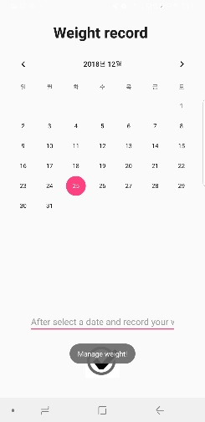
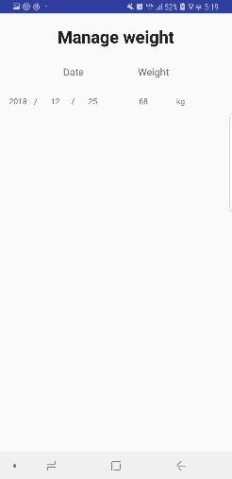
Contents

Slide 5
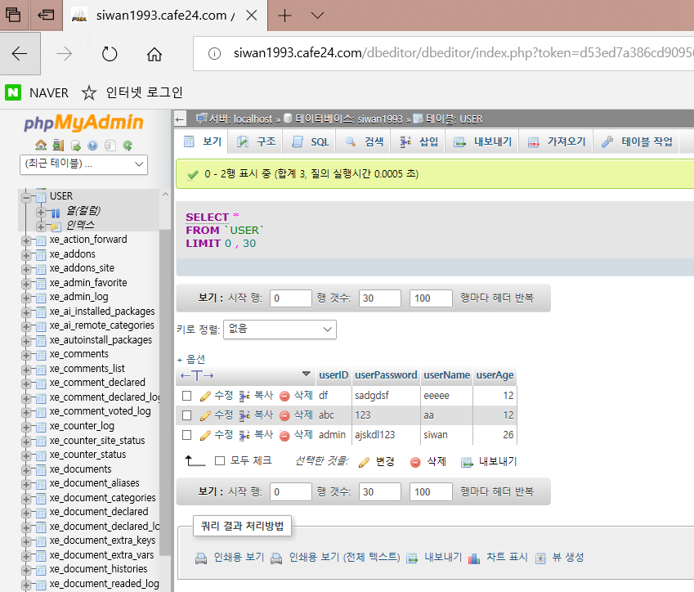
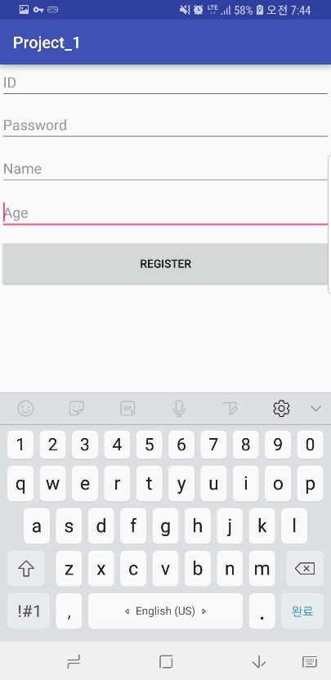
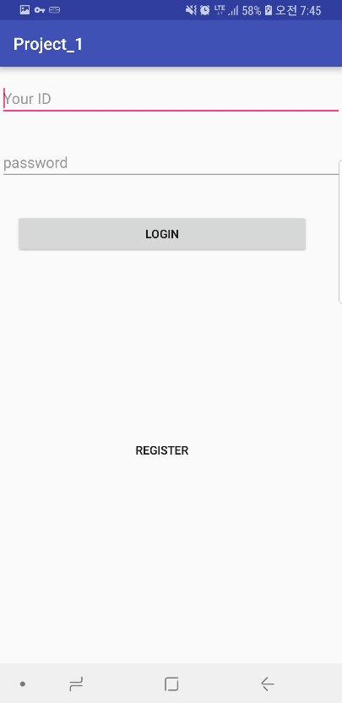
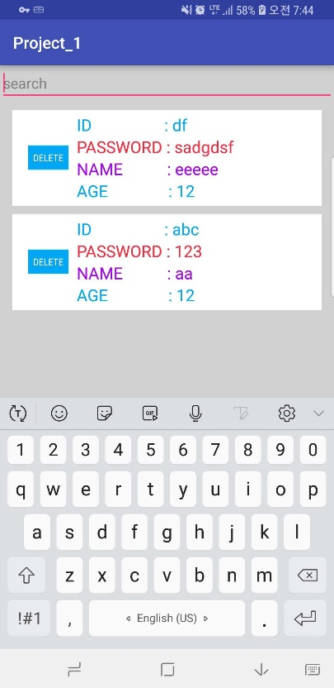
Functions
We made Log-In and Register function by using web hosing server. Admin account can manage users.

Slide 6


Functions
public void onSensorChanged( SensorEvent event )
{
index++;
textView.setText(" " + index / 2);
}
//Once sensor value is changed, function is executed.
btn1.setOnClickListener(new View.OnClickListener() {
public void onClick(View v) {
count++;
if(count==1)chr.setBase(SystemClock.elapsedRealtime());
chr.start(); } });
btn2.setOnClickListener(new View.OnClickListener() {
public void onClick(View v) {
chr.stop(); } });
btn3.setOnClickListener(new View.OnClickListener() {
public void onClick(View v) {
chr.setBase(SystemClock.elapsedRealtime()); } });
//If There is no count value in start function, it will be reset when re-stared.

Slide 7
Others
Other functions

Slide 8
Contents
Show various positions
Push up counting, Time check
Record Daily Weight
Listening to music
Log-In
Terminate App

Slide 9

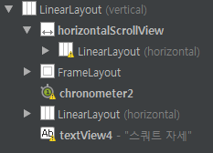

Contents
Using scroll view, the motions for exercise are listed with buttons and frame out is used to show the following motion and motion’s name.
In order to count time, Timer function is added.

Slide 10
Contents
Check number of movements and time
Show various positions
Record Weight
Listening to music
Log-In
Terminate App

Slide 11

Contents
Using Number EditText, we make it possible to enter only numbers because weight is number.
When the check button is clicked, the data is sent to another activity and received.
Intent go = new Intent(getApplicationContext(),MainActivity3.class);
go.putExtra("YEAR",year); go.putExtra("MO",month);
go.putExtra("DA",date); go.putExtra("DATA",data); startActivityForResult(go,0);
Transfer data to MainActivity3
Intent go=getIntent();
year =go.getStringExtra("YEAR");
month =go.getStringExtra("MO"); date =go.getStringExtra("DA"); data =go.getStringExtra("DATA"); texty.setText(" "+year); textm.setText(" "+month); textd.setText(" "+date); textw.setText(" "+data); setResult(0);
Receive data from MainActivity3 and display it in text

Slide 12
Contents
Check number of movements and time
Show various positions
Record Weight
Listening to music
Log-In
Terminate App

Slide 13
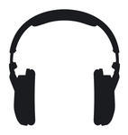
Contents
mp3.setOnClickListener(new View.OnClickListener() {
public void onClick(View v) {
Intent launchIntent = getPackageManager().getLaunchIntentForPackage(“com.netease.cloudmusic”);
If(launchIntent !=null){
startActivity(launchIntent);
}
Toast.makeText(getApplicationContext(),”Play Music”, Toast.LENGTH_SHORT).show();
}
});
Using Action View(Intent), put the NetEaseMusic’s Packagename in the intro and connect it directly.

Slide 14
Thank you

