Slide 1
Business Plan for Launching Municoin: Tokenized Municipal Bond

Slide 2
Agenda
1
Introduction: Overview of Municoin
2
Product Overview
3
Business Goals & Objectives
4
Market Opportunity
5
Steps to Launch Municoin
6
Compliance & Regulatory Considerations
7
Financial Projections
8
Conclusion: The Future of Municipal Finance

Slide 3



Introduction: Overview of Municoin
Defining the Future of Municipal Bonds
Definition of Municoin
Municoin is a cryptocurrency designed specifically for the municipal bond market, enabling digital ownership of bond assets through blockchain technology, enhancing accessibility and liquidity.
Purpose of Tokenized Municipal Bonds
Tokenized municipal bonds aim to democratize and simplify the process of bond investments, allowing fractional ownership and participation from a broader investor base, thus lowering barriers to entry.
Importance of Blockchain Technology
Blockchain ensures transparency, security, and immutability in transactions, significantly reducing the risks associated with traditional bonding processes, while also facilitating real-time tracking and auditing of financial data.
Notes:
The introduction of Municoin signifies a transformative approach to municipal finance. By utilizing blockchain technology, we can redefine how municipal bonds are structured and traded, making them more accessible for investors and enhancing the credibility of the financial systems in place. Moreover, the purpose of tokenized municipal bonds is crucial: it aims to broaden access to these investment opportunities, allowing everyday investors to engage in a market that has historically been reserved for institutional players.

Slide 4

Product Overview
Understanding Municoin's Value Proposition
What is Municoin?: Municoin serves as a digital representation of ownership in municipal bonds, enabling instantaneous transactions and a novel way to invest in local projects with real-world impact.
Fractionalized Ownership: Through Municoin, investors can own a fraction of larger bond issues, thereby mitigating individual financial risk and allowing more participation from smaller investors.
Smart Contracts and Governance: Smart contracts automate processes associated with bond transactions, including compliance and distribution of returns, enhancing operational efficiency and stakeholder involvement.
Benefits for Municipalities and Investors: Municipalities gain access to a wider pool of capital, while investors enjoy increased liquidity and reduced investment thresholds, fostering a more equitable financial landscape.
Photo by Nick Chong on Unsplash
Notes:
The product overview of Municoin showcases its role as a pivotal tool in bridging the gap between investors and municipalities. By harnessing the power of fractionalization, Municoin democratizes access to investments that were previously out of reach for many. This means that even smaller investors can now participate meaningfully in community projects. Additionally, our use of smart contracts will ensure that governance is transparent and effective, further solidifying the trust essential for a successful financial ecosystem.

Slide 5



Business Goals & Objectives
Setting the Stage for Growth and Impact
Raise Capital for Municipalities
By facilitating investment in local projects through tokenization, Municoin aims to provide municipalities with a new channel to secure funding needed for development initiatives.
Democratize Investments
Our goal is to enable every citizen, regardless of wealth, to invest in their local communities, thus increasing engagement and fostering a sense of ownership among residents.
Leverage Blockchain for Transparency
Utilizing blockchain allows for real-time tracking, providing stakeholders with access to critical information about the bonds they invest in, ensuring integrity and accountability.
Notes:
Establishing clear business goals and objectives is paramount for Municoin’s success. Our mission includes raising significant capital for municipalities while making the investment process accessible to all. This democratization of investment not only fosters local economic growth but also encourages broader public participation in municipal financing. Furthermore, by leveraging blockchain’s inherent transparency, we ensure that all stakeholders can trust in the integrity and accountability of their investments.

Slide 6

Market Opportunity
Positioning Municoin in a Thriving Financial Landscape
Current State of Municipal Bonds: The municipal bond market is a sizable but often inaccessible domain, presenting opportunities for innovation through tokenization, especially as digital currencies gain traction.
Retail Investor Access: Traditionally, access to municipal bonds has been limited to high-net-worth individuals and institutions. Municoin aims to open this market to retail investors through tokenized fractional ownership.
Market Size and Potential: The municipal bond market, valued in the trillions, represents a significant opportunity for growth and innovation, particularly as regulations evolve to accommodate blockchain technologies.
Positioning of Municoin: By focusing on transparency, efficiency, and democratization, Municoin is uniquely positioned to disrupt the existing paradigms of municipal finance and attract diverse investors.
Photo by Markus Winkler on Unsplash
Notes:
The market opportunity for Municoin is vast and largely untapped. The traditional municipal bond market is cumbersome and lacks engagement from a broader range of investors. With a market size reaching trillions, the potential to introduce a tokenized format is immense. Through careful positioning as a transparent, accessible, and efficient investment vehicle, Municoin can attract a new wave of retail investors, thus reshaping the landscape of municipal finance.

Slide 7



Steps to Launch Municoin
Roadmap to Success
Team Formation
Building a diverse team of experts in finance, technology, and regulation is crucial for the successful launch of Municoin, ensuring that all strategic and operational aspects are covered.
Pre-sale Preparation
Prior to launching, a robust marketing strategy and educational outreach will be required to inform potential investors and ensure a strong initial response.
Private Sale Overview
A targeted private sale will allow for early strategic investors to come on board, which can stabilize initial financing and generate buzz for the upcoming public offering.
Public Token Sale
After building momentum through pre-sales and private sales, a public token sale will be executed to open Municoin to the broader investment community, maximizing reach and investment.
Notes:
Launching Municoin requires a comprehensive approach, meticulously planned through distinct phases. It starts with team formation, where we bring together individuals with diverse backgrounds that can cover all necessary expertise—restricting no domain. After that, we will shift focus to pre-sale preparation, where we will create awareness and educate potential investors to ensure ample participation during the private and public sales. This structured approach will help Municoin establish a solid foundation for long-term success.

Slide 8




Compliance & Regulatory Considerations
Navigating the Financial Landscape
Securities Compliance
Ensuring that Municoin adheres to all securities regulations will be essential to protect investors and maintain the integrity of the token sale process.
KYC and AML Procedures
Establishing effective Know Your Customer (KYC) and Anti-Money Laundering (AML) procedures will bolster trust in Municoin and comply with legal requirements, safeguarding against illicit activities.
Legal Frameworks
Navigating the various legal frameworks across jurisdictions will ensure that Municoin can operate wherever there is interest, enhancing its potential market reach.
Ongoing Audits
Implementing ongoing audits will ensure that Municoin remains compliant and transparent, fostering continual trust among investors and stakeholders.
Notes:
Understanding and adhering to compliance and regulatory considerations is of utmost importance as we prepare for the launch of Municoin. We must ensure securities compliance to protect all involved parties and to establish the legitimacy of our offering. KYC and AML systems will be put in place to maintain financial integrity while our legal frameworks will allow us to participate in multiple markets effectively. To maintain trust, our commitment to ongoing audits will provide ongoing assurance of compliance and transparency.

Slide 9
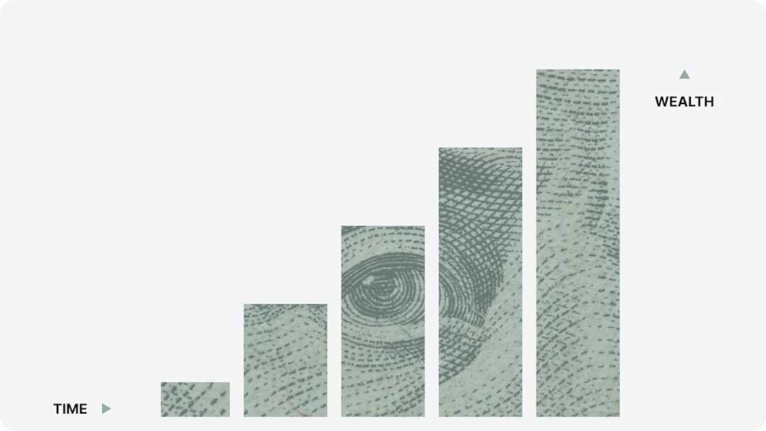
Financial Projections
Anticipating Growth and Sustainability
Revenue Streams: Municoin will generate revenue through transaction fees, subscription models, and potential partnerships with municipalities for data and analytics services.
Projected Growth: With the anticipated rise in interest for tokenized assets, Municoin's adoption is projected to grow exponentially, creating significant opportunities for returns on investment.
Transaction and Platform Fees: Establishing competitive transaction fees and platform fees ensures the sustainability of Municoin while providing value for investors and municipalities alike.
Long-term Financial Outlook: With strategic planning and execution, Municoin is poised for long-term financial success, influencing the municipal bond market and appealing to a diverse array of investors.
Photo by Morgan Housel on Unsplash
Notes:
We have established robust financial projections, focusing on diverse revenue streams that will ensure Municoin's sustainability and allure for investors. The projected growth, driven by the increased interest in tokenized assets, will position Municoin favorably within the financial landscape. Competitive transaction and platform fees will not only secure our revenue but also add value to participants. Ultimately, our long-term financial outlook is optimistic, paving the way for Municoin to reshape the municipal bond market.

Slide 10

Conclusion: The Future of Municipal Finance
Charting New Horizons
Disruption of Municipal Bond Market: Municoin stands to disrupt the traditional municipal bond landscape by introducing innovations that encourage flexibility, accessibility, and accountability in financing.
Access for Retail Investors: By breaking down historical barriers, Municoin creates an inclusive investment opportunity that empowers all community members to invest in their local governments.
Phased Approach to Launch: Transitioning smoothly through each phase of our launch is key to establishing credibility and investor trust in the Municoin platform.
Vision for Growth and Scaling: The ultimate goal of Municoin extends beyond just launching a product; it encompasses a vision for sustainable growth, scalability, and a foundational shift in municipal financing.
Photo by Chris Liverani on Unsplash
Notes:
In conclusion, Municoin is not merely an innovation in municipal finance; it represents a fundamental shift in how these financial instruments are designed, marketed, and accessed. By embracing a phased approach to launching Municoin, we ensure a reliable rollout that builds trust and credibility among investors. Our vision for growth and scaling is ambitious, looking toward a future where anyone can invest in their community and participate in local economic development. The potential to disrupt the municipal bond market is significant, paving the way for a brighter collective financial future.

