Slide 1

Scenario for Web App

Slide 2
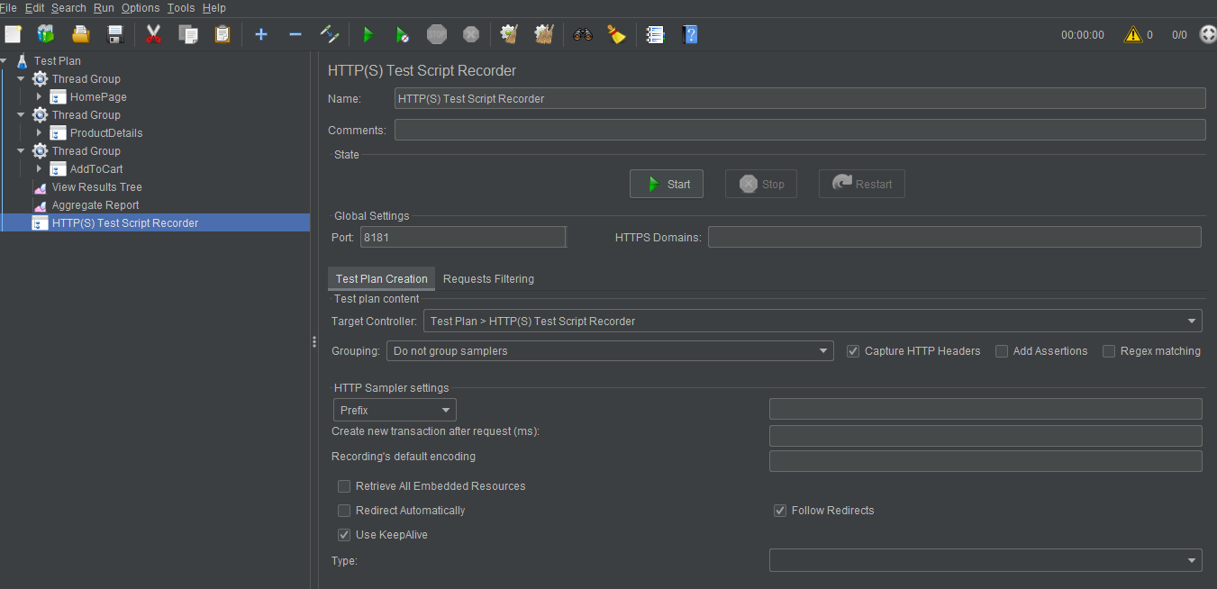
Jmeter-Template

Slide 3
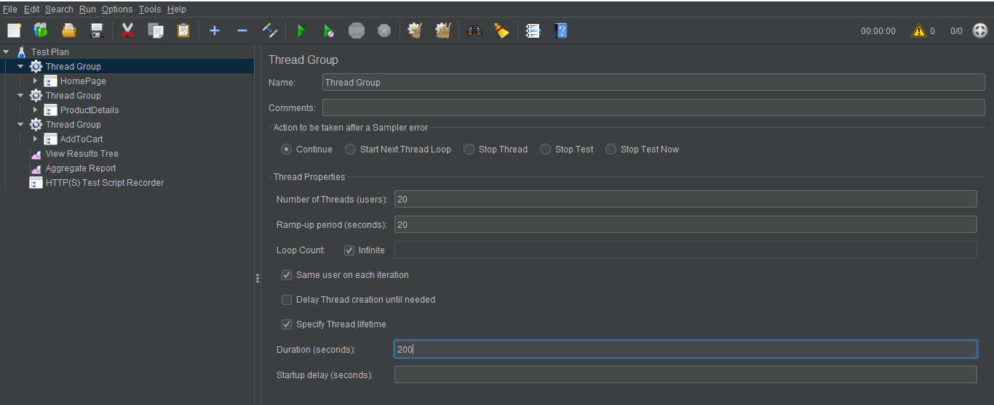
Home Page 20%

Slide 4
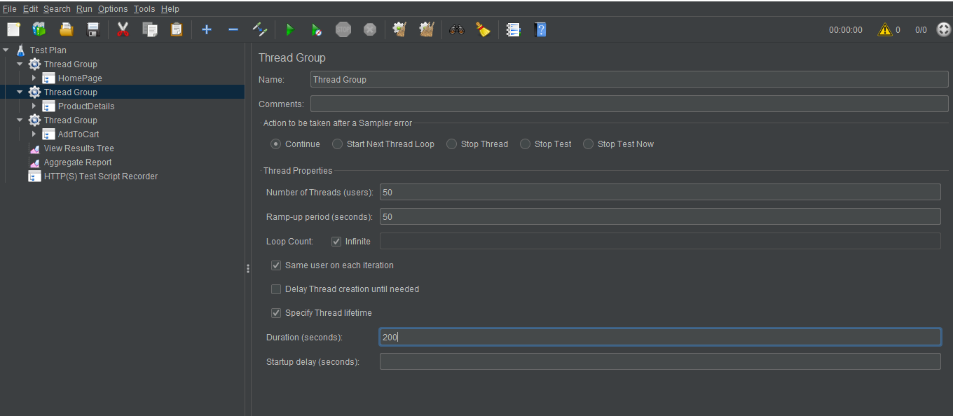
Product Details 50%

Slide 5
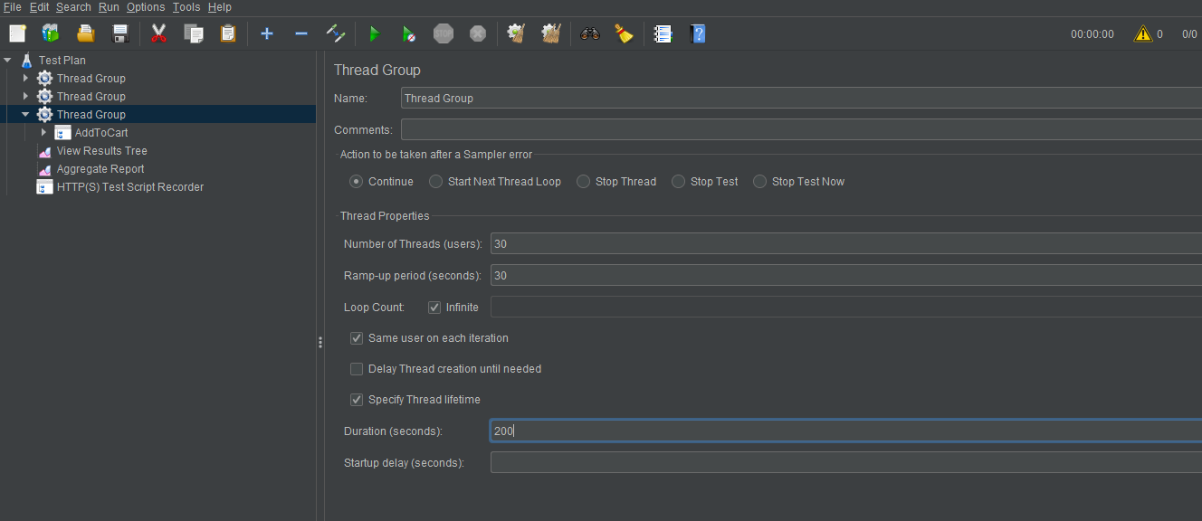
Add To Cart 30%

Slide 6
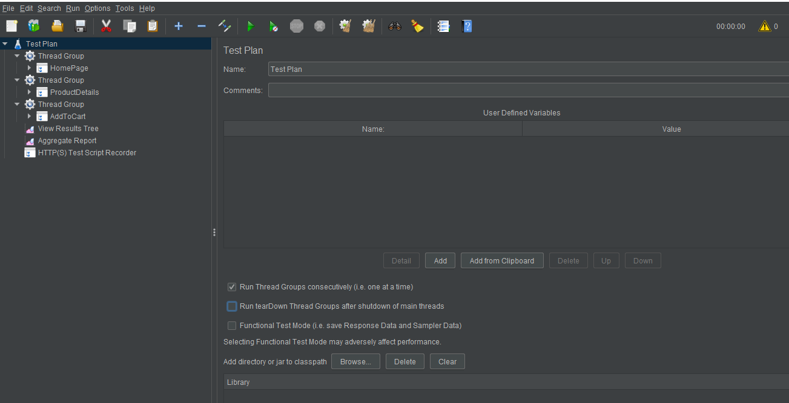
Run Thread Group

Slide 7
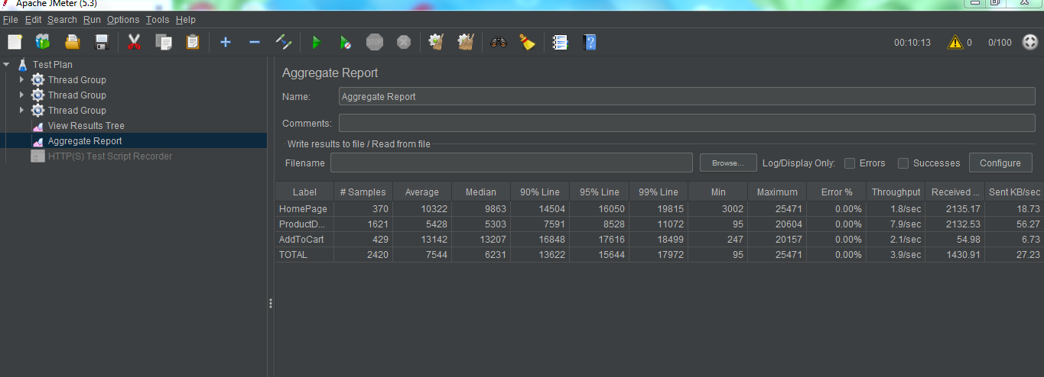
Aggregate Report

