Slide 1


अ
DEEP LEARNING · OCR
OCR for Handwritten
Devanagari Script
using Sequence Models
CNN → Bidirectional LSTM → CTC Loss
IIIT-HW-Dev Dataset · 97 Character Vocabulary · NVIDIA RTX 3050 Ti / NVIDIA QUADRO T2000
Kumar Ayush (BT23ECE032)
Devesh Dhurandher (BT23ECE040)
11.1%
Best CER Achieved

Slide 2
Motivation & Problem Statement
600M+
Devanagari
Speakers
Existing
Solutions
Fall Short
Cost &
Accessibility
Barrier
Hindi, Sanskrit, Marathi,
Nepali — all use this script.
Massive undigitized document
corpus with no OCR solution.
Google Vision & Tesseract
are not script-specific.
High error rates on
cursive handwriting.
Cloud APIs (Google, AWS)
charge per API call.
Not viable for academic
or low-resource settings.
Our Solution: A dedicated CNN + BiLSTM + CTC model trained exclusively on Devanagari handwriting — free, open, and accurate.

Slide 3
Project Workflow
01
02
03
04
05
Dataset
Acquisition
Preprocessing
& Augmentation
Vocabulary
Building
Model
Training
Evaluation
& Inference
IIIT-HW-Dev
95K word images
Devanagari script
Grayscale, resize
Blur, jitter, warp
Rotate, sharpen
94 characters
Blank token CTC
Encode / decode
CNN + BiLSTM
CTC Loss
50 epochs
CER / WER
Beam search
Plots & results
Each stage feeds directly into the next — the output of one step is the input of the next.

Slide 4
Dataset — IIIT-HW-Dev
95K+
3
69,853
12,869
Word Images
Splits
(Train / Val / Test)
Training
Samples
Test
Samples
File Structure
Annotation Format
IIIT-HW-Hindi_v1/
HindiSeg/ ← word images
HindiSeg/train/ (sub-folders)
HindiSeg/test/
HindiSeg/val/
train.txt ← 3.1 MB annotations
test.txt ← 565 KB
val.txt ← 551 KB
lexicon.txt / hindi_vocab.txt
HindiSeg/train/1/234/7.jpg दवाओं
Each line: <relative image path> <space> <Devanagari word>
Labels are UTF-8 encoded Unicode Devanagari strings.
Images are JPEG, grayscale, variable width.
Split breakdown
Split | Samples | File size
Train | 69,853 | 3.1 MB
Validation | 12,708 | 551 KB
Test | 12,869 | 565 KB

Slide 5
Preprocessing & Augmentation
Preprocessing Pipeline (all splits)
Augmentation (train split only)
1
Grayscale Conversion
Gaussian Blur
RGB → single channel L (PIL .convert('L'))
kernel=3 | p=0.30 — simulates ink blur / out-of-focus scan
Resize
Color Jitter
2
Fixed 32 × 128 px (H × W)
Preserves aspect ratio of character strokes
brightness+-0.4, contrast+-0.4 | p=0.50 — lighting variation
Random Rotation
3
ToTensor
+-4 degrees | always — natural pen tilt
PIL Image → FloatTensor [0,1]
Random Perspective
distortion=0.15 | p=0.40 — paper warp / scan angle
4
Normalize
mean=0.5, std=0.5 → values in [−1, +1]
Adjust Sharpness
factor=2 | p=0.30 — dry pen on rough paper
Augmentation increases effective dataset size and prevents overfitting to specific writing styles.

Slide 6
Model Architecture — CRNN
Input
Image
CNN
Backbone
Column
Attention
BiLSTM
×2 layers
Linear
Classifier
CTC
Loss
(B,1,32,128)
5 conv blocks
64→512 channels
Weighted
timestep focus
256 hidden
fwd + bwd
512→97
vocab size
Training
alignment
Tensor shape through the network:
(B,1,32,128)
→
(B,512,1,32)
→
(32,B,512)
→
(32,B,512)
→
(32,B,97)
CNN Detail (5 blocks):
BiLSTM Detail:
Block | Filters | Pool | Output H×W
1 | 64 | 2×2 | 16 × 64
2 | 128 | 2×2 | 8 × 32
3 | 256 | 2×1 | 4 × 32
4 | 512 | 2×1 | 2 × 32
5 | 512 | 2×1 | 1 × 32 ← height collapsed
Input size | 512 (CNN feature width)
Hidden size | 256 per direction
Directions | Forward + Backward
Layers | 2 stacked
Output | 256×2 = 512 per timestep
Dropout | 0.3 between layers
Total params | ~4.75 Million

Slide 7
CTC Loss — Connectionist Temporal Classification
What is CTC?
How We Implement CTC
The core problem: Our model outputs 32 predictions (one per column), but each word has only 3–12 characters. How do we train without per-pixel alignment? CTC solves this by allowing the model to predict blank tokens (−) and repeat characters, then collapsing the sequence. No manual segmentation needed.
Loss function:
nn.CTCLoss(blank=0, reduction='mean',
zero_infinity=True)
Blank token:
Index 0 in vocabulary (reserved)
Input format:
log_probs: (T=32, B, V=94)
input_lens: [32,32,...] per sample
Label format:
Flat concatenated tensor
label_lens tells CTC where each ends
Decoding:
Greedy: argmax → collapse repeats
Beam: width=10, pure Python
Example: predicting 'राम' (3 chars)
र
र
−
−
ा
ा
म
म
म
−
र
ा
म
→
Raw output (32 timesteps shown as 10)
Decoded: राम ✓
CTC Loss = −log P(y | x) summed over all valid alignments

Slide 8
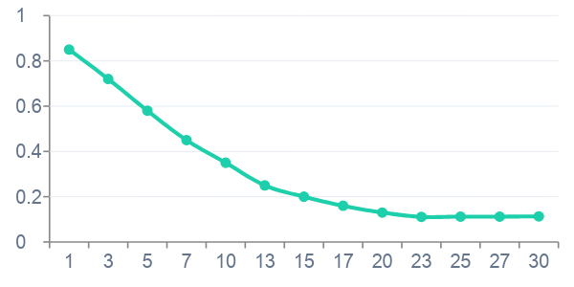
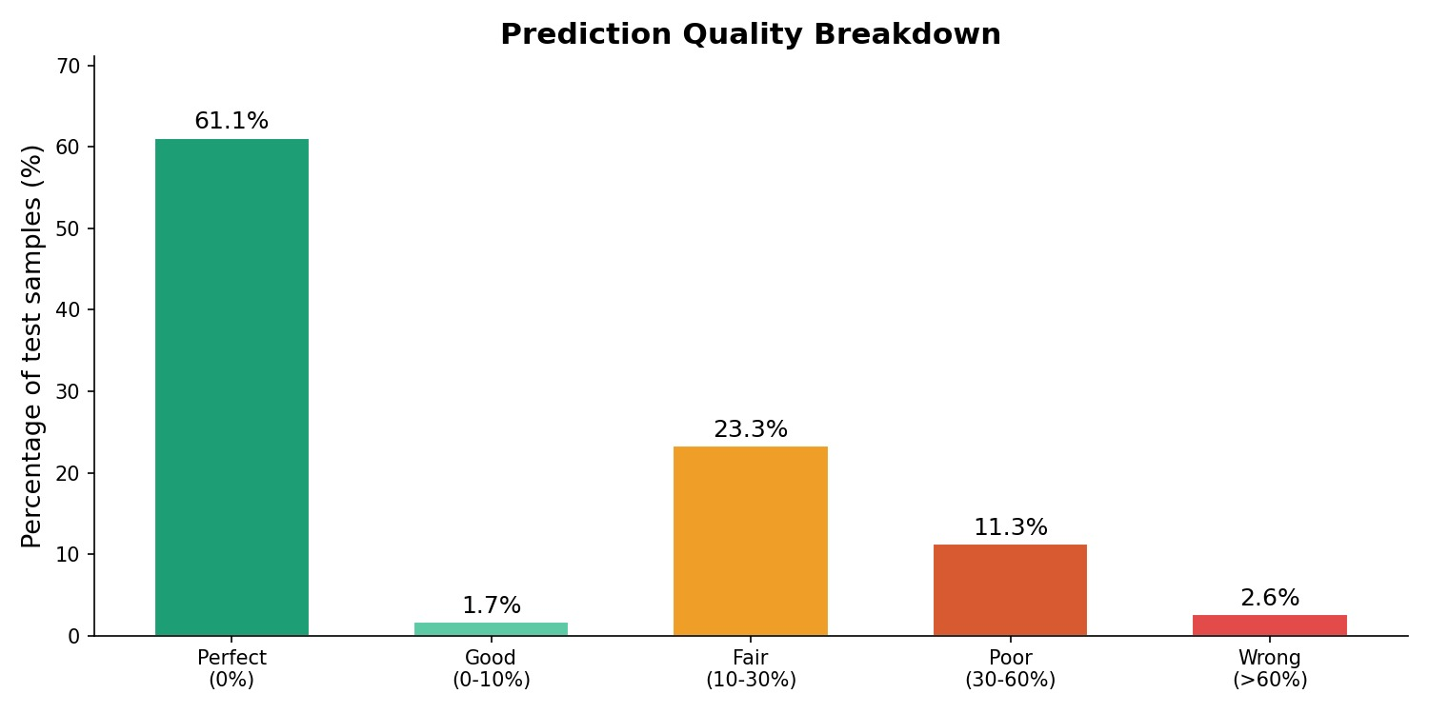
Results & Evaluation
11.1%
38.0%
62.0%
~9%
Best CER
(Greedy)
Word Error
Rate (WER)
Exact Word
Match
CER with
Beam Search
Epoch 23
Greedy decode
7,980 / 12,869
width = 10
Validation CER per Epoch (greedy decoding)
Prediction Quality Breakdown (beam search)

Slide 9
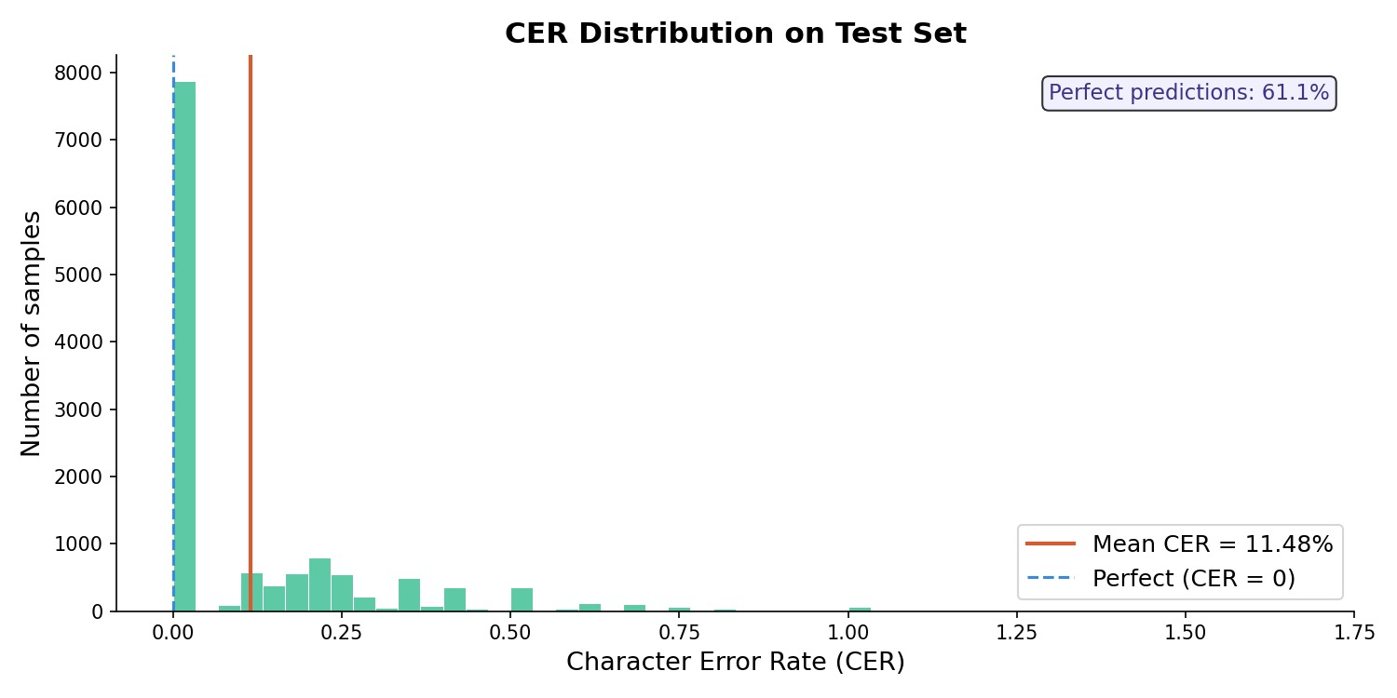
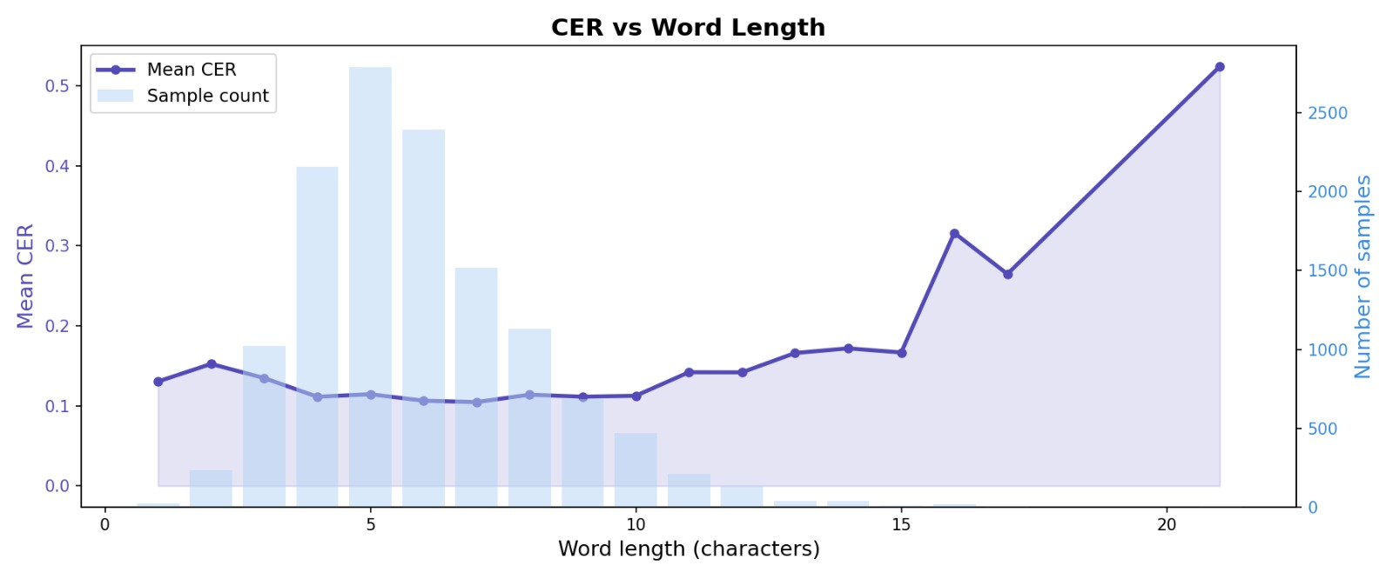
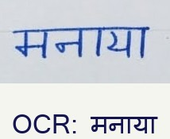
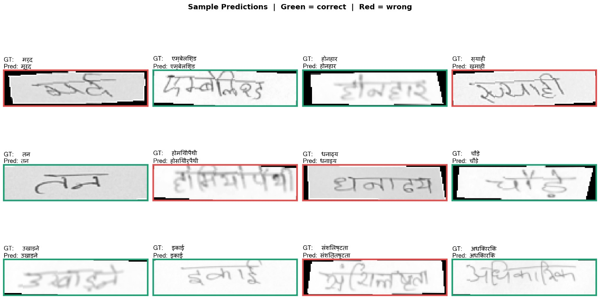
Results & Evaluation
Results with some Input
Sample prediction

Slide 10
Conclusion & Future Work
What We Achieved
Future Work
Built a fully custom OCR pipeline for Devanagari from scratch
Transformer Backbone
Replace BiLSTM with self-attention
(TrOCR-style) for better long-range context
11.1% CER on 12,869 test samples — no pre-trained backbone
Lexicon-guided Decoding
Constrain beam search to dictionary
words for lower WER
62% exact word match using greedy decoding
Line-level Recognition
Extend from word-level to full
handwritten line OCR
Beam search decoding brings CER down to ~9% post-training
Data Synthesis
Generate synthetic Devanagari words
to increase training diversity
4.75M parameter model — lightweight and deployable
Mobile Deployment
Export to ONNX / TFLite for
on-device inference
Trained entirely on IIIT-HW-Dev — under 3 hours on RTX 3050 Ti
"A small but dedicated model, trained right, outperforms a generic one trained on everything."

