Slide 1
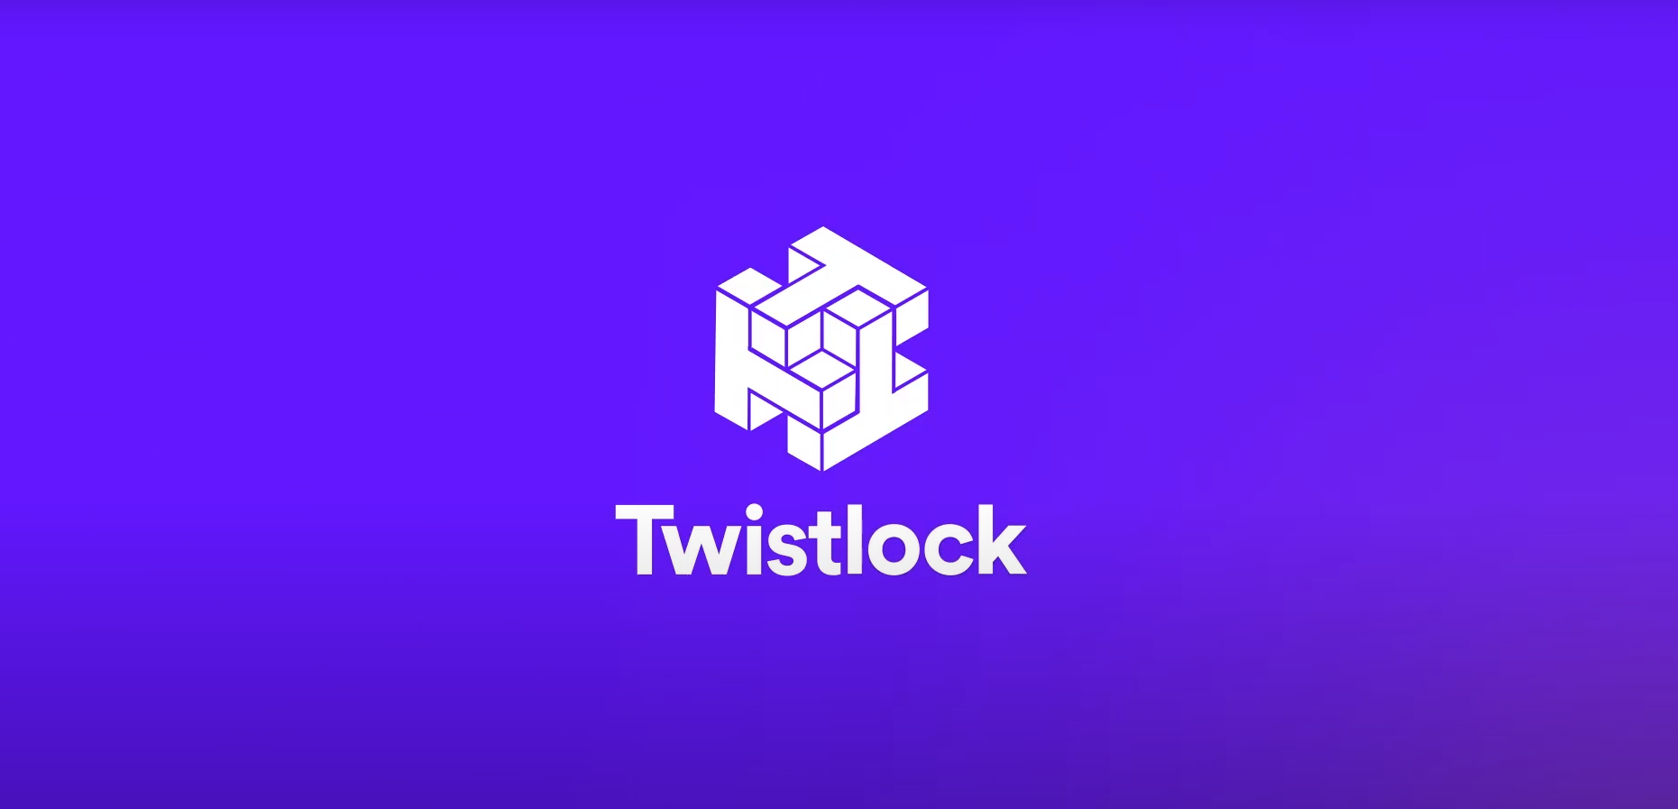

Slide 2
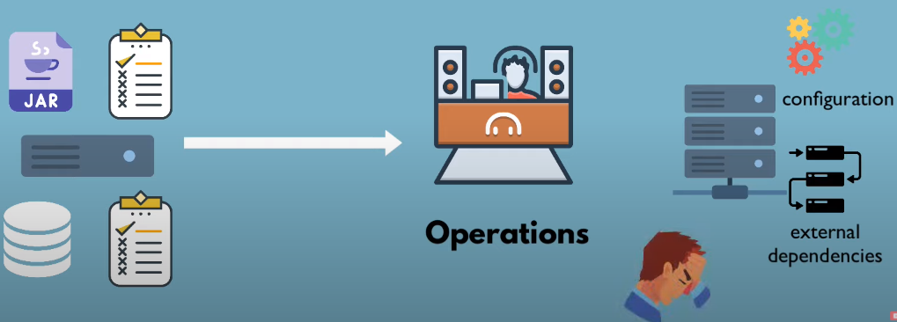
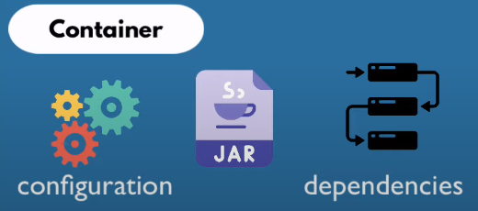



Slide 3


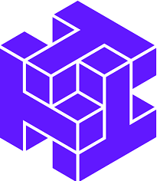
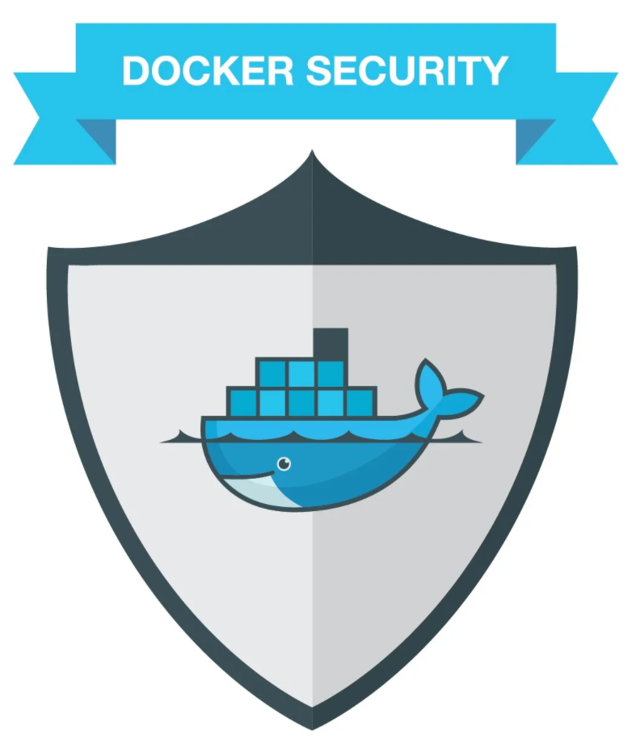
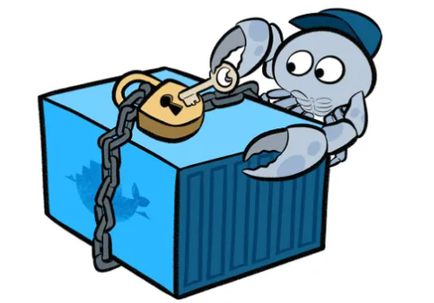

Slide 4
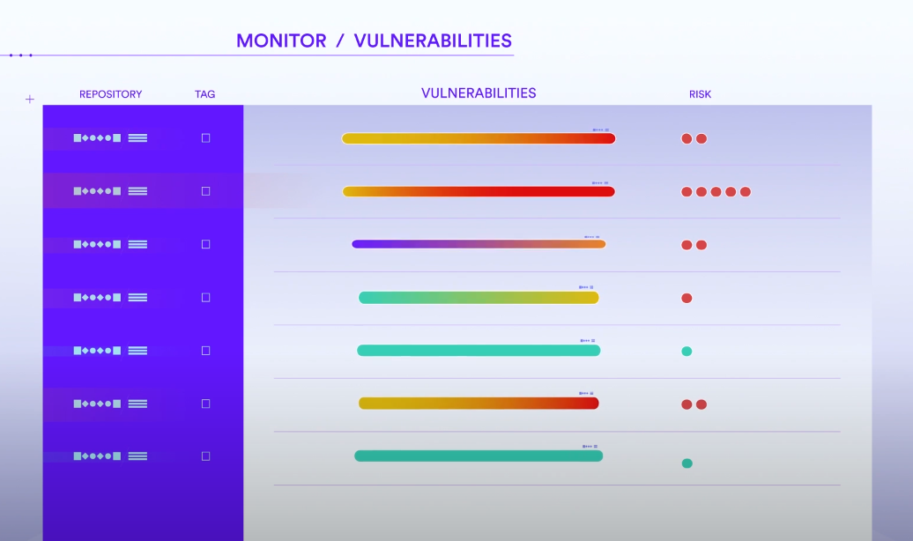

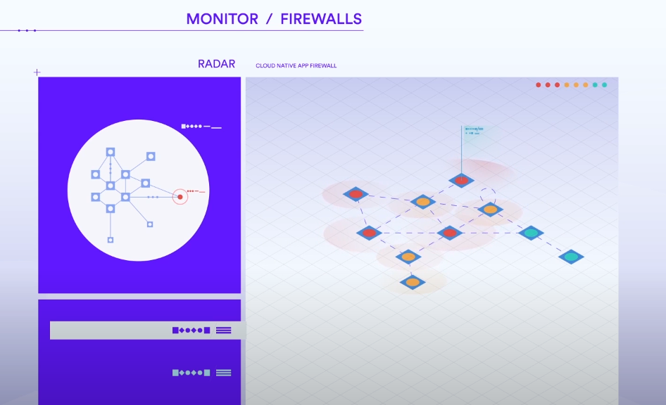

Slide 5
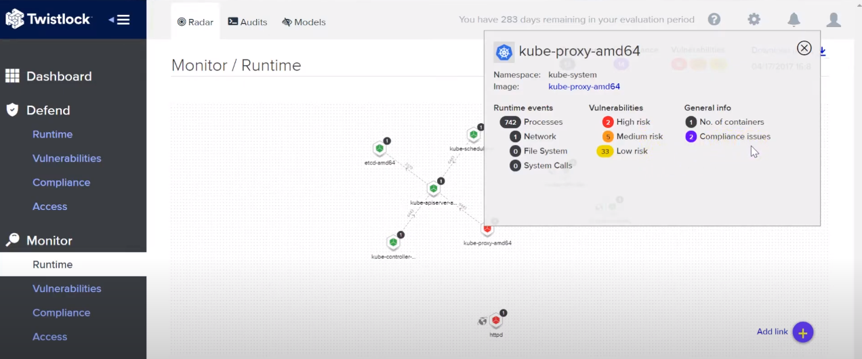

Slide 6
Twistlock provides deep insight into vulnerability management with cloud native intelligence and knowledge about your runtime deployments to create risk scoring that’s specific to your applications.
The Twistlock Platform provides vulnerability management and compliance across the application lifecycle by scanning images and serverless functions to prevent security and compliance issues from progressing through the development pipeline, and continuously monitoring all registries and environments.
Additionally, Twistlock provides defense in depth, with access control; automated, machine-learning driven runtime defense; and cloud native firewalls to protect modern applications from threats.
Twistlock is the full-lifecycle container and cloud-based cyber security for teams using dockers, Kubernetes, serverless and other native cloud technologies.
Twistlock helps organizations monitor, achieve and enforce compliance for containers and native cloud environments.
The Twistlock Cloud Native Cybersecurity Platform provides full lifecycle security for containerized environments.

