Slide 1
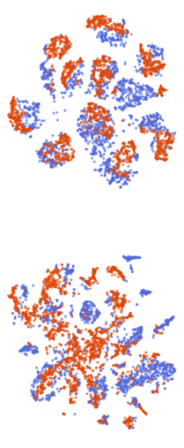

Learning Domain Invariant Features for Question Answering
Primary Team ID: 17
Code

Slide 2
Task Overview
Open Domain QA
Extractive QA
Domain Adaptation

Slide 3

Task Overview
Open Domain QA
Extractive QA
Domain Adaptation

Slide 4
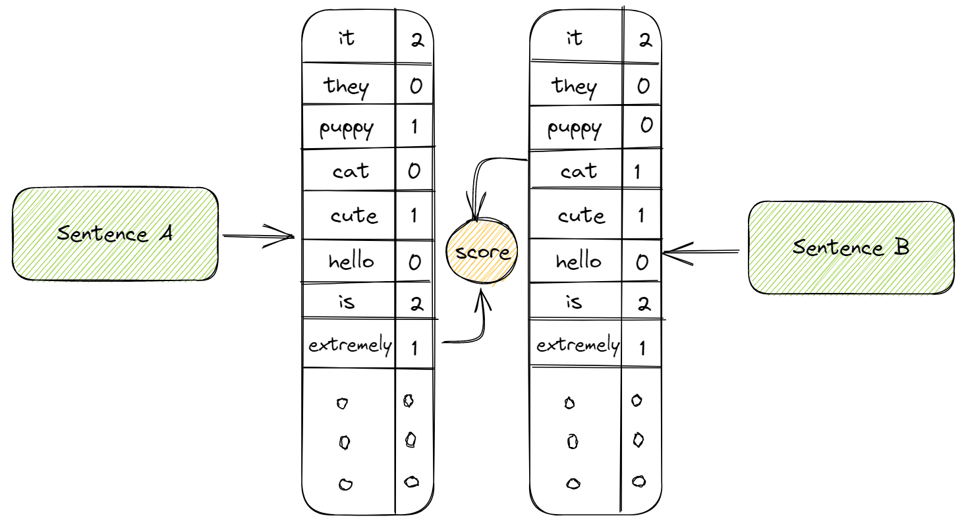
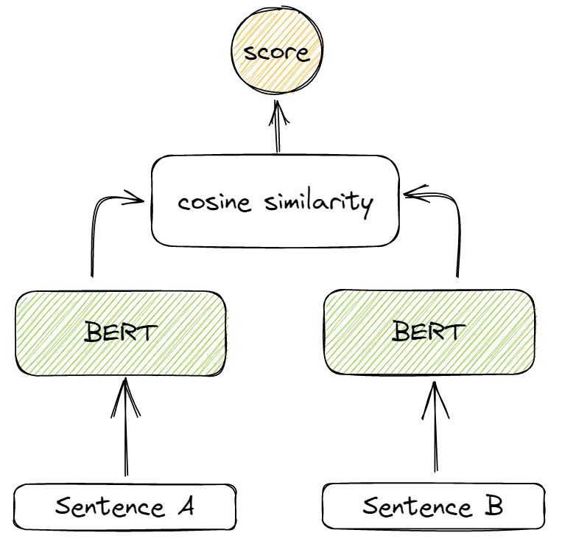
The Retriever
Lexical
BM25 Scores
Semantic
MPNet Embeddings

Slide 5
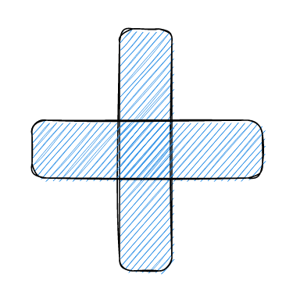
The Retriever

Slide 6
The Retriever
Approach | Top1 acc. | Top5 acc.
multi-qa-mpnet-base | 63.57 | 88.4
BM25 | 58.57 | 79.82
multi-qa-mpnet-base + BM25 | 70.67 | 89.63

Slide 7

Task Overview
Open Domain QA
Extractive QA
Domain Adaptation

Slide 8
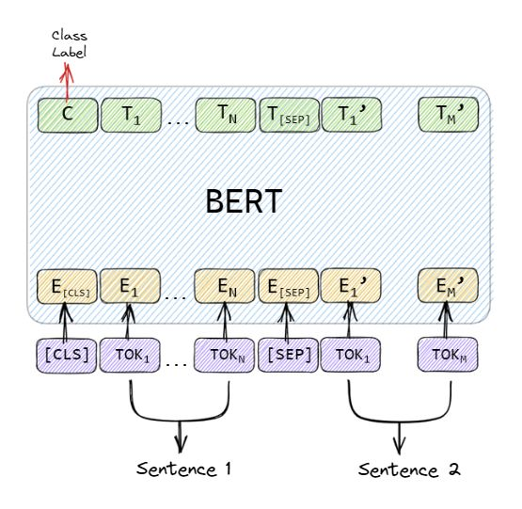
The Reader
Architecture | F1 | EM
BERT-base | 74.67 | 71.15
ELECTRA-base | 81.71 | 77.60
DeBERTa-v3-base | 87.41 | 83.82

Slide 9

Task Overview
Open Domain QA
Extractive QA
Domain Adaptation

Slide 10
Towards Domain Invariance
Adversarial Adaptation
Contrastive Adaptation
Synthetic Question Generation
Pseudo Labelling

Slide 11
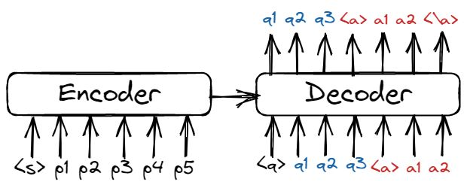
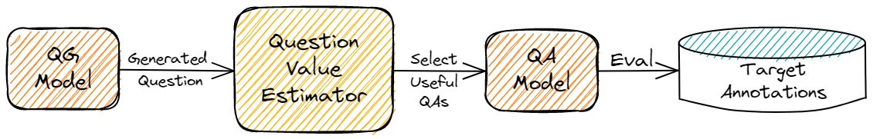
Synthetic Question Generation
QAGen-T5
Question Value Estimation

Slide 12
Question Generation: Critical Analysis
Number of Synthetic Questions Required
Effectiveness of Synthetic and Real Questions
Evaluation: SQuADV2 dev as target domain
Approach | F1 | EM
CAQA (5k train subset pairs) | 50.07 | 46.78
CAQA (5k synthetic pairs ) | 31.70 | 26.33
BERT-base pretrained model checkpoints finetuned on question answer pairs

Slide 13
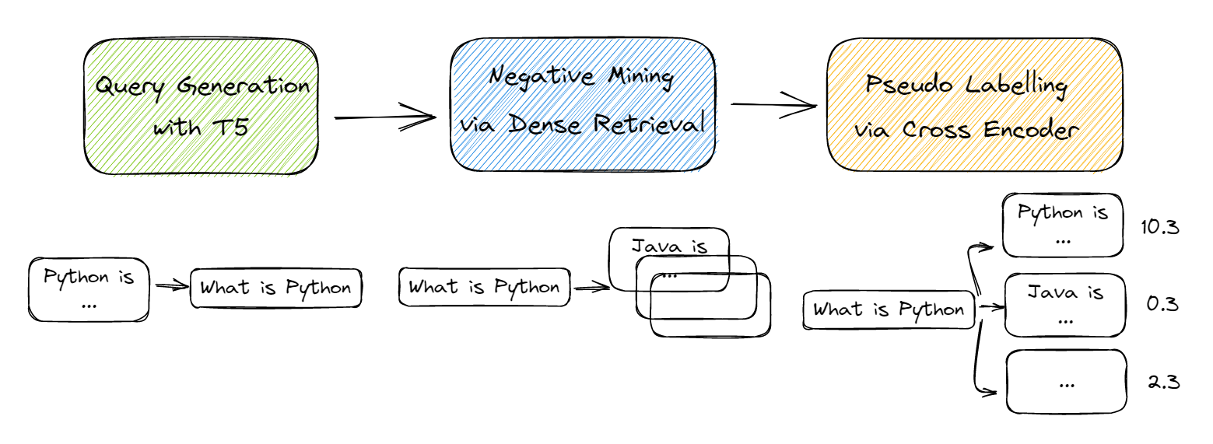
Domain Adaptation: Retriever
Generative Pseudo Labelling

Slide 14
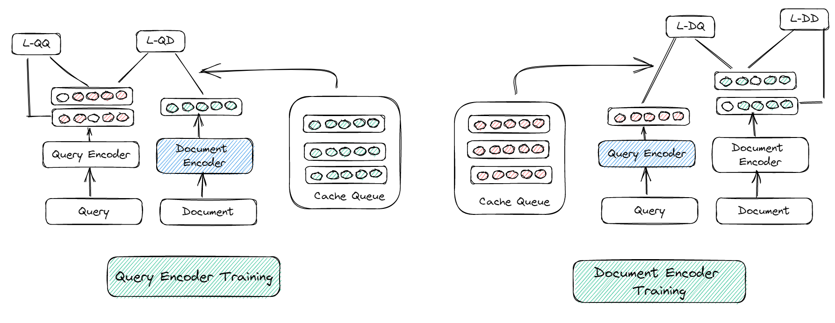
Domain Adaptation: Retriever
LaPraDoR

Slide 15
Domain Adaptation: Retriever
Approach | Top1 acc. | Top5 acc.
multi-qa-mpnet-base | 63.8 | 88.4
GPL (multi-qa-mpnet-base) | 66.5 | 86.4
LaPraDoR (checkpoint not trained on SQuADv2 retrieval) | 51.2 | 79.9
Why?

Slide 16
Domain Adaptation: Retriever
MPNet used is trained on datasets spanning across various domains for paragraph retrieval tasks
Train dataset consisted of 215M paragraph query pairs. For comparison, SQuADV2 consists of 0.15M paragraph question answer pairs

Slide 17
Domain Adaptation: Reader
CAQA: Uses contrastive losses with generated question answer pairs
QADA, QC4QA: State of the art approaches that pseudo label question paragraphs pairs instead of using generated questions
CAQA*: Same objective function as CAQA but using pseudo labelling rather than generating synthetic data
Approach | HotspotQA | NaturalQ | NewsQA | SearchQA | TriviaQA
BERT zero shot | 60.42 | 53.70 | 56.14 | 25.03 | 59.09
BERT (10k annotated paragraphs) | 66.56 | 68.10 | 61.85 | 66.96 | 60.73
CAQA (10k synthetic) | 61.57 | 62.60 | 55.90 | 42.94 | 63.23
CAQA* | 64.76 | 60.52 | 60.83 | 41.07 | 62.98
QC4QA | 66.10 | 62.98 | 61.71 | 44.37 | 64.57
QADA | 65.75 | 65.00 | 61.84 | 48.76 | 65.86

Slide 18
Domain Adaptation: Reader
Approach | F1 | EM
BERT-Base zero shot | 74.67 | 71.15
CAQA (Synthetic – QAGen-T5-base) | 72.42 | 68.91
CAQA (No Synthetic Data) | 76.27 | 72.87
QADA (4 epochs) | 76.50 | 73.23
Approach | F1 | EM
DeBERTa-v3-Base zero shot | 87.41 | 83.83
CAQA (Synthetic – QAGen-T5-base) | 86.12 | 82.68
CAQA (No Synthetic Data) | 88.93 | 85.07

Slide 19
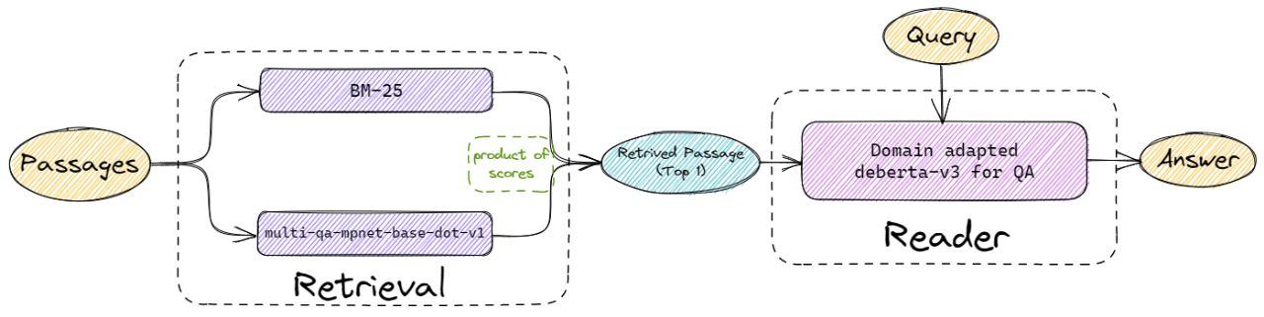
Final Pipeline
Approach | DevRev Metric (SQuADV2 Dev)
Retriever: MPNet + BM25 Reader: DeBERTa-v3-Base CAQA (No Synthetic Data) | 79.03

Slide 20
Future Directions
Explore QA Generation algorithms
Extensive evaluations for Phrase Retrieval approaches
Active Learning for query efficient learning on generated questions

Slide 21
Thank You :)

