Slide 1
T H E 80/20 Rule
The majority of the work you are going to do with AngularJS will fall within a core set of AngularJS components.

Slide 2
B U I LD A strong AngularJS Foundation
The AngularJS players
$compile
$digest and $apply
Model View Whatever
Controller and $Scope
View and Templates
Models and Services
Routes

Slide 3

Why use Angular?
What are the key factors in building a line of business application?
How is a line of business application built with Angular?

Slide 4







Slide 5

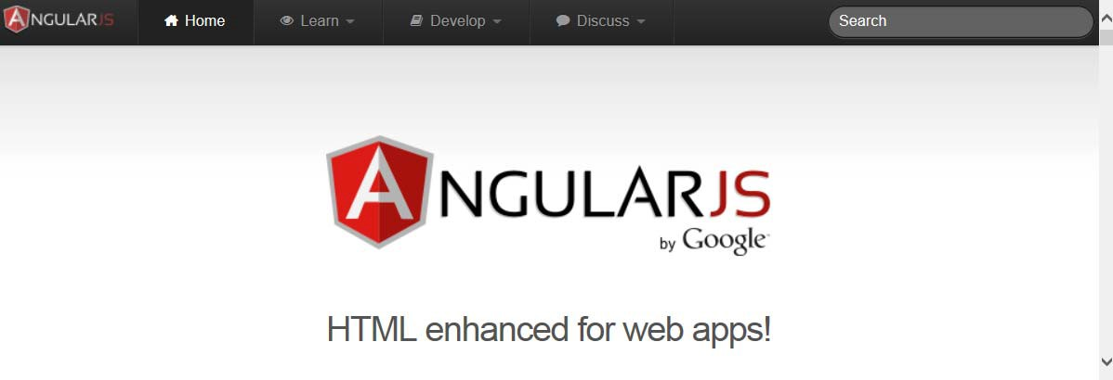
A client-side JavaScript framework for building interactive Web applications
Brings simple/clean back to complex Web applications
Originally developed by Google
Now open source
http://angularjs.org/

Slide 6
Why Angular?
Expressive HTML
Modularity
Rule-based Navigation
Powerful Data Binding
Testable
It’s Popular

Slide 7

What Are the Key Factors in Building a Line of Business Application?
Data is an Asset

Slide 8
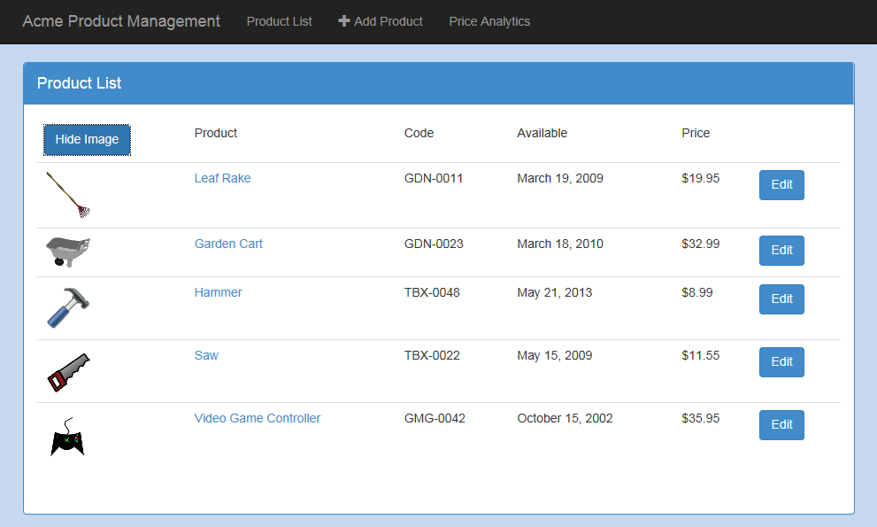
Data is an Asset
Amount of Data is Significant

Slide 9
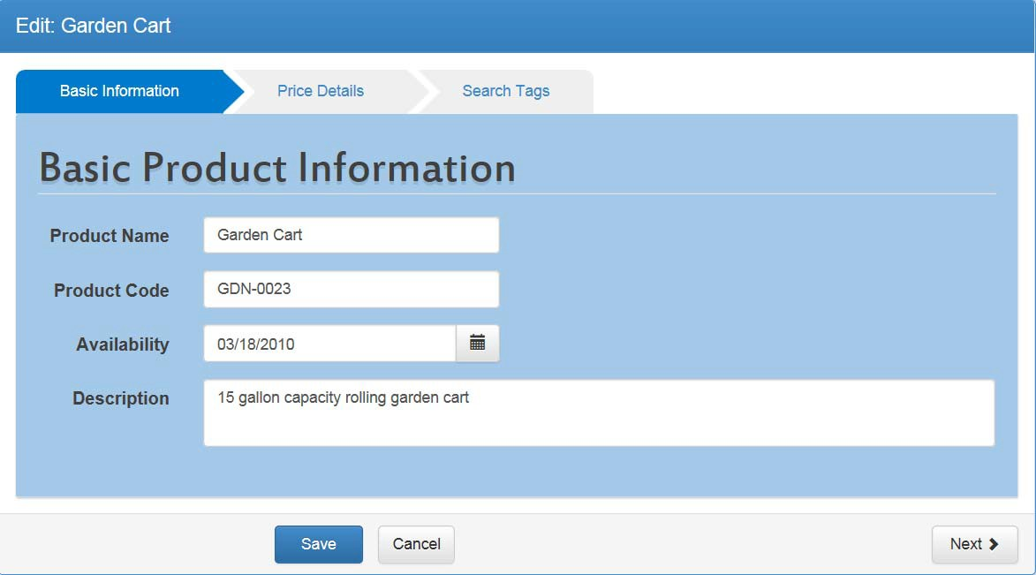
Data is an Asset
Amount of Data is Significant
Number of Data Fields is Significant

Slide 10
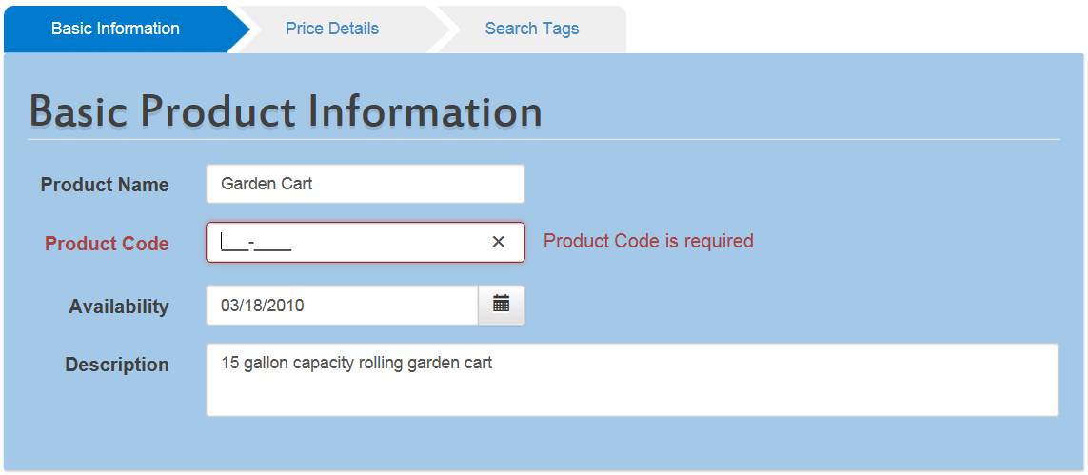
Data is an Asset
Amount of Data is Significant
Number of Data Fields is Significant
Data Integrity is Critical

Slide 11
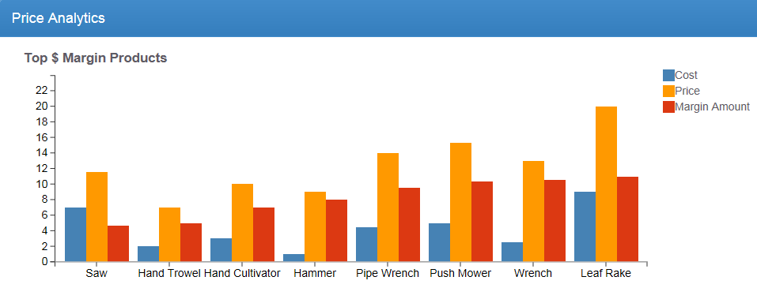
Data is an Asset
Amount of Data is Significant
Number of Data Fields is Significant
Data Integrity is Critical
Data Visualization

Slide 12

Business Requirements
Layout and Navigation
Data Access
Data Entry Forms Business Logic Data Visualization
Application Features
Design Considerations
Architecture
Page Layout (View)
Style (Bootstrap)
Navigation (Routing)
Retrieving data
Saving data
Form layout
Validation
Submittal
Services
Charts
Security
Unit Testing Exception Handling

Slide 13
Prerequisites
HTML
< ! DOCTYPE htm l >
<htm l >
<head l ang= " en">
<me t a
char se t= " UTF-8 ">
< t i t l e> Produc t
</head>
Management</ t i t l e>
<body>
</body>
</htm l >

Slide 14
HTML
CSS
< i mg s r c= " i mages/ l ogo . png"
s t y l e= " w i dth : 50px ; marg i n : 20px" />
<d i v c l ass= " pane l -head i ng"
t i t l e="Product Management" >< d i v>
/

Slide 15
HTML
CSS
JavaScript
var show I mage =
f a l se ;
func t i on
togg l e I mage () {
show I mage =
!show I mage ;
}

Slide 16
HTML
CSS
<d i v
ng- repea t=
JavaScript
" produc t i n produc t s ">
<d i v>
{{ produc t . produc t Name }}
</d i v>
<d i v>
{{ produc t . desc r i p t i on }}
</d i v>
</d i v>
AngularJS

Slide 17
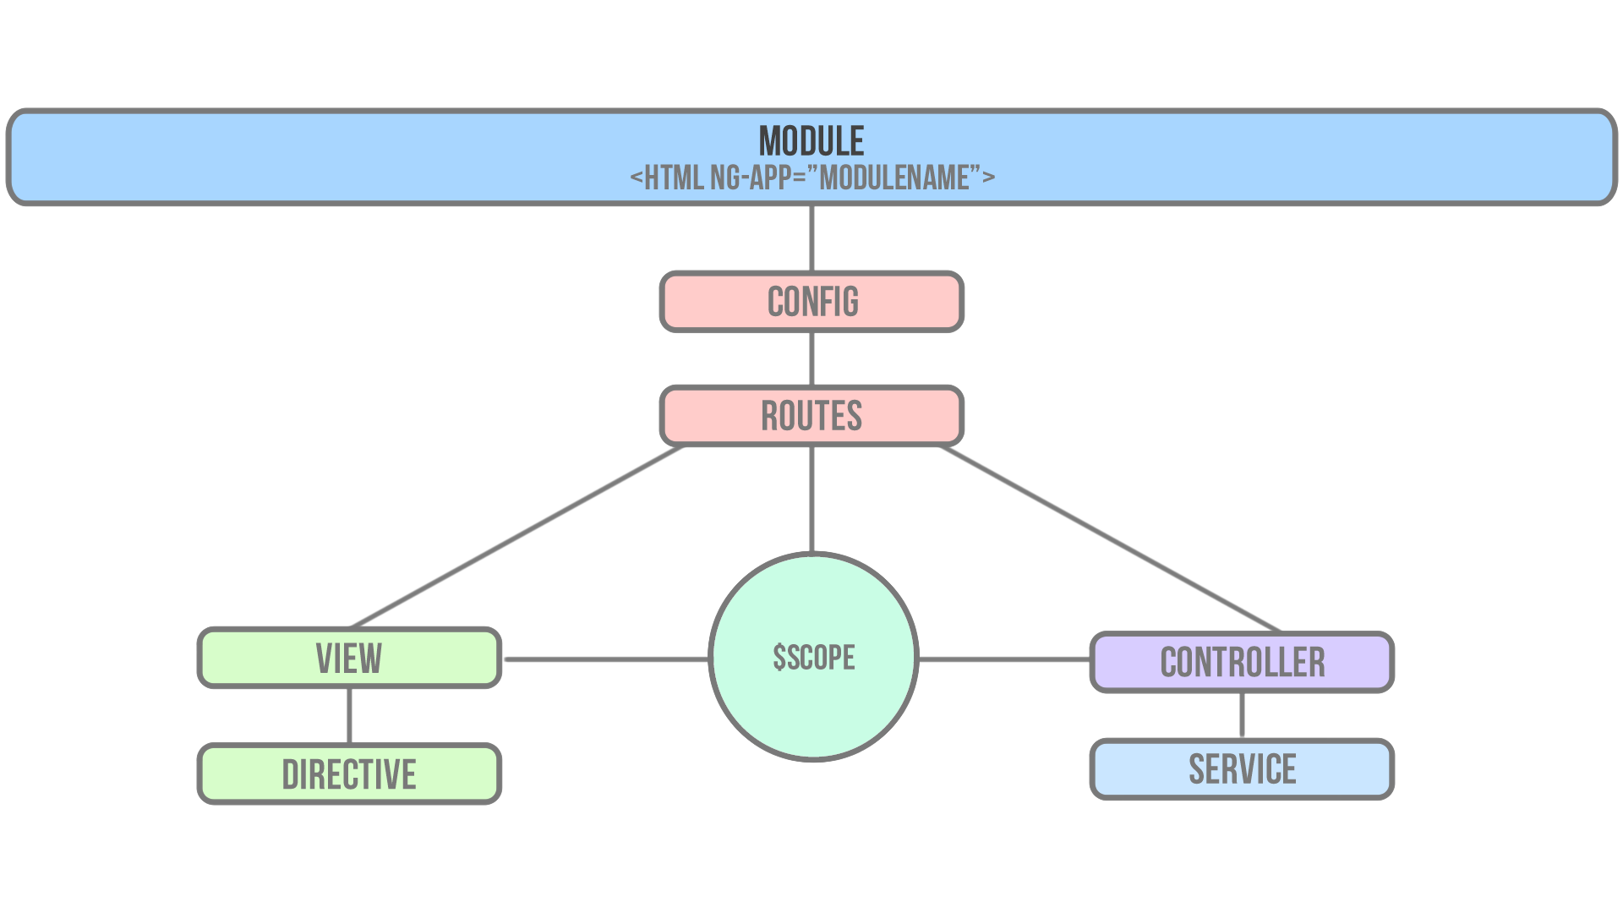

Slide 18
$Compile
$compile compiles DOM into a template function that can then be used to link scope and the View together

Slide 19
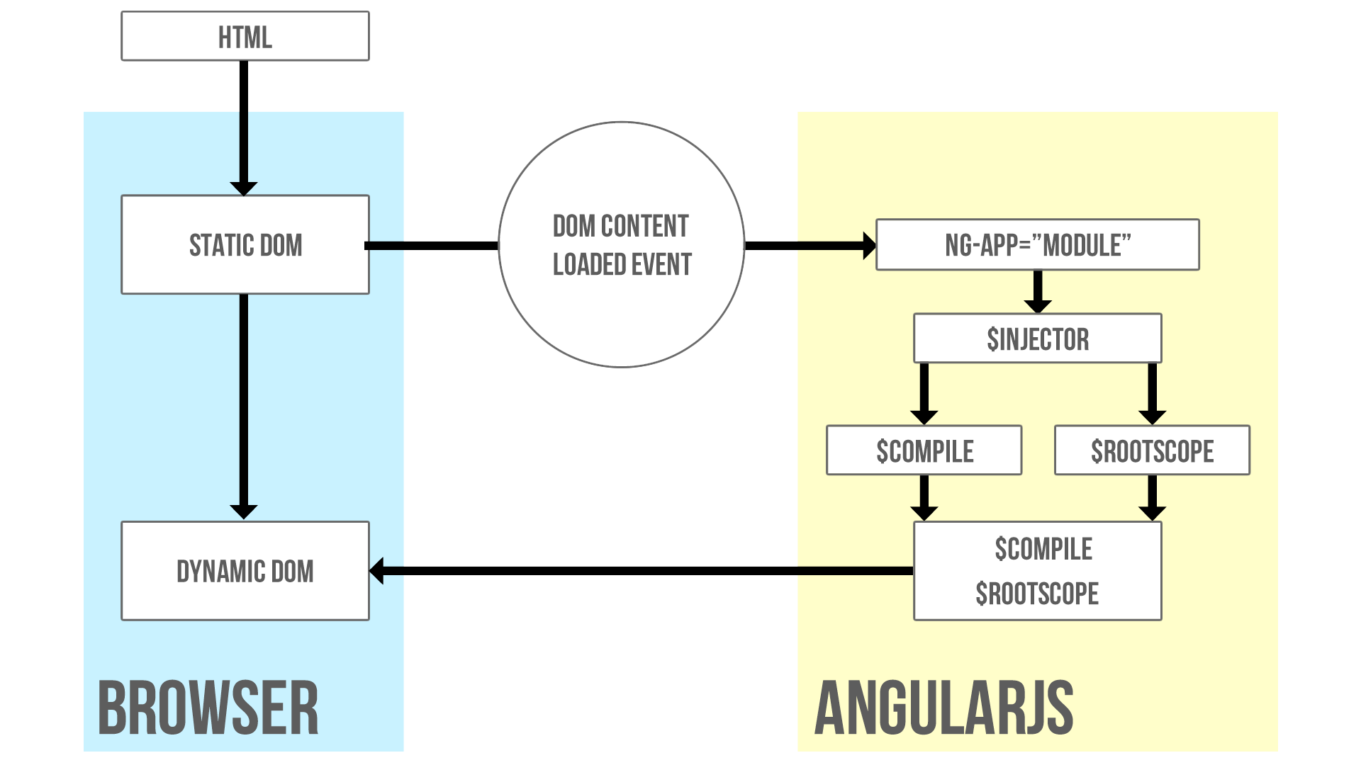

Slide 20
$ d i g e s t and $apply
$digest processes all of the watchers of the current scope
$apply() is used to notify that something has happened outside of the AngularJS domain
$apply forces a $digest cycle

Slide 21
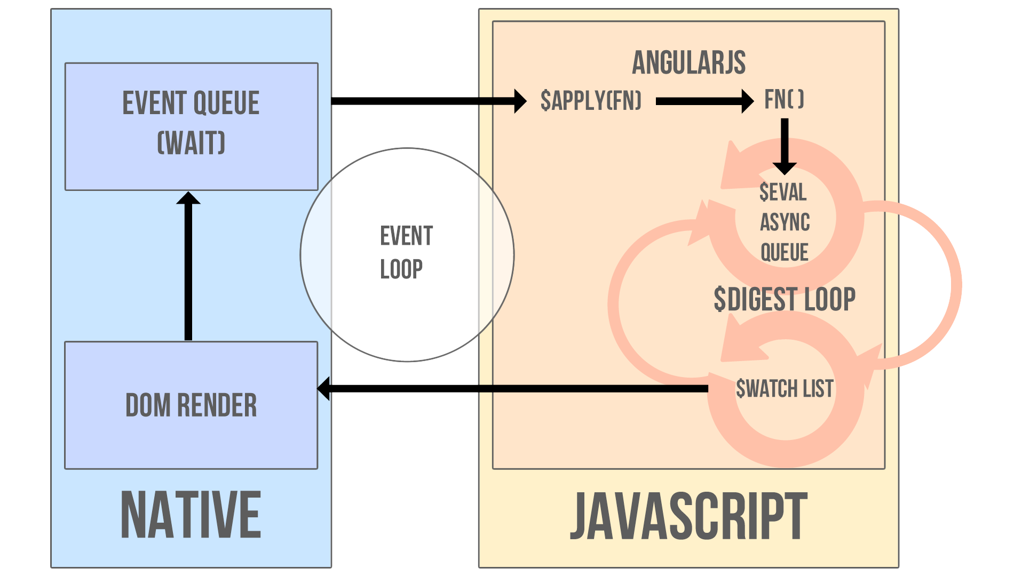

Slide 22
M V W h a t e v e r
Choose whichever pattern helps you be more productive

Slide 23
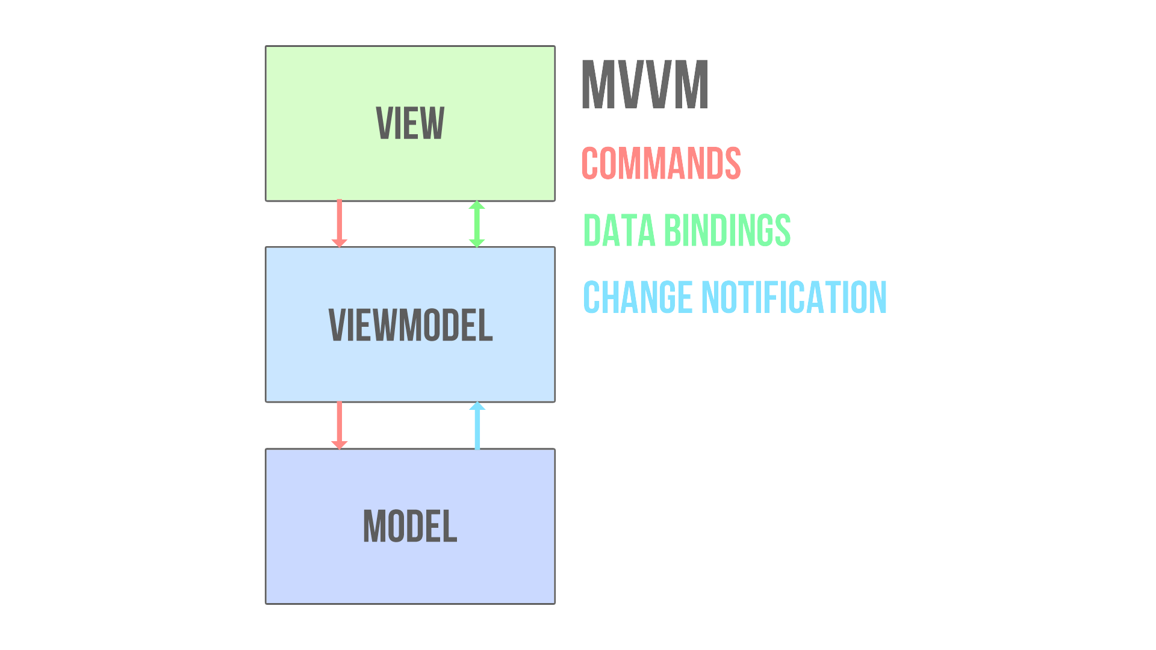

Slide 24
Controller and $Scope
$scope is the glue between the Controller and the View The Controller is responsible for constructing the model on
$scope and providing commands for the View to act upon
$scope provides context

Slide 25
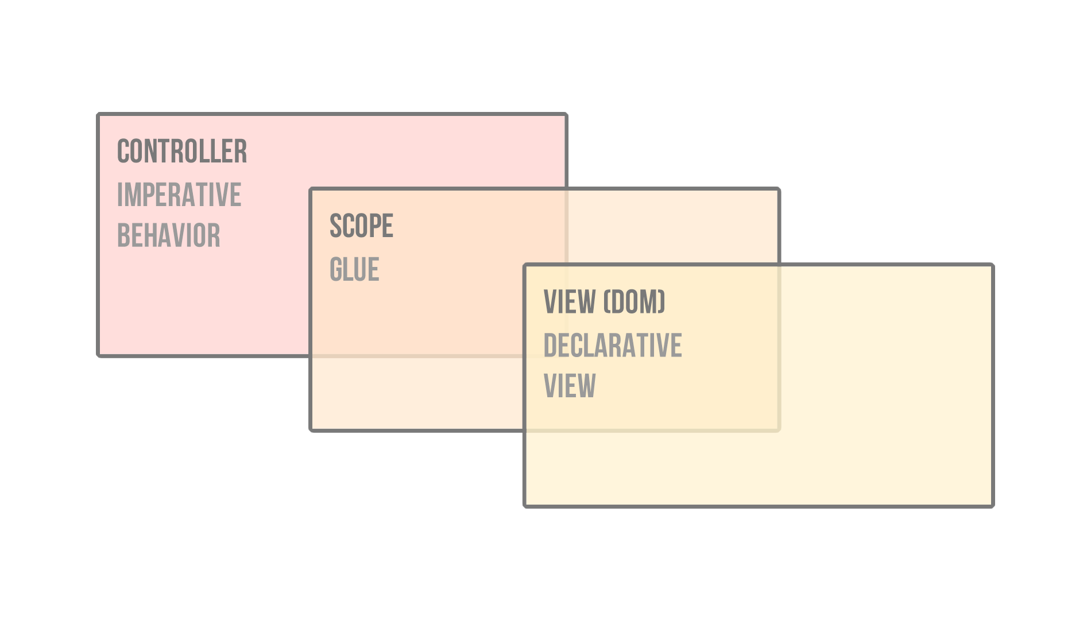

Slide 26
Best P R A C T I C E S
Controllers should...
Not know Anything about the view they control be small and focused
Should not talk to other controllers Should NOT own the domain model

Slide 27
V I E W and Template
The View is AngularJS compiled DOM
The View is the product of $compile merging the HTML template with $scope
DOM is no longer the single source of truth.

Slide 28
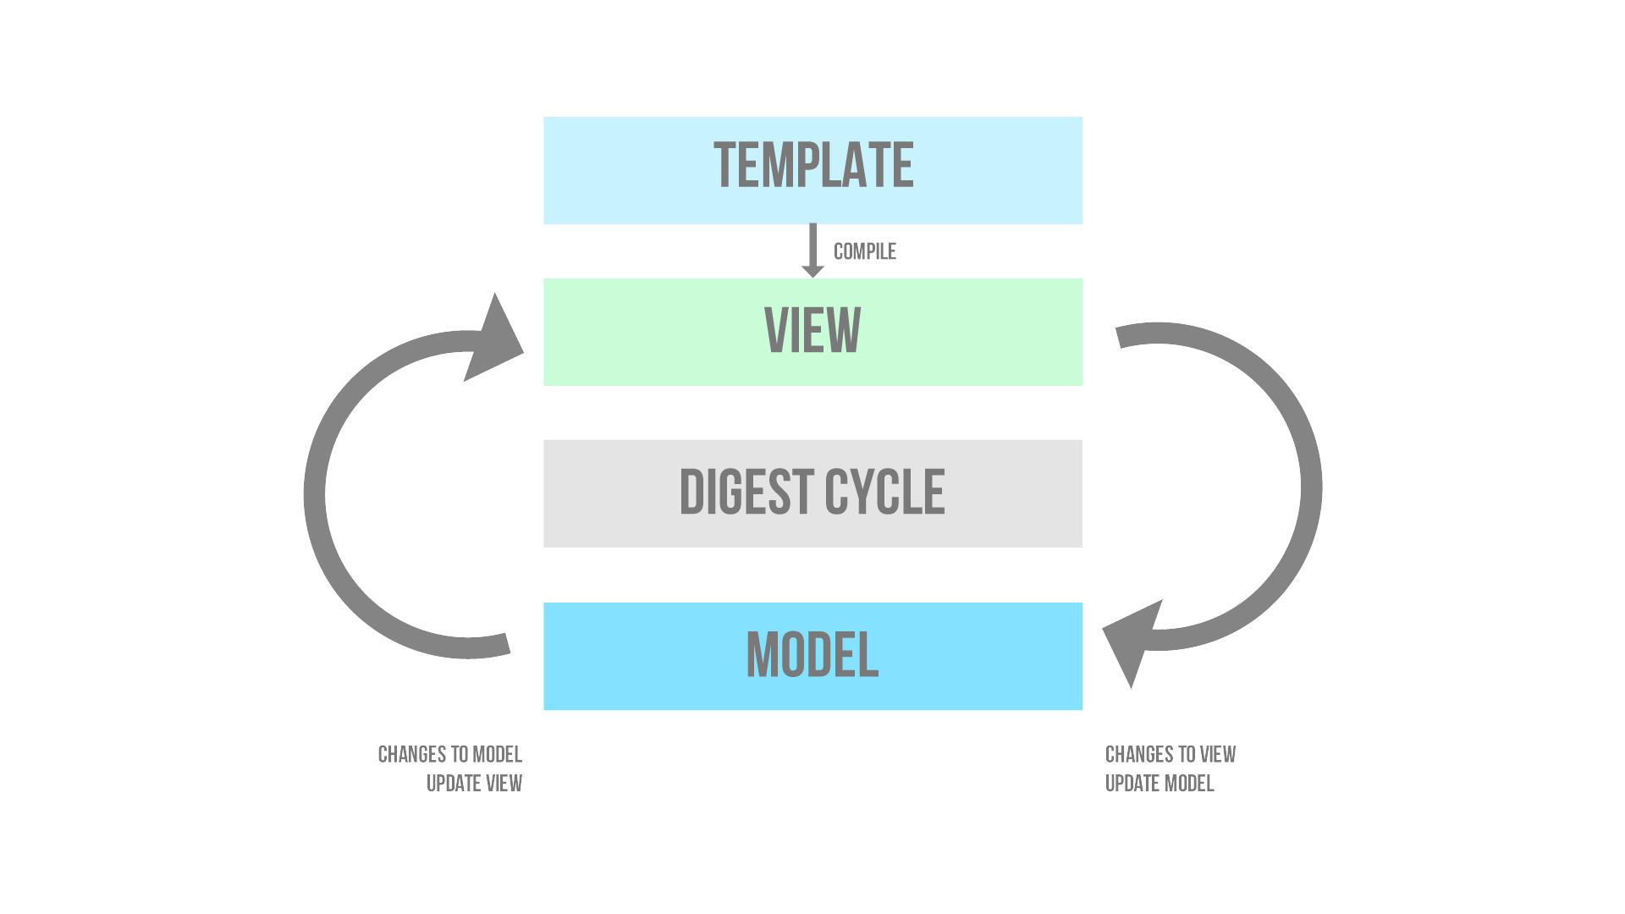

Slide 29
model and Services
Services carry out common tasks specific to the web application
Services are consumed via the AngularJS Dependency Injection subsystem
Services are application singletons Services are instantiated lazily

Slide 30
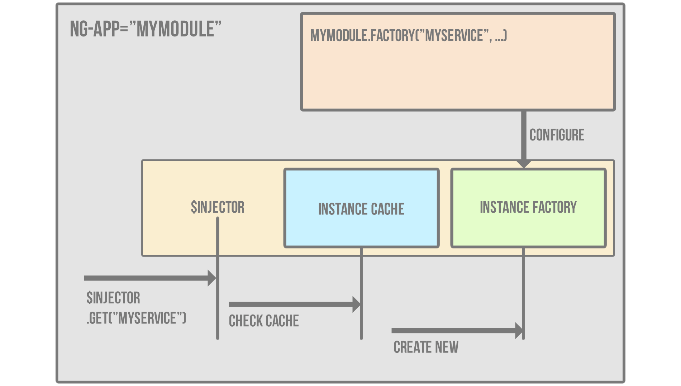

Slide 31
Routes
$route is used for deep linking URLs to Controllers and Views Define routes using $routeProvider
Typically used in conjunction with ngView directive and
$routeParams service

Slide 32
AngularJS Directive Basics
Directives as a DSL
The Simplified World View
Directive Definition Object
The Controller Function
The Link Function

Slide 33
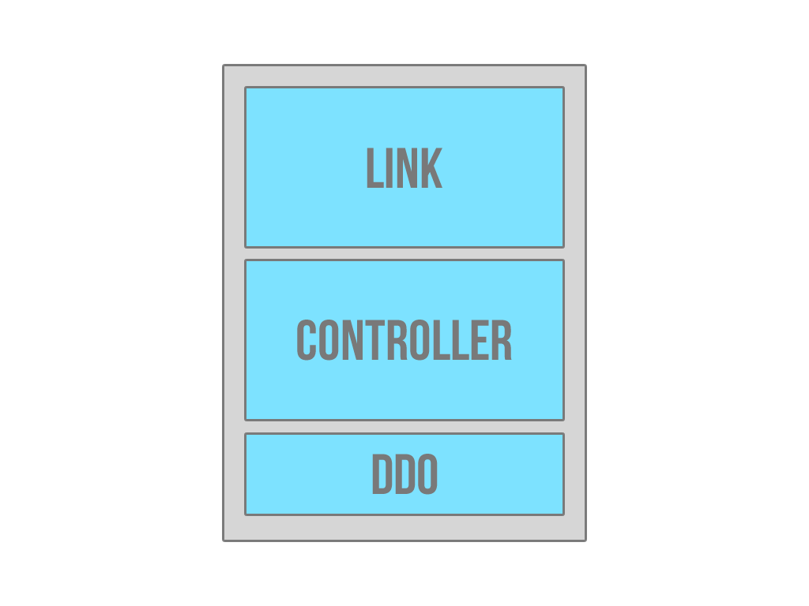

Slide 34
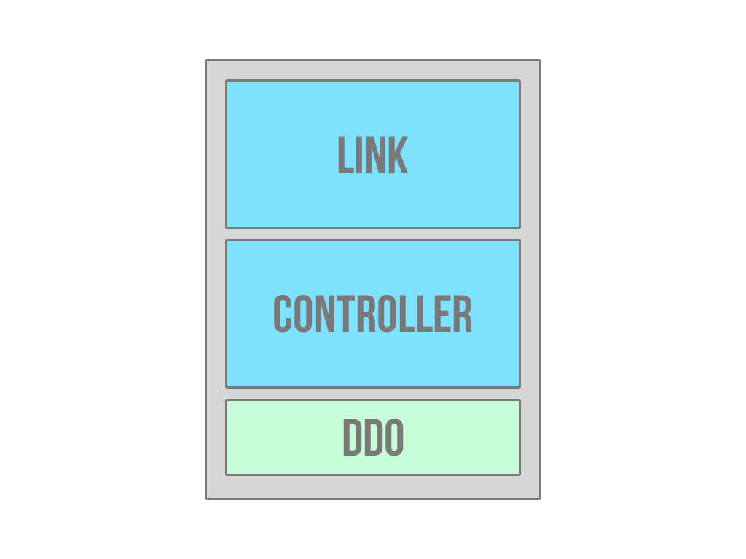

Slide 35
DirectIVE definition object
The Directive Definition Object (DDO) tells the compiler how a directive is supposed to be assembled
Common properties are the link function, controller function,
restrict, template and templateUrl

Slide 36
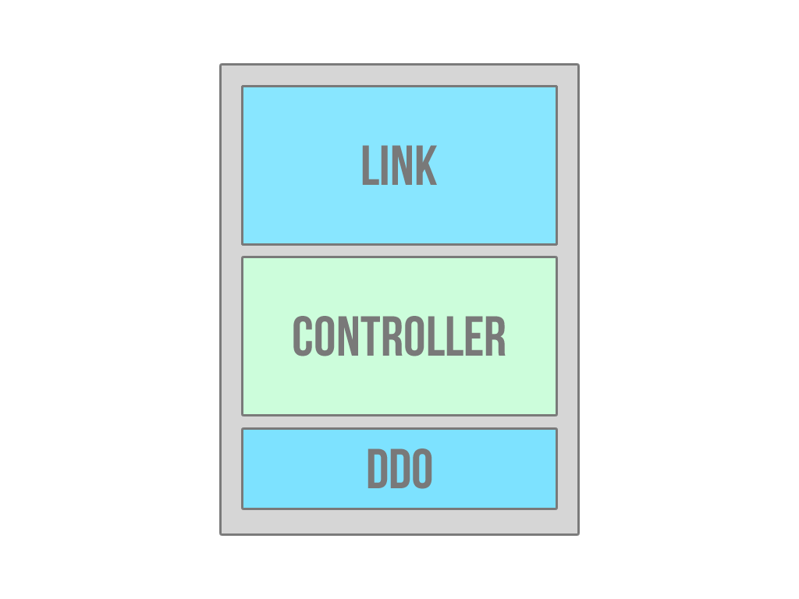

Slide 37
The controller function
The controller is constructed during the pre-linking phase Receives $scope which is the current scope for the element

Slide 38
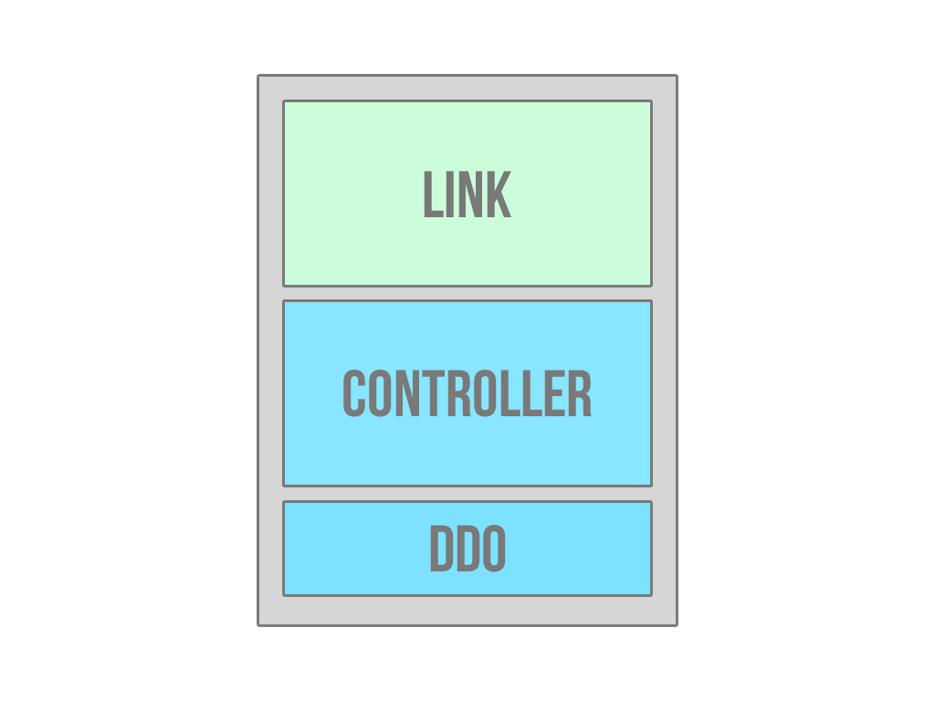

Slide 39
The link function
The link function is where DOM manipulation happens The link function comes with scope, element and attrs scope is the the same $scope in the controller function
element is a jQuery* instance of the DOM element the directive is declared on
attrs is a list of attributes declared on the element

Slide 40
Simple directive
Boards directive.

Slide 41
Simple directive with jquery
jQuery Transmit

Slide 42
The animation Naming Convention
The pattern is [class][event][destination] and stack on each other
.repeat-item.ng-enter.ng-enter-active
.my-elm.ng-hide-add.ng-hide-add-active
.my-animation.CLASS-add.CLASS-add-active

Slide 43
CSS transitionS
The easiest and fastest way to attach animations Support by every browser except for IE9 and below
As long as the matching CSS class is present then AngularJS will pick up the animation

Slide 44
css Animations
More extensive than transitions
Supported by every browser except IE9 and below
Does not require the destination class styling aka -active class

Slide 45
Javascript Animations
Allows for more control over your animations Define your animations with the animation service Naming convention is still class based
Make sure to call the done() function when the animation is over

