Slide 1

Heart Disease Prediction using Machine Learning
Parth Navadiya
Narender Kumar
B.Sc. Artificial Intelligence
Deggendorf Institute of Technology

Slide 2
Presentation Outline
Motivation
Dataset Overview
Data Exploration
Machine Learning Evaluation Pipeline
Model Development
Experimental Results
Discussion
Conclusion

Slide 3
Motivation
Why Heart Disease Prediction?
Leading cause of death worldwide
Early detection improves treatment
Machine Learning can support clinical decision-making

Slide 4
Dataset Overview
Property | Description
Dataset | BRFSS 2015
Source | CDC Behavioral Risk Factor Surveillance System
Learning Task | Binary Classification
Target | HeartDiseaseorAttack
BRFSS 2015 Dataset

Slide 5
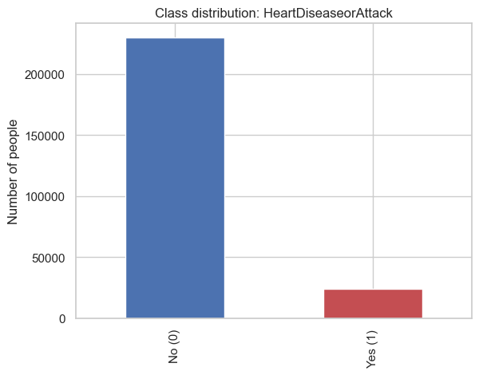
Dataset Characteristics
• Majority class = Healthy
• Minority class = Heart Disease
• Strong class imbalance
253,680 responses (229,781 after removing duplicates)
21 numeric features + 1 binary target
Source: CDC BRFSS 2015 self-reported telephone survey

Slide 6

Exploratory Data Analysis

Slide 7
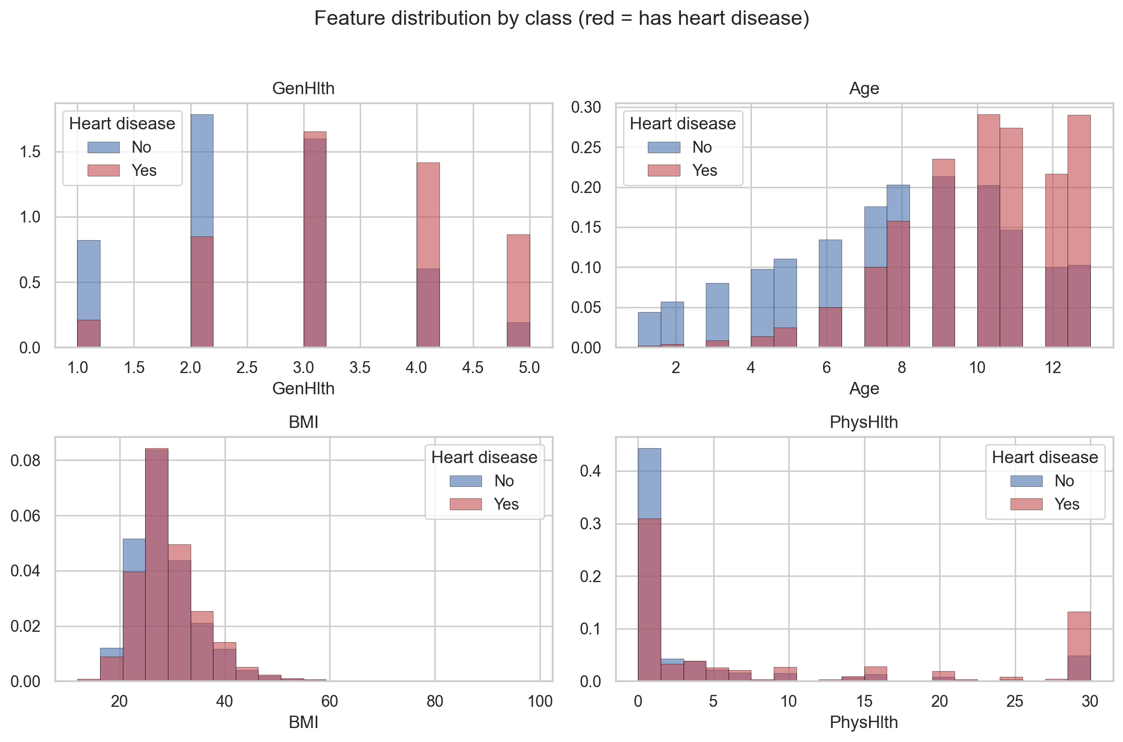

Slide 8
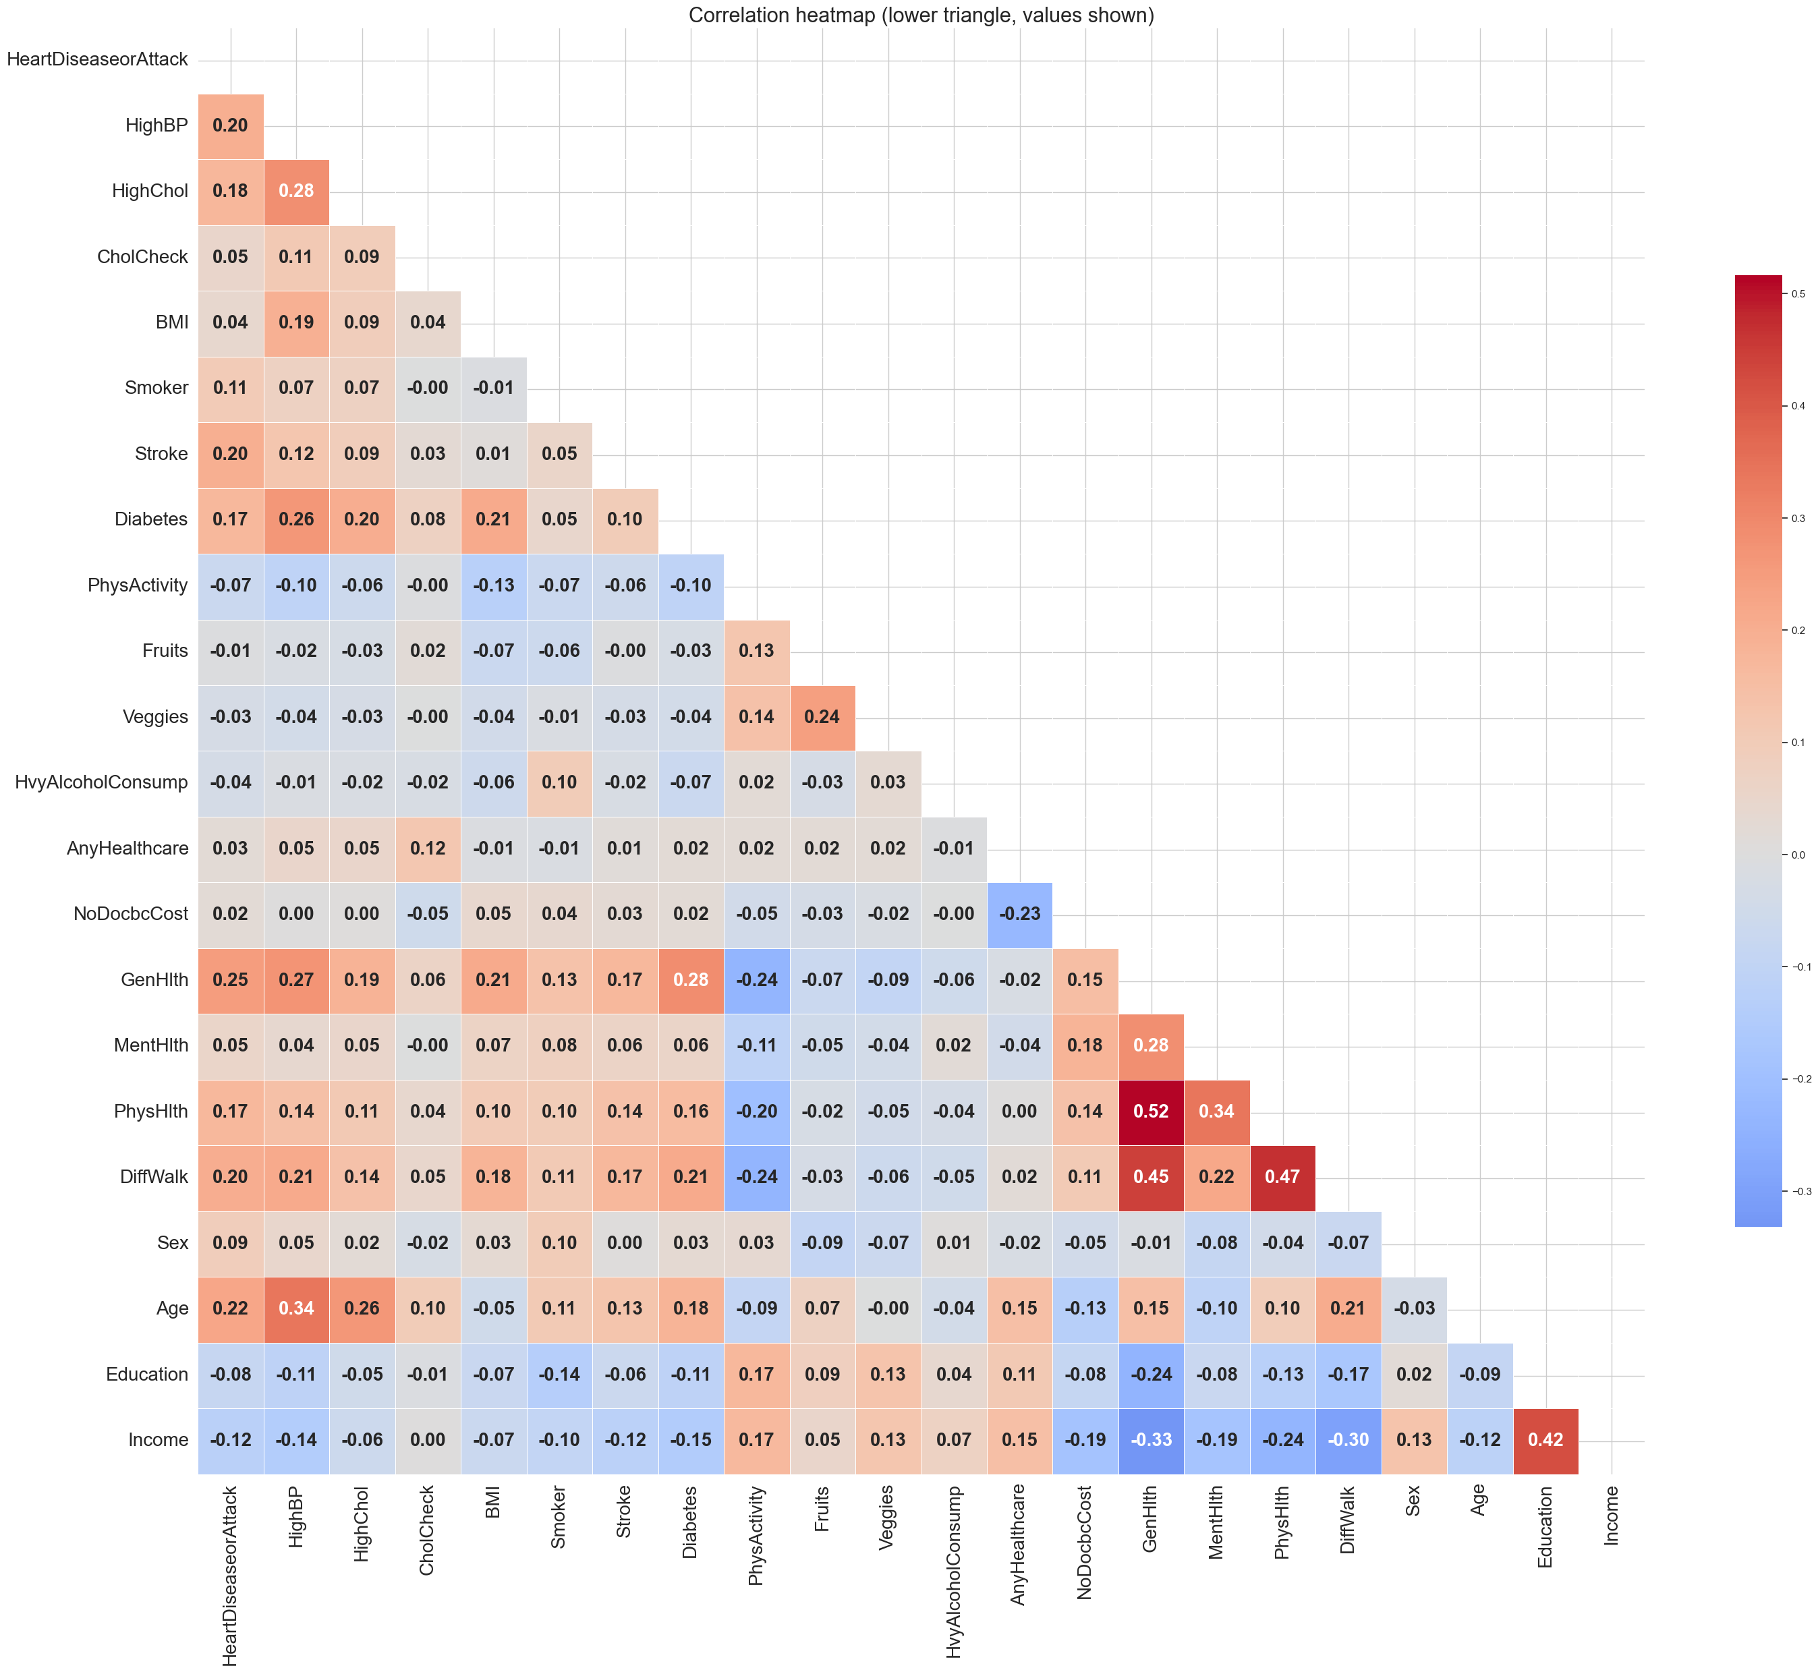

Slide 9
Correlation Heatmap
Key Observations
Age is associated with several health-related variables.
High Blood Pressure and High Cholesterol show noticeable relationships.
Most correlations are moderate, indicating that multiple features contribute to prediction.

Slide 10

Correlation with Target Variable

Slide 11
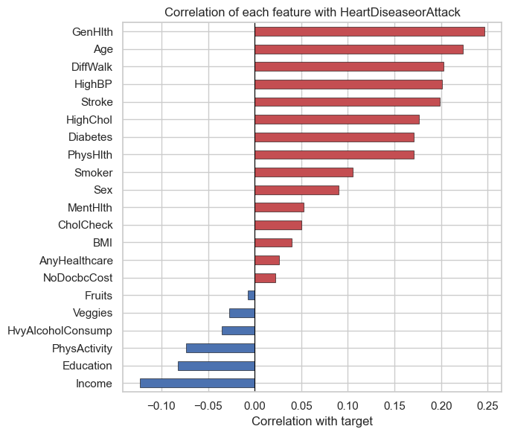
Most Influential Features
Age
General Health
High Blood Pressure
High Cholesterol
Difficulty Walking

Slide 12
Machine Learning Evaluation Pipeline
Dataset
Data Cleaning
Feature Selection
Train/Test Split
Feature Scaling
Baseline Model
Advanced Models
Hyperparameter Optimization
Cross Validation
Model Evaluation
EDA

Slide 13
Experimental Design
Training Data
Feature Scaling
Feature Selection
GridSearchCV
Best Model
Testing Data
Step | Description
Train/Test Split | 70% / 30% (split first, avoids leakage)
Feature Scaling | StandardScaler (kNN/SVM use distances)
Feature Selection | Evaluated; kept all 21 features (p << n)
Cross Validation | 5-Fold
Hyperparameter Search | GridSearchCV
The same experimental setup was applied to every
model to ensure a fair comparison.

Slide 14
Models Evaluated
Model | Purpose
k-Nearest Neighbors | Baseline Model
Random Forest | Advanced Model
Linear SVM | Advanced Model
Evaluation Metrics
Accuracy
Balanced Accuracy
Sensitivity
Specificity
ROC-AUC

Slide 15
Hyperparameter Optimization
1. Optimization Method
GridSearchCV
2. Parameters Optimized
Random Forest
Number of Trees
Maximum Depth
Maximum Features
3. Linear SVM
Regularization Parameter (C)

Slide 16
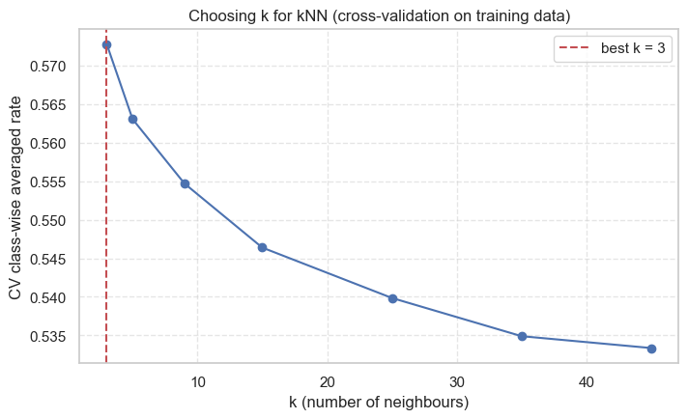
Cross Validation
Cross-Validation Setup
Method: 5-Fold Cross Validation
Model: k-Nearest Neighbors
Training Data Only
Metric: Accuracy
Result
Mean Accuracy : 0.8775
Standard Deviation : 0.0018
The low standard deviation indicates that the model performs consistently across different folds, suggesting stable generalization on unseen data.

Slide 17
Evaluation Metrics
Metric | Why Used
Accuracy | Overall correctness
Balanced Accuracy | Handles imbalance
Sensitivity | Detect heart disease
Specificity | Detect healthy people
ROC-AUC | Overall discrimination

Slide 18
Initial Model Performance
Model | Accuracy | Balanced Accuracy | Sensitivity | ROC-AUC
kNN | 87.7% | 57.1% | 18.5% | 0.666
Random Forest | 89.2% | 54.5% | 10.8% | 0.804
Linear SVM | 89.9% | 52.3% | 5.0% | 0.836
All three models achieved high overall accuracy (>89%). However, sensitivity remained very low, indicating that many heart disease cases were missed.
Despite high overall accuracy, all models struggled to detect
heart disease cases.

Slide 19
Why Was Sensitivity So Low?
Root Cause
The dataset is highly imbalanced.
Healthy individuals form the majority class.
The models mainly learned patterns from the majority class.
As a result, many heart disease cases were classified as healthy.
High accuracy was mainly caused by the model predicting the majority class correctly. This is why we decided to improve our evaluation using class-weight balancing.

Slide 20
Addressing the Class Imbalance Problem
Class Imbalance
Poor Sensitivity
Train New Models
Apply Class Weight
Improvement Strategy
Applied class_weight = "balanced"
Retrained Random Forest
Retrained Linear SVM
Compared with original models

Slide 21
Results after Class Weight
Model | Accuracy | Balanced Accuracy | Sensitivity | ROC-AUC
Random Forest (Balanced) | 86.8% | 63.4% | 34.0% | 0.808
Linear SVM (Balanced) (best) | 73.6% | 76.1% | 79.2% | 0.837
Sensitivity increased significantly after introducing class weights, although overall accuracy
decreased slightly.

Slide 22
Before vs After
Metric | Original SVM | Balanced SVM
Accuracy | 89.9% | 73.6%
Balanced Accuracy | 52.3% | 76.1%
Sensitivity | 5.0% | 79.2%
ROC-AUC | 0.836 | 0.837
Sensitivity improved from approximately 5% to 79%, making the model much more suitable for medical screening.

Slide 23
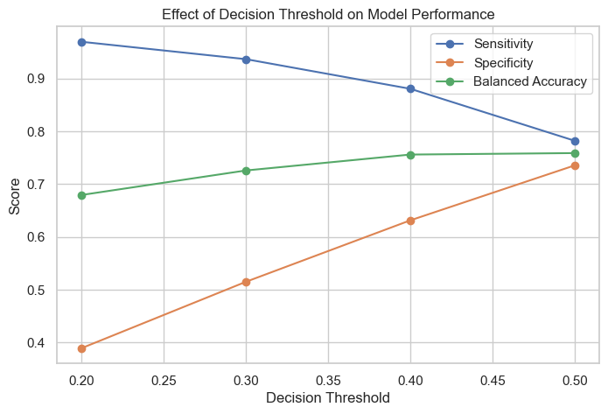
Threshold Tuning
Observation
Lower threshold → Higher sensitivity
Higher threshold → Higher specificity
Trade-off between false positives and false negatives

Slide 24
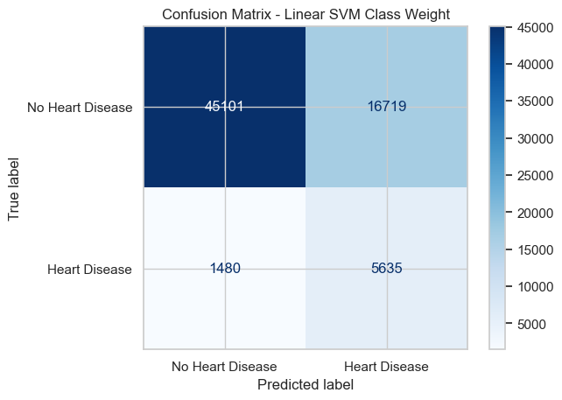
Confusion Matrix
More heart disease cases were correctly detected.
False negatives were reduced.
Predictions became more balanced across both classes.

Slide 25
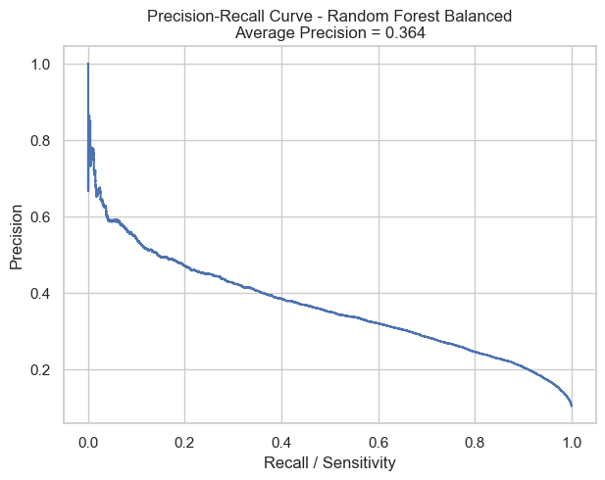
Precision–Recall Curve
Suitable for imbalanced datasets.
Focuses on positive-class performance.
Complements ROC-AUC.
The curve confirms that the balanced model performs better on the minority class.

Slide 26
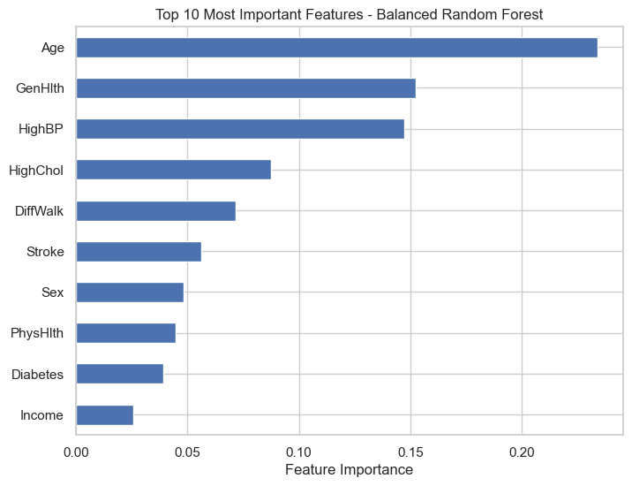
Feature Importance
Top Features
BMI
Age
Income
General Health
Physical Health

Slide 27
Final Model Comparison
Model | Accuracy | Balanced Accuracy | Sensitivity | ROC-AUC
Random Forest (Default) | 89.2% | 54.5% | 10.8% | 0.804
Linear SVM (Default) | 89.9% | 52.3% | 5.0% | 0.836
Random Forest (Balanced) | 86.8% | 63.4% | 34.0% | 0.808
Linear SVM (Balanced) (best) | 73.6% | 76.1% | 79.2% | 0.837

Slide 28
Key Findings
Before | After
High Accuracy | Balanced Performance
Low Sensitivity | High Sensitivity
Majority Bias | Better Minority Detection
Initial models achieved high accuracy (>89%).
Sensitivity was very low because of class imbalance.
Class-weight balancing significantly improved sensitivity.
Linear SVM with Class Weight achieved the best overall balance.

Slide 29
Limitations
Highly imbalanced dataset
Survey data only (no laboratory or clinical measurements)
Results may not generalize to all populations
Only three machine learning algorithms were evaluated

Slide 30
Future Work
Apply SMOTE or other oversampling techniques
Evaluate additional ensemble models (e.g., XGBoost)
Test the model on external datasets
Incorporate clinical measurements (ECG, blood tests, etc.)

Slide 31
Key Takeaways
High accuracy can be misleading in imbalanced datasets.
Class imbalance caused the initial models to miss many heart disease cases.
Applying class-weight balancing greatly improved sensitivity and balanced accuracy.
Linear SVM with Class Weight achieved the best overall balance for this dataset.

Slide 32
Conclusion
Objective: Predict heart disease using machine learning based on health survey data.
Three machine learning models were evaluated.
Initial models achieved high accuracy but poor sensitivity due to class imbalance.
Applying class-weight balancing significantly improved the detection of heart disease cases.

Slide 33
Thank You

