Slide 1

Heart Disease Prediction using Machine Learning
Parth Navadiya-22202538
Narender Kumar
B.Sc. Artificial Intelligence
Deggendorf Institute of Technology

Slide 2
Presentation Outline
Motivation
Exploratory Data Analysis
Dataset Overview
Machine Learning Evaluation Pipeline
Model Development
Experimental Results
Discussion
Conclusion

Slide 3
Motivation
Why Heart Disease Prediction?
Leading cause of death worldwide
Early detection improves treatment
Machine learning can identify patterns from health survey data.
Proper evaluation is essential to select a reliable prediction model.

Slide 4
Dataset Overview
Property | Description
Dataset | BRFSS 2015
Source | CDC Behavioral Risk Factor Surveillance System
Samples | 253,680
Features | 21 Health Indicators
Target | HeartDiseaseorAttack
Task | Binary Classification

Slide 5
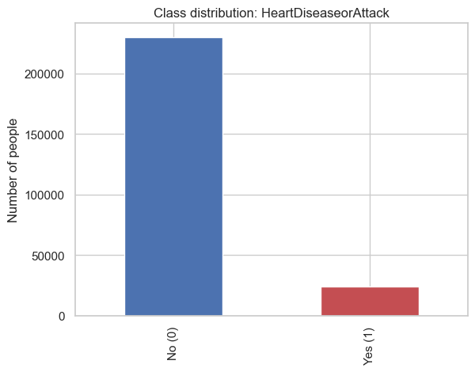
Dataset Characteristics
Majority class = Healthy
Minority class = Heart Disease
Strong class imbalance
253,680 responses (229,781 after removing duplicates)
21 numeric features + 1 binary target

Slide 6

Exploratory Data Analysis

Slide 7
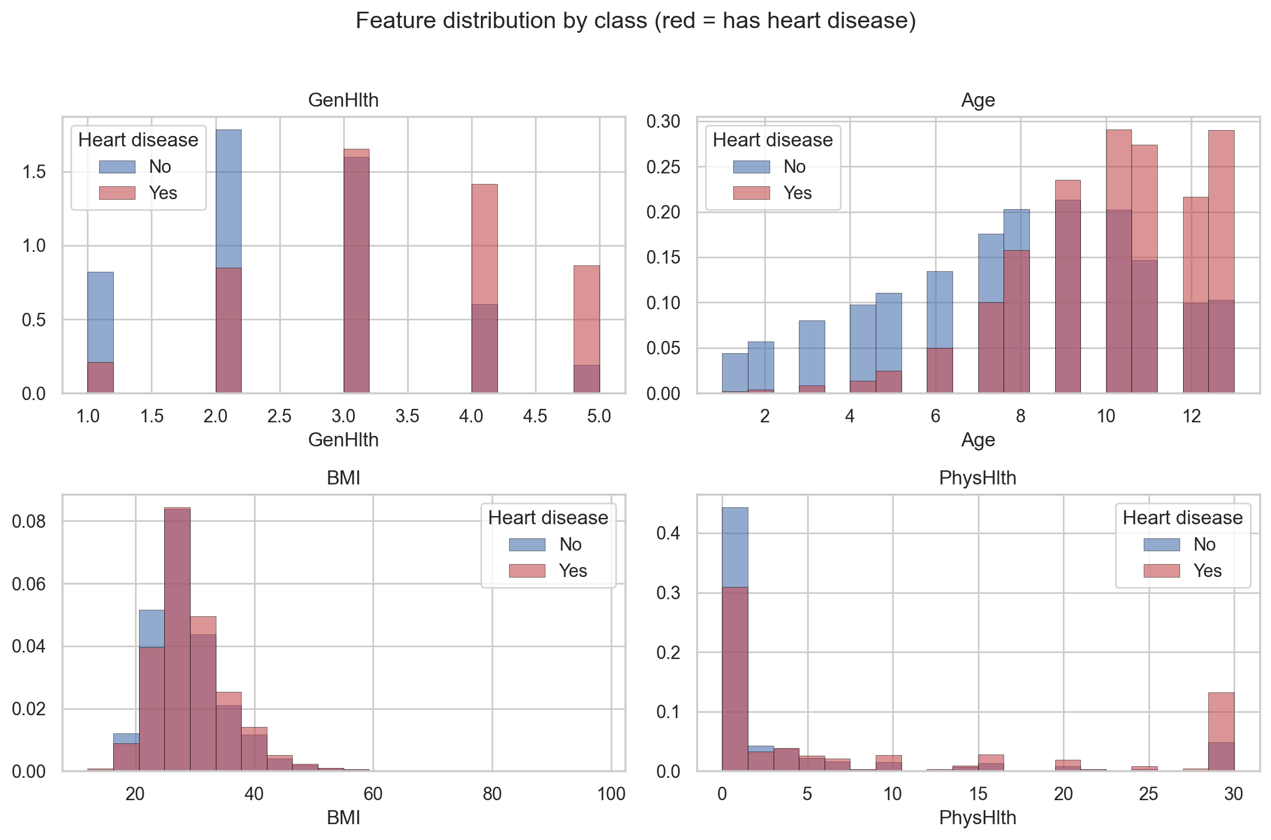

Slide 8
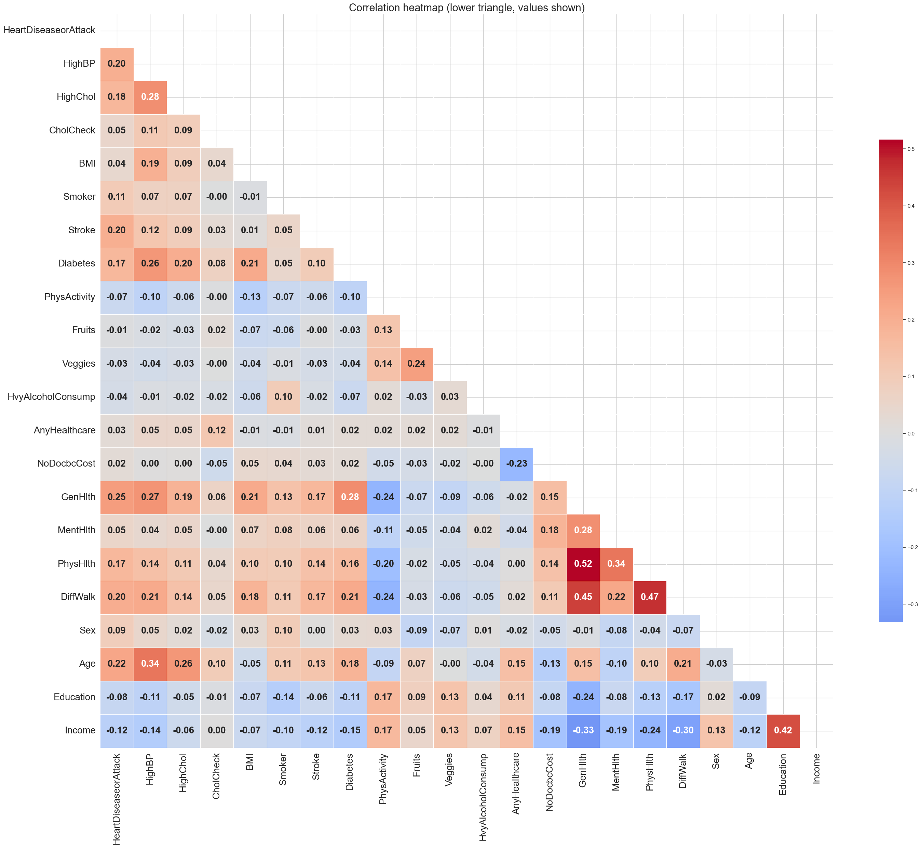

Slide 9
Correlation Heatmap
Key Observations:
Most features have weak to moderate correlations, indicating low multicollinearity.
General Health and Physical Health show the strongest positive correlation (r = 0.52).
Age, High Blood Pressure, and Stroke are positively associated with Heart Disease.
No highly correlated features were found, so Forward Feature Selection was used to identify the most important features.

Slide 10
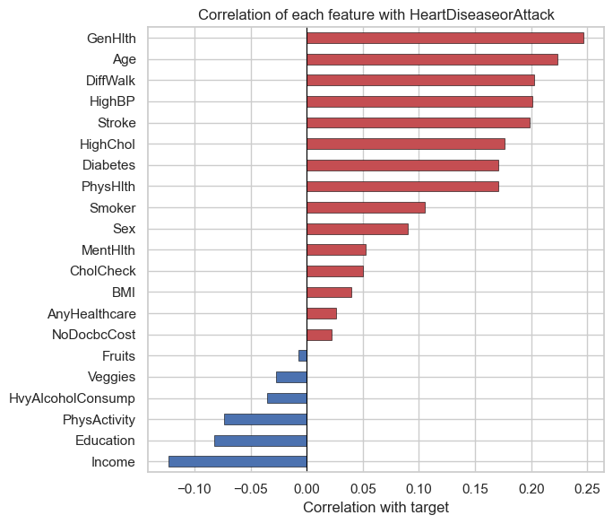
Correlation with Target Variable
Most Influential Features:
Age
General Health
High Blood Pressure
High Cholesterol
Difficulty Walking

Slide 11
Forward Feature Selection
Purpose:
Identify a smaller subset of informative features while maintaining predictive performance.
Selected Features:
CholCheck, BMI, Stroke, PhysActivity, AnyHealthcare, NoDocbcCost, MentHlth, Education
Why did we do this?
Reduce dimensionality.
Remove less informative features.
Compare models trained on all features versus selected features.

Slide 12
Machine Learning Evaluation Pipeline
Dataset
Data Cleaning
Exploratory Data Analysis
Train/Test Split
Feature Scaling
Forward Feature Selection
Model Training
Hyperparameter Optimization
Model Evaluation
Model Comparison

Slide 13
Experimental Setup
Step | Method
Train/Test Split | 70% Training / 30% Testing
Feature Scaling | StandardScaler (kNN & Linear SVM)
Feature Selection | Forward Feature Selection
Hyperparameter Optimization | GridSearchCV
Cross Validation | 3-Fold Cross Validation
Evaluation Metrics | Accuracy, Balanced Accuracy, Sensitivity, Specificity, ROC-AUC
Why?
Same experimental setup for all models.
Hyperparameter tuning performed only on the training data.
Final evaluation performed on the unseen test set.

Slide 14
Models Evaluated
Model | Role | Hyperparameters
kNN | Baseline | Number of Neighbors (k)
Random Forest | Advanced | n_estimators, max_depth, max_features
Linear SVM | Advanced | C (Regularization Parameter)
Hyperparameter Optimization
Method: GridSearchCV
Validation: 3-Fold Cross Validation
Selection: Best average validation score
Purpose
Finds the optimal hyperparameters.
Improves model performance.
Reduces manual tuning.

Slide 15
Baseline Model – k-Nearest Neighbors (kNN)
Results:
Metric | Value
Accuracy | 87.7%
Balanced Accuracy | 57.1%
Sensitivity | 18.5%
Specificity | 95.6%
ROC-AUC | 0.666
Configuration:
StandardScaler
Selected Features
Hyperparameter optimized using 3-Fold GridSearchCV
Baseline model achieved good overall accuracy but struggled
to detect positive heart disease cases.

Slide 16
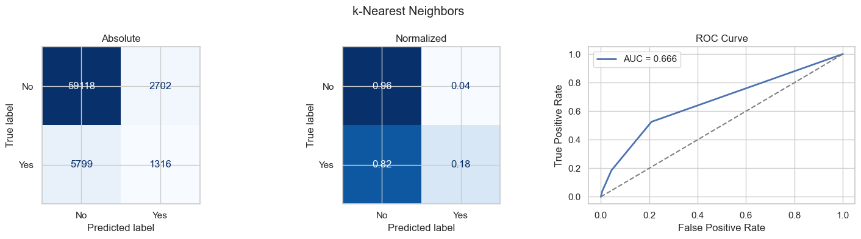
Key Observation:
Correctly classified most healthy individuals but missed many heart disease cases.
Low sensitivity (18.5%) indicates poor detection of the minority class.
ROC-AUC (0.666) shows only fair classification performance.

Slide 17
Random Forest
Metric | All Features | Selected Features
Accuracy | 89.2% | 89.2%
Balanced Accuracy | 54.5% | 52.0%
Sensitivity | 10.8% | 5.2%
Specificity | 98.2% | 98.8%
ROC-AUC | 0.804 | 0.622
Configuration:
All Features and Selected Features
GridSearchCV (3-Fold CV)
Scoring: Balanced Accuracy
Parameter Search
n_estimators: 100, 200
max_depth: None, 10
max_features: sqrt, log2
Best: 100 | None | sqrt
Feature selection reduced sensitivity and ROC-AUC while accuracy remained unchanged.
The optimized model with all features performed better overall.

Slide 18
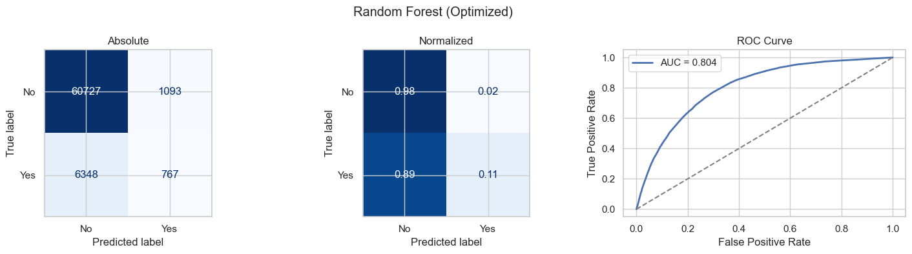
*Optimized with all features.
Key Observations:
Higher overall accuracy than kNN with better class separation.
Majority class was classified well, but sensitivity remained low (10.8%).
ROC-AUC (0.804) indicates good discriminative performance.

Slide 19
Linear SVM
Metric | All Features | Selected Features
Accuracy | 89.9% | 89.7%
Balanced Accuracy | 52.3% | 50.0%
Sensitivity | 5.0% | 0.1%
Specificity | 99.6% | 100.0%
ROC-AUC | 0.836 | 0.651
Configuration:
Features: All Features and Selected Features
Scaling: StandardScaler
Tuning: GridSearchCV (3-Fold CV)
Scoring: Balanced Accuracy
Parameter Search:
C: 0.01, 0.1, 1, 10, 100
Best Parameter:
C = 1
Highest overall accuracy.
Lowest sensitivity.
Selected features reduced minority detection.

Slide 20
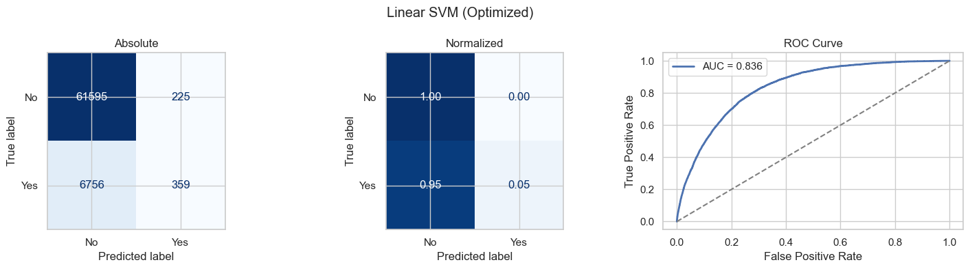
Key Observation:
Achieved the highest overall accuracy (89.9%).
Correctly classified most healthy individuals but detected very few heart disease cases (Sensitivity: 5.0%).
ROC-AUC (0.836) indicates good discrimination despite low sensitivity.
*Optimized with all features.

Slide 21
Initial Model Comparison
Model | Accuracy | Balanced Accuracy | Sensitivity | ROC-AUC
kNN | 87.7% | 57.1% | 18.5% | 0.666
Random Forest | 89.2% | 54.5% | 10.8% | 0.804
Linear SVM | 89.9% | 52.3% | 5.0% | 0.836
Observation:
All models achieved high accuracy (>87%).
Sensitivity remained very low.
Models favored the majority (healthy) class.

Slide 22
Why Was Sensitivity Low?
Observation
Majority class dominated the dataset.
Models learned the majority class.
Heart disease cases were frequently misclassified.
Key Takeaway:
Accuracy alone was misleading because the models rarely predicted the minority class correctly.
Imbalanced Dataset
Majority Class Bias
High Accuracy
Low Sensitivity

Slide 23
Handling Class Imbalance
Model | Accuracy | Balanced Accuracy | Sensitivity | Specificity | ROC-AUC
Random Forest (Balanced) | 86.8% | 63.4% | 34.0% | 92.8% | 0.808
Linear SVM (Balanced) | 73.6% | 76.1% | 79.2% | 73.0% | 0.837
Approach:
Applied class_weight="balanced"
Retrained Random Forest
Retrained Linear SVM
Objective:
Increase the importance of the minority class during training and improve heart disease detection.
Key Observations:
Sensitivity improved substantially.
Balanced Accuracy increased.
Small reduction in overall Accuracy.

Slide 24
Final Model Comparison
Model | Accuracy | Balanced Accuracy | Sensitivity | ROC-AUC
kNN (Baseline) | 87.7% | 57.1% | 18.5% | 0.666
Random Forest (Default) | 89.2% | 54.5% | 10.8% | 0.804
Random Forest (Balanced) | 86.8% | 63.4% | 34.0% | 0.808
Linear SVM (Default) | 89.9% | 52.3% | 5.0% | 0.836
Linear SVM (Balanced) | 73.6% | 76.1% | 79.2% | 0.837
Highest Accuracy → Linear SVM (Default)
Best Medical Performance → Linear SVM (Balanced)

Slide 25
Key Findings
The dataset was highly imbalanced, making accuracy alone misleading.
Hyperparameter optimization had minimal impact on model performance.
Applying class_weight="balanced" significantly improved minority class detection.
Balanced Linear SVM achieved the best trade-off between sensitivity and overall performance.

Slide 26
Conclusion
Evaluated one baseline and two advanced classifiers.
Compared all features and selected features.
Addressed class imbalance using class weights.
Balanced Linear SVM was selected as the final model because it provided the best balance between detecting heart disease cases (high sensitivity) and maintaining overall classification performance.

Slide 27
Thank You

