Slide 1


Microsoft AI

Slide 2
Azure Open AI Offerings
Advanced Language Models:
Azure OpenAI Service offers access to powerful language models, including OpenAI GPT-4, OpenAI GPT-3, Codex, DALL-E, Whisper, Text-to-Speech models.
2.Security and Enterprise Promise:
Azure OpenAI Service combines the capabilities of OpenAI with the security and compliance features of Azure.
Co-developed APIs ensure compatibility and a smooth transition from one model to another.
3.Use Cases:
Developers can apply generative AI to a variety of scenarios, including Conversational AI, Content creation and Data grounding. Whether it’s building chatbots, generating code, or enhancing content, Azure OpenAI Service provides the tools.
4.Customer Stories:
Organizations like CarMax, AT&T, KPMG, Mercedes-Benz, and SymphonyAI have leveraged Azure OpenAI Service to innovate and improve their processes.

Slide 3
















Azure Cognitive Services

Slide 4


Custom Speech
Speech API
Text Analytics
Translator Speech
Speech
Unified Speech
Text to
speech
Cognitive
Services Lab
Language
Bing Speech
Translator Text
Speaker Recognition
Anomaly Detector
Language Understanding (LUIS)
Decisions
Cognitive Services APIs
Computer
Vision
Custom Vision
Personalize
Content Moderator
Bing Visual Search
Video Indexer
Bing Entity Search
Vision
Bing Statistics add-in
Bing Custom Search
Emotion
Bing Search
Bing Autosuggest
Search
Face

Slide 5















Cognitive Services capabilities
Infuse your apps, websites, and bots with human-like intelligence

Slide 6
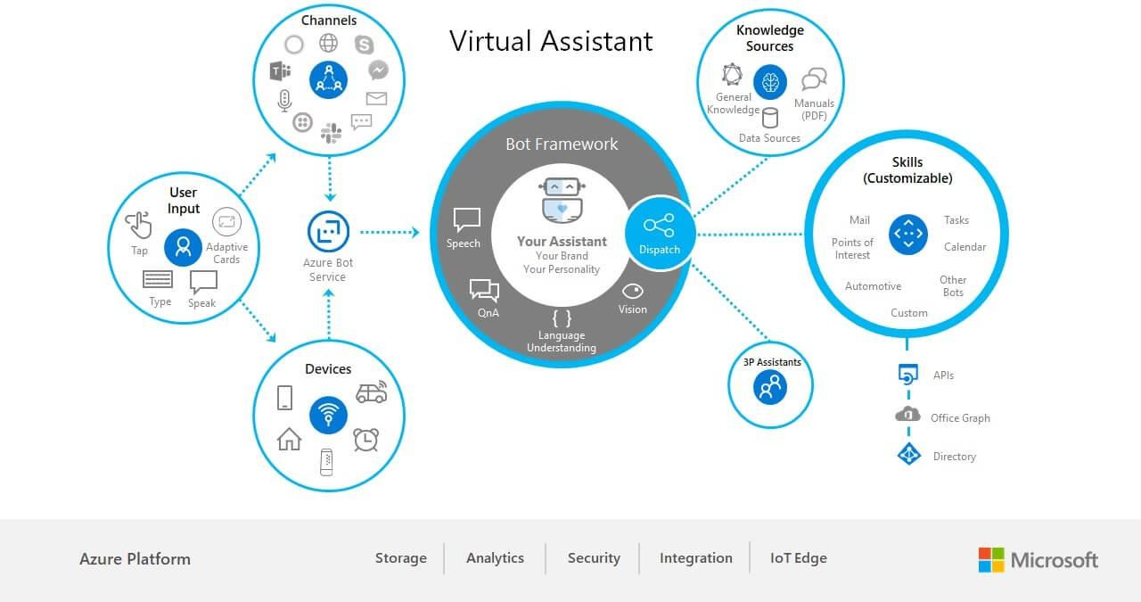
33

Slide 7
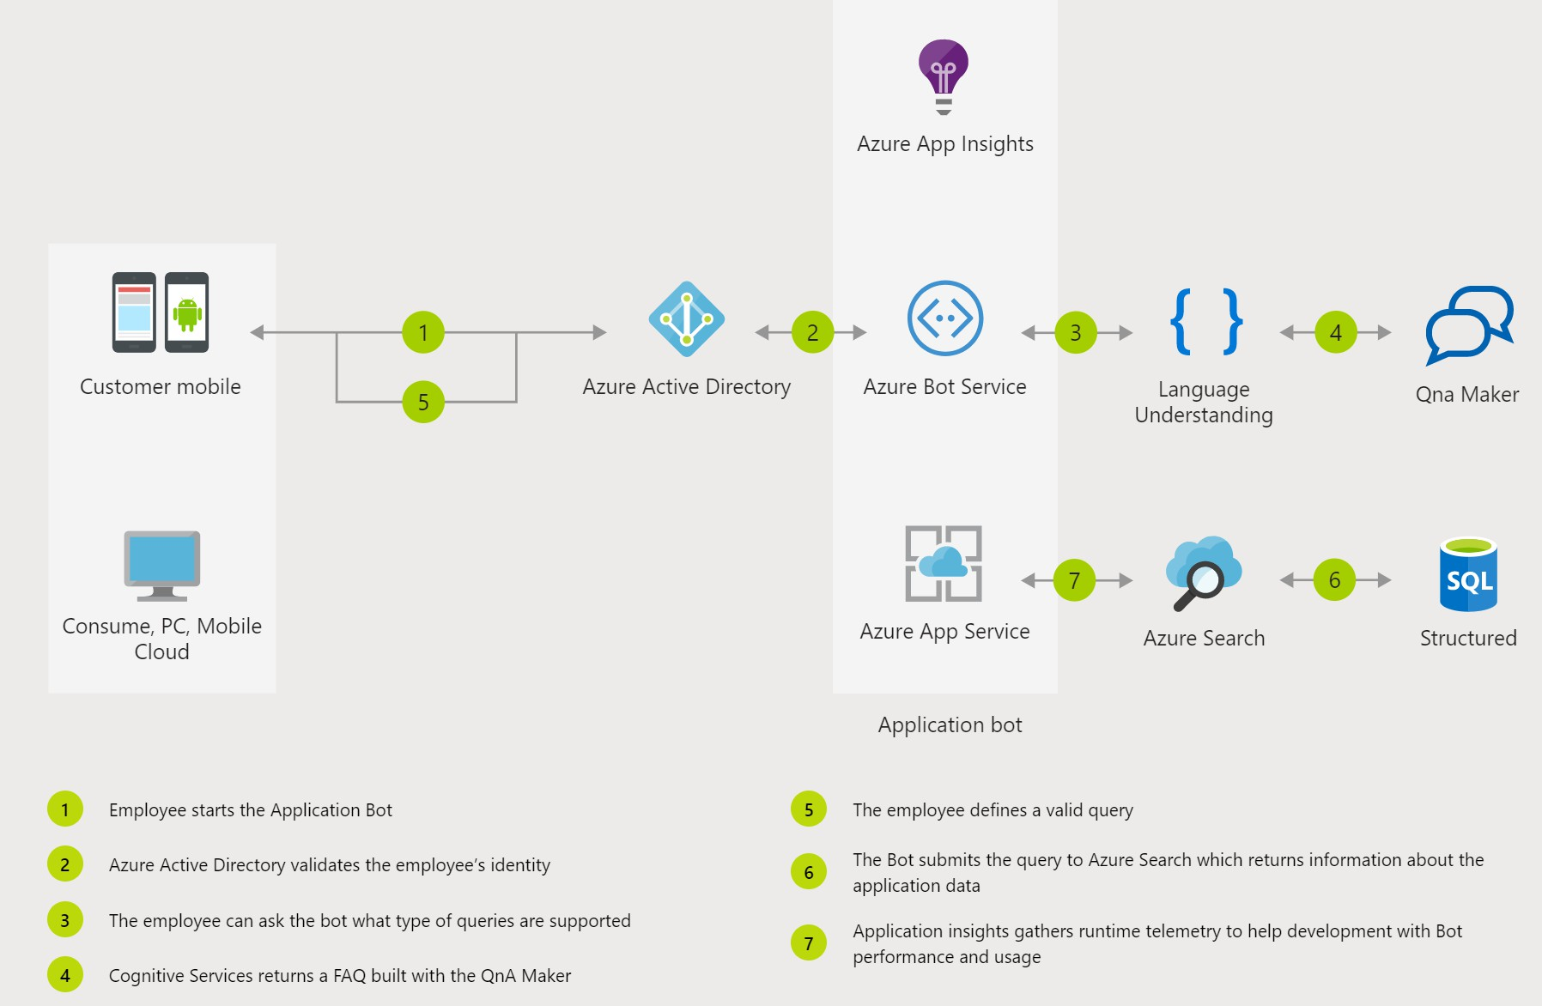

Slide 8
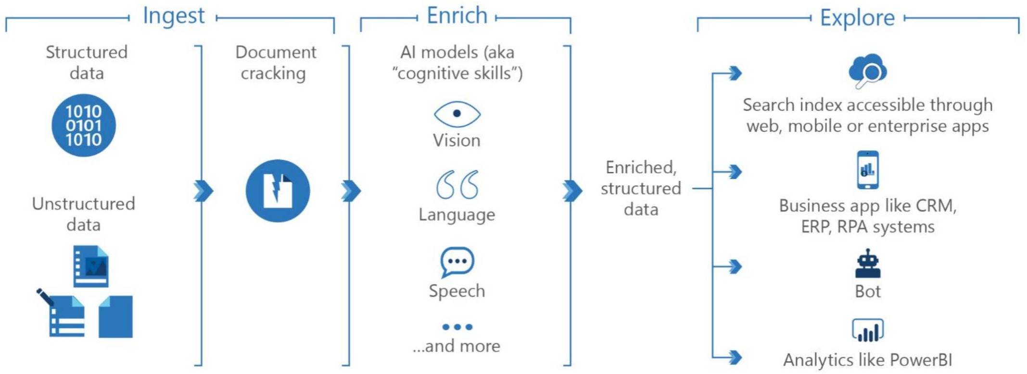
AI Driven Knowledge Mining

Slide 9
Azure Cognitive Search
Search-as-a-Service
management free keyword search faceting
language analyzers geospatial support suggestions/auto-complete customizable scoring proximity search
synonyms complex types etc.

Slide 10
Azure Search Indexing
Data Sources
Accept text as JSON documents.
Indexers automate data import from sources like Azure SQL Database, Cosmos DB, and Blob storage.
Hierarchical Structures
Model complex JSON structures using complex types and collections.
Express one-to-many and many-to-many relationships.
Linguistic Analysis
Default: Standard Lucene analyzer.
Use language analyzers for linguistics (e.g., verb tenses, plurals).
Employ custom lexical analyzers for advanced queries.

Slide 11
Vector Search
Vector Indexing
Add vector fields within a search index to support vector search scenarios.
Vector fields can co-exist with non-vector fields in the same search document.
Vector Queries
Formulate both single and multiple vector queries.
Use Hierarchical Navigable Small World (HNSW) or exhaustive K-Nearest Neighbors (KNN) algorithms to find similar vectors.
Vector Search Algorithms
Enhance precision during information retrieval.

Slide 12
Features
Free-Form Text Search
Full-text search is a primary use case.
Relevance
Simple scoring based on document values.
Scoring profiles model relevance (e.g., newer or discounted products appearing higher).
Semantic ranker (premium feature) reranks results based on semantic relevance to the query.
Geospatial Search
Filter and match on geographic coordinates.
Match by distance or inclusion in a polygon shape.
Filters and Facets
Faceted navigation via a single query parameter.
Faceted navigation structure for categories, self-directed filtering (e.g., price-range, brand).
Create filters using OData syntax.
User Experience
Autocomplete for type-ahead queries in a search bar.
Search suggestions based on partial text inputs (results are actual documents in the index).

Slide 13
Cognitive Search Architecture
Cognitive
Skill
Built-in Cognitive Skills
OCR, Key Phrase Extraction, People Names, Company Names, Sentiment Analyzer, Computer Vision, etc.
Customer Data
Document Cracking
Annotated Documents
Indexing For Search
Search Index
Third Party Enrichers
Third Party Enrichers
Custom classification models, Custom entity
extraction, etc.

Slide 14



Natural Language Processing
Key Phrase Extraction Sentiment Analysis Organization Entity Extraction Location Entity Extraction Persons Entity Extraction Language Detection
Text Translation
Built-in Skills in Multiple Languages
Image Processing
Face Detection Tag Extraction
Celebrity Recognition
Landmark Detection Handwriting Recognition Printed Text Recognition
Utilities
Complex Type Shaping
Text Merging Text Splitting Conditional Skill

Slide 15
Case Study : Smart Attendance System
Implementation
The university adopted a Smart Attendance System powered by Azure AI for facial recognition and Azure Search for quick data retrieval.
Real-time facial capture marked students’ attendance automatically as they entered the classroom.
Data was stored securely on the cloud, ensuring privacy and accessibility.
Improvements
Accuracy:
Eliminated human errors, ensuring 99% accuracy in attendance marking.
Efficiency:
Reduced time taken to mark attendance by 80%, freeing up time for educational activities.
Analytics:
Provided insights into attendance patterns, helping identify at-risk students early.

Slide 16
Case Study : Enterprise Search
Implementation
Data Ingestion:
Documents were ingested from various sources into Azure Blob Storage.
Text Extraction and Translation:
An Azure Function was triggered to extract text from the documents.
For PDFs or images, Azure AI Document Intelligence extracted the text.
Embedding Creation:
Extracted text was chunked and converted into embeddings using the Azure OpenAI embedding model.
User Query and Retrieval:
The query was converted into vector embeddings using the Azure OpenAI embedding model.
A vector similarity search in the vector database returned the top matching content.
The search results were presented as answers or used as grounding data for multi-turn conversations.
Improvements
Accuracy:
Eliminated manual search efforts, resulting in accurate and relevant results.
Efficiency:
Reduced search time significantly, improving overall productivity.
Insights:
Enabled analytics on search patterns, helping identify trends and areas of interest.

