Slide 1

Notes:
1st slide (Mandatory)

Slide 2

GRAPHS

Slide 3
Introduction
0
A
A graph is a pictorial representation of a set of objects connected by links.
1
B
4
E
5
F
2
C
6
F
3
D

Slide 4
Vertices
The objects are represented by points termed as vertices.
1
VERTICES
2

Slide 5
Edges
The links that connect the vertices are called edges.
EDGES
2
1
3

Slide 6
Path
Path represents a sequence of edges between the two vertices.
1
3
Path from 1 – 5
Path from 1-5 through 3
Path from 1-4
5
2
4

Slide 7
Adjacency
Two node or vertices are adjacent if they are connected to each other through an edge
(1,2) are adjacent.
(1,3) are adjacent.
(2,4) are adjacent.
(3,4) are adjacent
But, (2,3) are not adjacent as it is not connected by edges.
3
1
2
4

Slide 8
Example For Graph
0
A
From the above example,
VERTICES: {A , B , C , D, E, F , G}.
EDGES: The lines from A to B, B to C, and so on represents edges.
PATH: ABCD represents a path from A to D.
1
B
4
E
5
F
2
C
6
F
3
D

Slide 9
Types of Graph
A) DIRECTED GRAPH:
C
A
B
E
D
F
G

Slide 10
B) UNDIRECTED GRAPH:
A
B
E
F
C

Slide 11
c) CYCLIC GRAPH:
A
B
E
F
C

Slide 12
D) ACYCLIC GRAPH :
1
2
3
4
5
6
7
8

Slide 13
E) WEIGHTED GRAPH:
3
0
1
4
7
4
2
2
8
3
6
2
6
1
1
8
8
4
5

Slide 14
F) UNWEIGHTED GRAPH:
C
B
E
F

Slide 15
Graph and its Representations
Adjacency Matrix
Adjacency List

Slide 16
Adjacency Matrix
Adjacency Matrix is a 2D array of size V x V where V is the number of vertices in a graph.
Let the 2D array be adj[][], a slot adj[i][j] = 1 indicates that there is an edge from vertex i to vertex j. Adjacency matrix for undirected graph is always symmetric.
Adjacency Matrix is also used to represent weighted graphs. If adj[i][j] = w, then there is an edge from vertex i to vertex j with weight w.

Slide 17
Adjacency Matrix
0 1 2 3 4
0
1
2
3
4
0 0 0 0 0
0
0 0 0 0 0
0 0 0 0 0
1
2
3
0 0 0 0 0
0 0 0 0 0
4
Initialize the matrix

Slide 18
Adjacency Matrix
0 1 2 3 4
0
1
2
3
4
0 1 0 0 0
0
1 0 0 0 0
0 0 0 0 0
1
2
3
0 0 0 0 0
0 0 0 0 0
Edge 0->1. So, mark 1 A[0][1] and A[1][0] ( because this is an undirected graph.
4

Slide 19
Adjacency Matrix
0 1 2 3 4
0
1
2
3
4
0 1 1 0 0
0
1 0 0 0 0
1 0 0 0 0
1
2
3
0 0 0 0 0
0 0 0 0 0
Edge 0->2. So, mark 1 A[0][2] and A[2][0].
4

Slide 20
Adjacency Matrix
0 1 2 3 4
0
1
2
3
4
0 1 1 1 0
0
1 0 0 0 0
1 0 0 0 0
1
2
3
1 0 0 0 0
0 0 0 0 0
Edge 0->3. So, mark 1 A[0][3] and A[3][0].
4

Slide 21
Adjacency Matrix
0 1 2 3 4
0
1
2
3
4
0 1 1 1 0
0
1 0 0 0 1
1 0 0 0 0
1
2
3
1 0 0 0 0
0 1 0 0 0
Edge 1->4. So, mark 1 A[1][4] and A[4][1].
4

Slide 22
Adjacency Matrix
0 1 2 3 4
0
1
2
3
4
0 1 1 1 0
0
1 0 0 0 1
1 0 0 0 1
1
2
3
1 0 0 0 0
0 1 1 0 0
Edge 2->4. So, mark 1 A[2][4] and A[4][2].
4

Slide 23
Adjacency Matrix
0 1 2 3 4
0
1
2
3
4
0 1 1 1 0
0
1 0 0 0 1
1 0 0 0 1
1
2
3
1 0 0 0 1
0 1 1 1 0
Edge 3->4. So, mark 1 A[3][4] and A[4][3].
4

Slide 24
Adjacency Matrix
0 1 2 3 4
0
1
2
3
4
0 1 1 1 0
0
1 0 0 0 1
1 0 0 0 1
1
2
3
1 0 0 0 1
0 1 1 1 0
All the edges have been marked. This is the adjacency matrix for the given graph.
4

Slide 25
Adjacency List
An array of linked lists is used.
Size of the array is equal to number of vertices. Let the array be array[].
An entry array[i] represents the linked list of vertices adjacent to the ith vertex.
This representation can also be used to represent a weighted graph. The weights of edges can be stored in nodes of linked lists.

Slide 26
Adjacency list
0
0
NULL
1
NULL
1
2
3
2
NULL
3
NULL
4
NULL
4
Initialize the list

Slide 27
Adjacency list
0
0
1
NULL
1
0
NULL
1
2
3
2
NULL
3
NULL
4
NULL
4
Edge 0->1.

Slide 28
Adjacency list
0
0
2
1
NULL
1
0
NULL
1
2
3
2
0
NULL
3
NULL
4
NULL
4
Edge 0->2.

Slide 29
Adjacency list
0
0
3
2
1
NULL
1
0
NULL
1
2
3
2
0
NULL
3
0
NULL
4
NULL
4
Edge 0->3.

Slide 30
Adjacency list
0
0
3
2
1
NULL
1
4
0
NULL
1
2
3
2
0
NULL
3
0
NULL
4
1
NULL
4
Edge 1->4.

Slide 31
Adjacency list
0
0
3
2
1
NULL
1
4
0
NULL
1
2
3
2
4
0
NULL
3
0
NULL
4
2
1
NULL
4
Edge 2->4.

Slide 32
Adjacency list
0
0
3
2
1
NULL
1
4
0
NULL
1
2
3
2
4
0
NULL
3
4
0
NULL
4
3
2
1
NULL
4
Edge 3->4.

Slide 33
Adjacency list
0
0
3
2
1
NULL
1
4
0
NULL
1
2
3
2
4
0
NULL
3
4
0
NULL
4
3
2
1
NULL
4
This is the adjacency list for the given graph.

Slide 34
Types of Traversals
Depth First Search (DFS) algorithm.
Breadth First Search (BFS) algorithm.

Slide 35
DFS
S
1)(DFS) algorithm traverses a graph in a depth ward motion
2)Uses a stack to remember to get the next vertex to start a search, when a dead end occurs in any iteration.
A
B
C
D
E
F
G

Slide 36

DFS
S
1
1)(DFS) algorithm traverses a graph in a depth ward motion
2)Uses a stack to remember to get the next vertex to start a search, when a dead end occurs in any iteration.
A
B
C
D
E
F
G

Slide 37
DFS
S
1
1)(DFS) algorithm traverses a graph in a depth ward motion
2)Uses a stack to remember to get the next vertex to start a search, when a dead end occurs in any iteration.
A
B
C
2
D
E
F
G

Slide 38
DFS
S
1
1)(DFS) algorithm traverses a graph in a depth ward motion
2)Uses a stack to remember to get the next vertex to start a search, when a dead end occurs in any iteration.
A
B
C
2
D
E
F
3
G

Slide 39
DFS
S
1
1)(DFS) algorithm traverses a graph in a depth ward motion
2)Uses a stack to remember to get the next vertex to start a search, when a dead end occurs in any iteration.
A
B
C
2
D
E
F
4
3
G

Slide 40
DFS
S
1
1)(DFS) algorithm traverses a graph in a depth ward motion
2)Uses a stack to remember to get the next vertex to start a search, when a dead end occurs in any iteration.
A
B
C
2
5
D
E
F
4
3
G

Slide 41
DFS
S
1
1)(DFS) algorithm traverses a graph in a depth ward motion
2)Uses a stack to remember to get the next vertex to start a search, when a dead end occurs in any iteration.
A
B
C
2
5
D
E
F
4
6
3
G

Slide 42
DFS
S
1
1)(DFS) algorithm traverses a graph in a depth ward motion
2)Uses a stack to remember to get the next vertex to start a search, when a dead end occurs in any iteration.
A
B
C
2
5
7
D
E
F
4
6
3
G

Slide 43
Traversal and its Description
Determine the Depth first traversal .
S
A
B
C
D

Slide 44
DFS Traversal Rules
Rule 1 − Visit the adjacent unvisited vertex. Mark it as visited. Display it. Push it in a stack.
Rule 2 − If no adjacent vertex is found, pop up a vertex from the stack. (It will pop up all the vertices from the stack, which do not have adjacent vertices.)
Rule 3 − Repeat Rule 1 and Rule 2 until the stack is empty.

Slide 45
S
Initialize the stack
A
B
C
D
STACK

Slide 46
Mark S as visited and put onto the stack. Explore any unvisited adjacent node from S. We have three nodes and we can pick any of them. For this example, we shall take the node in an alphabetical order.
S
A
B
C
D
S
top ->
STACK

Slide 47
S
Mark A as visited and put it onto the stack. Explore any unvisited adjacent node from A. Both S and D are adjacent to A but we are concerned for unvisited nodes only.
A
B
C
A
top ->
D
S
STACK

Slide 48
S
Visit D and mark it as visited and put onto the stack. Here, we have B and C nodes, which are adjacent to D and both are unvisited.
D
top ->
A
B
C
A
D
S
STACK

Slide 49
S
We choose B, mark it as visited and put onto the stack. Here B does not have any unvisited adjacent node. So, we pop B from the stack.
B
top ->
D
A
B
C
A
D
S
STACK

Slide 50
S
Now the only unvisited node from D is C.
C
top ->
D
A
B
C
A
D
S

Slide 51
Breadth First Search
S
(BFS) algorithm traverses a graph in a breadth ward motion
Uses a queue to remember to get the next vertex to start a search, when a dead end occurs in any iteration.
A
B
C
D
E
F
G

Slide 52
Breadth First Search
S
(BFS) algorithm traverses a graph in a breadth ward motion
Uses a queue to remember to get the next vertex to start a search, when a dead end occurs in any iteration.
1
A
B
C
D
E
F
G

Slide 53

Breadth First Search
S
(BFS) algorithm traverses a graph in a breadth ward motion
Uses a queue to remember to get the next vertex to start a search, when a dead end occurs in any iteration.
1
2
A
B
C
D
E
F
G

Slide 54
Breadth First Search
S
(BFS) algorithm traverses a graph in a breadth ward motion
Uses a queue to remember to get the next vertex to start a search, when a dead end occurs in any iteration.
1
3
2
A
B
C
D
E
F
G

Slide 55
Breadth First Search
S
(BFS) algorithm traverses a graph in a breadth ward motion
Uses a queue to remember to get the next vertex to start a search, when a dead end occurs in any iteration.
1
3
2
A
B
C
4
D
E
F
G

Slide 56
Breadth First Search
S
(BFS) algorithm traverses a graph in a breadth ward motion
Uses a queue to remember to get the next vertex to start a search, when a dead end occurs in any iteration.
1
3
2
A
B
C
4
5
D
E
F
G

Slide 57
Breadth First Search
S
(BFS) algorithm traverses a graph in a breadth ward motion
Uses a queue to remember to get the next vertex to start a search, when a dead end occurs in any iteration.
1
3
2
A
B
C
4
5
6
D
E
F
G

Slide 58
Breadth First Search
S
(BFS) algorithm traverses a graph in a breadth ward motion
Uses a queue to remember to get the next vertex to start a search, when a dead end occurs in any iteration.
1
3
2
A
B
C
4
5
6
D
E
F
7
G

Slide 59
TRAVERSAL AND ITS DESCRIPTIONS
Determine the Breadth first traversal .
S
A
B
C
D

Slide 60
BFS Traversal Rules
Rule 1 − Visit the adjacent unvisited vertex. Mark it as visited. Display it. Insert it in a queue.
Rule 2 − If no adjacent vertex is found, remove the first vertex from the queue.
Rule 3 − Repeat Rule 1 and Rule 2 until the queue is empty.

Slide 61
S
A
B
C
Initialize the queue
D

Slide 62
S
A
B
C
We start from visiting S(starting node), and
mark it as visited.
D

Slide 63
S
A
A
B
C
We then see an unvisited adjacent node from S.
In this example, we have three nodes but
alphabetically we choose A, mark it as visited and
enqueue it.
D

Slide 64
S
B
A
A
B
C
Next, the unvisited adjacent node from S is B.
We mark it as visited and enqueue it.
D

Slide 65
S
C
B
A
A
B
C
Next, the unvisited adjacent node from S is C.
We mark it as visited and enqueue it.
D

Slide 66
S
D
C
B
A
B
C
From A we have D as unvisited adjacent node.
We mark it as visited and enqueue it.
D

Slide 67
MINIMUM SPANNING TREE

Slide 68
A Spanning Tree
A
B
C
Minimum Spanning Trees
A
A
A
B
C
B
C
B
C

Slide 69
Minimum Spanning Tree
The cost of the spanning tree is the sum of the weights of all the edges in the tree.
Minimum spanning tree is the spanning tree where the cost is minimum among all the spanning trees.

Slide 70
Find the minimum spanning tree of the following graph.
1
6
5
1
2
5
4
5
3
3
2
6
4
5
6
6
A connected graph

Slide 71
1
5
2
4
5
3
3
4
5
6
6
A spanning tree with cost = 23

Slide 72
1
1
2
5
4
5
3
6
4
5
6
A spanning tree with cost = 21

Slide 73
1
1
2
5
4
3
3
2
4
5
6
MST, cost = 15

Slide 74
Applications
1) Cluster Analysis
2) Handwriting recognition
3) Image segmentation

Slide 75
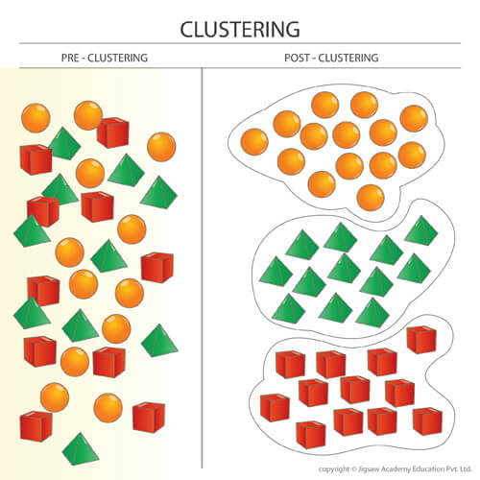
Cluster Analysis

Slide 76
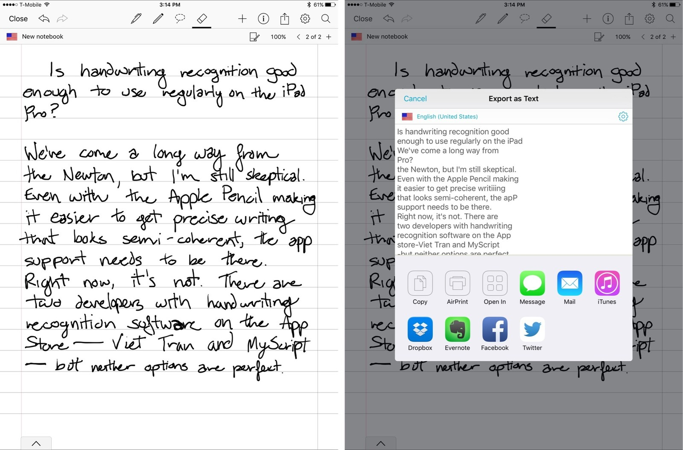
Handwriting Recognition

Slide 77

Image Segmentation

Slide 78

THANK YOU
Notes:
Thank you slide

