Slide 1

Notes:
1st slide (Mandatory)

Slide 2


Push and Pop
3
1
2
2
1
3
Push
Pop
Initially
Top Of the Stack
Top Of the Stack = -1
Means, the Stack is empty.
TOP=
-1
0
1
Push and Pop
2
Notes:
Stack is an ordereStack is an ordered list of similar data type.
Stack is a LIFO structure. (Last in First out).
push() function is used to insert new elements into the Stack and pop() is used to delete an element from the stack. Both insertion and deletion are allowed at only one end of Stack called Top.
d list of similar data type.
Stack is a LIFO structure. (Last in First out).
push() function is used to insert new elements into the Stack and pop() is used to delete an element from the stack. Both insertion and deletion are allowed at only one end of Stack called Top.
Stack is said to be in Overflow state when it is completely full and is said to be in Underflow state if it is completely empty.

Slide 3
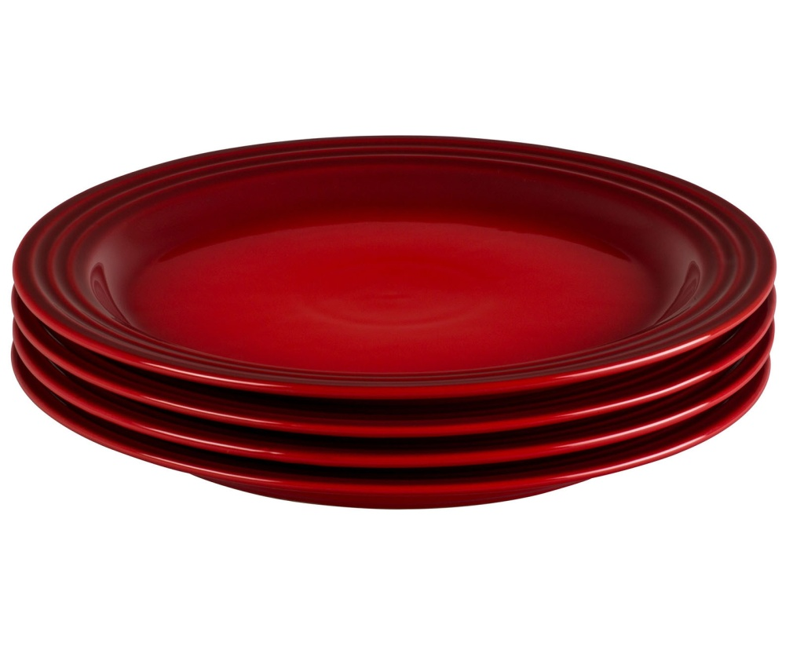

Real time example

Slide 4
Stack Using Array
Push
Inserting a value into the stack
In Array, it’s
Insert at position 0
Pop
Deleting a value from the Stack
In Array, it’s
Delete at end

Slide 5
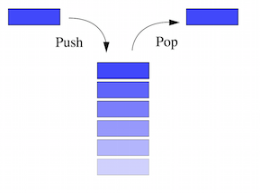
Stack Using Linked List
• Push
Inserts element at position 0.
• Pop
Deletes the element from position 0.
Top

Slide 6
Stack Using Linked List
(head)
1000
 | …
 | …
 | …
 | …
 | …
NULL
void push(struct node **headadd,int data){
struct node *newnode;
newnode=(struct node *)malloc(sizeof(struct node));
newnode->data=data;
newnode->link=NULL;
if(*headadd==NULL)
*headadd = newnode;
else{
newnode->link=*headadd;
*headadd=newnode;
}
}
Only a two elements :
3
5

Slide 7
Stack Using Linked List
(head)
1000
 | …
 | …
 | …
 | …
 | …
NULL
void push(struct node **headadd,int data){
struct node *newnode;
newnode=(struct node *)malloc(sizeof(struct node));
newnode->data=data;
newnode->link=NULL;
if(*headadd==NULL)
*headadd = newnode;
else{
newnode->link=*headadd;
*headadd=newnode;
}
}
(headadd)
2000
1000
Only a two elements :
3
5

Slide 8
Stack Using Linked List
(head)
1000
 | …
 | …
 | …
 | …
 | …
NULL
void push(struct node **headadd,int data){
struct node *newnode;
newnode=(struct node *)malloc(sizeof(struct node));
newnode->data=data;
newnode->link=NULL;
if(*headadd==NULL)
*headadd = newnode;
else{
newnode->link=*headadd;
*headadd=newnode;
}
}
(headadd)
2000
1000
(newnode)
3000
Only a two elements :
3
5

Slide 9
Stack Using Linked List
(head)
1000
 | …
 | …
 | …
 | …
 | …
NULL
void push(struct node **headadd,int data){
struct node *newnode;
newnode=(struct node *)malloc(sizeof(struct node));
newnode->data=data;
newnode->link=NULL;
if(*headadd==NULL)
*headadd = newnode;
else{
newnode->link=*headadd;
*headadd=newnode;
}
}
(headadd)
2000
1000
(newnode)
3000
3
Only a two elements :
3
5

Slide 10
Stack Using Linked List
(head)
1000
 | …
 | …
 | …
 | …
 | …
NULL
void push(struct node **headadd,int data){
struct node *newnode;
newnode=(struct node *)malloc(sizeof(struct node));
newnode->data=data;
newnode->link=NULL;
if(*headadd==NULL)
*headadd = newnode;
else{
newnode->link=*headadd;
*headadd=newnode;
}
}
(headadd)
2000
1000
(newnode)
3000
3
NULL
Only a two elements :
3
5

Slide 11
Stack Using Linked List
(head)
1000
 | …
 | …
 | …
 | …
 | …
NULL
void push(struct node **headadd,int data){
struct node *newnode;
newnode=(struct node *)malloc(sizeof(struct node));
newnode->data=data;
newnode->link=NULL;
if(*headadd==NULL)
*headadd = newnode;
else{
newnode->link=*headadd;
*headadd=newnode;
}
}
(headadd)
2000
1000
(newnode)
3000
3
NULL
Only a two elements :
3
5

Slide 12
Stack Using Linked List
(head)
1000
 | …
 | …
 | …
 | …
 | …
NULL
3000
void push(struct node **headadd,int data){
struct node *newnode;
newnode=(struct node *)malloc(sizeof(struct node));
newnode->data=data;
newnode->link=NULL;
if(*headadd==NULL)
*headadd = newnode;
else{
newnode->link=*headadd;
*headadd=newnode;
}
}
(headadd)
2000
1000
(newnode)
3000
3
NULL
Only a two elements :
3
5

Slide 13
Stack Using Linked List
(head)
1000
 | …
 | …
 | …
 | …
 | …
3000
void push(struct node **headadd,int data){
struct node *newnode;
newnode=(struct node *)malloc(sizeof(struct node));
newnode->data=data;
newnode->link=NULL;
if(*headadd==NULL)
*headadd = newnode;
else{
newnode->link=*headadd;
*headadd=newnode;
}
}
(headadd)
2000
1000
3000
3
NULL
Only a two elements :
3
5

Slide 14
Stack Using Linked List
(head)
1000
 | …
 | …
 | …
 | …
 | …
3000
void push(struct node **headadd,int data){
struct node *newnode;
newnode=(struct node *)malloc(sizeof(struct node));
newnode->data=data;
newnode->link=NULL;
if(*headadd==NULL)
*headadd = newnode;
else{
newnode->link=*headadd;
*headadd=newnode;
}
}
(headadd)
2000
1000
3000
3
NULL
(newnode)
Only a two elements :
3
5
4000

Slide 15
Stack Using Linked List
(head)
1000
 | …
 | …
 | …
 | …
 | …
3000
void push(struct node **headadd,int data){
struct node *newnode;
newnode=(struct node *)malloc(sizeof(struct node));
newnode->data=data;
newnode->link=NULL;
if(*headadd==NULL)
*headadd = newnode;
else{
newnode->link=*headadd;
*headadd=newnode;
}
}
(headadd)
2000
1000
3000
3
NULL
(newnode)
Only a two elements :
3
5
5
4000

Slide 16
Stack Using Linked List
(head)
1000
 | …
 | …
 | …
 | …
 | …
3000
void push(struct node **headadd,int data){
struct node *newnode;
newnode=(struct node *)malloc(sizeof(struct node));
newnode->data=data;
newnode->link=NULL;
if(*headadd==NULL)
*headadd = newnode;
else{
newnode->link=*headadd;
*headadd=newnode;
}
}
(headadd)
2000
1000
3000
3
NULL
(newnode)
Only a two elements :
3
5
5
4000
NULL

Slide 17
Stack Using Linked List
(head)
1000
 | …
 | …
 | …
 | …
 | …
3000
void push(struct node **headadd,int data){
struct node *newnode;
newnode=(struct node *)malloc(sizeof(struct node));
newnode->data=data;
newnode->link=NULL;
if(*headadd==NULL)
*headadd = newnode;
else{
newnode->link=*headadd;
*headadd=newnode;
}
}
(headadd)
2000
1000
3000
3
NULL
(newnode)
Only a two elements :
3
5
5
4000
NULL

Slide 18
Stack Using Linked List
(head)
1000
 | …
 | …
 | …
 | …
 | …
3000
void push(struct node **headadd,int data){
struct node *newnode;
newnode=(struct node *)malloc(sizeof(struct node));
newnode->data=data;
newnode->link=NULL;
if(*headadd==NULL)
*headadd = newnode;
else{
newnode->link=*headadd;
*headadd=newnode;
}
}
(headadd)
2000
1000
3000
3
NULL
(newnode)
Only a two elements :
3
5
5
4000
NULL

Slide 19
Stack Using Linked List
(head)
1000
 | …
 | …
 | …
 | …
 | …
3000
void push(struct node **headadd,int data){
struct node *newnode;
newnode=(struct node *)malloc(sizeof(struct node));
newnode->data=data;
newnode->link=NULL;
if(*headadd==NULL)
*headadd = newnode;
else{
newnode->link=*headadd;
*headadd=newnode;
}
}
(headadd)
2000
1000
3000
3
NULL
(newnode)
Only a two elements :
3
5
5
4000
NULL
3000

Slide 20
Stack Using Linked List
(head)
1000
 | …
 | …
 | …
 | …
 | …
3000
4000
void push(struct node **headadd,int data){
struct node *newnode;
newnode=(struct node *)malloc(sizeof(struct node));
newnode->data=data;
newnode->link=NULL;
if(*headadd==NULL)
*headadd = newnode;
else{
newnode->link=*headadd;
*headadd=newnode;
}
}
(headadd)
2000
1000
3000
3
NULL
(newnode)
Only a two elements :
3
5
5
4000
3000

Slide 21

THANK YOU
Notes:
Thank you slide

