Slide 1

Notes:
1st slide (Mandatory)

Slide 2




QUEUE
Back < Front. Means, the Queue is empty.
Back = Front. Means, the Queue has only 1 element.
1
2
3
Front=
0
1
2
3
Dequeue
Enqueue
Enqueue and Dequeue
Back=
-1
0
1
2

Slide 3

Real time example

Slide 4
Queue Using Array
Enqueue
Inserting a value into the queue
In Array, it’s
Insert at end
Dequeue
Deleting a value from the queue
In Array, it’s
Delete at position 0
Notes:
Title + Image + Text

Slide 5
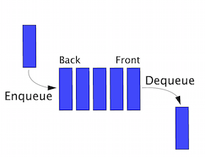
Queue Using Linked List
Enqueue
Inserts element at the end of a linked list.
Dequeue
Deletes the element from front of a linked list.
Notes:
Title + Image + Text

Slide 6

THANK YOU
Notes:
Thank you slide

