Slide 1


Slide 2

VIT
Topic/Course
Sub-Topic (Example: name of college)

Slide 3

Data interpretation

Slide 4

Question 1-3
Directions for the Questions:
The following table provides test results of two tests of the students of a class. Refer to the table to answer the questions.
Group I: Students failed in both tests
Group II: Students passed only in test 1
Group III: Students passed only in test 2
Group IV: Students passed in both tests

Slide 5
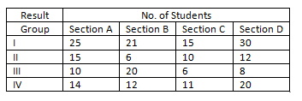
Question 1-3

Slide 6
Question 1
How many students are there in the class?
A)
235
B)
178
C)
144
D)
None
Notes:
Answer: A
No. of students in Sec-A =64No. of students in Sec-B =59
No. of students in Sec-C = 42
No. of students in Sec- D = 70
Total = 235

Slide 7
Question 2
In which of the sections did the maximum students pass?
A)
D
B)
C
C)
B
D)
A
Notes:
Answer: A
Section A=15+10+14=39
Section B=6+20+12=38
Section C=10+6+11=27
Section D=12+8+20=40
Section D

Slide 8
Question 3
In which of the sections did the minimum students pass?
A)
D
B)
C
C)
B
D)
A
Notes:
Answer: B
Section A=15+10+14=39
Section B=6+20+12=38
Section C=10+6+11=27
Section D=12+8+20=50
Section C

Slide 9
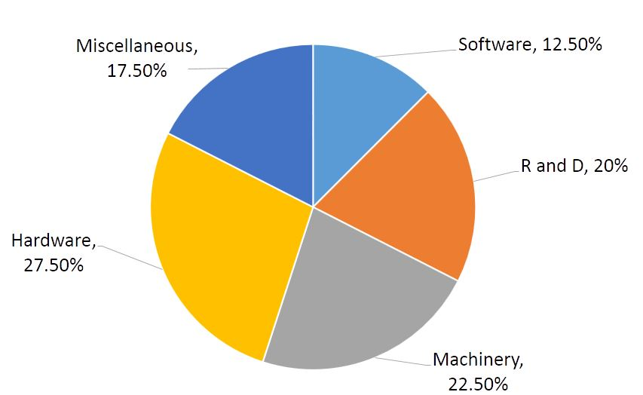
Question 4-10
Direction : The following pie chart shows the expenditure incurred in the manufacturing of a Scientific calculator under various heads. Study the following pie chart carefully and answer the questions given.

Slide 10
Question 4
What is the cost price of a calculator, for which the cost of R & D and machinery charges amount to Rs.170?
A)
Rs. 255
B)
Rs. 300
C)
Rs. 350
D)
Rs. 400
E)
Rs. 382.50
Notes:
Answer: D
R & D = 20% Machinery = 22.5% => 42.5 % which is equal to Rs.170 => 42.5% = 170 => 1% = 4 => 100% = 400Hence, Cost Price = Rs.400

Slide 11
Question 5
If the profit is 20% and the selling price of calculator is Rs.240, then how much money has been spent on it as miscellaneous charges?
A)
Rs.28
B)
Rs.35
C)
Rs.40
D)
Rs.25
E)
Rs.45
Notes:
Answer: B
Selling price = 120% of Cost price = Rs.240 => Cost price = Rs.200 Miscellaneous charges are 17.5% of Cost price => 17.5% of 200 => 35 So the miscellaneous amount spent is Rs.35.

Slide 12
Question 6
If the machinery charges of a single unit is Rs 67.5 and the marked price is 30% more than the cost price, then what is the marked price of the calculator?
A)
Rs.515
B)
Rs.600
C)
Rs.510
D)
Rs.410
E)
Rs.390
Notes:
Answer: E
Machinery charges contribute 22.5% of cost price. Then 100 % is, ( 67.5/22.5 ) x 100 = Rs.300 30% of 300 = Rs.90 Marked price = Rs.90 + Rs.300 = Rs.390 or 22.5% = Rs.67.5 multiply both side with 6 135% = Rs.405 only option less than 405 is Rs.390

Slide 13
Question 7
The marked price of a calculator is 24% more than its cost price. If the marked price of a calculator is Rs.372, then what is the cost of R and D incurred in a single unit of calculator?
A)
Rs.15
B)
Rs.60
C)
Rs.30
D)
Rs.90
E)
None of the options
Notes:
Answer: B
Marked price is 24% more than Cost price Marked price = 1.24 x Cost price 372 = 1.24 Cost price Cost price = Rs.300 R and D is 20% 100% = Rs.300 So, 20% = Rs.60

Slide 14
Question 8
If the profit is 20% and the selling price of calculator is Rs.240, then how much money has been spent on it as machinery?
A)
Rs.15
B)
Rs.30
C)
Rs.45
D)
Rs.60
E)
Rs.75
Notes:
Answer: C
Selling price = 120% of Cost price = Rs.240 Cost price = Rs.200 Machinery charges are 22.5% of Cost price=> That can be written as 20 + 2.5% 20 % of 200=> 40 2.5% of 200=> 5 So the total amount spent for machinery is Rs.45

Slide 15
Question 9
If Software charges amount to be Rs.150, then what is the cost price of a calculator?
A)
Rs.1000
B)
Rs.1100
C)
Rs.1200
D)
Rs.1000
E)
Rs.1400
Notes:
Answer: C
12.5% => Rs.150 1 % => 12 100 % => 1200So, the Cost price of the calculator is found to be Rs.1200

Slide 16
Question 10
The marked price of a calculator is 24% more than its cost price. If the marked price of a calculator is Rs.372, then what is the cost of Software used in a single unit of calculator?
A)
Rs.37.5
B)
Rs.40
C)
Rs.27.5
D)
Rs.47.5
E)
Rs.43.5
Notes:
Answer: A
Marked price is 24% more than Cost price Marked price = 1.24 Cost price 372 = 1.24 Cost price Cost price = Rs.300 Software is 12.5% 100% = 300 So, 10% = 30 2.5% = 7.5 Answer = Rs.37.5

Slide 17
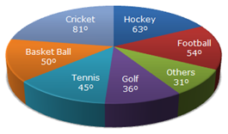
Question 11-12
Directions for the Questions:
The following pie chart shows the expenditure of a company on various sports.

Slide 18
Question 11
How much does the amount spent on Cricket exceeds on Hockey, if the total amount spent on sports during the year be Rs. 1,80,00,000?
A)
Rs. 9,00,000
B)
Rs. 8,40,000
C)
Rs. 5,000
D)
Rs. 25000
Notes:
Answer: A
360 degrees 180 lakhs
81 degrees - 63 degrees=18 degrees
360 degrees = 180 lakhs
18 degrees = x
x=18*180/360=9 lakhs

Slide 19
Question 12
If the total amount spent on sports during the year was Rs. 2 Crore, the amount spent on Golf and Football together was __________.
A)
Rs.1 Crore
B)
Rs. 7000000
C)
Rs. 2500000
D)
Rs.0.5 Crore
Notes:
Answer: D
360 degrees -2 crores
Golf and Football together =36+54=90 degrees
360 degrees = 2 crores
then 90 degrees = x
x = 0.5 crore

Slide 20
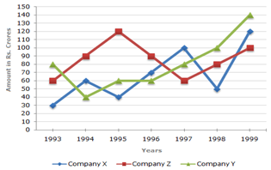
Question 13
The following chart gives the sales of 3 companies over years. Study the chart and answer the given question.
In which of the given pairs of years the total sales of the 3 companies together are equal?

Slide 21
Question 13
A)
1995, 1998
B)
1996, 1998
C)
1997, 1998
D)
1995, 1996
Notes:
Answer: D
1995 , 1998 = (40 + 60 +120 ) = 220, ( 50 + 80 +100 ) = 230
1996, 1998 = (60 + 70 + 90 ) = 220, ( 50 + 80 +100 ) = 230
1997, 1998 = ( 60 + 80 +100 ) = 240, ( 50 +80 + 100 ) = 230
1995, 1996 = ( 40 + 60 + 120 ) = 220, ( 60 + 70 + 90 )= 220
In 1995 , 1996 the sales of 3 companies together is equal

Slide 22
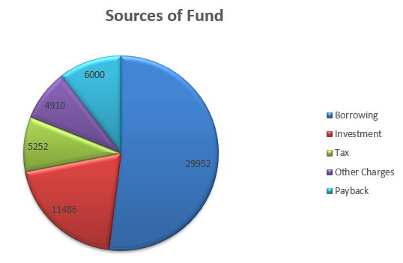
Question 14
The following pie chart shows the sources of funds collected by a company for its new project. Study the graph carefully and answer the question given below. By what percentage is the borrowed amount greater than that of the Payback amount?

Slide 23
Question 14
A)
314.42%
B)
225.6%
C)
336.76%
D)
399.2%
Notes:
Answer: D
Borrowed amount = Rs. 29,952
Pay back amount = Rs. 6000
% increase = ( 29,952 - 6000 ) / 6000 * 100 = 399.2 %

Slide 24
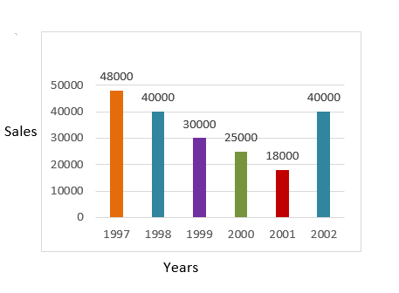
Question 15
The sales of the products of a sales company during 1997 to 2002 are shown in the following bar graph. Which are the two consecutive year between which the rate of change of sales is minimum?

Slide 25
Question 15
A)
1997 &1998
B)
1999 & 2000
C)
Both '1997 &1998' and
'1999 & 2000'
D)
None
Notes:
Answer: C
a) Rate of change of sales between 1997 & 1998 = ((48000-40000) / 48000)*100 = 16.66
b) Rate of change of sales between 1999 & 2000 = ((30000-25000) / 30000)*100
= 16.66

Slide 26

THANK YOU

