Slide 1

Notes:
1st slide (Mandatory)

Slide 2

Orientation
Topic/Course
Sub-Topic (Example: name of college)

Slide 3
Aptitude Tests
Aptitude test is just about testing memory
Has its part in
Company Interviews
Competitive exams – CAT, GATE, MAT, SBI PO, RRB
Promotion exams

Slide 4
Aptitude test is just about testing memory
Aptitude tests are designed to assess thinking performance

Slide 5
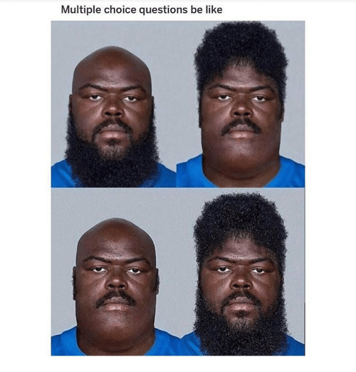
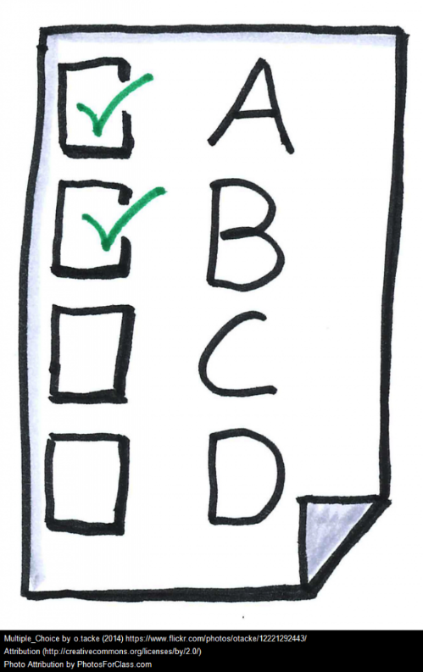
Aptitude Tests
They contain multiple choice questions and are administered under exam conditions.
Notes:
Title + Image + Text

Slide 6


Aptitude Tests
They are strictly timed and a typical test might allow 30 minutes for 30 or so questions
Notes:
Title + Image + Text

Slide 7
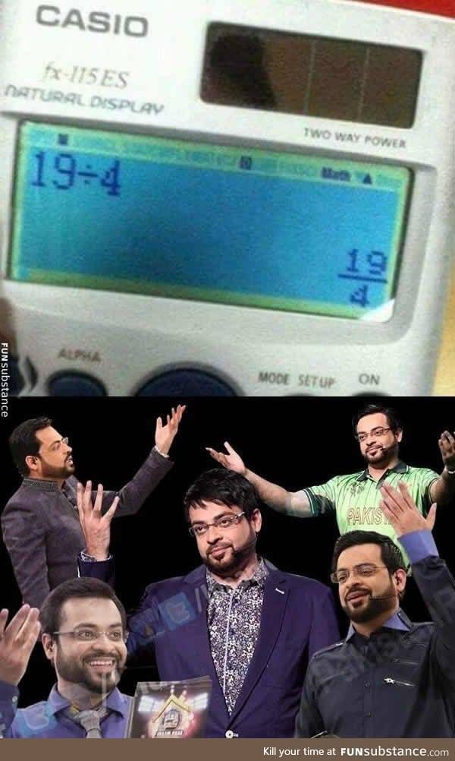

Aptitude Tests
Usage of calculator may or may not be permitted – depends on the company.
Notes:
Title + Image + Text

Slide 8
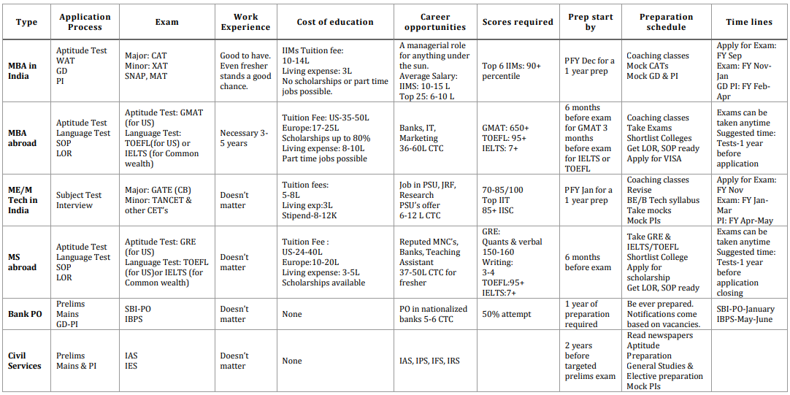
Notes:
Title + Image + Text

Slide 9
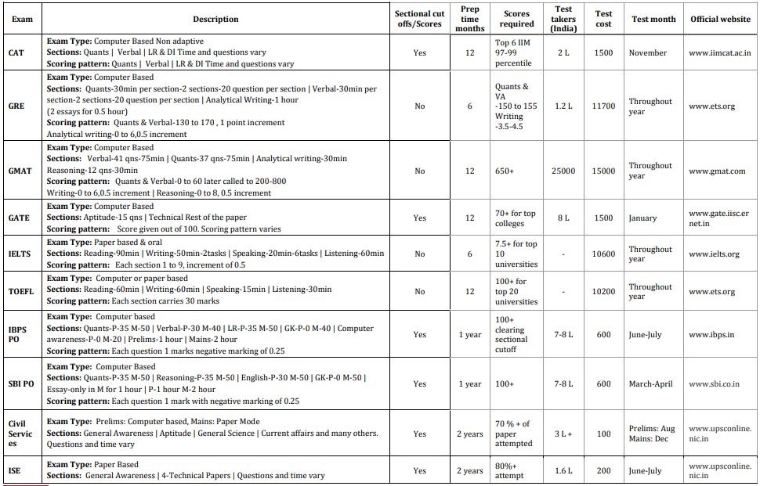
Notes:
Title + Image + Text

Slide 10
Corporate Uses
Ability to problem solve
The ability to analyze situations
The ability to reason
The ability to think logically
To take decisions based on data
To take decisions based on past trends
Ability to understand graphs, tables and charts
The ability to comprehend written and verbal communication
The ability to communicate well [verbal and written]
Language and Grammar skills

Slide 11
Corporate Uses
The ability to write coherently
Basic numeric skills
Advanced quantitative skills
The ability to learn new things quickly
The ability to detect patterns and establish relationships
The ability to plan and strategies
The ability to comprehend complex issues
The ability to visualize
Basic Computer Skills
Attention to Detail

Slide 12
Soft Skills
Difference between adequate candidates and ideal candidates
Recruitment criteria do not stop at technical ability and specialist knowledge
Interacting with colleagues
Notes:
An instructive example of the difference made by soft skills is a medical doctor. A doctor is required to have an extensive repertoire of hard skills, especially the ability to diagnose and prescribe treatments for an array of ailments.
But a doctor who does not have the soft skills of emotional intelligence, trustworthiness and approachability is not likely to be very highly regarded by their patients.
Similarly, a salesperson who may have an unrivalled and exhaustive knowledge of their market will find it difficult to close a deal and retain their clients if they lack the soft skills of interpersonal skills and negotiation.
Soft skills are not just important when facing external customers and clients. They are equally important when it comes to interacting with colleagues.
Employers value soft skills because they enable people to function and thrive in teams and in organisations as a whole.
A productive and healthy work environment depends on soft skills. After all, the workplace is an interpersonal space, where relationships must be built and fostered, perspectives must be exchanged, and occasionally conflicts must be resolved.

Slide 13
Soft Skills
Key soft skills are
Communication
Self Motivation
Leadership
Responsibility
Teamwork

Slide 14
Syllabus (Tech)
ORIENTATION | Data Structure 1.1 | Data Structure 1.2 | Data Structure 1.3 | Data Structure 1.4 | Data Structure 1.5 | Data Structure 1.6 | Data Structure 1.7 | Data Structure 1.8 | Data Structure 1.9 | Data Structure 1.10
Data Structure 1.11 | Data Structure 1.12 | Data Structure 1.13 | Data Structure 1.14

Slide 15
Syllabus (Apti)
Resume skills 1.1 | Resume skills 1.2 | Permutation-Combinations 1.1 | Permutation-Combinations 1.2 | Probability 1.1 | Probability 1.2 | Geometry | mensuration | Trigonometry 1.1 | Trigonometry 1.2 | Logarithms
Functions 1.1 | Functions 1.2 | Quadratic Equations | Set Theory | Set Theory | Syllogisms | Binary logic | Sequential output tracing | Crypto arithmetic | Data Sufficiency | Data interpretation 1.1
Data interpretation 1.2 | Data interpretation 1.3 | Reading comprehension 1.1 | Reading comprehension 1.2 | Para Jumbles 1.1 | Para Jumbles 1.2 | Critical Reasoning 1.1 | Critical Reasoning 1.2

Slide 16

THANK YOU
Notes:
Thank you slide

