Slide 1


Slide 2

VIT
Topic/Course
Sub-Topic (Example: name of college)

Slide 3

Set Theory

Slide 4

Set Theory
A Set is an unordered collection of objects, known as elements or members of the set.
An element ‘a’ belong to a set A can be written as ‘a ∈ A’, ‘a ∉ A’ denotes that a is not an element of the set A.

Slide 5
Set Theory
Statement form:
In this representation, the well-defined description of the elements of the set is given. Below are some examples of the same.
1. The set of all even number less than 10.
2. The set of the number less than 10 and more than 1.

Slide 6
Set Theory
Roster form
In this representation, elements are listed within the pair of brackets {} and are separated by commas. Below are two examples.
Let N is the set of natural numbers less than 5.
N = { 1 , 2 , 3, 4 }.
The set of all vowels in the English alphabet.
V = { a , e , i , o , u }.

Slide 7
Set Theory
Set builder form:
In Set-builder set is described by a property that its member must satisfy.
{x : x is even number divisible by 6 and less than 100}.
{x : x is natural number less than 10}.

Slide 8
Set Theory
Union:
The union of two sets is a new set that contains all of the elements that are in at least one of the two sets. The union is written as A∪B or “A or B”.
Intersection:
The intersection of two sets is a new set that contains all of the elements that are in both sets. The intersection is written as A∩B or “A and B”.

Slide 9
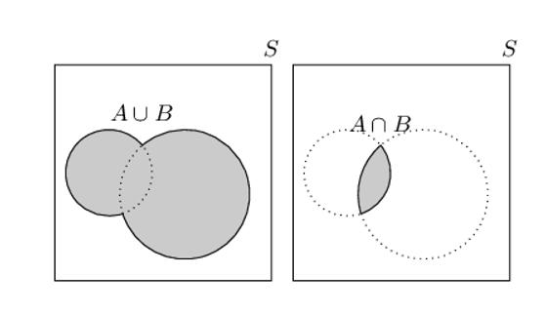
Set Theory

Slide 10
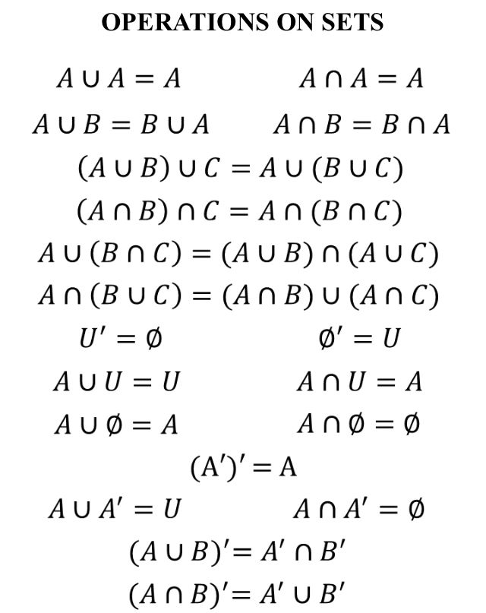
Set Theory

Slide 11
Question 1
The set of intelligent students in a class is ____________.
A)
A null set
B)
A singleton set
C)
A finite set
D)
Not a well defined collection
Notes:
Answer: D
Since, intelligency is not defined for students in a class i.e., Not a well defined collection.

Slide 12
Question 2
Which of the following is the empty set?
A)
{x:x is a real number and x²−1=0}
B)
{x : x is a real number and x²+1=0}
C)
{x : x is a real number and x²−9=0}
D)
{x : x is a real number and x²=x+2}
Notes:
Answer: B
Since x²+1=0, gives x²=−1 ⇒ x=±i ∴ x is not real but x is real (given) ∴ No value of x is possible.

Slide 13
Question 3
If a set A has n elements, then the total number of subsets of A is __________.
A)
n
B)
n²
C)
2^{n}
D)
2n
Notes:
Answer: C
Number of subsets of A=^{n}C₀+^{n}C₁+.........+^{n}C_{n}=2^{n}.

Slide 14
Question 4
If A={a,b},B={c,d},C={d,e}, then{(a,c),(a,d),(a,e),(b,c),(b,d),(b,e)} is equal to _________.
A)
A ∩ (B ∪ C)
B)
A ∪ (B ∩ C)
C)
A × (B ∪ C)
D)
A × (B ∩ C)
Notes:
Answer: C
A × (B ∪ C)

Slide 15
Question 5
The number of non-empty subsets of the set {1, 2, 3, 4} is ________.
A)
15
B)
14
C)
16
D)
17
Notes:
Answer: A
The number of non- empty subsets = 2^{n}−1 = 2⁴−1=16−1=15.

Slide 16
Question 6
Let U={1,2,3,4,5,6,7,8,9,10}, A={1,2,5},B={6,7}, then A∩B′ is ___________.
A)
B′
B)
A
C)
A′
D)
B
Notes:
Answer: B
B′={1,2,3,4,5,8,9,10} A∩B′={1,2,5}∩{1,2,3,4,5,8,9,10} ={1,2,5}=A

Slide 17
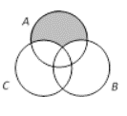
Question 7
The shaded region in the given figure is _________.
A)
A ∩ (B ∪ C)
B)
A ∪ (B ∩ C)
C)
A ∩ (B − C)
D)
A − (B ∪ C)
Notes:
Answer: D
It is obvious.

Slide 18
Question 8
Let U be the universal set and A∪B∪C=U. Then {(A−B)∪(B−C)∪(C−A)}′ is equal to __________.
A)
A∪B∪C
B)
A∪(B∩C)
C)
A∩B∩C
D)
A∩(B∪C)
Notes:
Answer: C
From Venn-Euler’s Diagram, Clearly, {(A−B)∪(B−C)∪(C−A)}′=A∩B∩C.

Slide 19
Question 9
20 teachers of a school either teach mathematics or physics. 12 of them teach mathematics while 4 teach both the subjects. Then the number of teachers teaching physics only is ___________.
A)
12
B)
8
C)
16
D)
None of these
Notes:
Answer: A
Let n(P)= Number of teachers in Physics. n(M)= Number of teachers in Maths
n(P∪M)=n(P)+n(M)−n(P∩M) 20=n(P)+12−4
n(P)=12.

Slide 20
Question 10
In a class of 100 students, 55 students have passed in Mathematics and 67 students have passed in Physics. Then the number of students who have passed in Physics only is _________.
A)
22
B)
33
C)
10
D)
45
Notes:
Answer: D
n (M)=55,n (P)=67,n (M∪P)=100 Now, n(M∪P)=n(M)+n(P)−n(M∩P) 100=55+67−n(M∩P) n(M∩P)=122−100=22 Now n (P only) =n (P) – n (M∩P) = 67−22 = 45.

Slide 21
Question 11
If (1, 3), (2, 5) and (3, 3) are three elements of A × B and the total number of elements in A×B is 6, then the remaining elements of A×B are ___________.
A)
(1, 5); (2, 3); (3, 5)
B)
(5, 1); (3, 2); (5, 3)
C)
(1, 5); (2, 3); (5, 3)
D)
None of these
Notes:
Answer: A
It is obvious.

Slide 22
Question 12
A = {1, 2, 3} and B = {3, 8}, then (A ∪ B) × (A ∩ B) is __________.
A)
{(3, 1), (3, 2), (3, 3), (3, 8)}
B)
{(1, 3), (2, 3), (3, 3), (8, 3)}
C)
{(1, 2), (2, 2), (3, 3), (8, 8)}
D)
{(8, 3), (8, 2), (8, 1), (8, 8)}
Notes:
Answer: B
A∪B={1, 2, 3, 8}; A∩B={3} (A∪B)×(A∩B)={(1,3),(2,3),(3,3),(8,3)}

Slide 23
Question 13
If A = {2, 3, 5}, B = {2, 5, 6}, then (A − B) × (A ∩ B) is _____________.
A)
{(3, 2), (3, 3), (3, 5)}
B)
{(3, 2), (3, 5), (3, 6)}
C)
{(3, 2), (3, 5)}
D)
None of these
Notes:
Answer: C
A−B={3},A∩B={2,5} (A−B)×(A∩B)={(3,2);(3,5)}.

Slide 24
Question 14
In a class of 30 pupils, 12 take needle work, 16 take physics and 18 take history. If all the 30 students take at least one subject and no one takes all three then the number of pupils taking 2 subjects is ____________.
A)
16
B)
6
C)
8
D)
20
Notes:
Answer: A
Given n(N)=12, n(P)=16, n(H)=18, n(N∪P∪H)=30 , n(N∩P∩H) = 0 From, n(N∪P∪H)=n(N)+n(P)+n(H)−n(N∩P) −n(P∩H)−n(N∩H)+n(N∩P∩H) n (N∩P)+n(P∩H)+n(N∩H)=16 Now, number of pupils taking two subjects =n (N∩P) + n (P∩H) + n (N∩H) − 3n (N∩P∩H) =16−0=16.

Slide 25
Question 15
If there are 400 elements in consideration, set A has 100 elements, set B has 150 elements, and 75 are the common elements. Find how many elements is neither in A nor in B.
A)
100
B)
200
C)
225
D)
125
Notes:
Answer: C
Given n (U) = 400, n (A) = 100, n (B) = 150 and n (A ∩ B) = 75. We have to calculate the elements which are neither in A nor in B and according to the De Morgan’s law of complement law, we know that n (A′ ∩ B′) = n (A ∪ B)′ = n (U) – n (A ∪ B) i.e. the complement of any set is U –A and here we have to calculate the complement of the union of A and B so Venn diagram n (A ∪ B)′= n (U) – n (A ∪ B) = n (U) – n (A) – n (B) + n (A ∩ B) = 400 – 100 – 150 + 75 = 225

Slide 26

THANK YOU

