Slide 1


Slide 2

VIT
Topic/Course
Sub-Topic (Example: name of college)

Slide 3

Trigonometry 1.1

Slide 4
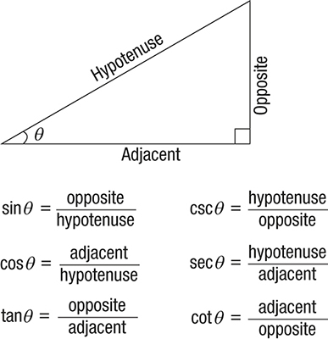

Trigonometry 1.1

Slide 5
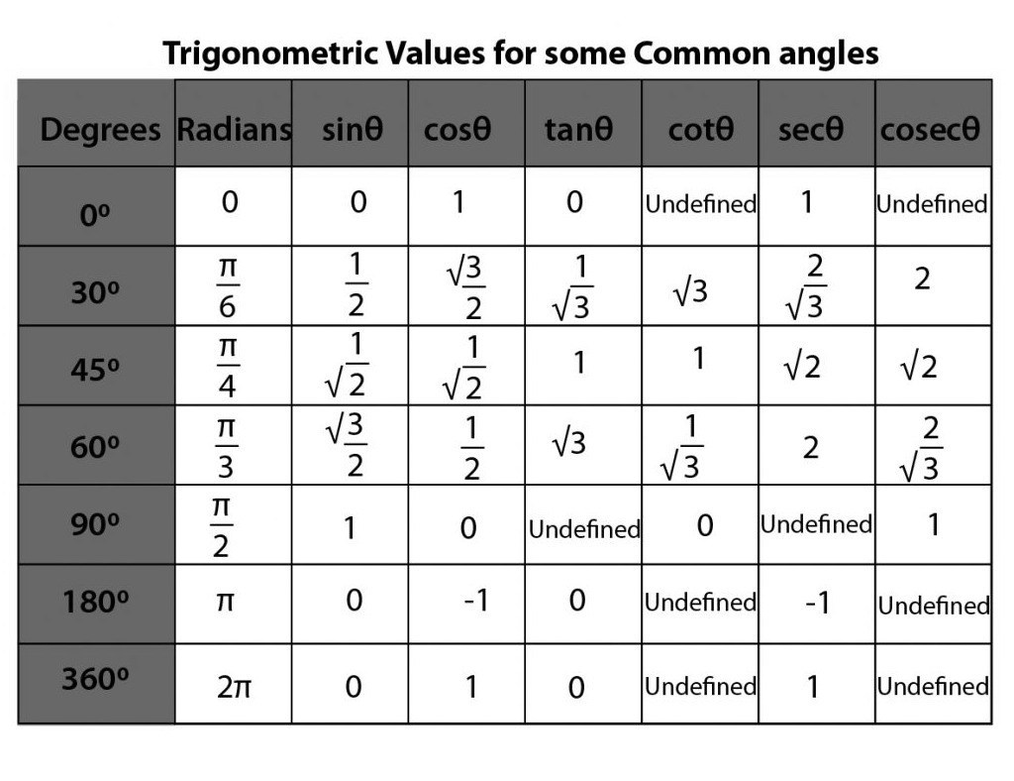
Trigonometry 1.1

Slide 6
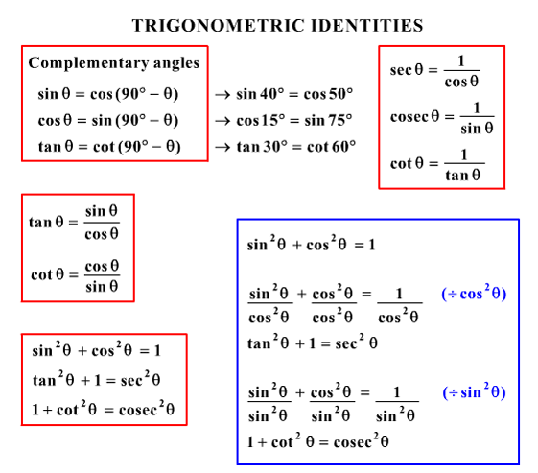
Trigonometry 1.1

Slide 7
Question 1
The angle of elevation of a ladder leaning against a wall is 60° and the foot of the ladder is 4.6 m away from the wall. The length of the ladder is ________________.
A)
2.3 m
B)
4.6 m
C)
7.8 m
D)
9.2 m
Notes:
Answer: D
Image: View->Notes page
Let AB be the wall and BC be the ladder. Then, ACB = 60° and AC = 4.6 m. AC/BC = cos 60° = 1/2 BC = 2 x AC = (2 x 4.6) m = 9.2 m.

Slide 8
Question 2
An observer 1.6 m tall is 20√3 away from a tower. The angle of elevation from his eye to the top of the tower is 30°. The heights of the tower is ____________.
A)
21.6 m
B)
23.2 m
C)
24.72 m
D)
None of these
Notes:
Answer: A
Image: View->Notes page
Let AB be the observer and CD be the tower. Draw BE ⊥ CD. Then, CE = AB = 1.6 m, BE = AC = 20√3 m. DE / BE = tan 30° = 1/√3 DE = 20√3 / √3 m = 20 m. ∴CD = CE + DE = (1.6 + 20) m = 21.6 m.

Slide 9
Question 3
The angle of elevation of the sun, when the length of the shadow of a tree √3 times the height of the tree, is ____________.
A)
30°
B)
45°
C)
60°
D)
90°
Notes:
Answer: A
Image: View->Notes page
Let AB be the tree and AC be its shadow. Let ∠ACB = Θ . Then, AC / AB = √3 => cot Θ = √3 ∴ Θ = 30°.

Slide 10
Question 4
From a point P on a level ground, the angle of elevation of the top of the tower is 30°. If the tower is 100 m high, the distance of point P from the foot of the tower is _________.
A)
149 m
B)
156 m
C)
173 m
D)
200 m
Notes:
Answer: C
Image: View->Notes page
Let AB be the tower. Then ∠APB = 30° and AB = 100 m. AB / AP = tan 30° = 1/ √3 AP = (AB x √3) m = 100√3 m = (100 x 1.73) m = 173 m.

Slide 11
Question 5
An observer 2 m tall is 10√3 m away from a tower. The angle of elevation from his eye to the top of the tower is 30º. The height of the tower is ___________.
A)
12 m
B)
14 m
C)
10 m
D)
None of these
Notes:
Answer: A
Image: View->Notes page
SR = PQ = 2 m PS = QR = 10√3 m tan 30° = TS / PS 1/√3 = TS / 10√3 TS = 10 √3 / √3 = 10 m TR = TS + SR = 10 + 2 = 12 m

Slide 12
Question 6
If tan (x+y) tan (x-y) = 1, then find tan (2x/3).
A)
2/√3
B)
1/2
C)
1/√2
D)
1/√3
Notes:
Answer: D
tanA = cotB, tanA*tan B = 1 So, A +B = 90° (x+y)+(x-y) = 90°, 2x = 90° , x = 45° Tan (2x/3) = tan 30° = 1/√3

Slide 13
Question 7
What is the maximum value of 5 Sinθ + 12 cosθ?
A)
16
B)
13
C)
10
D)
12
Notes:
Answer: B
Maximum value = √(a² + b²) =13

Slide 14
Question 8
Find the value of tan 60° + tan 120°.
A)
1/2
B)
0
C)
2
D)
2/3
Notes:
Answer: B
tan(60)° + tan(180-120)° =tan(60)° + (-tan(60)°) {because in second quadrant tan is -ve} =0

Slide 15
Question 9
The least value of 2 sin ²θ + 3 cos ²θ is _________.
A)
1/3
B)
4/3
C)
2
D)
3/4
Notes:
Answer: C
2 sin² θ + 2 cos² θ + cos² θ =2(sin²θ + cos²θ) + cos²θ ; (by putting sin²θ + cos²θ=1) = 2 + cos²θ ;(the minimum value of cos²θ=0) = 2 + 0 = 2

Slide 16
Question 10
The angle of elevation of the sun, when the length of the shadow of a tree is equal to the height of the tree, is __________.
A)
60°
B)
30°
C)
45°
D)
None of these
Notes:
Answer: C
Image: View->Notes page
Consider the diagram shown above where QR represents the tree and PQ represents its shadow. We have, QR = PQ Let angle ∠QPR = θ tan θ = QR/PQ = 1 (since QR = PQ) => θ = 45° i.e., required angle of elevation = 45°

Slide 17
Question 11
The top of a 15 metre high tower makes an angle of elevation of 60° with the bottom of an electronic pole and angle of elevation of 30° with the top of the pole. What is the height of the electric pole?
A)
5 metres
B)
8 metres
C)
10 metres
D)
12 metres
Notes:
Answer: C
Image: View->Notes page
Consider the diagram shown above. AC represents the tower and DE represents the pole. Given that AC = 15 m, angle ADB = 30°, angle AEC = 60° Let DE = h Then, BC = DE = h, AB = (15-h) (∵ AC=15 and BC = h), BD = CE tan 60° = AC / CE => √3 = 15 / CE => CE = 15 / √3 ⋯(1) tan 30° = AB/BD => 1 /√3 = 15 − h / BD => 1 /√3 = 15 − h / ( 15/√3) (∵ BD = CE and substituted the value of CE from equation 1 ) => ( 15−h) = 1/√3 * 15/√3 = 15/3 = 5 => h = 15 − 5 = 10 m i.e., height of the electric pole = 10 m

Slide 18
Question 12
Two ships are sailing in the sea on the two sides of a lighthouse. The angle of elevation of the top of the lighthouse is observed from the ships are 30° and 45° respectively. If the lighthouse is 100 m high, the distance between the two ships is _______________.
A)
173 m
B)
200 m
C)
273 m
D)
300 m
Notes:
Answer: C
Image: View->Notes page
Let AB be the lighthouse and C and D be the positions of the ships. Then, AB = 100 m, ACB = 30° and ADB = 45°. AB/AC = tan 30° = 1 /√3 AC = AB x √3 = 100√3 m. AB/AD = tan 45° = 1 AD = AB = 100 m. CD = (AC + AD) = (100√3 + 100) m = 100(√3 + 1) = (100 x 2.73) m = 273 m.

Slide 19
Question 13
A man standing at a point P is watching the top of a tower, which makes an angle of elevation of 30° with the man’s eye. The man walks some distance towards the tower to watch its top and the angle of the elevation becomes 60°. What is the distance between the base of the tower and the point P?
A)
4√3 units
B)
8 units
C)
12 units
D)
Data inadequate
Notes:
Answer: D
Image: View->Notes page
One of AB, AD and CD must have given.
So, the data is inadequate.

Slide 20
Question 14
If 7 sin² Θ + 3 cos² Θ = 4 and 0 ≤ Θ ≤ π/2, then the value of tan Θ is __________.
A)
√(3/7)
B)
√(2/7)
C)
1/√3
D)
1/√7
Notes:
Answer: C
7 sin² Θ + 3 cos²Θ= 4 ⇒ 7 sin² Θ + 3(1 – sin² Θ )= 4 ⇒ sin2 Θ = 1/4 . So, sin Θ = 1/2 Cos θ= √(1-〖sin〗^2 θ) = √(1-(1/4)) = √3 / 2 tan θ=sin⁡θ/ cos θ = [(1/2) * (2/√3)] = 1/√3 Hence, 1/√3 is correct.

Slide 21
Question 15
A man is watching from the top of a tower a boat speeding away from the tower. The boat makes an angle of depression of 45° with the man’s eye when at a distance of 60 meters from the tower. After 5 seconds, the angle of depression becomes 30°. What is the approximate speed of the boat, assuming that it is running in still water?
A)
32 kmph
B)
36 kmph
C)
40 kmph
D)
44 kmph
Notes:
Answer: A
Let the tower be PQ and the boat be at positions R and S when making angles of 45° and 30° respectively. Given, PR = 60 m. Now, PQ/PR = tan 45° = 1. So, PQ = PR = 60 m. Again, PQ/PS = tan 30° = 1/√3. So, PS = 60 * √3 m = 103.92 m. Distance covered in 5 seconds = 103.92 – 60 = 43.92 m. Speed in kmph = (43.92/5) * (18/5) = 32 kmph (approximately)

Slide 22

THANK YOU

