Slide 1


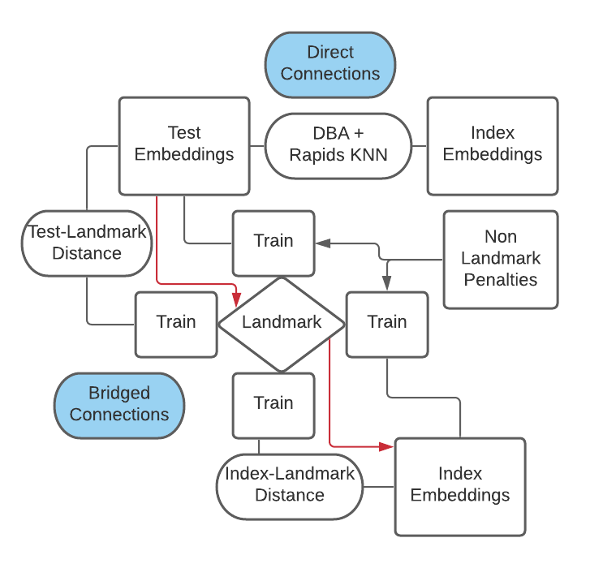
[1] Acroquest Technology Co., Ltd, [2] Saavn Media Pvt. Ltd.
Google Landmark Retrieval 2021 5th Place Solution ~Metric Learning + Bridged Confidence~
[1]
[2]
Hiroki Yamamoto, Kumar Shubham
Overview
Postprocessing
EfficientNetV2s 800 Public 0.37091 Private0.38652
GLDv2 Train Pre-Computing
New Test set
EfficientNetV2m 640 Public:0.38723 Private 0.39461
EfficientNetV2m 732 Public: 0.37473 Private:0.38743
Concatenate Public: 0.42486 Private: 0.43425
Post Process (Bridged Confidence) Public:0.49686 Private:0.50825
Final Result
New Index set
EfficientNetV2l 720 Public: 0.38159 Private:0.39036
EfficientNetV2xl 640 Public 0.39346 Private:0.39936
Training
Backbone
GAP
ArcFace
Model:
EfficientNetV2s
EfficientNetV2m x 2 EfficientNetV2l
EfficientNetV2xl
Data: GLDv2 (4.1M)
Optimizer: Adam with Cosine Annealing
Epoch:15
Hardware: TPU v3 8 core(Thanks to TRC Program!)
Other Training Tricks:
Gradient Accumulation
Mixed Precision
Hflip TTA
Concatenate All embedding vector(2560D)
DropOut
Dense
Landmark Distance Computation: Pick k (k=2) nearest train images from reference image (test/index) belonging to landmark and average their distances Bridged Distance = Min( Max((test,landmark_id),(index,landmark_id)) for all landmark_id belonging to gldv2 train set) Confidence = (Direct Confidence)**3 + (Bridged Confidence)**3
Embedding(512D) (apply L2)

