Slide 1
PROJECT ON
BRAIN TUMOR SEGMENTATION WITH UNET
VIVEK KUMAR
(UE208118)
IT SEC-2
--Under DIC

Slide 2
TITLE OF THE PROJECT:- BRAIN TUMOR SEGMENTATION WITH UNET
OBJECTIVE OF THE PROJECT:
The objective is of segmenting tumors from other brain artefacts in MRI image of the brain, and compare it with the actual segment given.
TECHNOLOGY USED:
Python , Machine Learning , Artificial Intelligence.

Slide 3
Introduction:-
A brain tumor is a mass or growth of abnormal cells in our brain.
Many different types of brain tumors exist. Some brain tumors are noncancerous (benign), and some brain tumors are cancerous (malignant).
Glioma, the most common primary brain tumors, occurs due to the carcinogenesis of glial cells in the spinal cord and brain.
Glioma is characterized by several histological and malignancy grades, and an average survival time of fewer than 14 months after diagnosis for glioblastoma patients

Slide 4
MRI:-
Magnetic Resonance Imaging (MRI) is a non-invasive imaging technology that produces three dimensional detailed anatomical images. It is often used for disease detection, diagnosis, and treatment monitoring.
However, the manual segmentation and analysis of structural MRI images of brain tumors is an arduous and time-consuming task which, thus far, can only be accomplished by professional neuroradiologists
Therefore, an automatic and robust brain tumor segmentation will have a significant impact on brain tumor diagnosis and treatment. Furthermore, it can also lead to timely diagnosis and treatment of neurological disorders such as Alzheimer’s disease (AD), schizophrenia, and dementia.

Slide 5
UNET ARCHITECTURE:-
Image Segmentation
Image Segmentation is the process of partitioning an image into separate and distinct regions containing pixels with similar properties. The segmented regions should depict/represent some object of interest so that it is useful for analytical purposes. These are the three most common ways of segmentation.
UNET
The U-Net is an elegant architecture that solves most of the occurring issues. It uses the concept of fully convolutional networks for this approach. The intent of the U-Net is to capture both the features of the context as well as the localization.

Slide 6
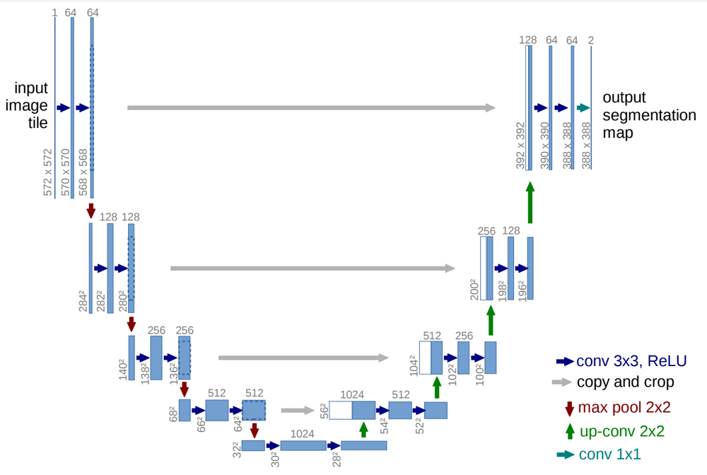
The segmentation will be done using the UNET Architecture
UNET is a U-shaped encoder-decoder network architecture, which consists of four encoder blocks and four decoder blocks that are connected via a bridge. The encoder network (contracting path) half the spatial dimensions and double the number of filters (feature channels) at each encoder block.

Slide 7
CONVOLUTIONAL NEURAL NETWORK
A Convolutional Neural Network (ConvNet/CNN) is a Deep Learning algorithm which can take in an input image, assign importance (learnable weights and biases) to various aspects/objects in the image and be able to differentiate one from the other.
The pre-processing required in a ConvNet is much lower as compared to other classification algorithms. While in primitive methods filters are hand-engineered, with enough training, ConvNets have the ability to learn these filters/characteristics.

Slide 8
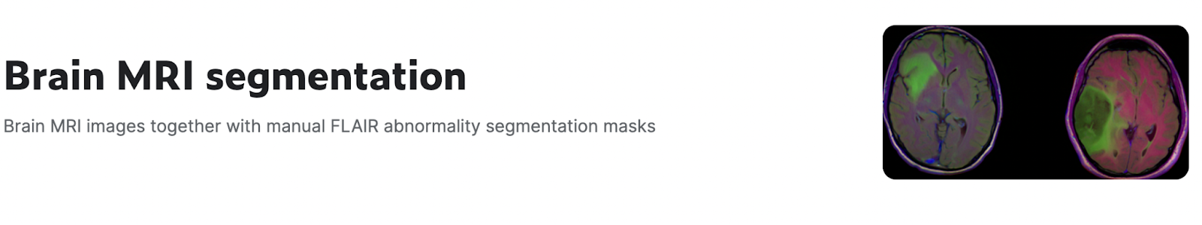
The dataset for this project was taken from KAGGLE.
It contains ~3900 images and masks
About the Project:-
The dataset for this project was taken from KAGGLE.
It contains ~3900 images and masks.

Slide 9
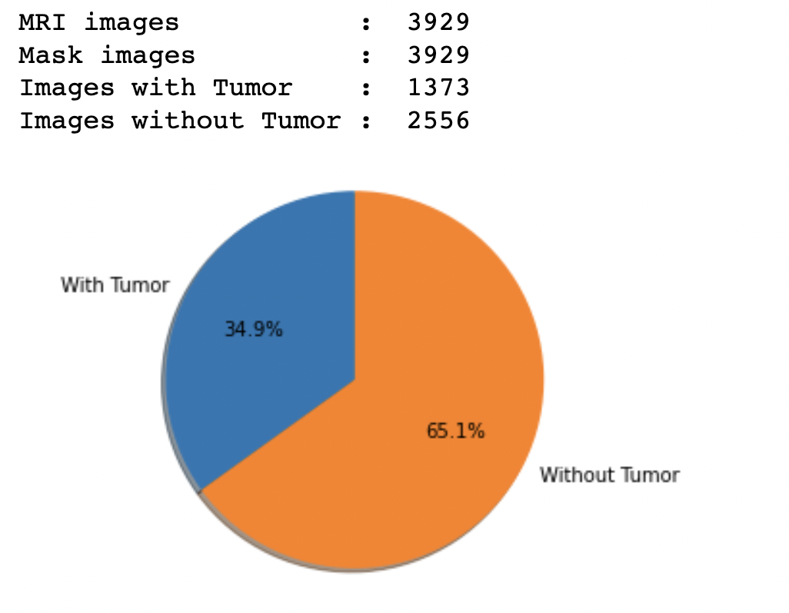
REPRESENTING THE DIVISION OF THE DATASET

Slide 10
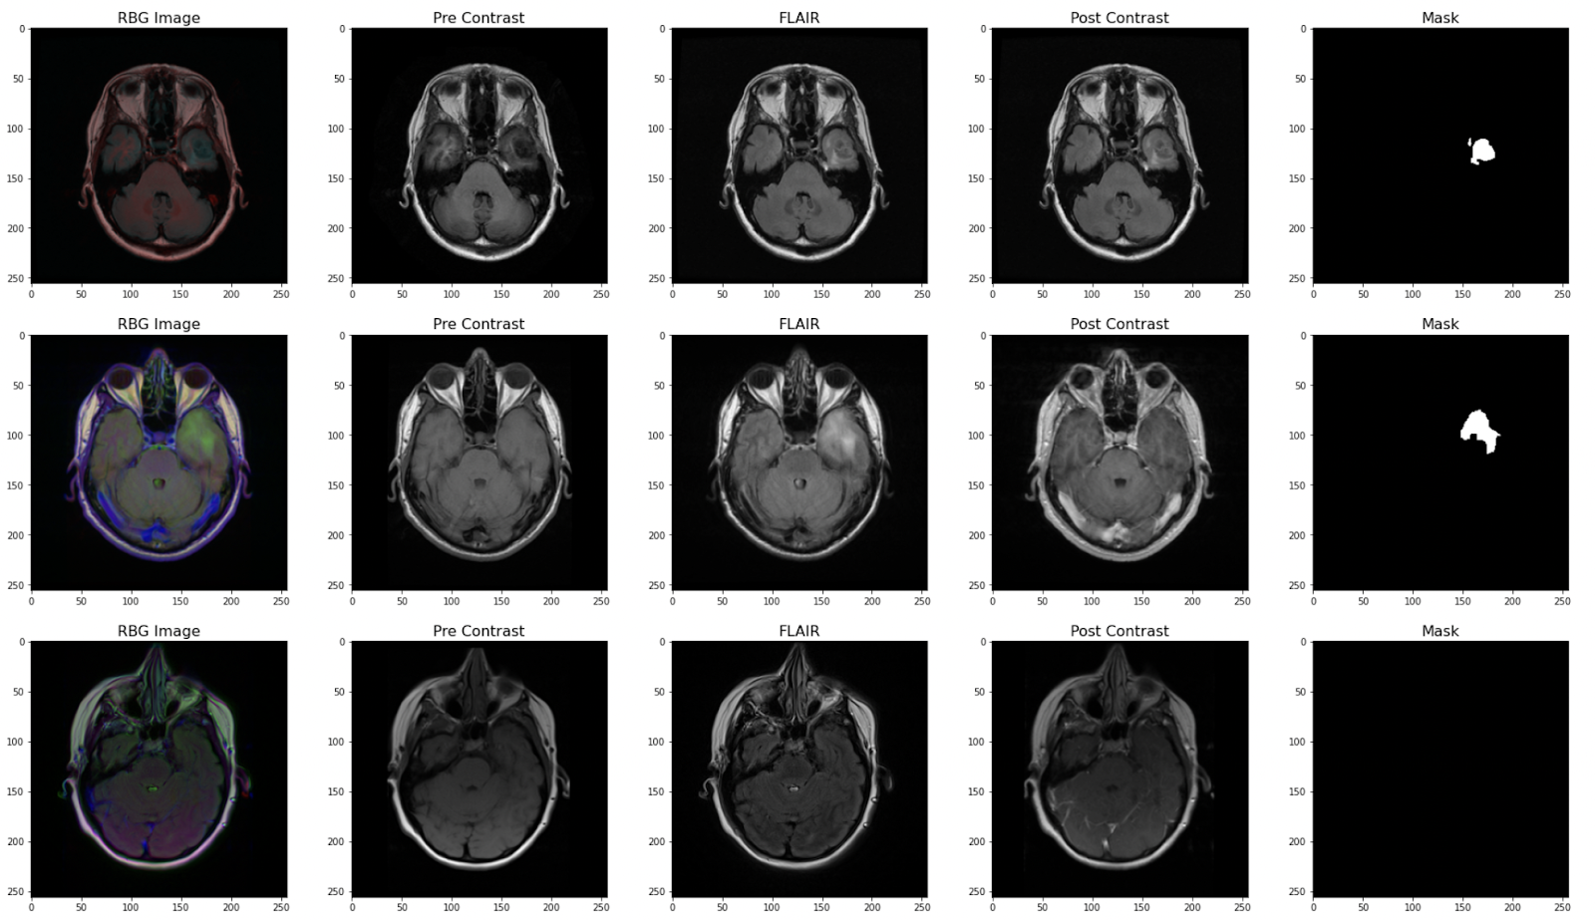
Sample Images

Slide 11
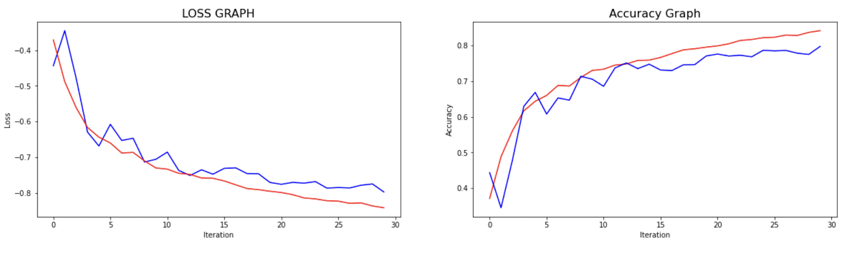
After applying the UNET Architecture. The model will be trained.
We set the epochs to 30 and below is the graph showing the progress

Slide 12
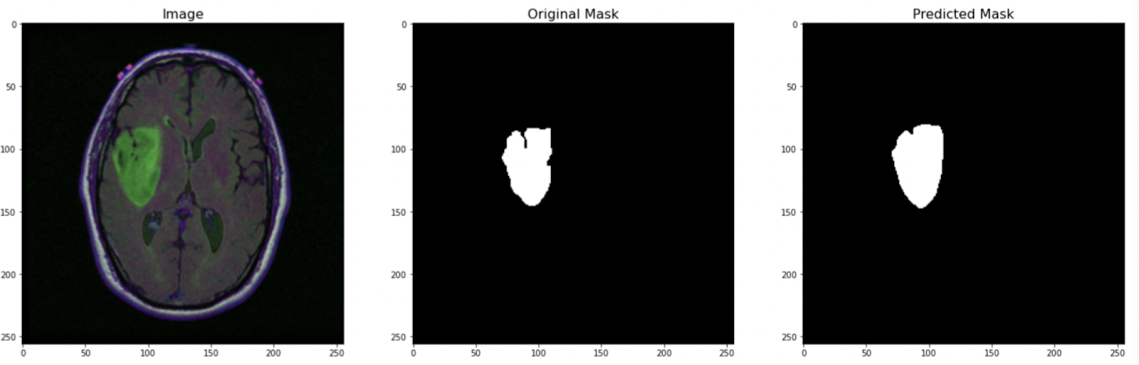
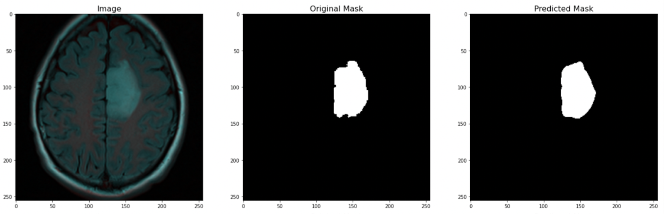
Comparing the predicted images with the original ones

Slide 13
Thank You

