Slide 1
Cleaning Validation Application
for Pharmaceutical Manufacturing — Carryover Limit Management
A Full-Stack Web Application for MACO Calculation, Protocol Management,
Cleaning Validation Reporting & Audit Compliance
M.Tech (Software Systems) — Viva Voce Presentation
BITS Pilani, WILP | 2023TM93530
Supervisor: Venkateswara Reddy | May 2026

Slide 2
Problem Statement
Why Cleaning Validation Management Needs a Dedicated System
Industry Challenge
Current Gaps
• Pharmaceutical equipment is shared across multiple drug products
• Residue of one product can contaminate the next — a critical patient-safety risk
• Regulatory bodies (FDA, EMA, ICH Q7) mandate validated cleaning procedures
• MACO (Maximum Allowable Carryover) limits must be calculated per product pair
• Manual spreadsheet-based methods are error-prone and non-traceable
• No unified system to manage facilities, equipment, and products together
• MACO calculations (PDE, Dose-based, 10 ppm) done in isolation without audit
• Protocol generation and cleaning validation reports maintained separately
• Audit trail is fragmented — no single source of truth
• Analysts lack real-time dashboard visibility of validation status across sites
Goal: Build a single integrated platform that automates MACO calculation, manages cleaning protocols end-to-end, and provides full regulatory-grade audit compliance.
Cleaning Validation Application | Pharmaceutical Manufacturing
2 / 41

Slide 3
Project Objectives
MACO Engine
Master Data Mgmt
Protocol Workflow
Implement three ICH-compliant calculation methods (PDE, Dose-based, 10 ppm) with configurable policy
Centralised management of Facilities, Equipment categories, and Product parameters with RBAC
Generate, archive and version cleaning validation protocols with immutable snapshot storage
O1
O2
O3
Report Management
Dashboard & VMP
Audit & Security
Create, submit, review and archive cleaning validation reports linked to approved protocols
Real-time site dashboard + Validation Master Plan with worst-case and all-products strategy
Complete tamper-evident audit trail, role-based access, JWT authentication, password-protected actions
O4
O5
O6
Cleaning Validation Application | Pharmaceutical Manufacturing
3 / 41

Slide 4
System Architecture
Three-Tier Web Application
PRESENTATION TIER
APPLICATION TIER
DATA TIER
React 19 (SPA)
FastAPI (Python)
PostgreSQL 15
▸ React Router (page state)
▸ JWT OAuth2 authentication
▸ 13 normalised tables
▸ Axios HTTP client
▸ Pydantic v1 validation
▸ FK-enforced integrity
▸ SVG Charts (no library)
⇄
▸ SQLAlchemy ORM
⇄
▸ Alembic migrations
▸ Responsive CSS layout
REST / HTTPS
▸ MACO calculation engine
SQLAlchemy
▸ Immutable protocol snapshots (JSON)
▸ Print / PDF export
▸ Ollama LLM integration
▸ Audit log table
Cleaning Validation Application | Pharmaceutical Manufacturing
4 / 41

Slide 5
Technology Stack
Frontend
Backend
Database & Infra
● React 19 — Component-based SPA
● FastAPI — Async Python web framework
● PostgreSQL 15 — Primary relational DB
● Axios — HTTP client with interceptors
● Pydantic v1 — Request/response validation
● SQLAlchemy ORM — Model definitions
● SVG — Inline charts (no third-party library)
● python-jose — JWT encode/decode
● Alembic — Schema migrations
● OAuth2 Bearer token (JWT)
● bcrypt — Password hashing
● 13 tables, FK constraints, JSON blobs
● CSS-in-JS — Inline styles, responsive layout
● Ollama (llama3.2:1b) — Local LLM queries
● File-based structured logging (daily rotation)
Cleaning Validation Application | Pharmaceutical Manufacturing
5 / 41

Slide 6
Database Design
PostgreSQL — 13 Normalised Tables
facilities
facility_id, facility_name
protocol_archive
archive_id, doc_number, version, product_id, snapshot_json, status
equipment_category
category_id, category_name
sampling_plan_entry
entry_id, category_id, sample_number, location_description
equipment
equipment_id, name, facility_id, surface_area_cm2, rinse_vol_L
cleaning_validation_reports
report_id, archive_id, product_id, results_data (JSON), submitted_by
products
product_id, facility_id, name, min_dose, max_dose, PDE, yield, solubility
users
user_id, username, hashed_password, role, is_archived
product_equipment
id, product_id, equipment_id [M:N link table]
audit_log
audit_id, event_type, entity_type, entity_id, old_value, new_value, performed_by
maco_runs
run_id, source_product, target_product, governing_maco, limits
system_config
config_key, config_value [e.g. maco_policy]
maco_results
result_id, calc_id, MACO_ug, method, is_governing
Cleaning Validation Application | Pharmaceutical Manufacturing
6 / 41

Slide 7
MACO Calculation Engine
Maximum Allowable Carryover — Three ICH-Compliant Methods
Method 1 PDE / ADE Based
Method 2 Dose-Based (1/1000th)
Method 3 10 ppm Criterion
MACO_PDE = (PDE_source × Yield_target × 10⁶) ÷ MaxDailyDose_target
MACO_Dose = (MinTherapDose_source × Yield_target × 10⁶) ÷ (MaxDailyDose_target × 1000)
MACO_10ppm = 10,000 × MinYield_target
Uses Permitted Daily Exposure (HBEL approach) ICH Q3C / EMA guideline on cleaning validation
1/1000th of minimum therapeutic dose in the maximum daily dose of the next product
10 ppm of source residue allowed in the maximum daily dose of the next product (μg)
Governing MACO:
min(MACO_PDE, MACO_Dose, MACO_10ppm) → most conservative value selected based on configurable policy (all_min | pde_only | dose_only | 10ppm_only | combinations)
Rinse Limit (ppm) = Governing MACO ÷ Total Rinse Volume (L)
Swab Limit (μg/cm²) = (Governing MACO × 90) ÷ Total Equipment Area (in²)
Cleaning Validation Application | Pharmaceutical Manufacturing
7 / 41

Slide 8
Master Data Management
Facilities · Equipment · Products — Foundation of Validation
Facility Master
Equipment Master
Product Master
▸ Multi-facility support across manufacturing sites
▸ Category-based grouping (Mixer, Granulator…)
▸ Min therapeutic dose, max daily dose, PDE, yield
▸ Equipment and products scoped per facility
▸ Surface area (cm²) and rinse volume (L) per item
▸ LOD / LOQ and analytical method stored
▸ Facility filter in MACO matrix and reporting
▸ Many-to-many product–equipment mapping
▸ USP solubility rating for worst-case risk ranking
▸ Audit-logged add / delete operations
▸ Used to derive rinse & swab acceptance limits
▸ AI-assisted product info lookup (Ollama LLM)
▸ OpenFDA + PubChem CAS number auto-lookup
▸ Archive/restore workflow with full audit trail
Cleaning Validation Application | Pharmaceutical Manufacturing
8 / 41

Slide 9
Protocol & Cleaning Validation Report Workflow
Step 1
Step 2
Step 3
Step 4
Step 5
MACO Matrix
Sampling Plan
Archive Protocol
Create Report
View / Archive
Run MACO matrix for source–target product pairs → governing limits derived
Configure per-category swab sample locations (sample No. + description)
Freeze protocol snapshot (Doc No., version, date) Status: Draft → Final
Select approved protocol, enter run results + swab data → password-protected submit
Formatted report document, print-to-PDF, version history, signature block
→
→
→
→
Immutable JSON snapshot — protocol is frozen at archive time; report uses live sampling plan
Password-protected submit / delete — QA or ADMIN role required
Doc number + version tracking across protocol iterations
Swab results per sample location per run — fully structured data
Cleaning Validation Application | Pharmaceutical Manufacturing
9 / 41

Slide 10
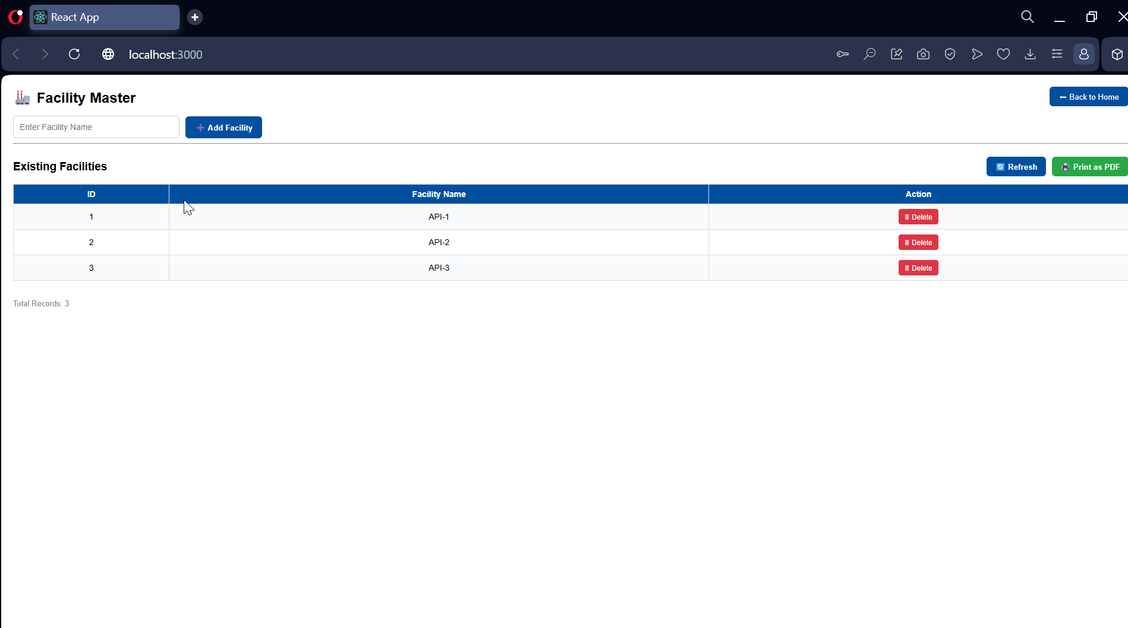
Application Screenshot
Facility Master
Facility Master
3 manufacturing sites configured: API-1, API-2, API-3 — add/delete with audit log
Cleaning Validation Application | Pharmaceutical Manufacturing
10 / 41

Slide 11
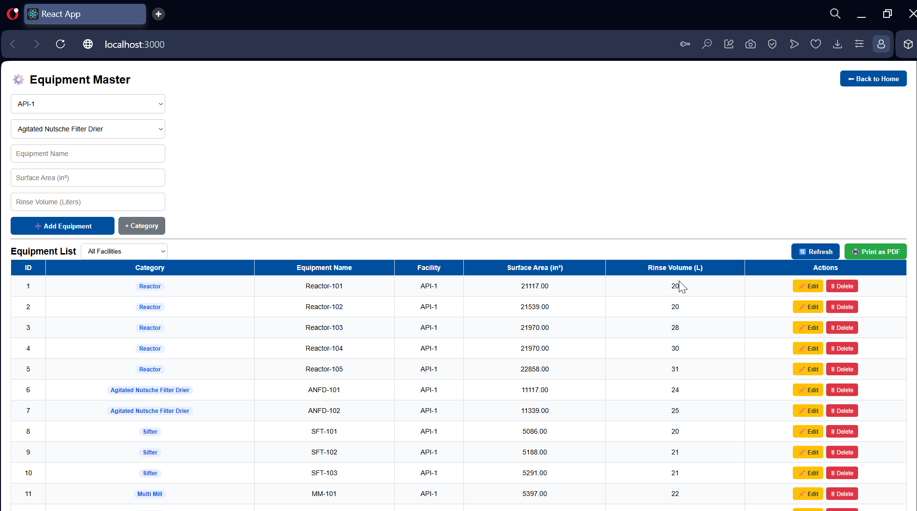
Application Screenshot
Equipment Master
Equipment Master
Reactors, ANFDs, Sifters, Multi Mills — surface area (in²) and rinse volume (L) per unit
Cleaning Validation Application | Pharmaceutical Manufacturing
11 / 41

Slide 12
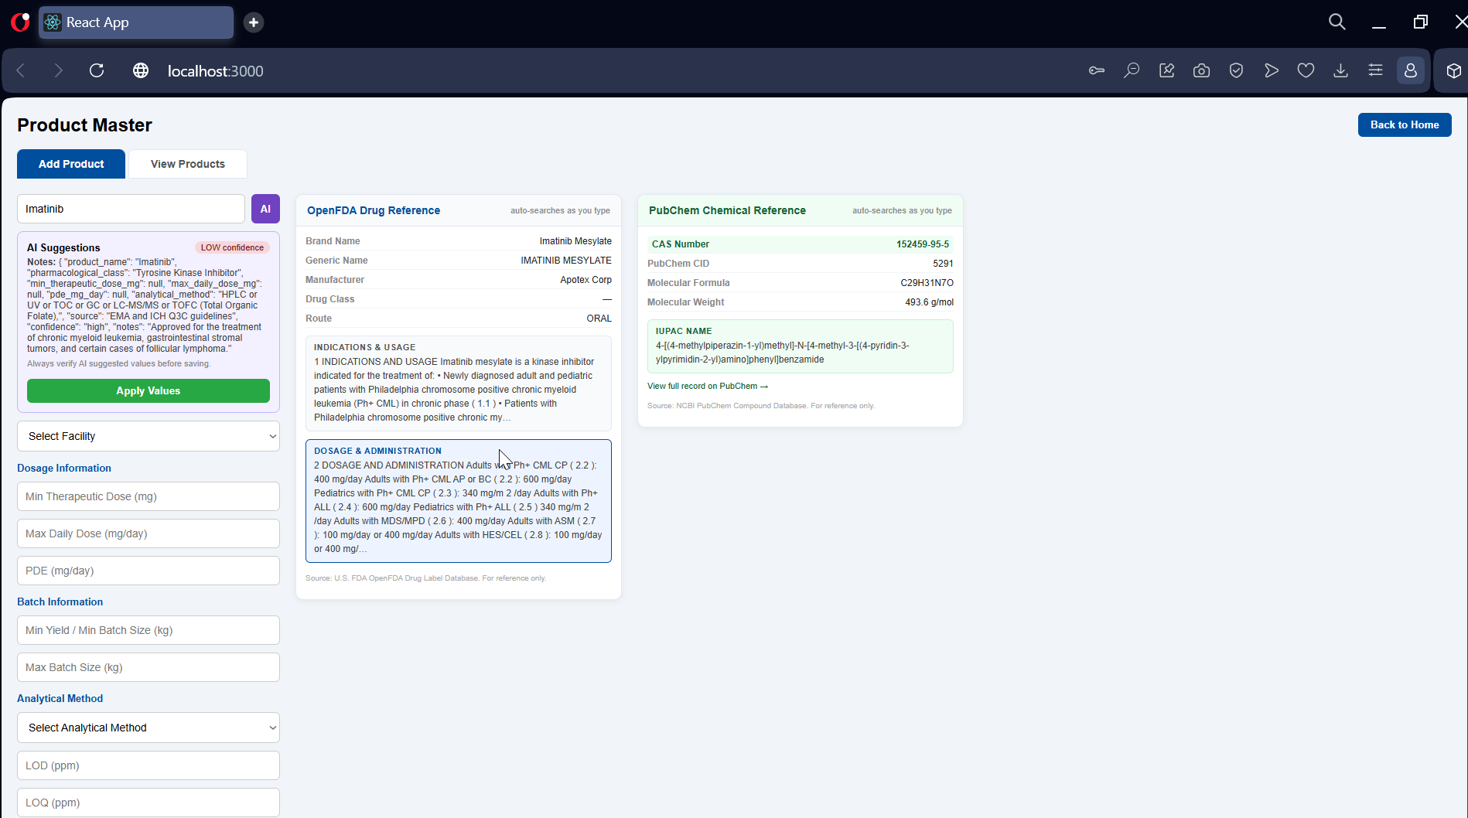
Application Screenshot
Product Master — Add Product
Product Master — Add Product
Imatinib: AI suggestions + OpenFDA label + PubChem CAS 152459-95-5 auto-lookup side panels
Cleaning Validation Application | Pharmaceutical Manufacturing
12 / 41

Slide 13
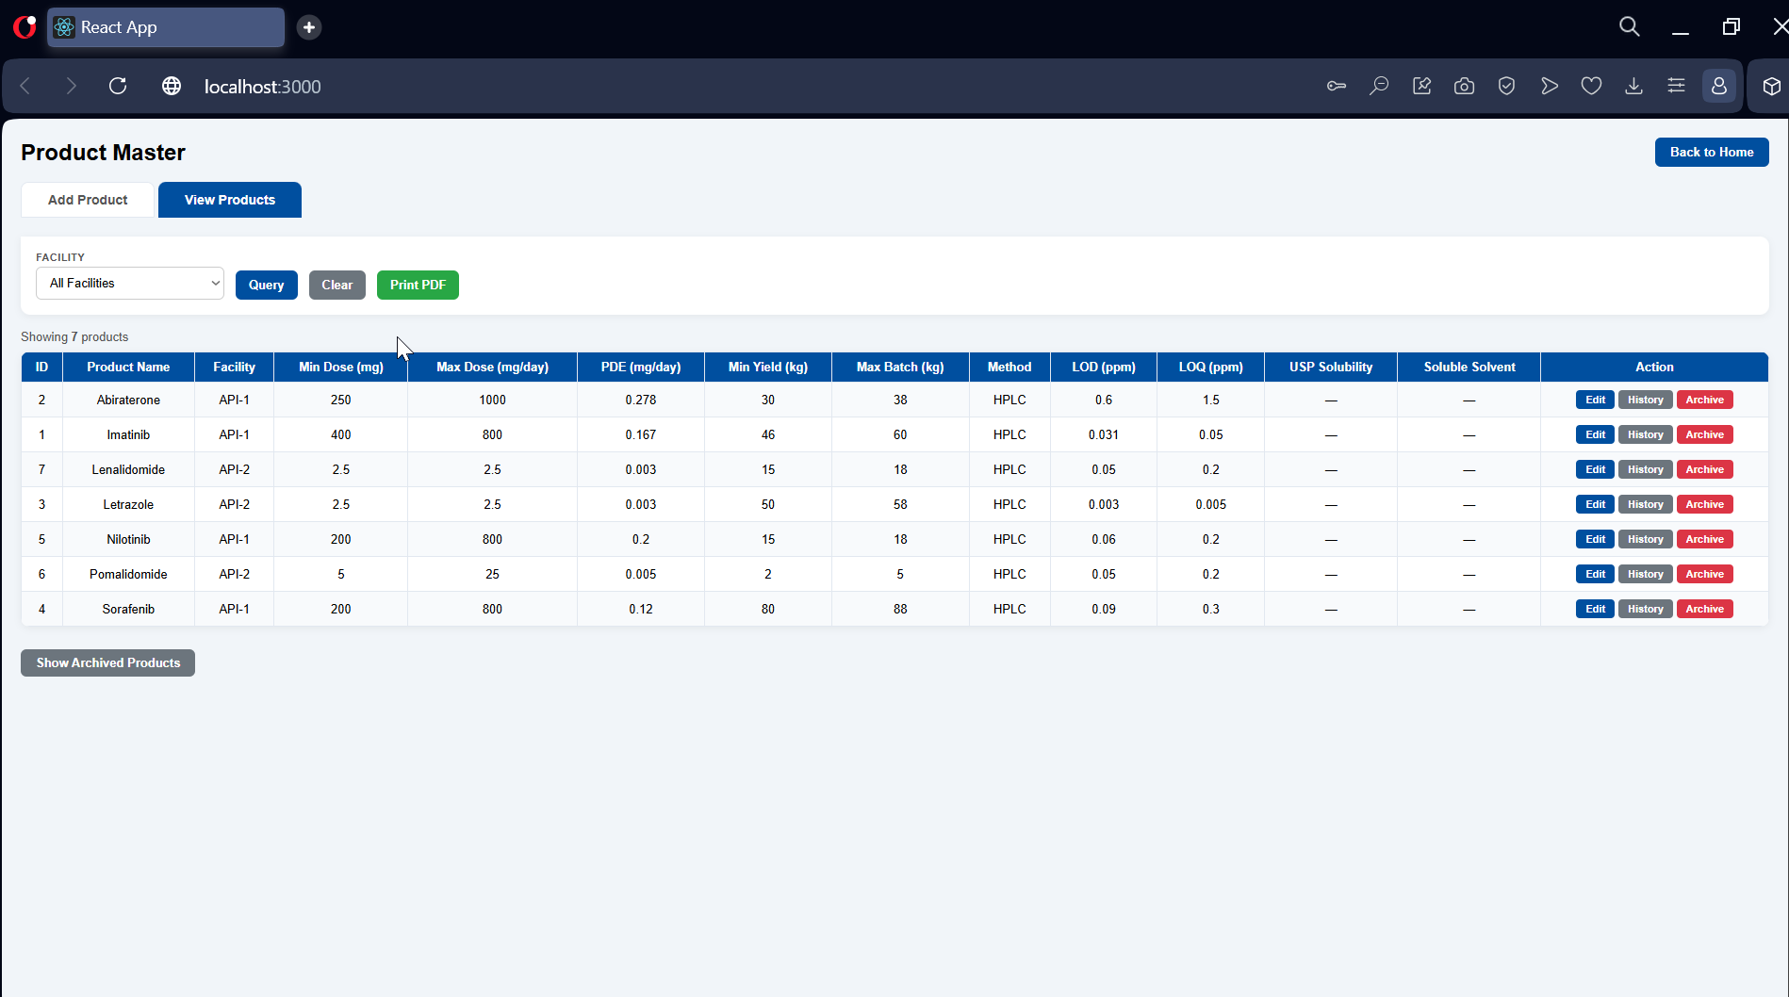
Application Screenshot
Product Master — View Products
Product Master — View Products
7 active products across API-1 / API-2 with dose, PDE, yield, method, solubility columns
Cleaning Validation Application | Pharmaceutical Manufacturing
13 / 41

Slide 14

Application Screenshot
Product Master — Archived Toggle
Product Master — Archived Toggle
Show/Hide Archived Products — no archived products; History and Archive actions per row
Cleaning Validation Application | Pharmaceutical Manufacturing
14 / 41

Slide 15
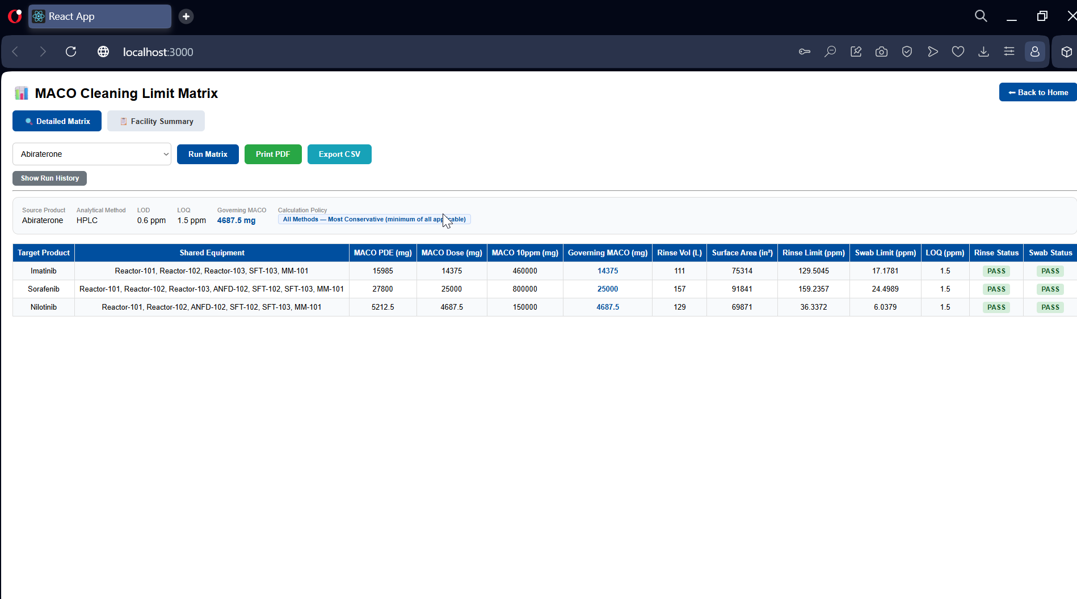
Application Screenshot
MACO Matrix — Detailed View
MACO Matrix — Detailed View
Abiraterone source: governing MACO 4687.5 mg, all target products PASS rinse & swab
Cleaning Validation Application | Pharmaceutical Manufacturing
15 / 41

Slide 16
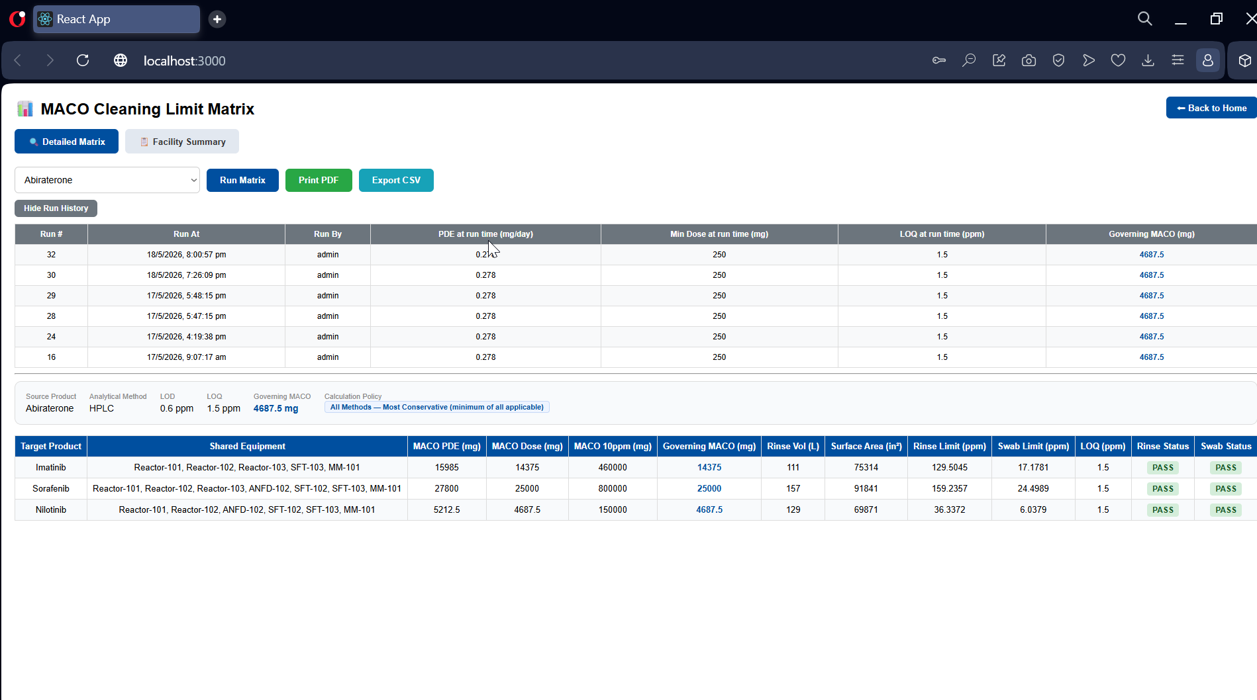
Application Screenshot
MACO Matrix — Run History
MACO Matrix — Run History
Audit trail of all previous MACO runs — PDE, min dose, LOQ and governing MACO at run time
Cleaning Validation Application | Pharmaceutical Manufacturing
16 / 41

Slide 17
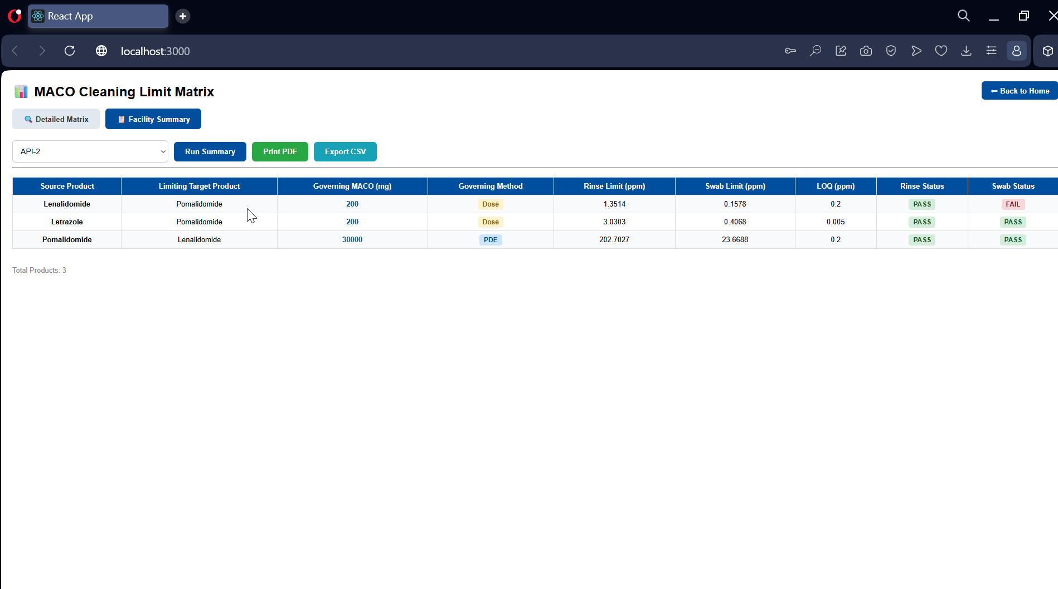
Application Screenshot
MACO Matrix — Facility Summary
MACO Matrix — Facility Summary
API-2 facility summary — Lenalidomide → Pomalidomide FAIL on swab (governing: Dose method)
Cleaning Validation Application | Pharmaceutical Manufacturing
17 / 41

Slide 18
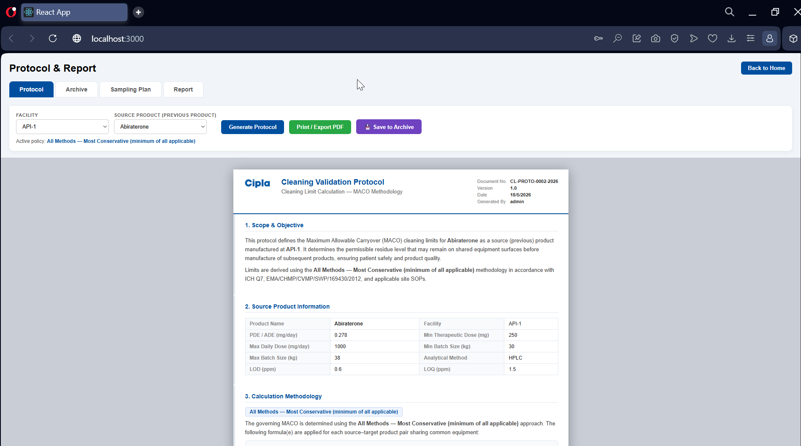
Application Screenshot
Protocol — Generate
Protocol — Generate
Generated Cleaning Validation Protocol: CL-PROTO-0002-2026, scope, product info, methodology
Cleaning Validation Application | Pharmaceutical Manufacturing
18 / 41

Slide 19
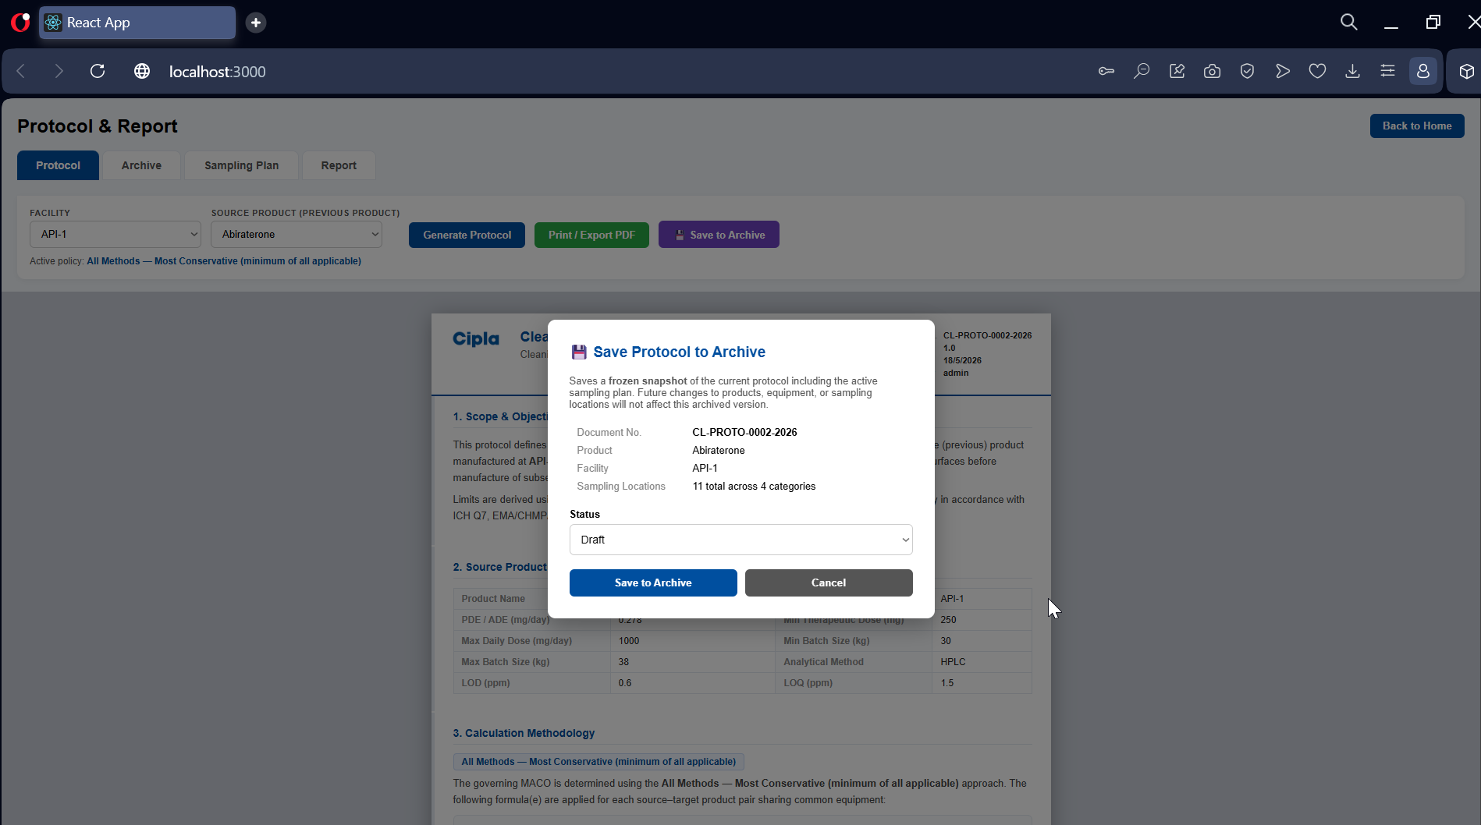
Application Screenshot
Protocol — Save to Archive
Protocol — Save to Archive
Save to Archive modal — frozen snapshot with doc number, product, facility, sampling locations
Cleaning Validation Application | Pharmaceutical Manufacturing
19 / 41

Slide 20
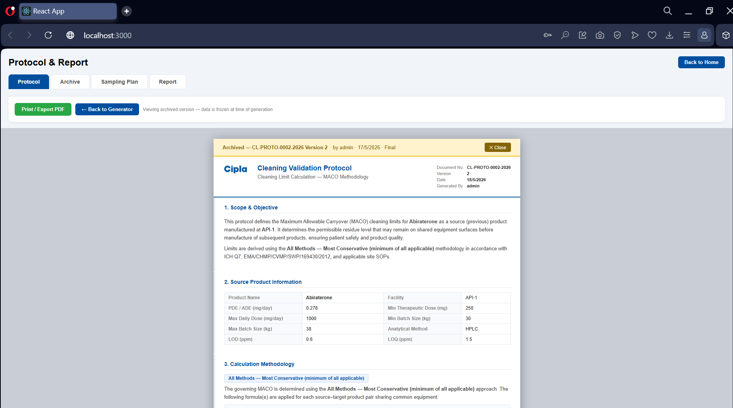
Application Screenshot
Protocol — Archived Version
Protocol — Archived Version
Viewing archived CL-PROTO-0002-2026 Version 2 (Final) — data frozen at time of archival
Cleaning Validation Application | Pharmaceutical Manufacturing
20 / 41

Slide 21
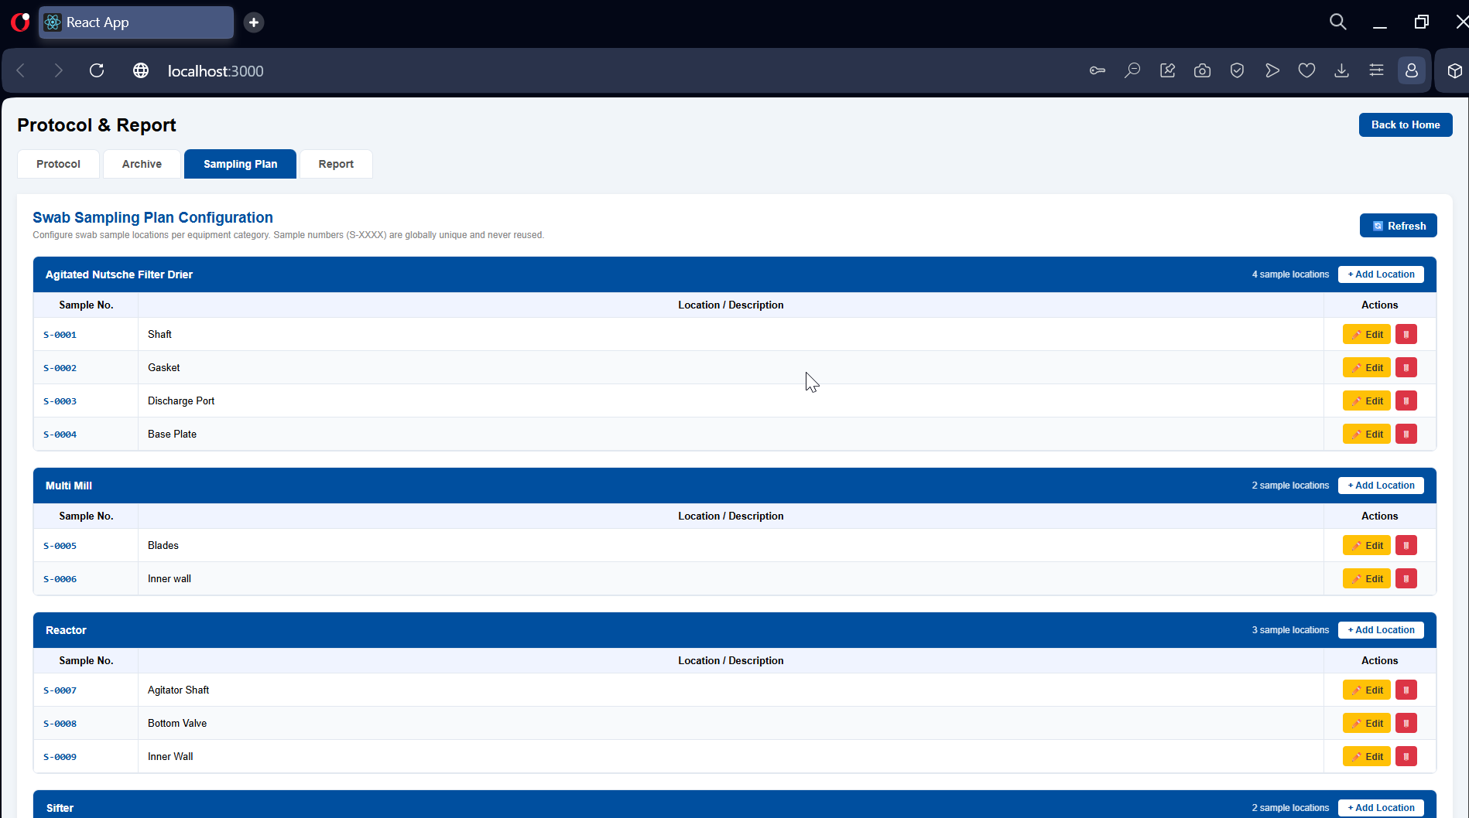
Application Screenshot
Sampling Plan Configuration
Sampling Plan Configuration
11 swab sample locations across 4 equipment categories — globally unique S-XXXX numbers
Cleaning Validation Application | Pharmaceutical Manufacturing
21 / 41

Slide 22
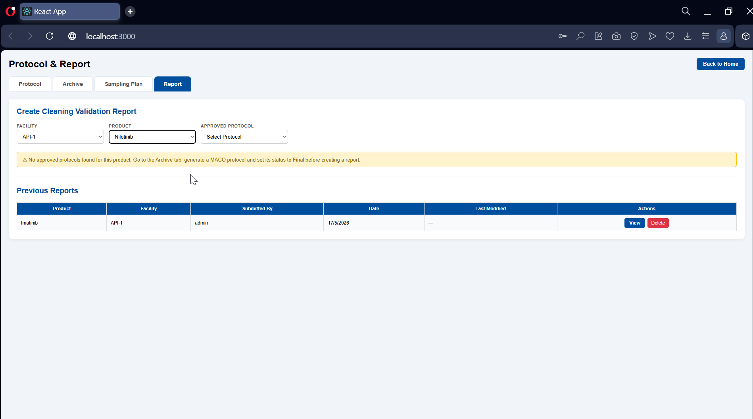
Application Screenshot
CV Report — Create Form
CV Report — Create Form
Create Cleaning Validation Report — no approved protocol for Nilotinib; Imatinib report listed
Cleaning Validation Application | Pharmaceutical Manufacturing
22 / 41

Slide 23
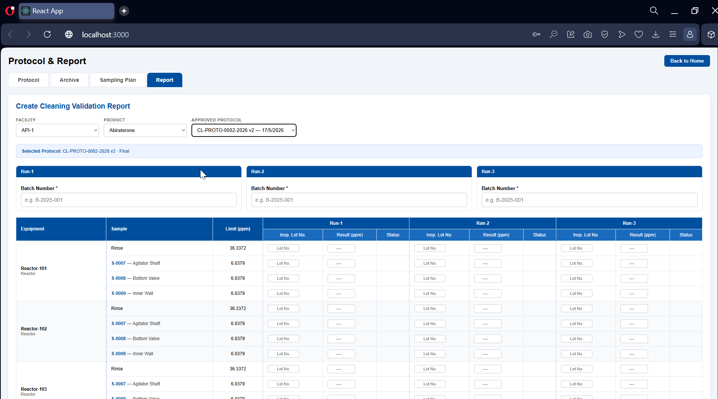
Application Screenshot
CV Report — Swab Entry Grid (Top)
CV Report — Swab Entry Grid (Top)
Abiraterone report: 3-run swab data entry grid with lot numbers, limits and status per sample
Cleaning Validation Application | Pharmaceutical Manufacturing
23 / 41

Slide 24
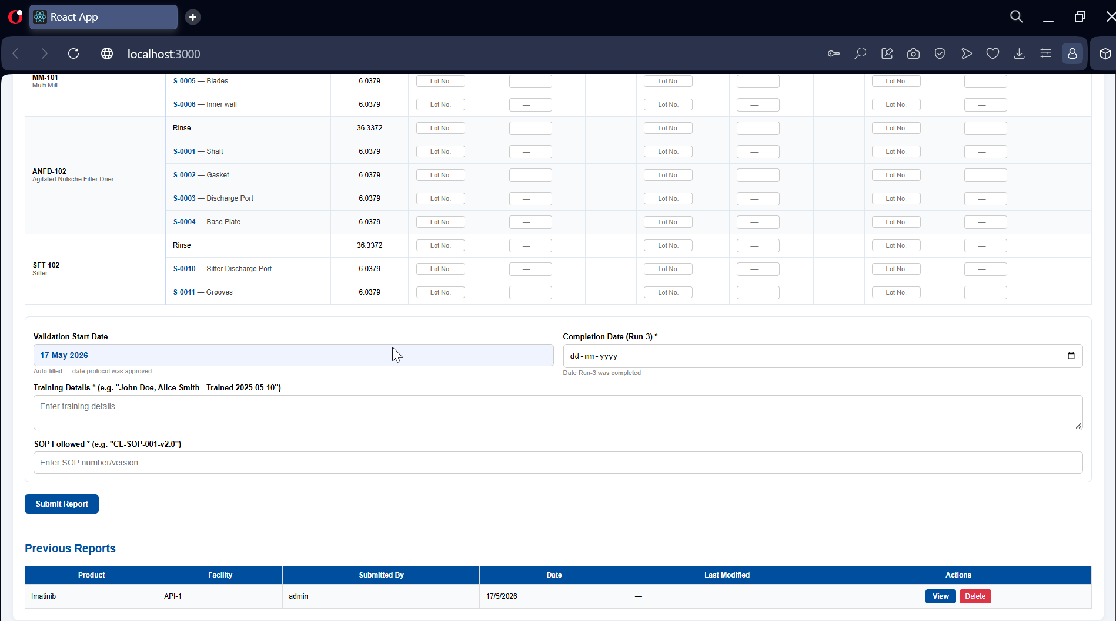
Application Screenshot
CV Report — Swab Entry Grid (Bottom)
CV Report — Swab Entry Grid (Bottom)
Report form continued: ANFD-102 and SFT-102 swab rows, validation dates, training, SOP
Cleaning Validation Application | Pharmaceutical Manufacturing
24 / 41

Slide 25
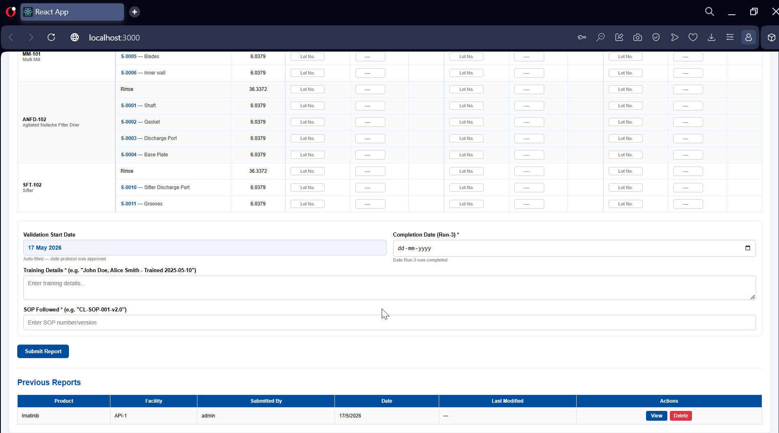
Application Screenshot
CV Report — Submit & History
CV Report — Submit & History
Submit Report button, previous Imatinib report in history; password-protected submission
Cleaning Validation Application | Pharmaceutical Manufacturing
25 / 41

Slide 26
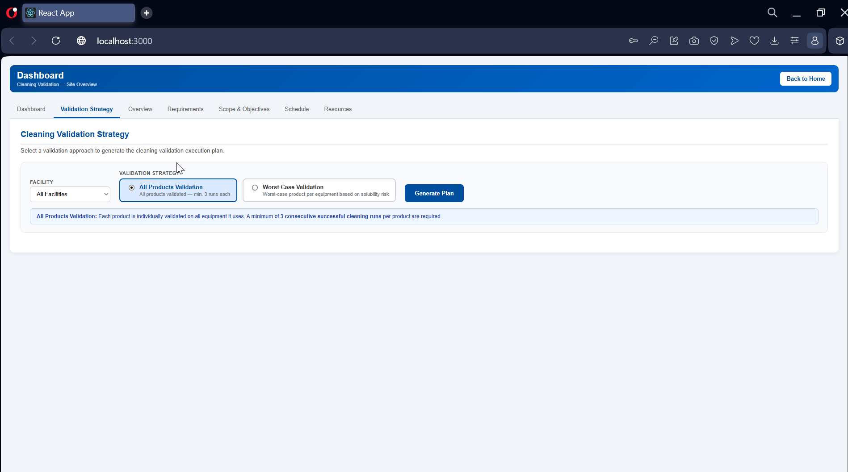
Application Screenshot
Validation Master Plan — Strategy
Validation Master Plan — Strategy
VMP strategy selector: All Products Validation (min 3 runs each) vs Worst-Case approach
Cleaning Validation Application | Pharmaceutical Manufacturing
26 / 41

Slide 27
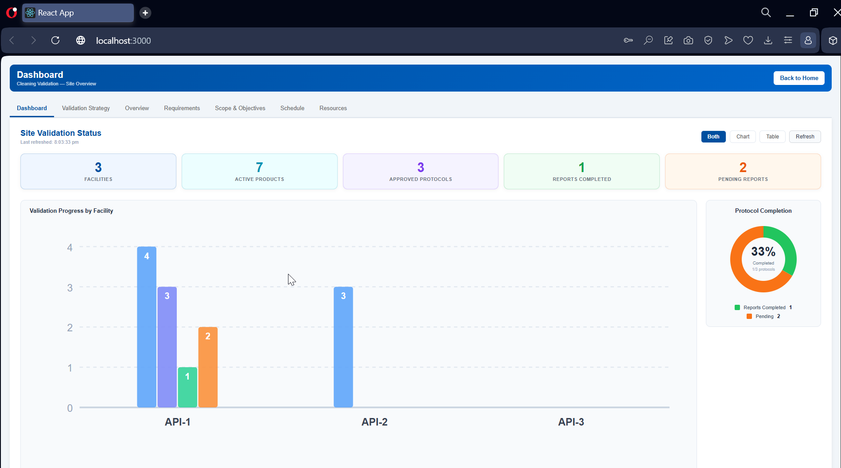
Application Screenshot
Dashboard — Site Overview
Dashboard — Site Overview
KPI cards: 3 Facilities, 7 Products, 3 Protocols, 1 Report Done, 2 Pending — live SVG bar chart
Cleaning Validation Application | Pharmaceutical Manufacturing
27 / 41

Slide 28
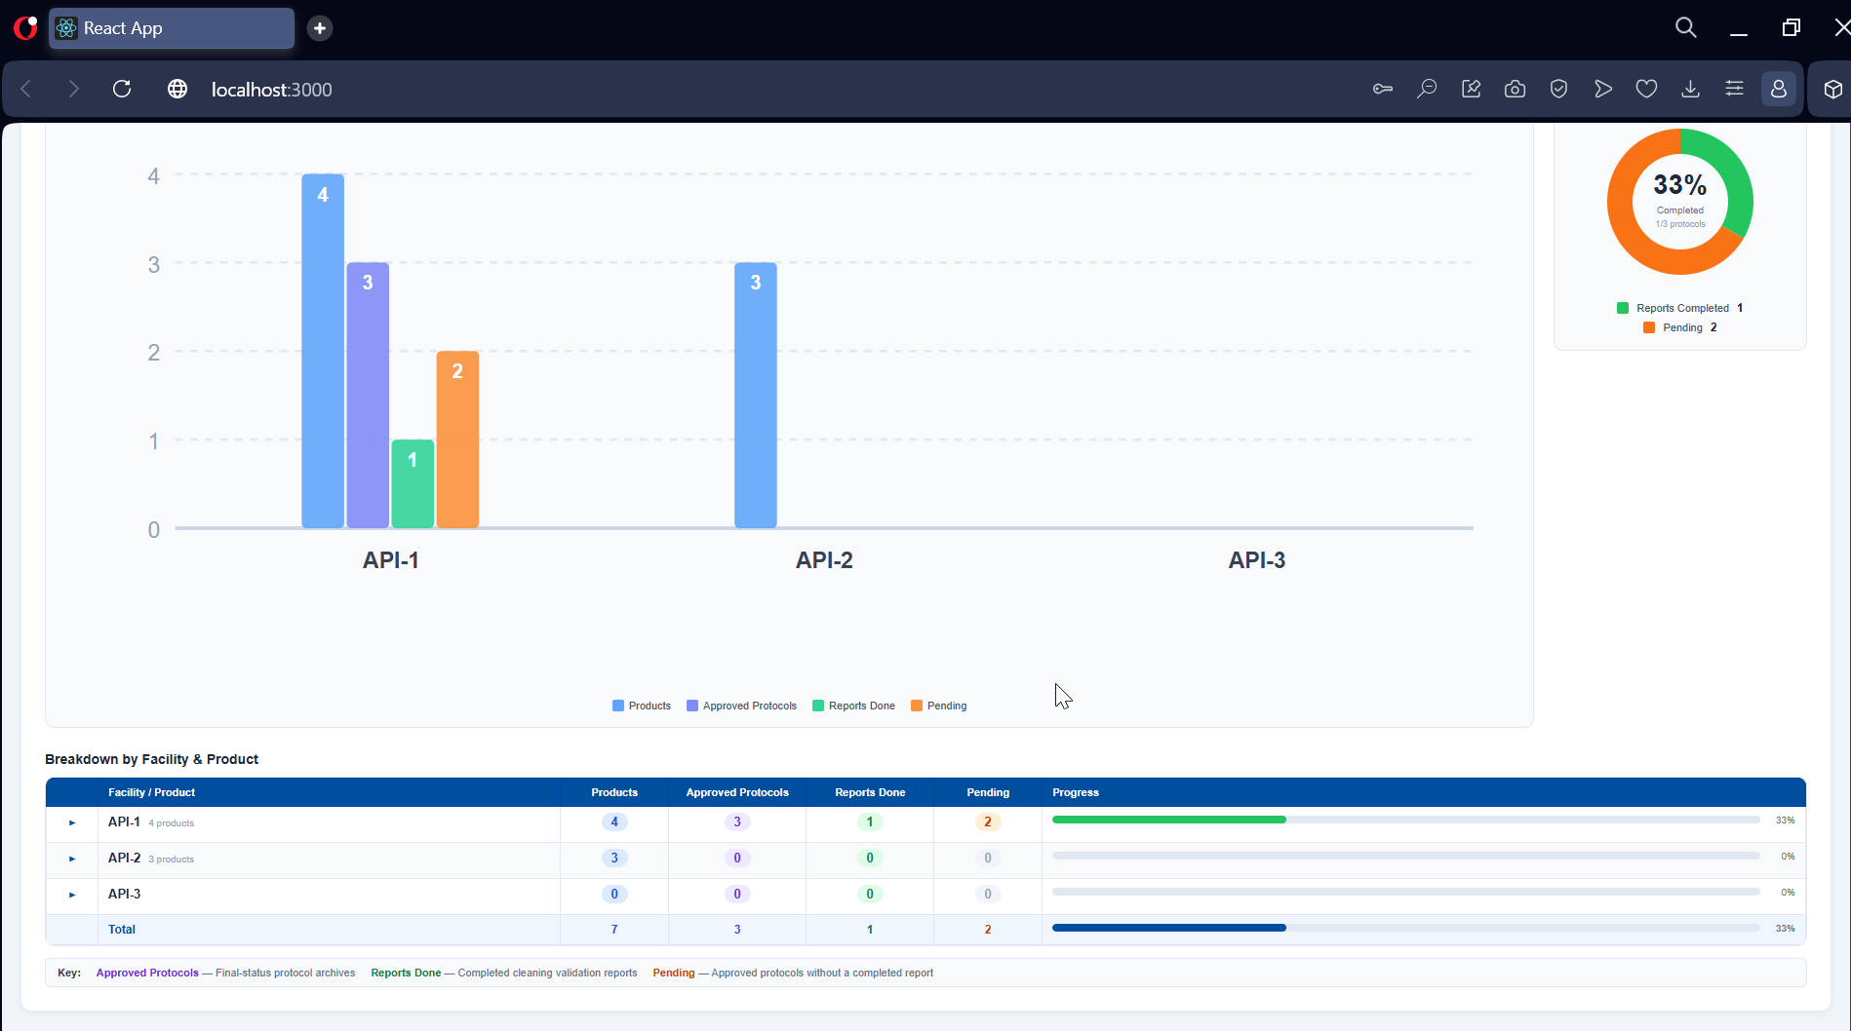
Application Screenshot
Dashboard — Charts & Breakdown
Dashboard — Charts & Breakdown
Bar chart (API-1/2/3) + donut chart (33% complete) + expandable facility–product breakdown table
Cleaning Validation Application | Pharmaceutical Manufacturing
28 / 41

Slide 29
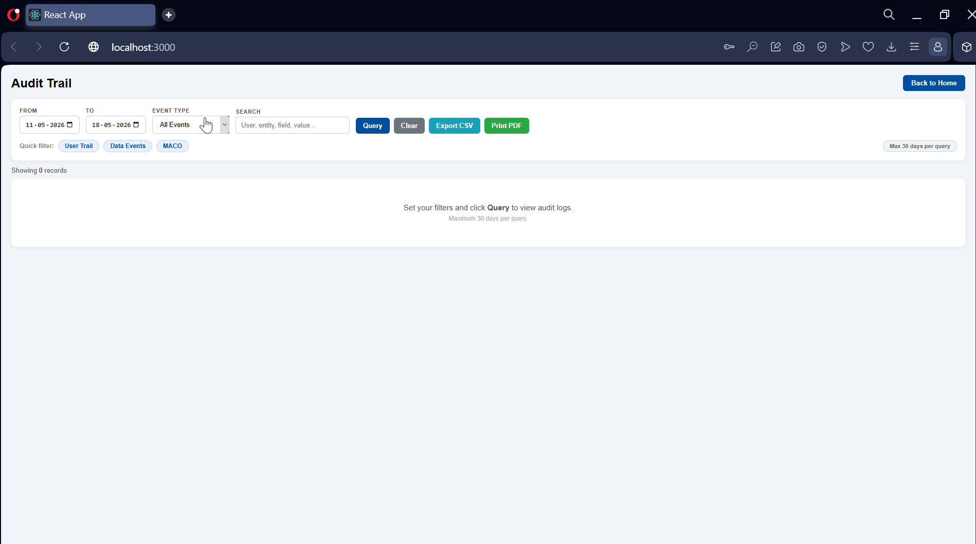
Application Screenshot
Audit Trail — Filter Panel
Audit Trail — Filter Panel
Date-range and event-type filters; quick-filter chips: User Trail, Data Events, MACO
Cleaning Validation Application | Pharmaceutical Manufacturing
29 / 41

Slide 30
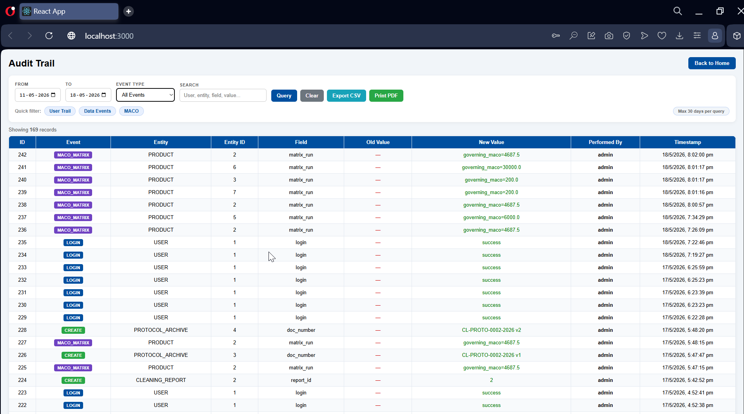
Application Screenshot
Audit Trail — 169 Records
Audit Trail — 169 Records
MACO_MATRIX, LOGIN, CREATE events with entity ID, old/new values, performer and timestamp
Cleaning Validation Application | Pharmaceutical Manufacturing
30 / 41

Slide 31
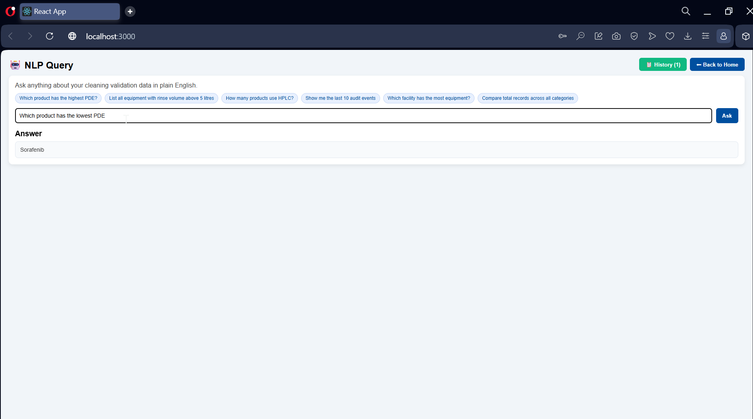
Application Screenshot
NLP Query Assistant
NLP Query Assistant
Question: "Which product has the lowest PDE?" — Answer: Sorafenib (Ollama llama3.2 local LLM)
Cleaning Validation Application | Pharmaceutical Manufacturing
31 / 41

Slide 32
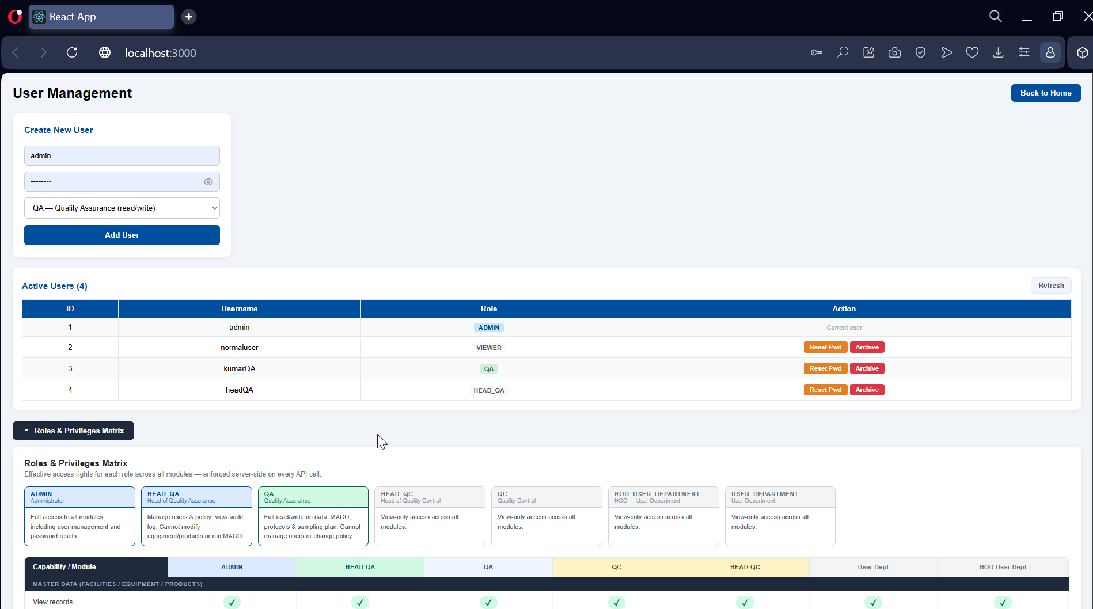
Application Screenshot
User Management & RBAC
User Management & RBAC
4 active users (ADMIN, VIEWER, QA, HEAD_QA) + Roles & Privileges Matrix overview
Cleaning Validation Application | Pharmaceutical Manufacturing
32 / 41

Slide 33
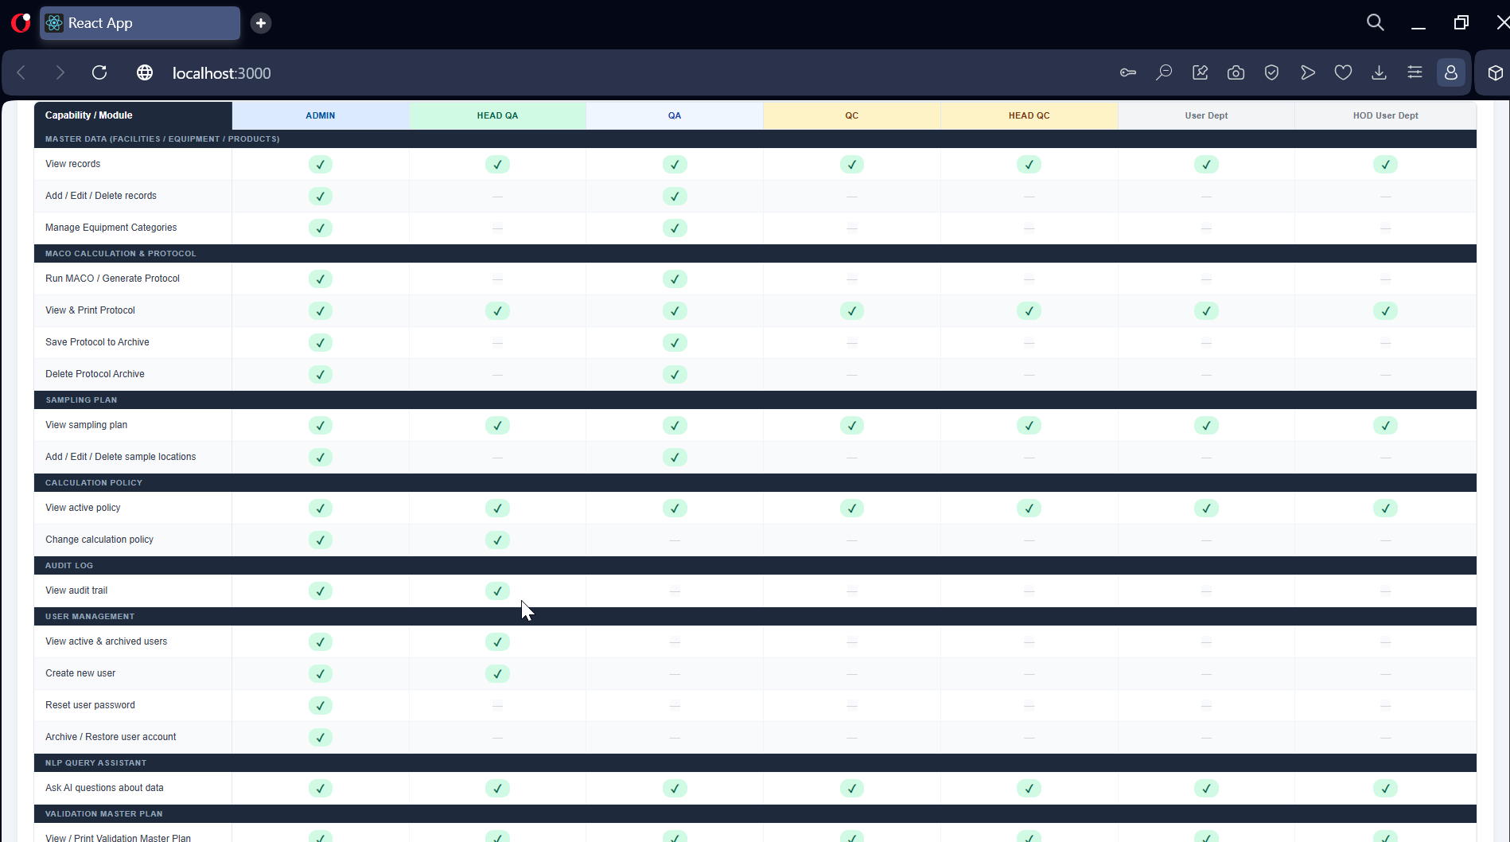
Application Screenshot
RBAC Matrix — Part 1
RBAC Matrix — Part 1
Privileges matrix: Master Data, MACO & Protocol, Sampling Plan, Calculation Policy sections
Cleaning Validation Application | Pharmaceutical Manufacturing
33 / 41

Slide 34
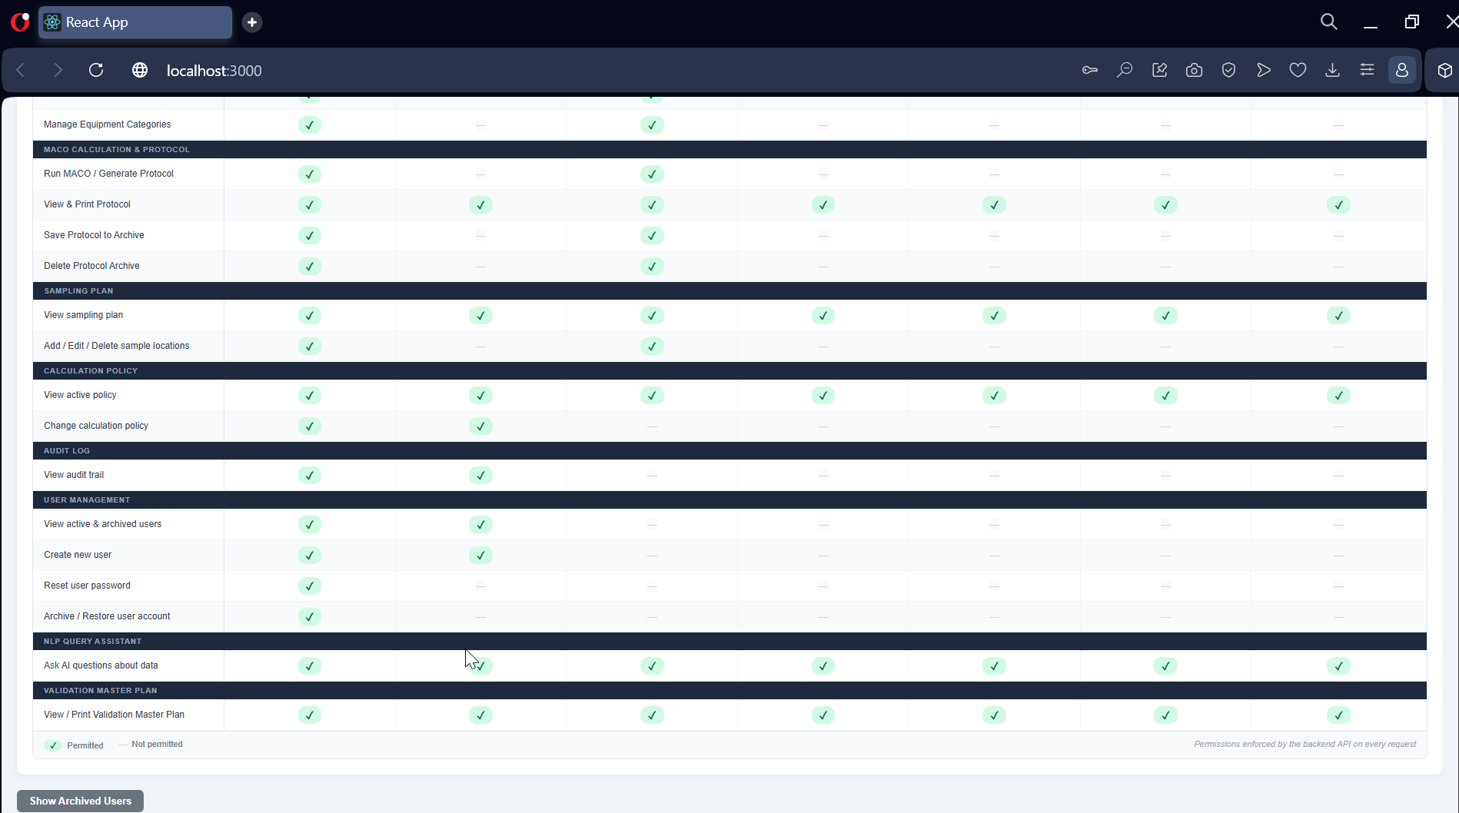
Application Screenshot
RBAC Matrix — Part 2
RBAC Matrix — Part 2
Privileges matrix continued: Audit Log, User Management, NLP Query, Validation Master Plan
Cleaning Validation Application | Pharmaceutical Manufacturing
34 / 41

Slide 35
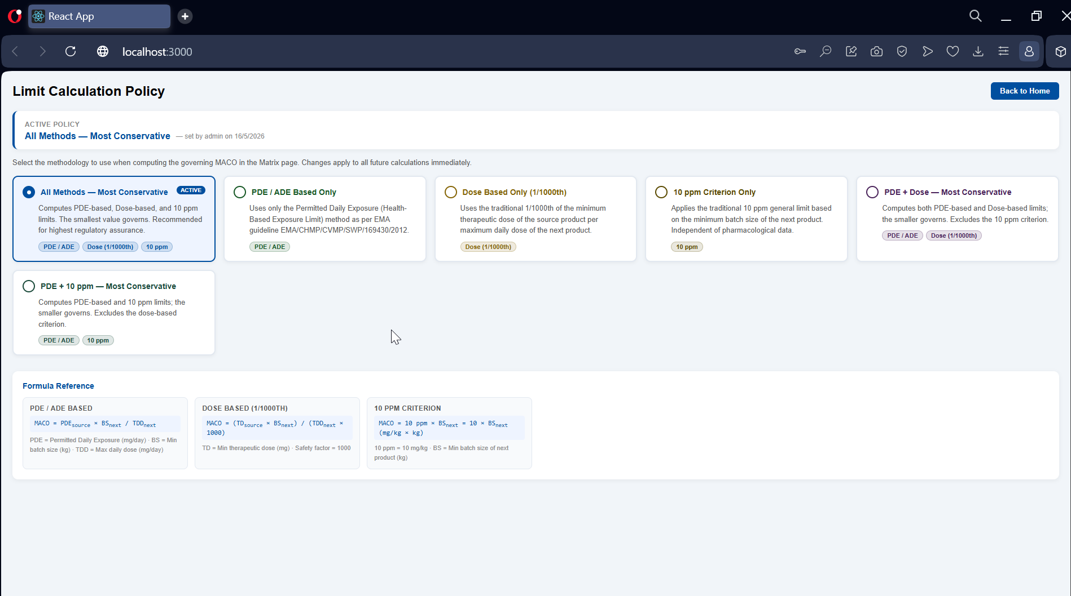
Application Screenshot
Calculation Policy
Calculation Policy
6 configurable MACO policies (All Methods, PDE Only, Dose Only, 10ppm, combinations) + formulas
Cleaning Validation Application | Pharmaceutical Manufacturing
35 / 41

Slide 36
Dashboard — Real-Time Site Validation Status
—
—
—
—
—
Facilities
Active Products
Approved Protocols
Reports Done
Pending
Facility-wise Progress — Grouped Bar Chart (SVG)
Protocol Completion — Donut Chart
33%
4
Completed
3
3
2
1 of 3 Approved Protocols have Reports
1
Expandable table: Facility → Products → Progress bars
API-1
API-2
API-3
Products
Protocols
Reports
Pending
Cleaning Validation Application | Pharmaceutical Manufacturing
36 / 41

Slide 37
Validation Master Plan (VMP)
Worst-Case & All-Products Strategy
Validation Strategies
Regulatory References
• All Products Strategy — every product validated individually on all shared equipment (min. 3 runs)
• Worst-Case Strategy — per equipment, the hardest-to-clean product (highest USP solubility rating = 7) is selected; one product covers all others on the same equipment
• USP Solubility Scale 1–7: Rating 7 (Practically Insoluble) = highest cleaning challenge
• Summary cards: total equipment, unique worst-case products, minimum runs required
• Printable / PDF export with full risk ranking table
• FDA 21 CFR Part 211
• ICH Q7 — GMP for APIs
• ICH Q10 — Pharmaceutical Quality System
• EMA Guideline EMA/CHMP/CVMP/SWP/169430/2012
• ISPE Baseline Guide Vol. 7
USP Solubility Risk Scale
1
2
3
4
5
6
7
Very Soluble
Freely Sol.
Soluble
Spar. Sol.
Slightly Sol.
Very Slightly
Prac. Insol.
Cleaning Validation Application | Pharmaceutical Manufacturing
37 / 41

Slide 38
Security & Role-Based Access Control
JWT Authentication · 7 Roles · Password-Protected Actions
Authentication
Role Hierarchy
• Login → bcrypt password verification → JWT issued (8-hour expiry, HS256)
• All state-changing endpoints require Bearer token via OAuth2PasswordBearer
• Destructive actions (delete, protocol approval, report submit) require inline password re-entry
• Force-password-reset flag on first login; inactivity auto-logout (10 min)
Role
Permissions
User Department / QC / HOD
View only — all modules
QA
View + Edit — all modules
Head QA / ADMIN
Full access — edit, delete, audit, users, policy
Audit Trail
Data Integrity
• Every CREATE / UPDATE / DELETE logged: entity_type, entity_id, old_value, new_value, performed_by, timestamp
• LOGIN / LOGIN_FAIL / LOGOUT events captured for user trail
• MACO_MATRIX events logged with governing MACO value
• Startup integrity check: validates DB consistency on every server boot
• Protocol snapshots are immutable — stored JSON never modified after archiving
• Report submission requires QA / ADMIN role + correct password
• Archived products removed from MACO matrix to prevent stale calculations
• File-based structured logs (daily rotation) as secondary trail
Cleaning Validation Application | Pharmaceutical Manufacturing
38 / 41

Slide 39
AI / NLP Integration
Local LLM — Ollama (llama3.2:1b) — Privacy-First Design
NLP Query Assistant (/nlp/query)
AI Integration Architecture
• Natural language questions about live database: "What is the MACO for Product A on Equipment X?"
• Context window includes facilities, equipment, products, and last 10 audit events
• LLM responds with structured JSON: text answer, or table with columns/rows, or chart hint
• Frontend renders LLM output as formatted table or plain text automatically
• No data leaves the organisation — fully on-premise via Ollama
User
Types natural language question in browser
Frontend
POST /nlp/query {question: "…"}
FastAPI
Builds compact DB context (JSON)
Prompt
Context + question → structured prompt
Ollama
llama3.2:1b (runs locally, no internet)
Response
JSON → text / table / chart type
UI
Renders formatted answer to user
AI-Assisted Product Info (/ai/product-info)
• Enter a drug/API name → LLM returns structured JSON with pharmacological data
• Fields pre-filled: min therapeutic dose, max daily dose, PDE, analytical method
• Significantly reduces manual data entry errors in Product Master
• Confidence indicator (high / medium / low) displayed with source reference
Cleaning Validation Application | Pharmaceutical Manufacturing
39 / 41

Slide 40
Results & Validation
Functional Outcomes & System Testing
3
7+
13
50+
7
Facilities Managed
Products Configured
DB Tables (PostgreSQL)
API Endpoints (FastAPI)
User Roles Defined
Functional Testing Highlights
Performance & Integration Testing
• MACO calculations verified against manual spreadsheet results for all 3 methods
• Protocol snapshot immutability confirmed — archived JSON unaffected by subsequent data edits
• Role-based access: each of 7 roles tested for correct allow/deny behaviour
• Audit log completeness: all 30+ state-changing endpoints verified to produce audit records
• Date persistence bug resolved: Pydantic v1 model updated to preserve start_date / completion_date
• Swab result propagation fixed: live sampling plan fetched instead of stale archived snapshot
• Response time < 300 ms for all MACO matrix queries (3 facilities, 7 products)
• PostgreSQL TRUNCATE + re-insert migration from SQLite completed in < 2 s
• JWT 8-hour session + 10-minute inactivity lockout validated
• Print-to-PDF layout tested across Chrome and Edge
• Concurrent requests: FastAPI async handling verified with multiple browser sessions
Cleaning Validation Application | Pharmaceutical Manufacturing
40 / 41

Slide 41
Conclusion & Future Work
Key Achievements
Future Enhancements
• Delivered a complete, production-ready cleaning validation platform from first principles
• MACO calculation engine implements three ICH-compliant methods with configurable policy
• End-to-end protocol-to-report workflow with immutable archival and version control
• Full RBAC, JWT security, and tamper-evident audit trail meet GMP documentation requirements
• Real-time dashboard eliminates manual reporting — instant site-wide validation status
• Local LLM (Ollama) integration enables natural-language querying without data privacy risks
• OpenFDA + PubChem CAS number lookup enriches product master data entry
• Migration from SQLite to PostgreSQL completed; Alembic manages schema evolution
• Electronic signature module (21 CFR Part 11 compliant) for reports
• Multi-site deployment with facility-specific admin delegation
• REST API versioning (v1 / v2) for long-term maintainability
• Automated MACO recalculation when product parameters change
• Scheduled batch reports and validation status email notifications
• Integration with LIMS for direct import of analytical results
• Mobile-responsive UI for shop-floor tablet usage
Cleaning Validation Application | Pharmaceutical Manufacturing
41 / 41

