Slide 1
HANDWRITTEN DIGIT RECOGNITION USING DEEP LEARNING
NAME: Dineshkumar J
STREAM: Software Engineering

Slide 2
OUTLINE OF PRESENTATIONS
INTRODUCTION
PROBLEM STATEMENT
LITERATURE SURVEY
FINDING LITERATURE SURVEY
OBJECTIVES
METHODOLOGY
SOFTWARE REQUIREMENTS
UML DIAGRAM (USE CASE)
CLASS DIAGRAM
REFERENCES

Slide 3
INTRODUCTION:
Handwritten digit recognition has emerged as a fundamental benchmark problem in the field of deep learning and computer vision.
The MNIST dataset, comprising 70,000 gray scale images of digits ranging from 0 to 9, has become the standard testing ground for evaluating learning models.
Among various approaches, CNNs stand out due to their ability to automatically learn spatial hierarchies of features, such as edges, curves, and shapes, directly from raw pixel data.
This eliminates the need for traditional manual feature extraction and enables models to achieve high levels of accuracy in digit classification.

Slide 4
Continue...
Beyond serving as a benchmark, handwritten digit recognition demonstrates the broader potential of deep learning in real-world applications.
The principles used in recognizing digits extend to advanced systems like Optical Character Recognition , license plate detection, and document digitization.
These applications highlight the robustness and scalability of CNN-based models in handling pattern recognition tasks across diverse domains.
Thus, the study of handwritten digit recognition not only validates deep learning techniques but also underscores their transformative role in modern technological solutions.

Slide 5
PROBLEM STATEMENT:
Despite significant progress in machine learning, accurately recognizing handwritten digits remains a challenging task due to variations in writing styles, shapes, and orientations.
Traditional methods that rely on manual feature extraction often fail to capture these variations effectively, leading to reduced accuracy and limited scalability.
There is a need for robust approaches, such as (CNNs), that can automatically learn and generalize features from large datasets like MNIST to achieve reliable digit recognition.
Addressing this problem is crucial, as it forms the foundation for advanced applications.

Slide 6
LITERATURE SURVEY:
SL.NO | AUTHOR+TITLE | METHODOLOGY | MERITS | DEMERITS
1 | R. Sethi & I. Kaushik (2020), Hand Written Digit Recognition using Machine Learning | ML techniques (e.g., ANN, SVM, KNN) on MNIST dataset. | Simple implementation, interpretable models. | Lower accuracy than deep learning; manual feature extraction needed.
2 | A. Shrivastava et al. (2019), Handwritten Digit Recognition Using Machine Learning: A Review | Comparative review of ML and DL approaches. | Broad survey; shows strengths/weaknesses across methods. | No new implementation; lacks experimental validation.
3 | J. Li et al. (2020), Handwritten Digit Recognition System Based on CNN | CNN architecture applied on MNIST dataset. | High accuracy; automatic feature extraction. | Computationally expensive; needs large dataset.
4 | Y. Hou & H. Zhao (2017), Handwritten digit recognition based on depth neural network | Deep Neural Network (DNN) approach. | Better accuracy than shallow models; robust learning. | Requires more training data; overfitting possible.
5 | M. Jain et al. (2021), Handwritten Digit Recognition Using CNN | CNN with TensorFlow implementation. | Very high accuracy on MNIST; scalable to other datasets. | Training time is long; hardware (GPU) dependency.

Slide 7
Continue..
SL.NO | AUTHOR+TITLE | METHODOLOGY | MERITS | DEMERITS
6 | F. Siddique et al. (2019), Recognition of Handwritten Digit using CNN in Python with TensorFlow | CNN with different hidden layers compared. | Performance comparison; optimized hidden layer selection. | More layers → higher complexity; risk of overfitting.
7 | P. Ma (2020), Recognition of Handwritten Digit Using CNN | CNN implementation with deeper layers. | Strong generalization; reliable recognition. | Higher computation; memory intensive.
8 | C. Zhang et al. (2020), Handwritten Digit Recognition Based on CNN | CNN model tested in Chinese automation context. | High recognition rate; adaptable. | Model tuning complexity; requires expertise.
9 | K. T. Islam et al. (2017), Handwritten digits recognition with ANN | ANN with backpropagation. | Simpler than CNN; requires less computation. | Accuracy lower than CNN; limited feature extraction.
10 | D. Beohar & A. Rasool (2021), Handwritten Digit Recognition using ANN & CNN | Compared ANN vs CNN on MNIST. | CNN clearly outperforms ANN; state-of-art validation. | ANN underperforms; CNN is resource-demanding.

Slide 8
Continue..
SL.NO | AUTHOR+TITLE | METHODOLOGY | MERITS | DEMERITS
11 | R. Sethi & I. Kaushik (2020), Hand Written Digit Recognition using Machine Learning | ML techniques (ANN, SVM, KNN) on MNIST dataset. | Simple implementation, interpretable models. | Lower accuracy than deep learning; manual feature extraction needed.
12 | Graves & Schmidhuber (2009), Offline handwriting recognition with multidimensional RNNs | Multidimensional Recurrent Neural Networks (MDRNNs) for sequence modeling. | Captures spatial and temporal dependencies effectively. | High computational cost; complex training.
13 | Wan et al. (2013), Regularization of neural networks using DropConnect | Introduced DropConnect regularization technique for neural networks. | Improves generalization; reduces overfitting. | Training slower; requires more resources.
14 | Ciresan et al. (2012), Deep neural networks segment neuronal membranes in microscopy images | Deep CNNs applied to image segmentation tasks. | Proved deep networks' power in vision tasks; transferable to digit recognition. | Needs large labeled datasets; computationally expensive.
15 | I. Patel, V. Jagtap & O. Kale (2015), A Survey on Feature Extraction Methods for Handwritten Digits Recognition | Survey of feature extraction techniques (PCA, LDA, Gabor filters, etc.). | Comprehensive review; highlights advantages of classical methods. | No experimental validation; lacks modern deep learning perspective.

Slide 9
FINDING LITERATURE SURVEY:
Convolutional Neural Networks (CNNs) have emerged as the most effective approach for handwritten digit recognition, offering high accuracy through automatic feature extraction.
While early ML models provided simplicity, they lagged behind in performance compared to deep learning.
such as deeper CNNs, RNNs, and regularization techniques further enhance recognition but demand greater computational resources.
Overall, the field has evolved from manual feature engineering to deep learning, establishing CNN-based models as the state-of-the-art solution.

Slide 10
OBJECTIVES:
To train and evaluate the model on the MNIST dataset for accurate digit classification.
To eliminate the need for manual feature extraction by leveraging CNN’s automatic feature learning capabilities.
To demonstrate the generalization ability of the model for handling variations in handwriting styles and shapes.
To explore the applicability of the approach in real-world domains such as OCR, license plate recognition, and document digitization.

Slide 11
METHODOLOGY:
Dataset Acquisition:
The MNIST dataset is used, containing 70,000 grayscale images of handwritten digits (60,000 for training and 10,000 for testing), each of size 28×28 pixels.
Data Pre-processing:
Pixel values are normalized to the range [0,1] to enhance training efficiency. Images are reshaped into 28×28×1 format to match CNN input requirements.
Optional augmentation (rotation, scaling, shifting) can be applied to increase data variability.
Feature Extraction using CNN Layers:
Convolution Layers automatically learn spatial features such as edges, curves, and digit strokes using filters.
Activation Function (ReLU) introduces non-linearity, improving feature learning capability.
Pooling Layers (MaxPooling) reduce feature map size, control overfitting, and retain dominant patterns.

Slide 12
Continue..
Flattening:
The 2D feature maps are converted into a 1D vector to prepare for fully connected layers.
Classification using Fully Connected Layers:
Dense layers learn higher-level representations of digit patterns.
The output layer uses the Softmax activation function to assign probability scores across 10 classes (digits 0–9).
Model Training:
The model is trained using the training dataset with an optimizer such as Adam and loss function categorical cross-entropy.
Multiple epochs are run, and model parameters (weights) are updated to minimize loss.

Slide 13
Continue..
Model Evaluation:
The trained CNN is evaluated on the test dataset to measure accuracy, precision, recall, and F1-score.
Typically, CNN models achieve 98–99% accuracy on the MNIST dataset.
Prediction Phase:
For unseen input images, the trained model predicts the corresponding digit by selecting the class with the highest probability.

Slide 14
SOFTWARE REQUIREMENTS:
Functional Requirements:
Image Input & Pre processing – The system must accept handwritten digit images (from MNIST or user input), normalize and reshape them for CNN processing.
Training the CNN Model – The system should train on the MNIST dataset, applying convolution, pooling, flattening, and dense layers for feature learning.
Digit Classification – The system must classify input images into one of the 10 classes (digits 0–9) using the trained CNN model.
Accuracy Evaluation – The system should evaluate model performance using metrics such as accuracy, precision, recall, and confusion matrix.

Slide 15
Continue..
Non-FunctionalRequirements:
Performance – The CNN model should achieve high accuracy (≥98%) on the MNIST test dataset.
Scalability – The system should be scalable to recognize digits from other datasets (e.g., EMNIST, custom handwriting samples).
Usability – The interface must be simple and user-friendly for non-technical users.
Efficiency – The system should minimize training time by utilizing GPU/TPU resources where available.

Slide 16
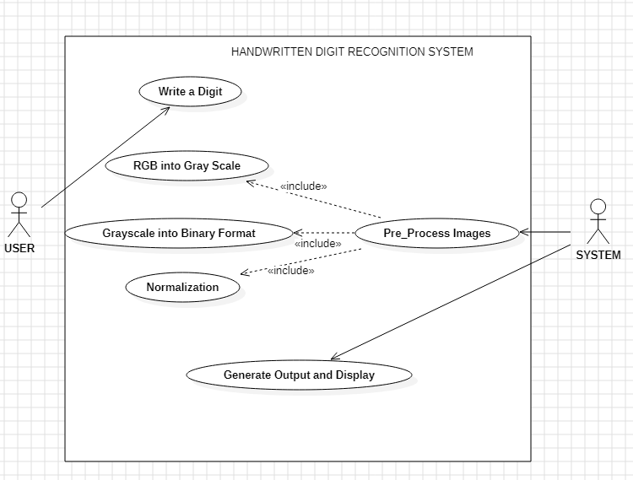
UML DIAGRAM (USE CASE):

Slide 17
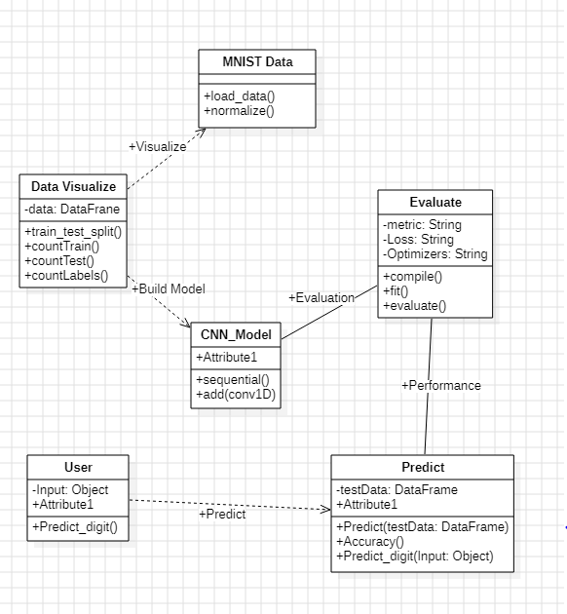
CLASS DIAGRAM:

Slide 18
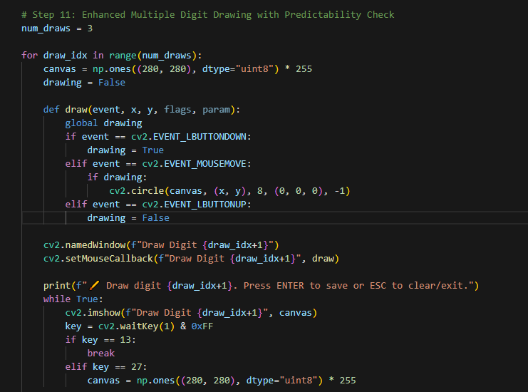
IMPLEMENTATION:

Slide 19
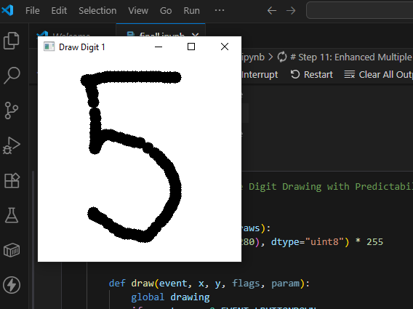
INPUT IMAGE:

Slide 20

OUTPUT:

Slide 21
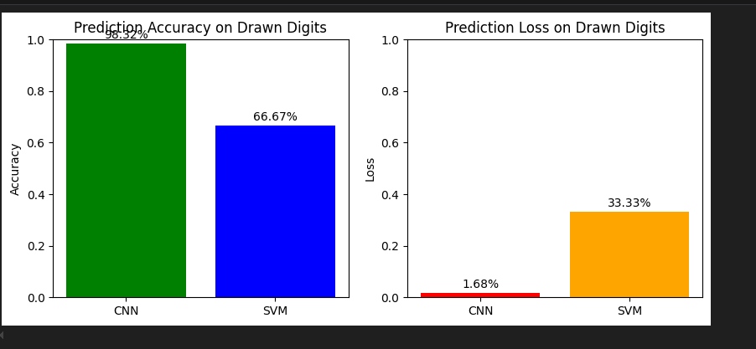
TESTING:

Slide 22
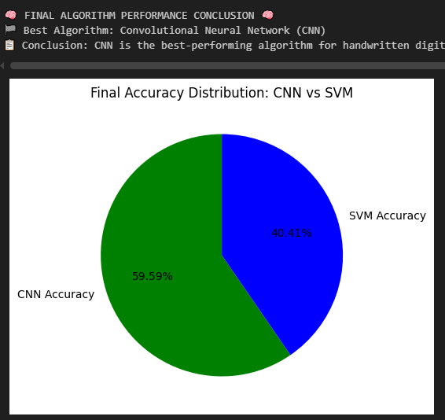
FINAL PREDICTION

Slide 23
REFERENCES:
R. Sethi and I. Kaushik, "Hand Written Digit Recognition using Machine Learning," 2020 IEEE 9th International Conference on Communication Systems and Network Technologies (CSNT), 2020, pp. 49-54.
A. Shrivastava, I. Jaggi, S. Gupta and D. Gupta, "Handwritten Digit Recognition Using Machine Learning: A Review," 2019 2nd International Conference on Power Energy, Environment and Intelligent Control (PEEIC), 2019, pp. 322-326.
J. Li, G. Sun, L. Yi, Q. Cao, F. Liang and Y. Sun, "Handwritten Digit Recognition System Based on Convolutional Neural Network," 2020 IEEE International Conference on Advances in Electrical Engineering and Computer Applications( AEECA), 2020, pp. 739-742.
Y. Hou and H. Zhao, "Handwritten digit recognition based on depth neural network," 2017 International Conference on Intelligent Informatics and Biomedical Sciences (ICIIBMS), 2017, pp. 35-38.
M. Jain, G. Kaur, M. P. Quamar and H. Gupta, "Handwritten Digit Recognition Using CNN," 2021 International Conference on Innovative Practices in Technology and Management (ICIPTM), 2021, pp. 211-215, doi: 10.1109/ICIPTM52218.2021.9388351.

Slide 24
Continue..
F. Siddique, S. Sakib and M. A. B. Siddique, "Recognition of Handwritten Digit using Convolutional Neural Network in Python with Tensorflow and Comparison of Performance for Various Hidden Layers," 2019 5th International Conference on Advances in Electrical Engineering (ICAEE), 2019, pp. 541-546, doi: 10.1109/ICAEE48663.2019.8975496.
P. Ma, "Recognition of Handwritten Digit Using Convolutional Neural Network," 2020 International Conference on Computing and Data Science (CDS), 2020, pp. 183-190, doi: 10.1109/CDS49703.2020.00044.
C. Zhang, Z. Zhou and L. Lin, "Handwritten Digit Recognition Based on Convolutional Neural Network," 2020 Chinese Automation Congress (CAC), 2020, pp. 7384-7388, doi: 10.1109/CAC51589.2020.9326781.
K. T. Islam, G. Mujtaba, R. G. Raj and H. F. Nweke, "Handwritten digits recognition with artificial neural network," 2017 International Conference on Engineering Technology and Technopreneurship (ICE2T), 2017, pp. 1-4, doi: 10.1109/ICE2T.2017.8215993.
Wan, L., Zeiler, M., Zhang, S., Cun, Y. L., & Fergus, R. (2013). Regularization of neural networks using dropconnect. Proceedings of the 30th Internationa Conference on Machine Learning, 1058-1066.

Slide 25
THANK YOU SIR

