Slide 1


Department of Computer Science and Engineering
Enhanced Cyberbullying Detection System In Social Media Forensic Using Neural Network
KUMAR K[211421104135]
LAKSHIMI NARAYANANA K[211421104136]
ABHIRAJ KANIFNATH MULAY[211421104316]
BATCH : D 16
Guide Name & Designation
Dr. KRISHNAMOORTHY M
ASSOCIATE PROFESSOR

Slide 2
Abstract
Cyberbullying on social media is a growing concern, affecting individuals emotionally and psychologically. Traditional detection methods struggle with informal language, sarcasm, and evolving online behavior.
This project aims to enhance cyberbullying detection using DistilBERT, a transformer-based model known for its efficiency and accuracy. By leveraging deep learning techniques, the system analyzes social media text to classify cyberbullying instances effectively.
The proposed model outperforms traditional machine learning approaches like LSTM, BiLSTM, and conventional BERT, achieving improved accuracy in detecting harmful content. The system is trained on datasets from Twitter, Instagram, and Facebook, ensuring a robust and scalable solution. With this advancement, the project contributes to creating a safer digital space by providing an automated, high-accuracy cyberbullying detection system for social media forensic analysis.

Slide 3
Introduction
Cyberbullying has become a growing concern on social media, impacting users emotionally and mentally. The anonymity and wide reach of online platforms allow harmful content to spread quickly, making it challenging to detect and control. Many traditional detection systems rely on keyword-based filtering or basic machine learning models, which often fail to capture sarcasm, slang, and context-dependent bullying. These limitations create a need for more advanced and efficient detection methods.
This project introduces an Enhanced Cyberbullying Detection System utilizing DistilBERT, a transformer-based model designed to improve accuracy and efficiency in text classification. By leveraging deep learning and natural language processing (NLP), the system can detect cyberbullying with better contextual understanding. Trained on datasets from Twitter, Instagram, and Facebook, it provides a scalable and effective solution compared to traditional approaches like LSTM and BiLSTM. This system aims to create a safer online space by enabling real-time monitoring and forensic analysis of harmful content

Slide 4
Objective of the Project
The primary objective of this project is to develop an Enhanced Cyberbullying Detection System that improves the accuracy and efficiency of detecting harmful content on social media. Cyberbullying is a widespread issue that negatively impacts users, particularly young individuals. Traditional detection methods struggle to handle informal language, sarcasm, and hidden meanings in online conversations, leading to misclassifications. This project aims to overcome these challenges by leveraging DistilBERT, a deep learning-based transformer model, to analyze and classify text effectively. By utilizing large datasets from platforms like Twitter, Instagram, and Facebook, the system will improve text classification accuracy and reduce false positives and false negatives in cyberbullying detection.
Additionally, this project aims to build a fast, scalable, and real-time detection system that can be integrated into social media platforms and online communities. The system will enhance digital safety by identifying and flagging harmful content before it spreads. Future enhancements may include multilingual support, integration with image and video content analysis, and real-time reporting features. Ultimately, this project will contribute to creating a safer and more respectful online environment, ensuring that social media remains a positive space for communication and interaction.

Slide 5
Literature Survey
 | Authors | Title | Source | Pages | Date
1 | Jamil et al. | GreenShip: A Social Networking Model for Cyberbullying Mitigation | Journal/Conference | 5 | 2011
2 | Roy et al. | Hate Speech Detection on Twitter: A Comparison of ML and DL Models | SpringerLink | 35 - 44 | 2020
3 | Rasel et al. | Offensive Comment Detection Using LSA and Machine Learning | Journal/Conference | 10 | 2016

Slide 6
Literature Survey
 | Authors | Title | Source | Pages | Date
4 | Kargutkar et al | CNN-Based Cyberbullying Detection on Social Media | Journal of AI & Society | 12 | 2017
5 | Dalvi et al. | Cyberbullying Detection Using SVM and Naïve Bayes on Twitter | Journal/conference | 15 | 2018
6 | Tsapatsoulis et al. | Feature Selection and Hybrid Models for Cyberbullying Detection | SIAM Conference on Data Mining | 7 | 2019

Slide 7
Literature Survey
 | Authors | Title | Source | Pages | Date
7 | Yadav et al. | BERT-Based Cyberbullying Detection System | IEEE Transactions on Cybernetics | 9 | 2021
8 | Di Capua et al. | Unsupervised Cyberbullying Detection Using GHSOM and k-Means | Springer - Neural Computing | 14 | 2022
9 | Trana et al. | Multimodal Cyberbullying Detection in YouTube Memes | ACM Digital Library | 11 | . 2023

Slide 8
Problem Statement
To improve cyberbullying detection on social media using DistilBERT for better accuracy and efficiency.
Cyberbullying is a major issue on social media, affecting many users, especially teenagers.
Harmful messages spread quickly, causing emotional distress and mental health issues.
Traditional detection methods are not effective due to the informal, ambiguous, and context-dependent nature of online language.
Existing models fail to identify slang, sarcasm, and hidden abusive content, leading to inaccurate results.
This project introduces an Enhanced Cyberbullying Detection System using DistilBERT to improve accuracy and efficiency.
The system analyzes large datasets from Twitter, Instagram, and Facebook for better cyberbullying detection.
It provides real-time monitoring to help create a safer online environment and prevent harmful content from spreading.

Slide 9
Proposed System
The proposed system aims to improve the accuracy and efficiency of cyberbullying detection on social media by utilizing DistilBERT, a lightweight yet powerful deep learning model. Unlike traditional machine learning approaches, which struggle with sarcasm, slang, and evolving abusive language, DistilBERT enhances text understanding by capturing contextual meaning more effectively. This system will analyze large-scale social media datasets, such as those from Twitter, Instagram, and Facebook, to detect harmful content in real-time and classify it with high accuracy.
By integrating natural language processing (NLP) techniques, this model can adapt to the dynamic nature of online conversations and minimize false positives and negatives. The system's real-time monitoring and classification capabilities will help in preventing cyberbullying incidents before they escalate. Ultimately, this project aims to create a safer and more inclusive online environment by efficiently detecting and mitigating cyberbullying across various platforms.

Slide 10
Software / Hardware used
HARDWARE REQUIREMENTS
Processor – Intel i5 or higher / AMD Ryzen 5 or higher
RAM – Minimum 8GB (16GB recommended for deep learning tasks)
GPU (Optional, for faster training) – NVIDIA GTX 1650 or higher
Storage – Minimum 100GB (for datasets and model training)
Internet Connection – Required for dataset collection and cloud processing

Slide 11
Software / Hardware used
Software Requirements
Programming Language – Python
Deep Learning Framework – TensorFlow / PyTorch
NLP Model – DistilBERT
Dataset Handling – Pandas, NumPy
Text Preprocessing – NLTK, SpaCy
Development Environment – Jupyter Notebook / VS Code
Database – MySQL / Firebase (if storing data)
Cloud Platform (Optional) – Google Colab / AWS for training models
TECHNOLOGIES USED
python
Machine Learning

Slide 12
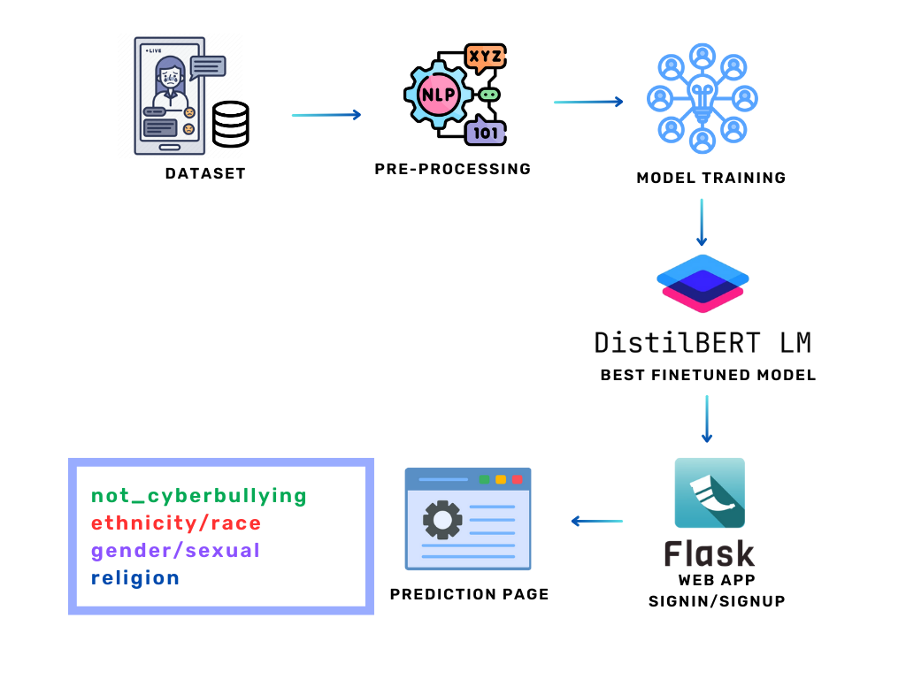
Architecture / Methodology used

Slide 13
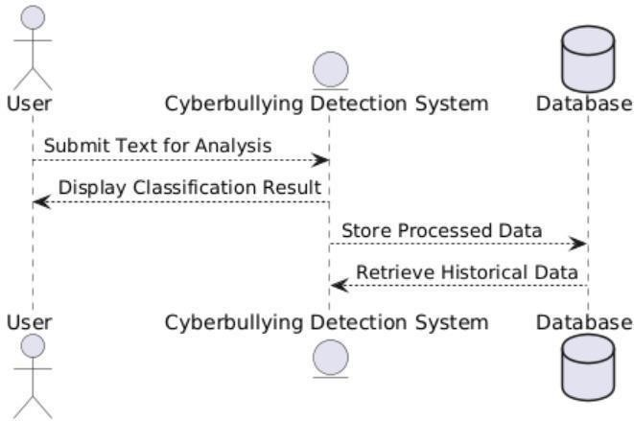
System Design – DFD
DFD LEVEL -1

Slide 14
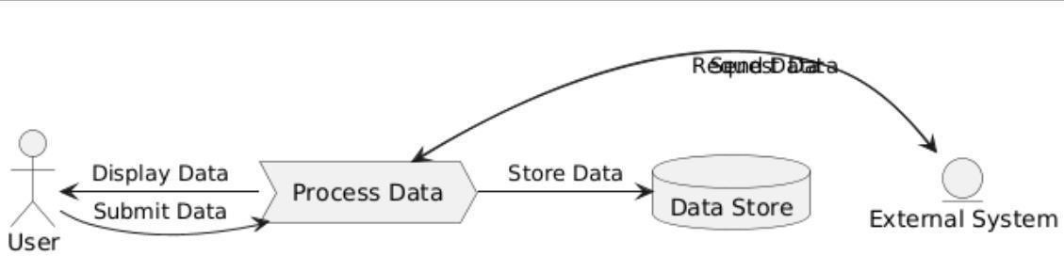
System Design – DFD
DFD LEVEL - 2

Slide 15
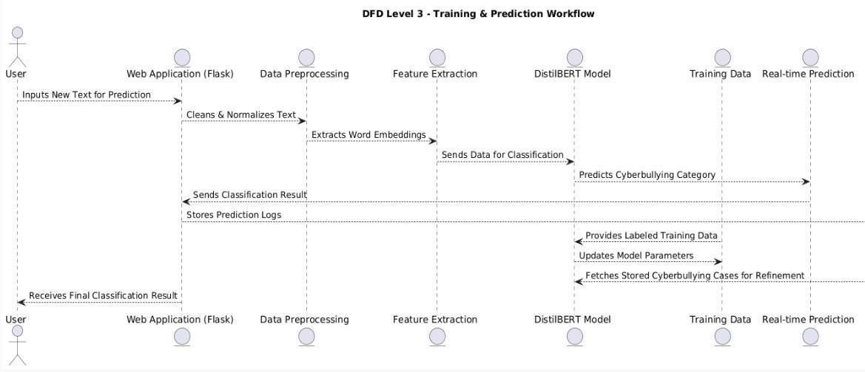
System Design – DFD
DFD LEVEL - 3

Slide 16
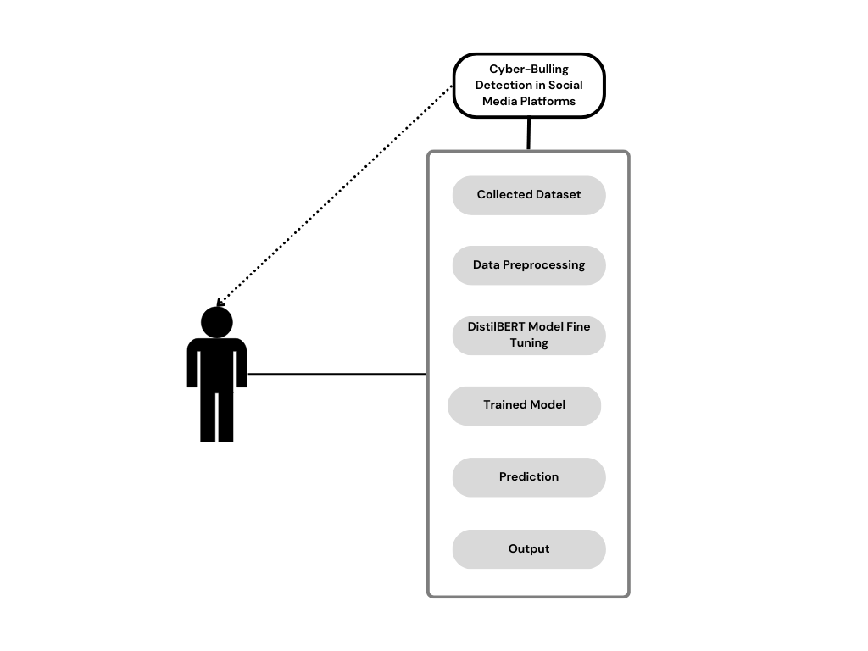
System Design – use case diagram

Slide 17
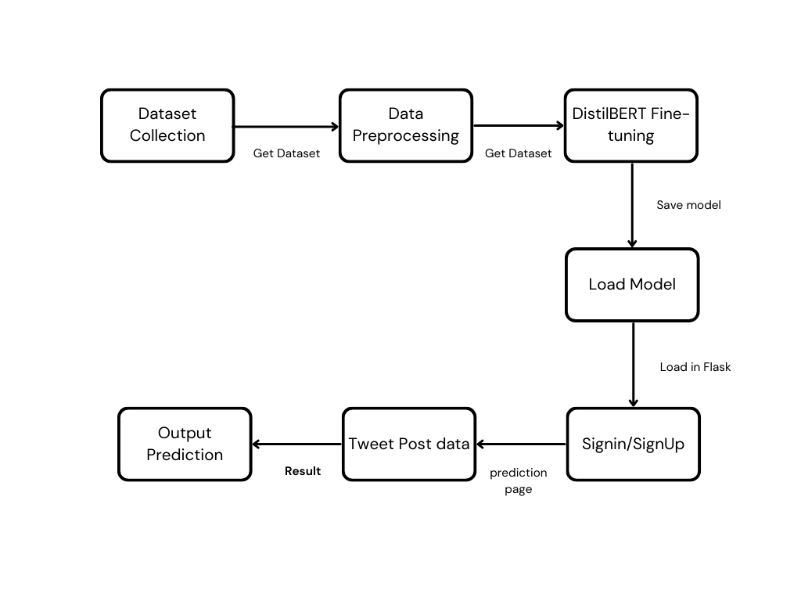
System Design – Collaboration Diagram

Slide 18
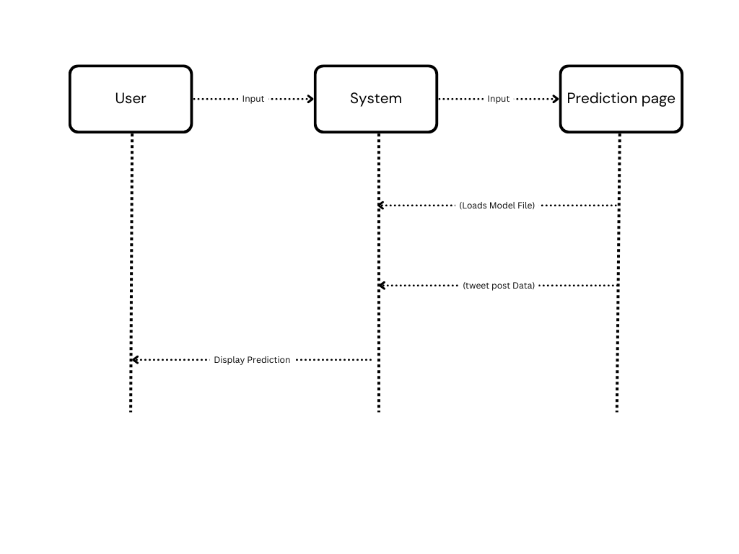
System Design – Sequence Diagram

Slide 19
Module Description
Modules:
Dataset Collection and Preprocessing
Model Training
Flask Web App

Slide 20
Module Description
Dataset Collection
To build an effective cyberbullying detection system, a large and diverse dataset is essential. This project gathers data from popular social media platforms like Twitter, Instagram, and Facebook, where incidents of cyberbullying are common. The dataset contains various types of text, including bullying-related comments, offensive language, and neutral conversations. To ensure the quality of the data, a series of preprocessing steps are applied, such as removing irrelevant content, duplicates, and unnecessary noise. Furthermore, advanced Natural Language Processing (NLP) techniques are used to organize and refine the data, making it more structured and relevant for training the detection model.

Slide 21
Module Description
Preprocessing
Text Cleaning: Removes special characters, URLs, hashtags, numbers, and emojis to keep only meaningful words.
Tokenization: Splits the text into individual words or phrases for better analysis.
Stopword Removal: Removes common words like "the," "is," "and," which do not add value to classification.
Lemmatization: Converts words into their base form (e.g., "running" → "run").
Vectorization: Converts text into numerical data using TF-IDF (for SVM) or Word Embeddings (for DistilBERT).

Slide 22
Module Description
Model Explanation
The Enhanced Cyberbullying Detection System is built using DistilBERT, a transformer-based model that efficiently analyzes and classifies text with high accuracy and low computational cost. Unlike traditional models such as LSTM and BiLSTM, which struggle with long-range dependencies and contextual understanding, DistilBERT excels at capturing the semantic and syntactic meaning of words in a sentence. The model is fine-tuned using a large dataset of social media comments, enabling it to distinguish between cyberbullying, hate speech, and non-offensive conversations.
The system follows a pipeline approach: First, raw text data is collected and pre-processed using Natural Language Processing (NLP) techniques like tokenization, stemming, stop-word removal, and lemmatization.
The processed text is then converted into numerical representations using word embeddings, which are fed into the DistilBERT model for classification. The model outputs a probability score indicating whether the text contains cyberbullying content. The final step includes post-processing techniques, such as threshold-based classification and confidence filtering, to refine predictions. This ensures high detection accuracy, minimal false positives, and real-time processing capabilities, making it an effective solution for moderating online interactions.

Slide 23
Module Description
Prediction System:
Input: The system takes a new social media comment as input.
Text Processing: The comment is processed using Natural Language Processing (NLP) techniques, such as tokenization.
Model Prediction: The processed text is passed through the DistilBERT model, which understands the context and meaning of the words.
Classification: The model classifies the comment as either cyberbullying or non-bullying based on patterns learned during training.
Real-Time Detection: The system provides instant feedback on whether the comment is harmful or safe.Actionable Outcome: This helps platforms quickly identify and moderate harmful content to protect users.

Slide 24
Testing /Performance Evaluation / Results
Software Testing Techniques
The cyberbullying detection system is evaluated based on standard performance matrics to ensure accuracy and efficiency. The model is tested using a large dataset from social media platforms like Twitter, Instagram, and Facebook to assess its ability to classify cyberbullying content correctly.
The evaluation metrics include:
Accuracy – Measures the overall correctness of predictions.
Precision – Determines how many detected bullying messages are actually bullying.
Recall – Identifies how well the model detects all instances of cyberbullying.
F1-Score – Balances precision and recall for better performance assessment.

Slide 25
Testing /Performance Evaluation / Results
Testing Methods & Key Strategies
The cyberbullying detection system is tested for accuracy, efficiency, and reliability using various methods. Unit testing ensures each module, like data preprocessing and prediction, functions correctly, while integration testing verifies smooth interaction between components. Performance and stress testing assess the system's ability to handle large datasets and real-time classification. Cross-validation improves accuracy by repeatedly training and testing on different dataset splits, while hyperparameter tuning optimizes model performance. The system’s results are compared with LSTM, BiLSTM, and BERT to validate improvements. Additionally, false positive and negative analysis refines predictions by correcting misclassified cases. These testing methods and strategies ensure high accuracy, stability, and real-time efficiency in detecting cyberbullying.

Slide 26


DATASET SCREENSHOT

Slide 27
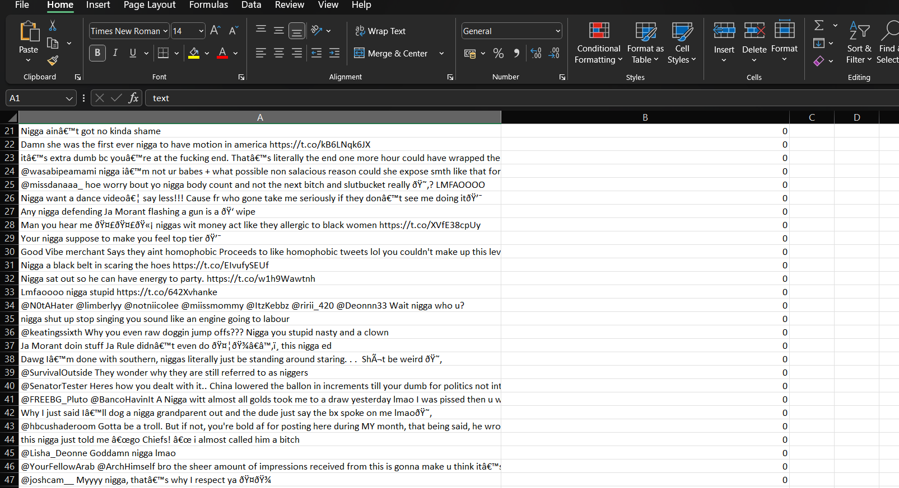

Slide 28
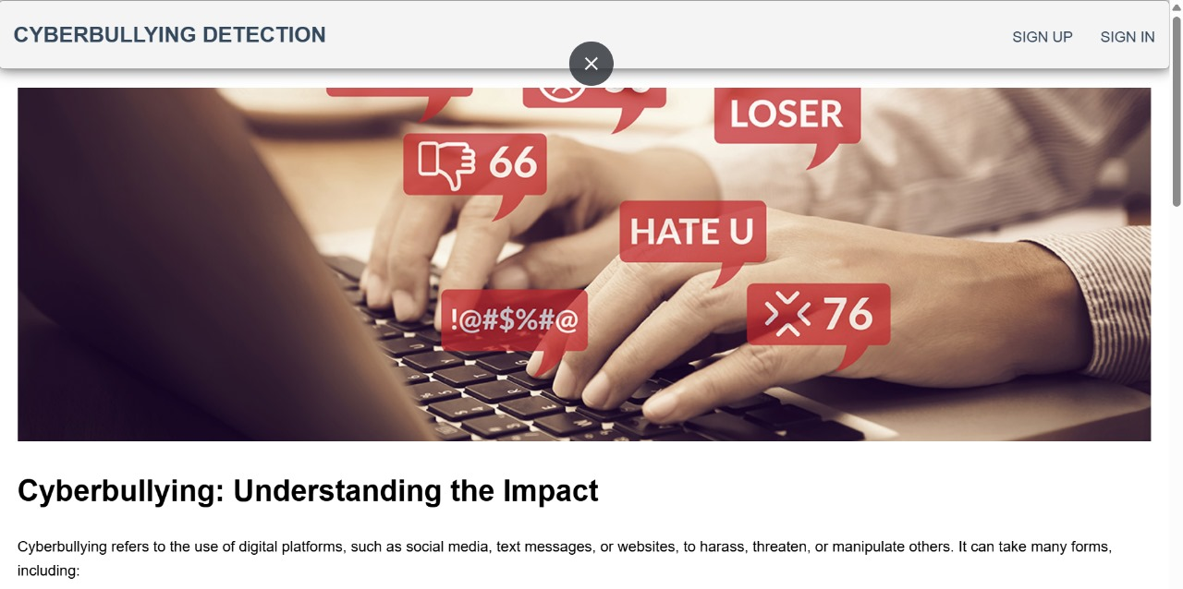
Screen Shots

Slide 29
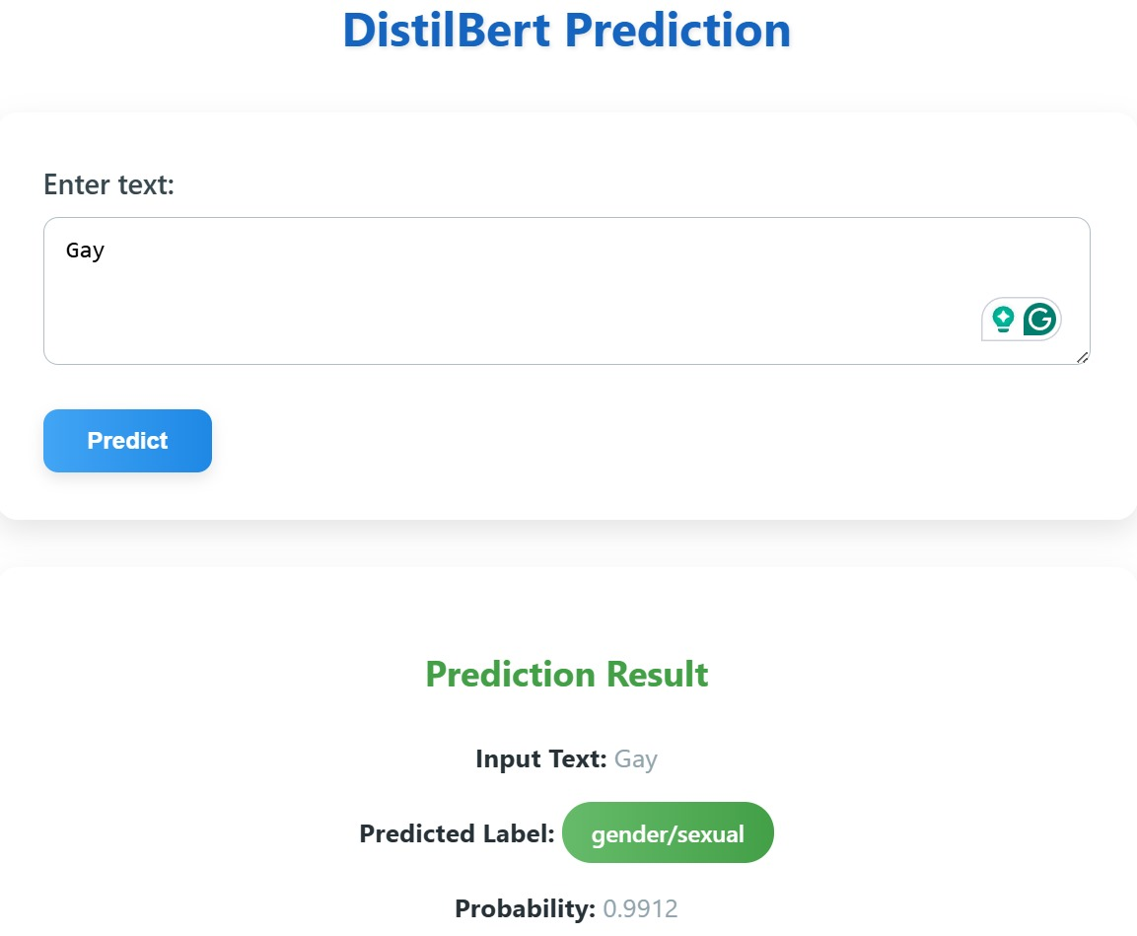
Screen Shots

Slide 30
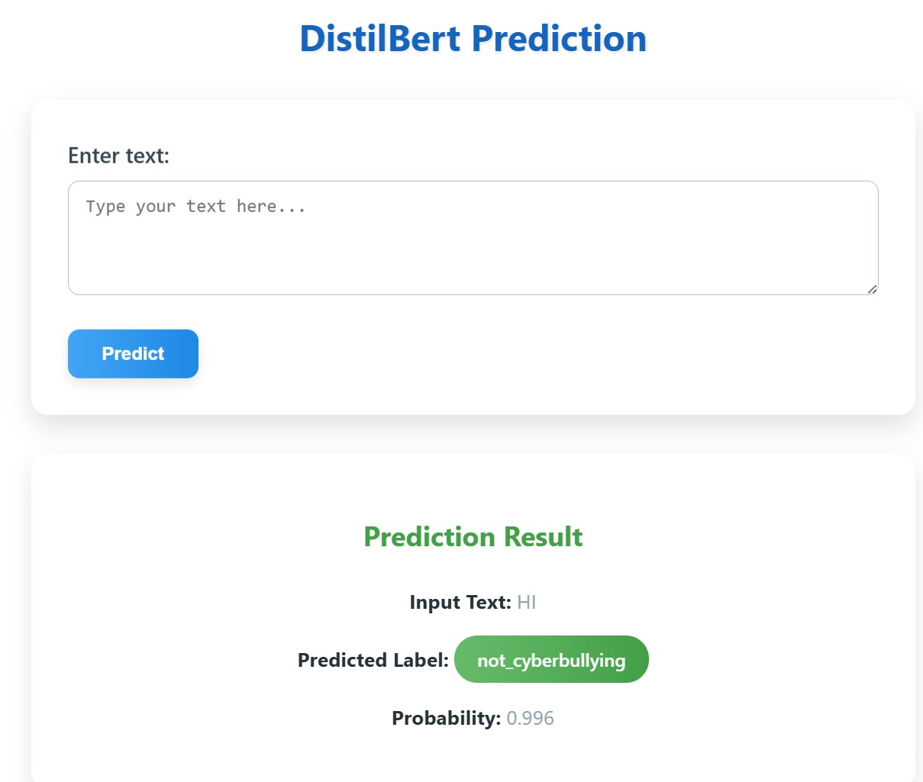

Slide 31
Conclusion / Feature Enhancement
Future Enhancement Directions:
Looking ahead, the system could expand to detect multiple forms of online abuse, like hate speech or misinformation, across various platforms. Enhancements like real-time threat analysis and broader language support could make the tool more impactful. Continued improvements in AI and user interaction will allow for a smarter, more adaptive solution.
Future Directions :
Comprehensive Abuse Detection: Expand beyond cyberbullying to detect hate speech, misinformation, and harassment.
Real-Time Monitoring & Intervention: Enable immediate threat detection and proactive action to stop harmful content.
Cross-Platform Expansion: Support more platforms like TikTok, Reddit, and YouTube for broader coverage.
Multilingual Detection: Add support for multiple languages to detect abuse in a global context.
Adaptive AI Models: Continuously evolve the AI to handle emerging trends and new forms of abuse.
Enhanced User Interaction: Focus on improving the user interface and making the system more interactive for better engagement and feedback.

Slide 32
Conclusion / Feature Enhancement
Conclusion:
The Enhanced Cyberbullying Detection System offers a powerful solution to identify and address harmful behavior on social media. Using DistilBERT, it accurately detects instances of cyberbullying in real-time, helping to create a safer online environment. This system is not only scalable but also adaptable, capable of expanding to handle various types of online abuse like hate speech and misinformation. By continuously improving through advancements in AI and integrating across multiple platforms, it ensures a broader reach and more effective detection. The future of this system looks promising, with potential upgrades to support more languages and platforms, making it a global tool for combating online harassment.

Slide 33
Reference Paper/ URL
Jamil et al. (2018) introduced GreenShip, a social networking system designed to mitigate cyberbullying using reputation metrics and social relationships. Unlike conventional text-based detection methods, GreenShip focuses on analyzing user interactions to filter harmful content dynamically. This approach is particularly effective in cases where text analysis alone fails to discern intent, offering a more robust moderation technique.
Roy et al. investigated hate speech detection on Twitter, comparing deep learning and traditional machine learning models. Their study found that Support Vector Machines (SVM) performed better than CNN and Logistic Regression. However, dataset imbalance remained a key challenge, affecting the real-world applicability of these models.
Rasel et al. (2018) developed an offensive comment detection framework using Latent Semantic Analysis (LSA) combined with machine learning classifiers such as Random Forest, Logistic Regression, and SVM. Their approach improved feature extraction and achieved over 93% accuracy, demonstrating the importance of advanced feature selection in cyberbullying detection.

Slide 34
Conference / Publication / Patent Certificate/ Project Contest Winner Certificates

