Slide 1
Advanced PDS
A Transparent & Improved Public Distribution System

Slide 2
Project Overview
Current PDS Challenges
• Manual record-keeping prone to errors and fraud
• Lack of real-time tracking of food grain distribution
• Duplicate and ghost beneficiaries in the system
• Limited transparency in supply chain operations
• Inefficient grievance redressal mechanisms
• No direct communication channel for farmers
Advanced PDS Solution
Our digital platform revolutionizes the Public Distribution System through a transparent, efficient, and accountable web-based portal with four integrated modules serving all stakeholders.
Key Benefits
• Real-time tracking and complete transparency
• Biometric authentication eliminates fraud
• Digital records ensure accountability
• Dedicated Kisan Portal empowers farmers
• Streamlined beneficiary verification process
• Efficient dealer management and monitoring

Slide 3
System Architecture
Login & Home Portal
Secure authentication system with Aadhaar integration. User-friendly dashboard displaying ration card details, entitlements, and transaction history. Role-based access control directing users to their respective modules.
Admin & Kisan Portal
Centralized admin dashboard for inventory management, dealer oversight, and beneficiary verification. Integrated Kisan Portal enables farmers to register produce, view MSP rates, and track procurement status directly.
Beneficiary & Dealer Module
Beneficiary portal for checking allocations, locating fair price shops, and raising grievances. Dealer module manages stock receipts, distribution records, and generates transparent transaction reports.

Slide 4
Admin Portal
The Admin Portal serves as the central control hub for the Advanced PDS system. Administrators can manage user accounts, approve dealer registrations, and oversee beneficiary enrollments. The dashboard provides real-time inventory tracking across all distribution centers with automated alerts for stock shortages.
Key administrative functions include comprehensive reporting tools that generate transparency reports, distribution analytics, and audit trails. The system enables inventory management with stock allocation, transfer requests between centers, and wastage tracking. All administrative actions are logged for accountability and compliance purposes.

Slide 5
Beneficiary Portal
Ration Card Management
Beneficiaries can view and manage their ration card details digitally. The portal displays family member information, card type, and eligibility status. Users can apply for new cards, request modifications, and track application status in real-time with complete transparency.
Entitlement & Complaints
Track monthly entitlements showing exact quantities of rice, wheat, sugar, and kerosene allocated. Real-time updates notify beneficiaries when stock arrives at dealers. A dedicated complaint registration system allows users to report issues with instant acknowledgment and tracking.

Slide 6
Dealer Module
Stock Management & Distribution
The dealer portal provides comprehensive inventory tracking with real-time stock updates. Dealers can monitor grain quantities, manage incoming shipments from FCI, and track distribution to beneficiaries. Automated alerts notify low stock levels, ensuring continuous supply chain efficiency.
Sales Recording System
Every transaction is digitally recorded with beneficiary verification. The system generates instant receipts, maintains detailed sales logs, and prevents duplicate distributions through smart validation checks.
Compliance & Reporting
Built-in compliance tools ensure dealers meet government regulations. Automated reports track daily sales, monthly distributions, and quota utilization. Transparent audit trails enable accountability and reduce corruption in the PDS network.

Slide 7
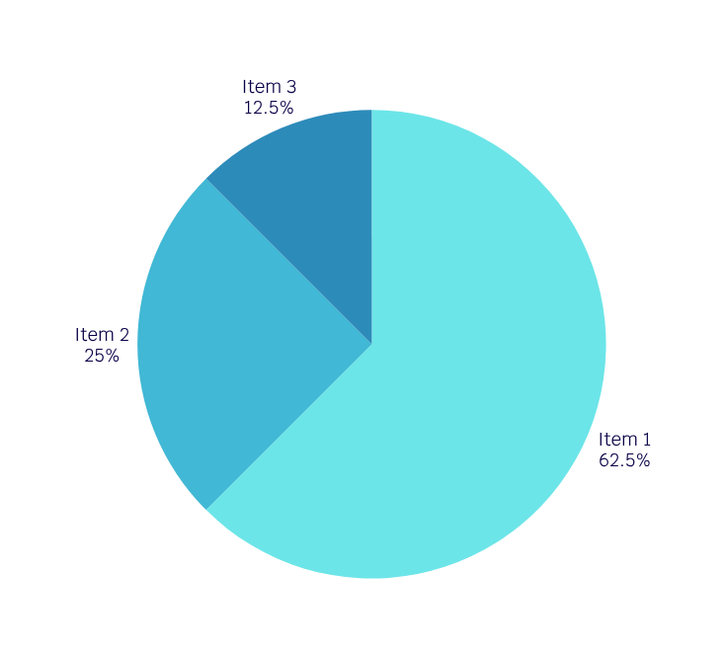
Key Results
Our Advanced PDS delivers measurable improvements over the traditional system. Digital records eliminate manual errors and ensure complete transparency. Real-time tracking enables instant verification of grain movement from warehouse to beneficiary. The accountability metrics dashboard provides clear visibility into system performance and identifies bottlenecks immediately.

Slide 8
Conclusion
Enhanced Transparency & Efficiency
Our Advanced PDS portal revolutionizes public distribution through real-time tracking, digital record-keeping, and automated inventory management. The system eliminates manual errors, reduces corruption, and ensures every grain reaches its intended beneficiary with complete accountability.
Farmer Support
The integrated Kisan Portal empowers farmers with direct market access and fair pricing. Combined with streamlined admin, beneficiary, and dealer modules, our solution creates a transparent ecosystem that strengthens food security and promotes inclusive digital governance for all stakeholders.

