Slide 1
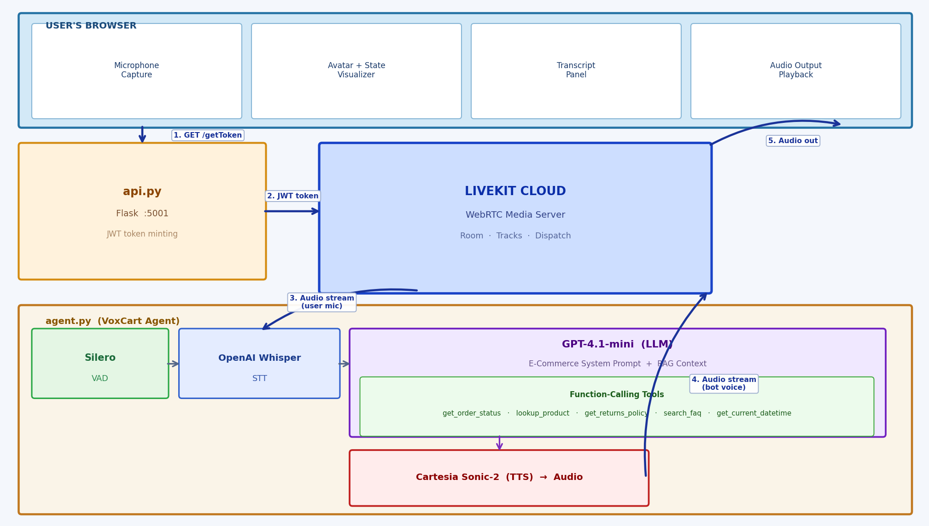
VoxCart — System Architecture

