Slide 1
SpectraRAG
An Agentic RAG ChatBot with MCP
GitHub URL: https://github.com/kumar8074/SpectraRAG
DEVELOPED BY:
Name: Lalan Kumar
Email: lalan.k.4590@gmail.com
GitHub: https://github.com/kumar8074
LinkedIn: https://www.linkedin.com/in/lalan-kumar-983267229/

Slide 2
PROBLEM STATEMENT & OBJECTIVE
Problem statement:
Build an intelligent chatbot that can answer user questions from uploaded documents using Retrieval-Augmented Generation (RAG) with an agent-based architecture and MCP (Model Context Protocol).
Objectives:
Support multiple document formats (PDF, DOCX, PPTX, CSV, TXT).
Modular agentic pipeline: Ingestion → Retrieval → LLM Response.
Use message-passing with structured MCP objects.
UI support for uploads and multi-turn chat.

Slide 3
PROPOSED ARCHITECTURE
Agents & Responsibilities
IngestionAgent: Parses, chunks, embeds docs, persists vectorDB.
RetrievalAgent: Generates semantic queries, retrieves relevant chunks.
LLMResponseAgent: Combines user query + context, calls LLM and generates response.
GeneralAgent: Answers general questions when no documents are uploaded.
CoordinatorAgent: Orchestrates all agents using MCP message passing.

Slide 4
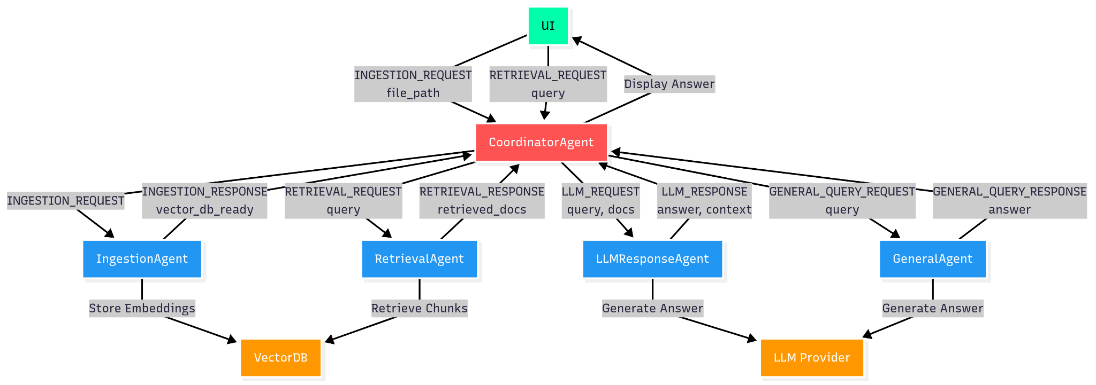
System Architecture Flow

Slide 5
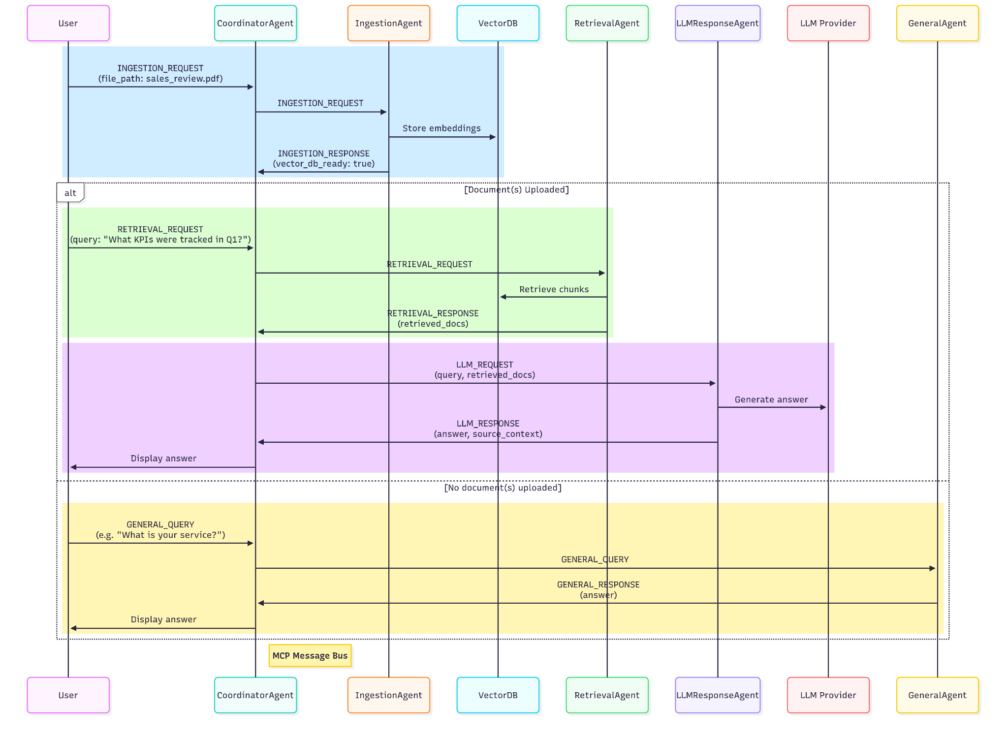
Message Flow Sequence Diagram

Slide 6
SYSTEM WORKFLOW
Document Upload
User uploads a file (PDF, DOCX, etc.). CoordinatorAgent triggers IngestionAgent to parse, embed & persist to VectorDB. Chat is disabled until vector_db_ready = True.
Query Handling (RAG Mode)
Once ready, user sends a query. RetrievalAgent fetches relevant chunks from VectorDB. LLMResponseAgent combines context + query, invokes LLM, and returns answer.
General Query (No Upload)
If no document, CoordinatorAgent routes query to GeneralAgent for direct LLM answer.
MCP Orchestration
All agents communicate via Model Context Protocol (MCP) with structured messages and traceability.

Slide 7
TECHSTACK
Python – Core backend logic & agent orchestration
LangGraph – Agent workflow engine
LangChain – Document parsing, embeddings, and vector store tools
MCP Protocol – Custom structured message passing between agents
AsyncIO – Concurrent agent communication
LLMs: Built & tested with Gemini (Supports GPT, Claude and extensible due to modular architecture)
Embeddings: GoogleGenerativeAIEmbeddings(models/text-embedding-004)/supports other
Vector Store: ChromaDB
UI: Streamlit (with custom dark theme & chat styling)
Logging: Python logging, per-session trace with trace_id

Slide 8
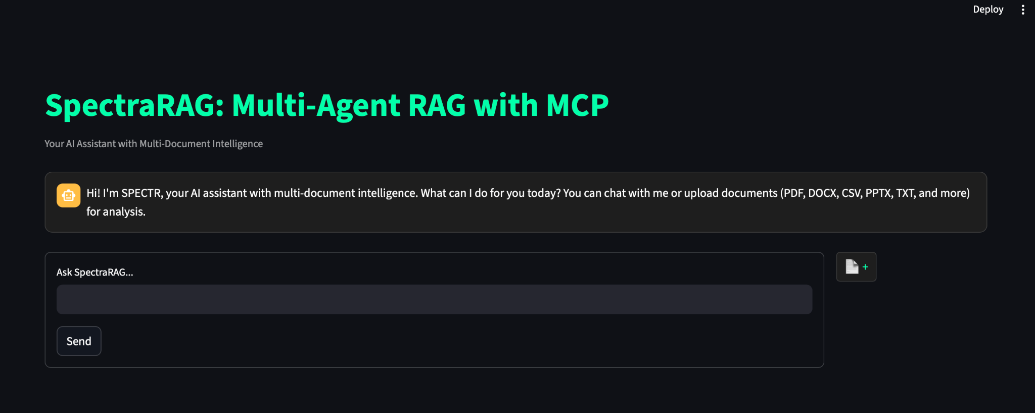
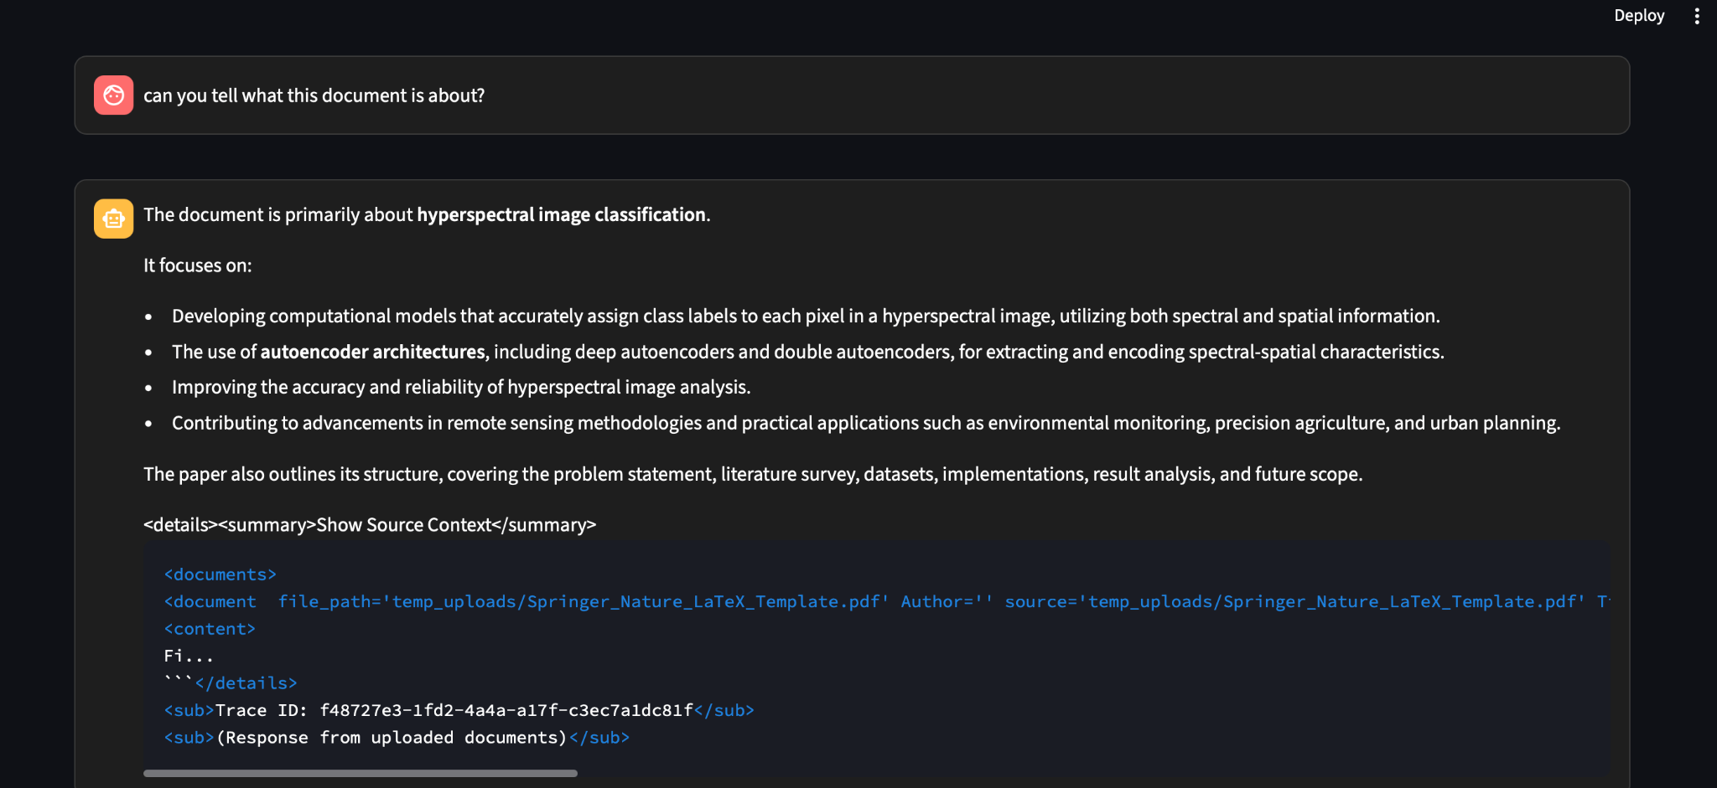
Working UI Snapshots

Slide 9
CHALLENGES FACED
Complex multi-Agent Coordination: Coordinating multiple agents (GeneralAgent, IngestionAgent, RetrievalAgent, LLMResponseAgent) in an async environment required precise task scheduling and communication under MCPCoordinator.
Solution:
Designed clear interfaces for agent interactions in MCPCoordinator. Implemented async task management with proper synchronization and error handling.
Unexpected IngestionAgent Activation: IngestionAgent triggered unnecessarily without valid document input, causing redundant processing.
Solution:
Added conditional logic in MCPCoordinator to activate IngestionAgent only with valid file paths. Enhanced logging to trace agent triggers and diagnose issues.
Streamlit & Asyncio Integration: Integrating asyncio with Streamlit’s event-driven model required managing a custom event loop, risking race conditions.
Solution:
Managed a single event loop in app.py with run_until_complete. Used session state to synchronize UI updates and reruns.
UI/UX & Session State Management: Reflecting document processing states in Streamlit UI (e.g., disabling send button) required complex session state logic.
Solution:
Implemented embedding_status and has_documents flags in app.py. Controlled UI elements based on processing states.

Slide 10
FUTURE SCOPE
Secure Communication: Replace MCP with more robust Agent2Agent (A2A) Protocol for secure agent messaging.
Smarter PDF Processing: Integrate Landing AI’s Agentic Document Extraction for more accurate parsing.
Real-Time Data: Add Web Search capability to GeneralAgent for live query handling.
Optimized Architecture: Shift to single-agent(or Max 2.) LangGraph RAG design (as in my chatTensorFlow project) for better performance and simplicity.
Performance Monitoring: Use LangSmith Tracing for evaluating agent interactions and LLM latency.
Multimodal Support: Extend system to handle images, tables, and structured data alongside text.

Slide 11
THANK YOU

