Slide 1
SUPPLY CHAIN MANAGEMENT USING BLOCKCHAIN

Slide 2
Introduction
Supply Chain Management (SCM) plays an important role in the smooth flow of goods, services, information, and finances from raw material suppliers to end consumers
This project is a decentralized, blockchain powered supply chain management system designed to track a product’s lifecycle from raw material to final retailers.
An immutable, real-time tracking platform built on the Ethereum blockchain that provides a "single source of truth" for all participants.

Slide 3
Motivation of Project
The traditional supply chain system lacks transparency, security, and real-time tracking. Issues like fraud, counterfeit products, and data manipulation reduce trust among stakeholders. The emergence of blockchain technology, with its decentralized and immutable nature, motivates the development of a more secure and transparent supply chain system.

Slide 4
Problem statement
The traditional approach to SCM has several challenges that need to be addressed. These challenges include issues of transparency, traceability, efficiency, and security . The lack of transparency in traditional SCM makes it difficult for stakeholders to track products as they move through the supply chain. This lack of traceability can lead to delays, errors, and even fraud. In addition, the centralized nature of traditional SCM makes it easy to hacking and tampering, which can compromise the security of the supply chain.
This project will explore the potential benefits and challenges of integrating blockchain technology in supply chain management, with a focus on its impact on transparency and efficiency.

Slide 5
Objective
Implement a Unified Ledger: Create a single, decentralized "source of truth" accessible to Suppliers, Manufacturers, Distributors, and Retailers.
Ensure Data Immutability: Utilize blockchain technology to ensure that all transaction history and status updates are permanent and tamper-proof.
Automate Lifecycle Tracking: Use Smart Contracts to trigger real-time status updates (from "Order Placed" to "Final Delivery") without manual intervention.
Verify Provenance: Provide a complete, verifiable digital footprint for every product to guarantee its authenticity and origin.

Slide 6
Project Feature
Key Features of our project:
Role-Based Dashboards: Custom interfaces for each participant (Supplier, Manufacturer, Distributor, Manager, Retailer) to manage their specific tasks.
Real-Time Status Tracking: Instant updates as a product moves through stages (e.g., Retailer Requested → Manufacturing → Delivered).
Immutable Order History: A permanent, unchangeable record of every action taken on an order, stored directly on the blockchain.
Smart Contract Automation: Automated logic that assigns actors to orders and prevents status updates from unauthorized users.
End-to-End Visibility: A dashboard to view the entire lifecycle of a product with precise timestamps and digitally verified.

Slide 7
Project Components
1. Blockchain Layer->
Smart Contracts (Solidity) : Handles all the logic for creating orders, updating status, and storing history
securely.
Ethereum/Hardhat : The decentralized network and development environment where the code lives.
2. Frontend Layer->
React & Vite : A fast, modern web framework used to build the user dashboards.
Tailwind CSS : Used for a clean, professional, and responsive design.
3.Backend Layer->
Node.js : Handles server-side logic
4. Integration Layer->
Ethers.js : The library that connects the website to the blockchain, allowing users to send transactions.
App Context : A central system in the code that manages user logins and global data across all pages.
5. Database (Off-chain Storage)->
MySQL : Stores user data, product details

Slide 8
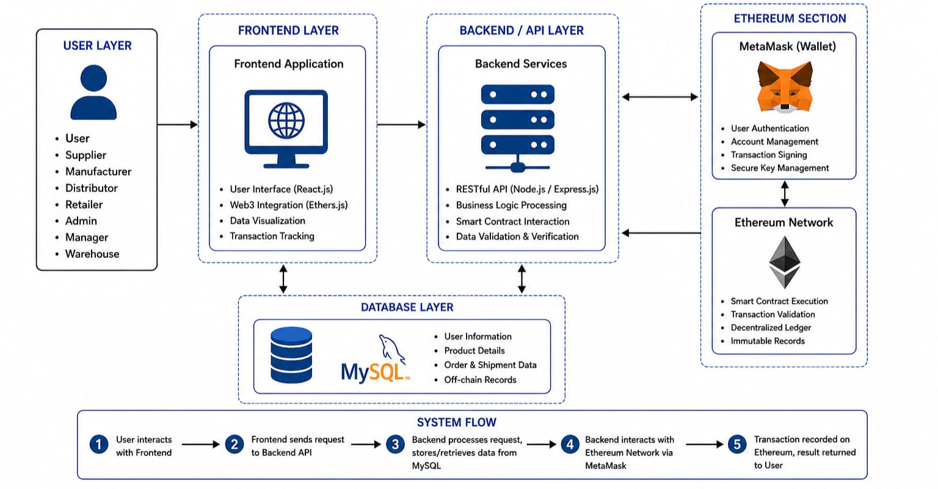

Slide 9
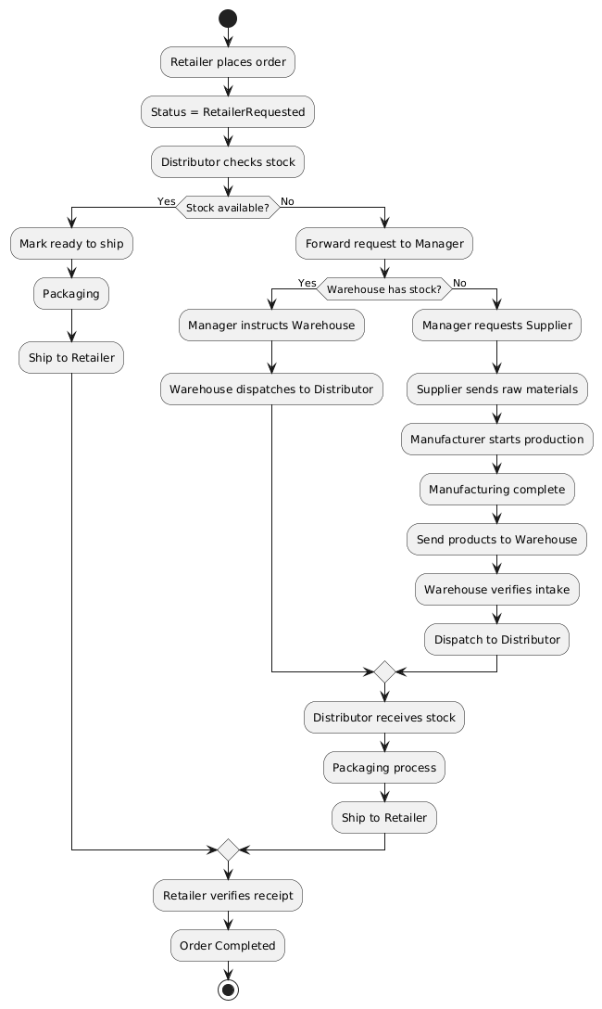
Flow Diagram

Slide 10
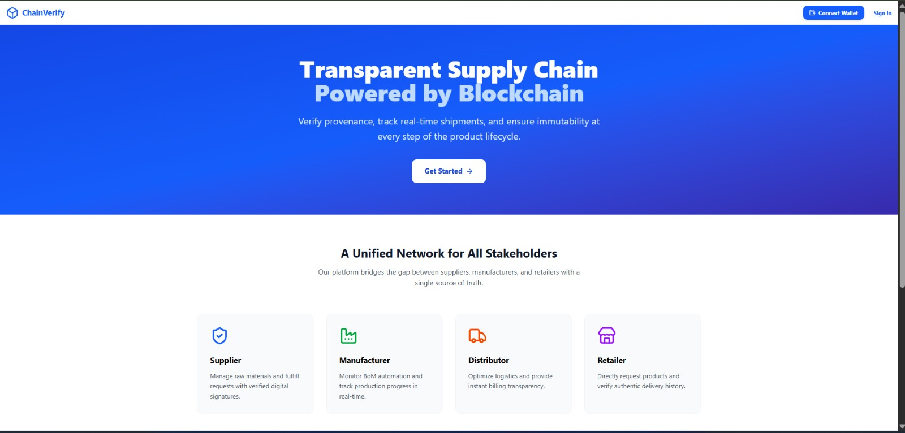
LANDING PAGE

Slide 11
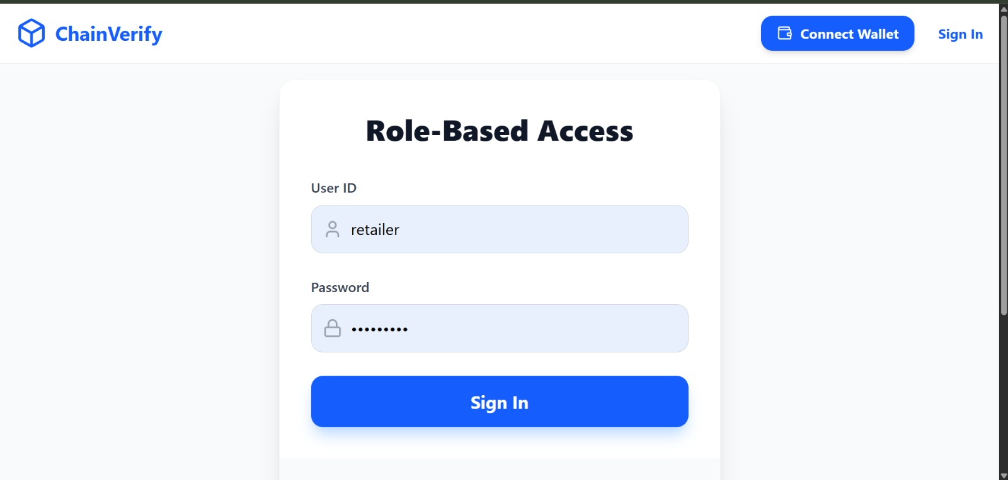

Slide 12
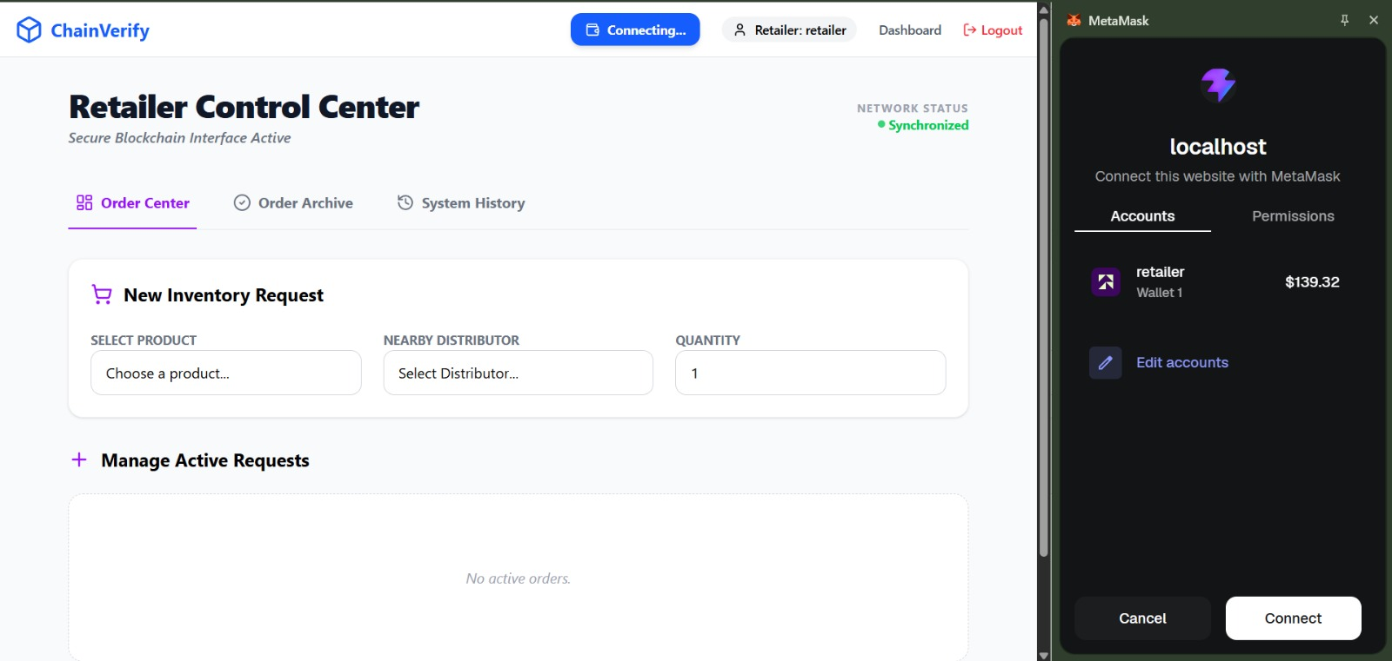
1.Retailer Module

Slide 13
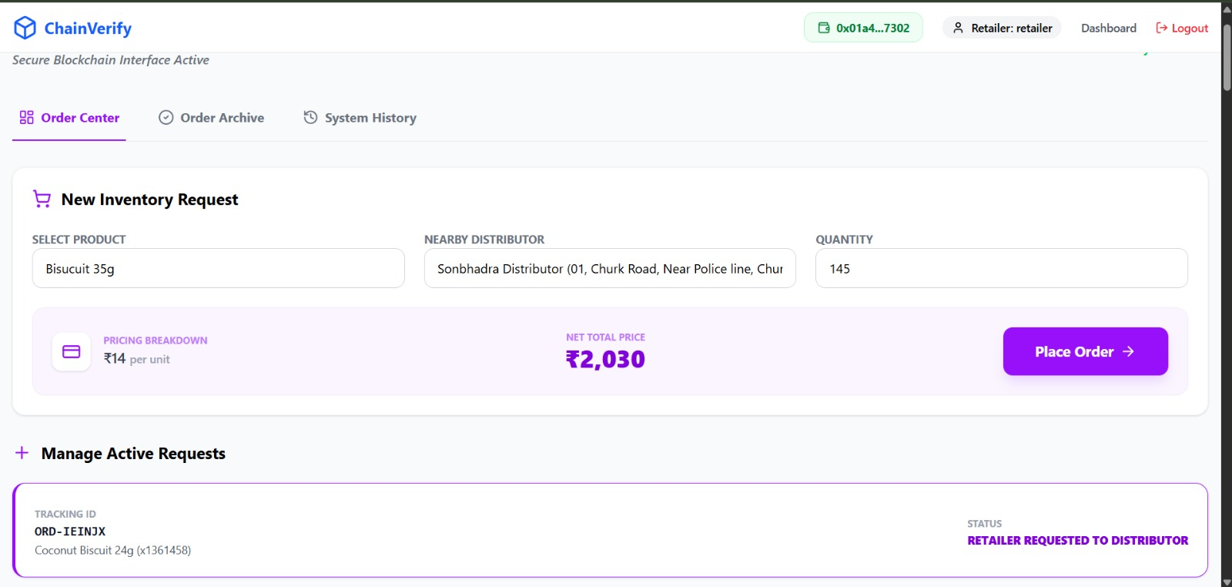

Slide 14
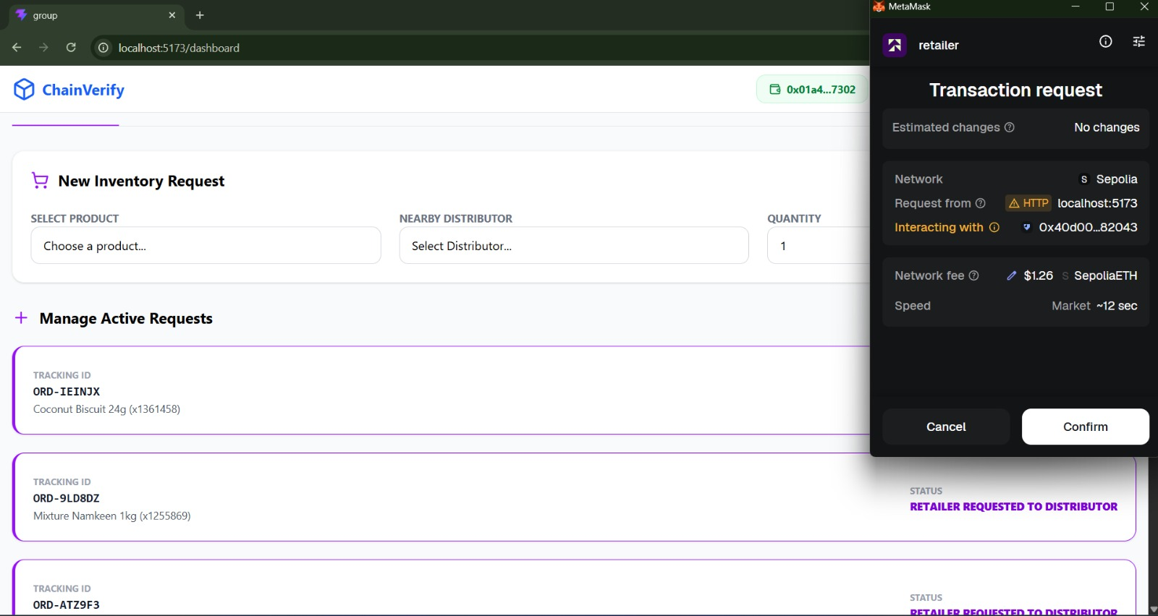

Slide 15
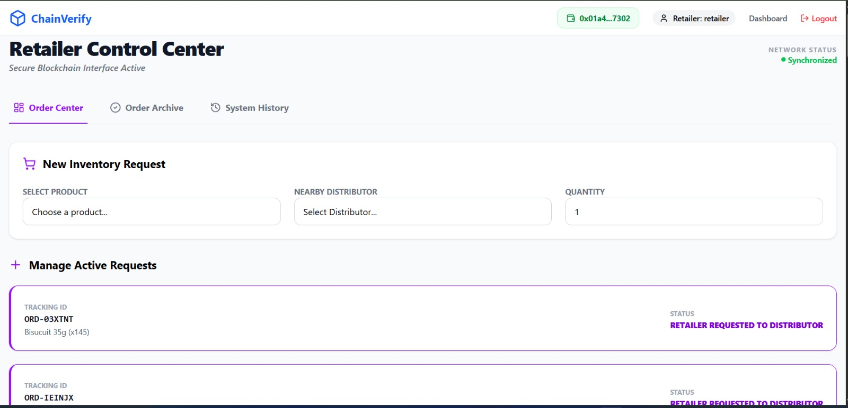

Slide 16
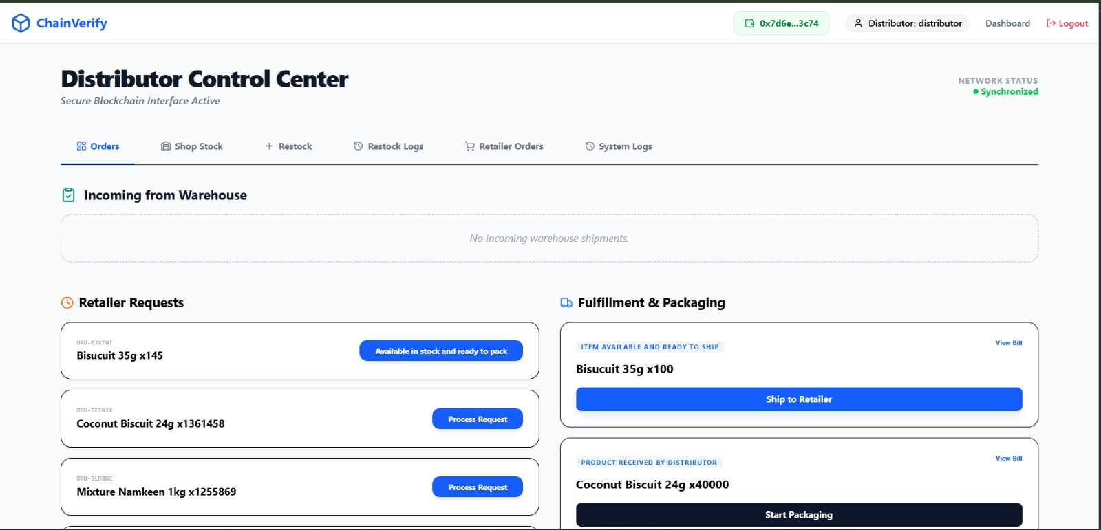
System Module
2. Distributor Module

Slide 17
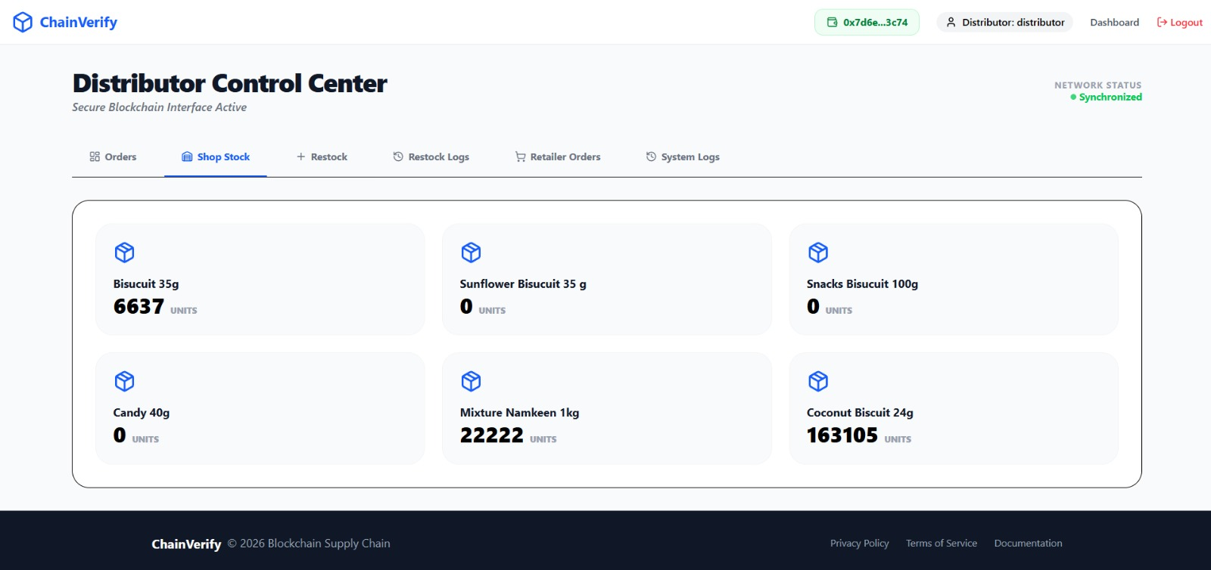

Slide 18
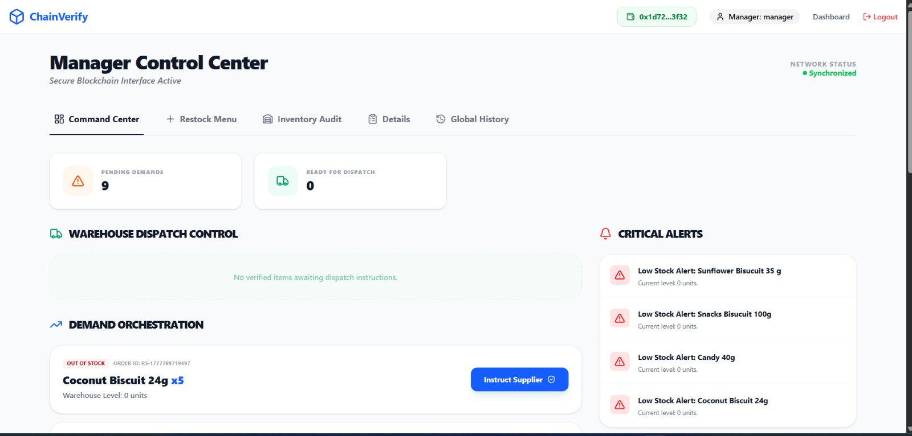
3.Manager Module

Slide 19
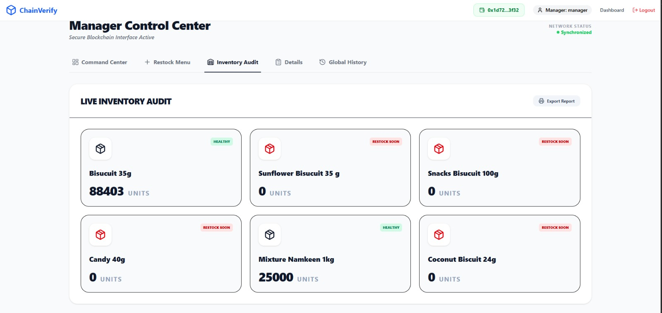

Slide 20
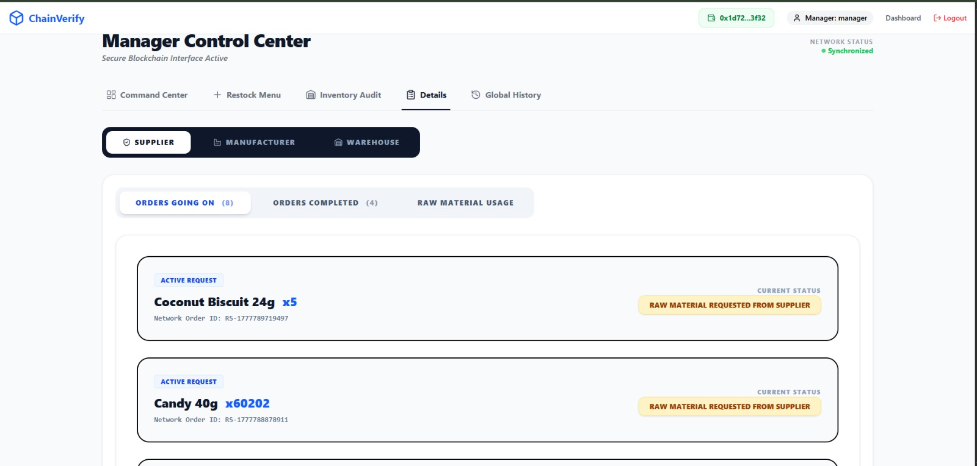

Slide 21
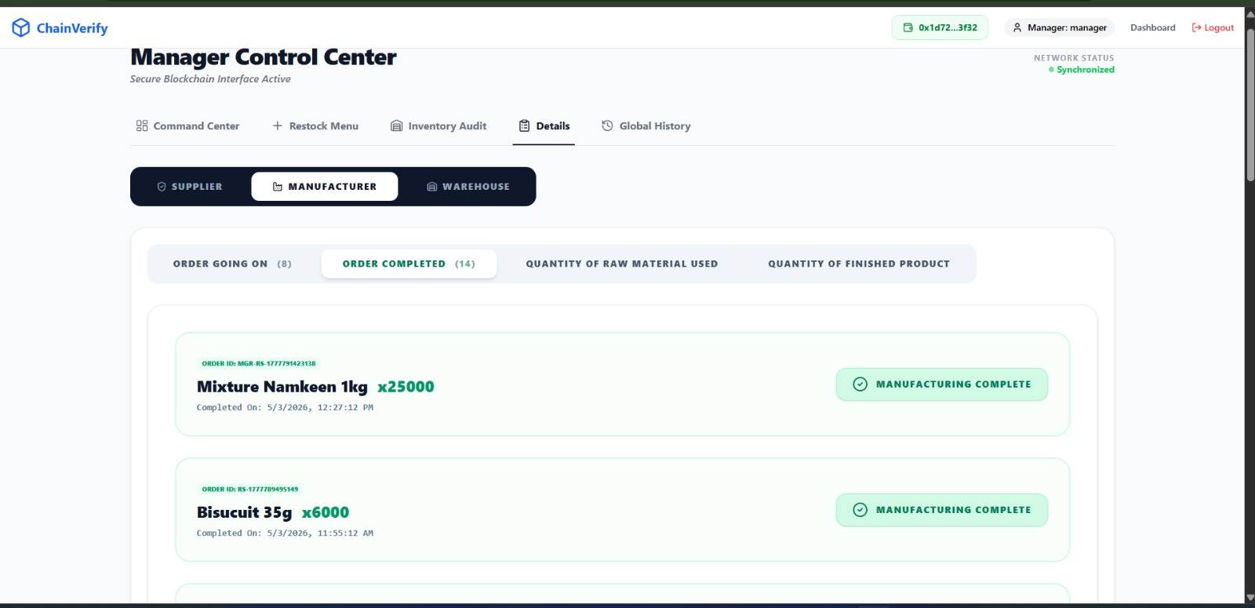

Slide 22
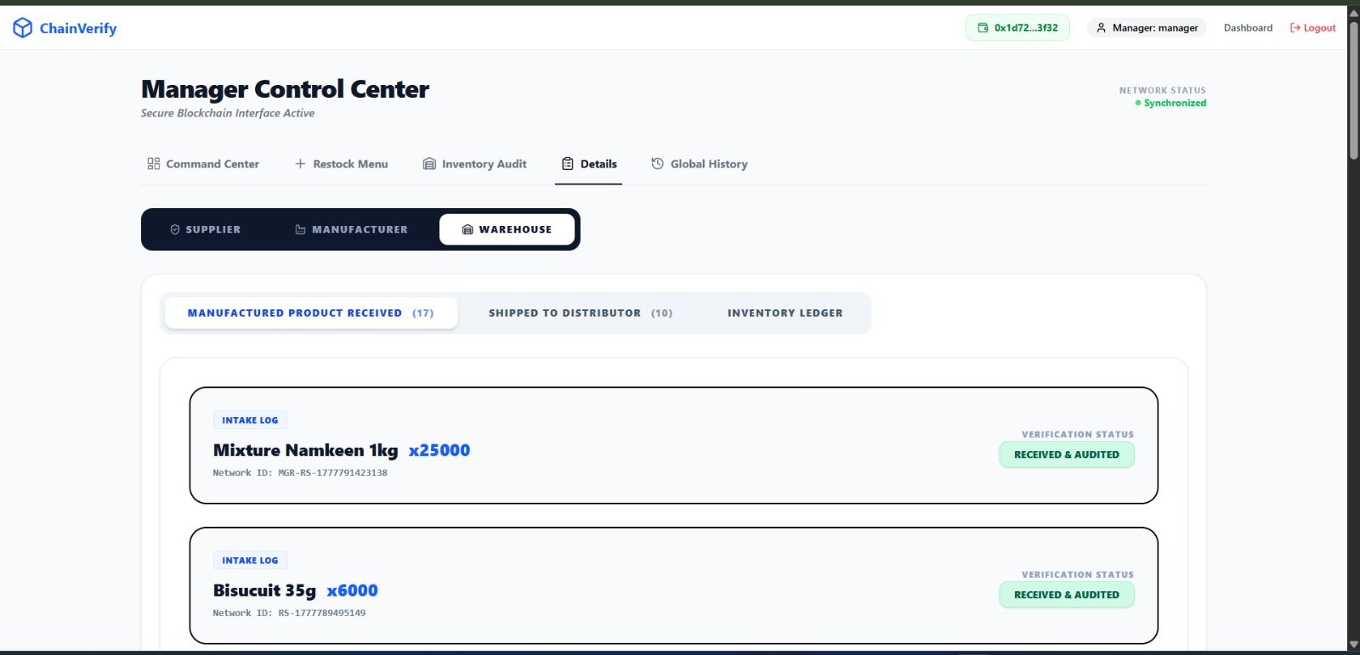

Slide 23
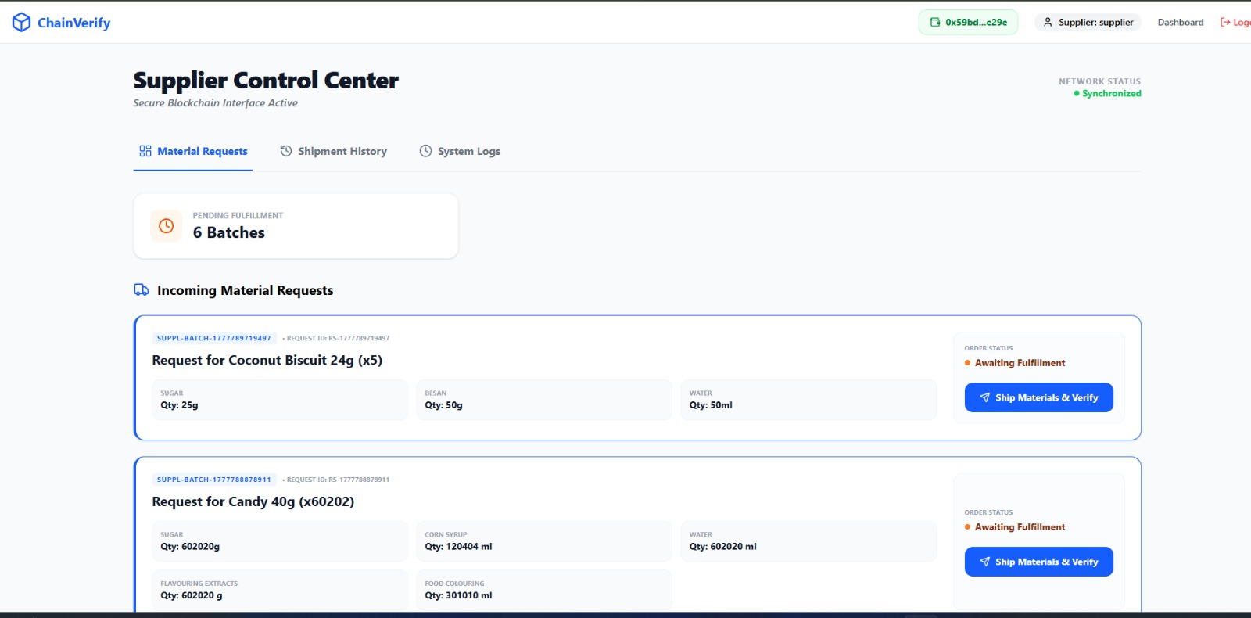
4.Supplier Module

Slide 24
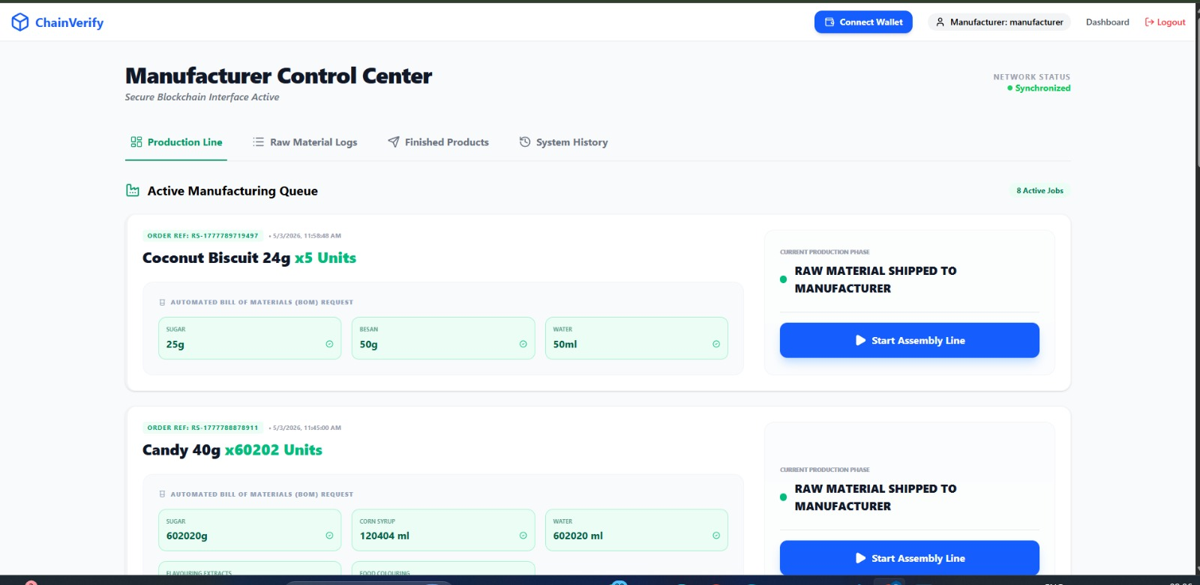

Slide 25
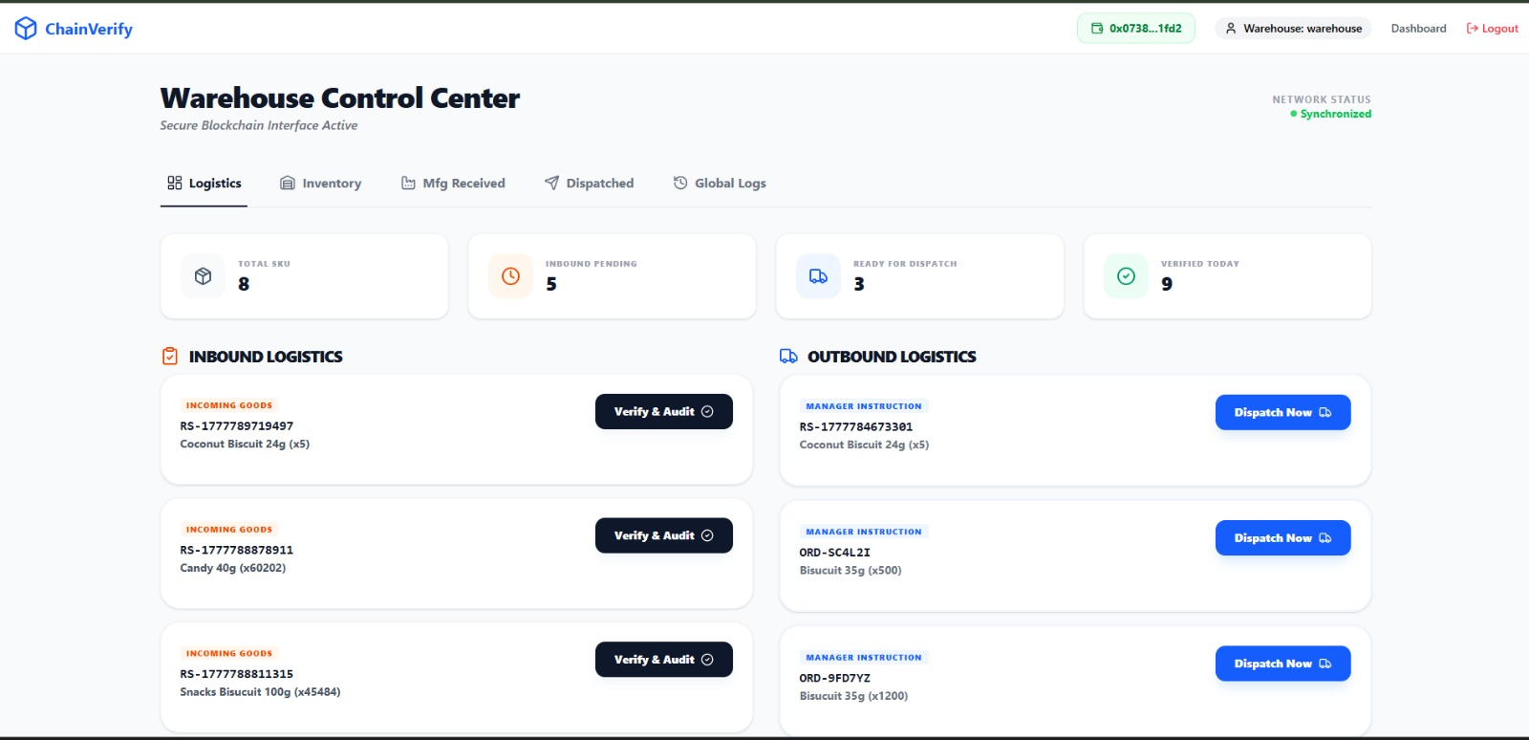

Slide 26
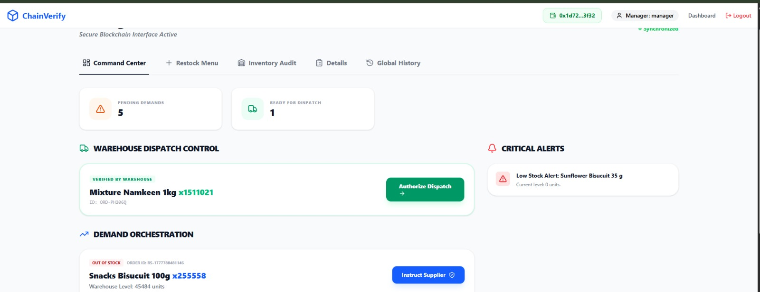

Slide 27
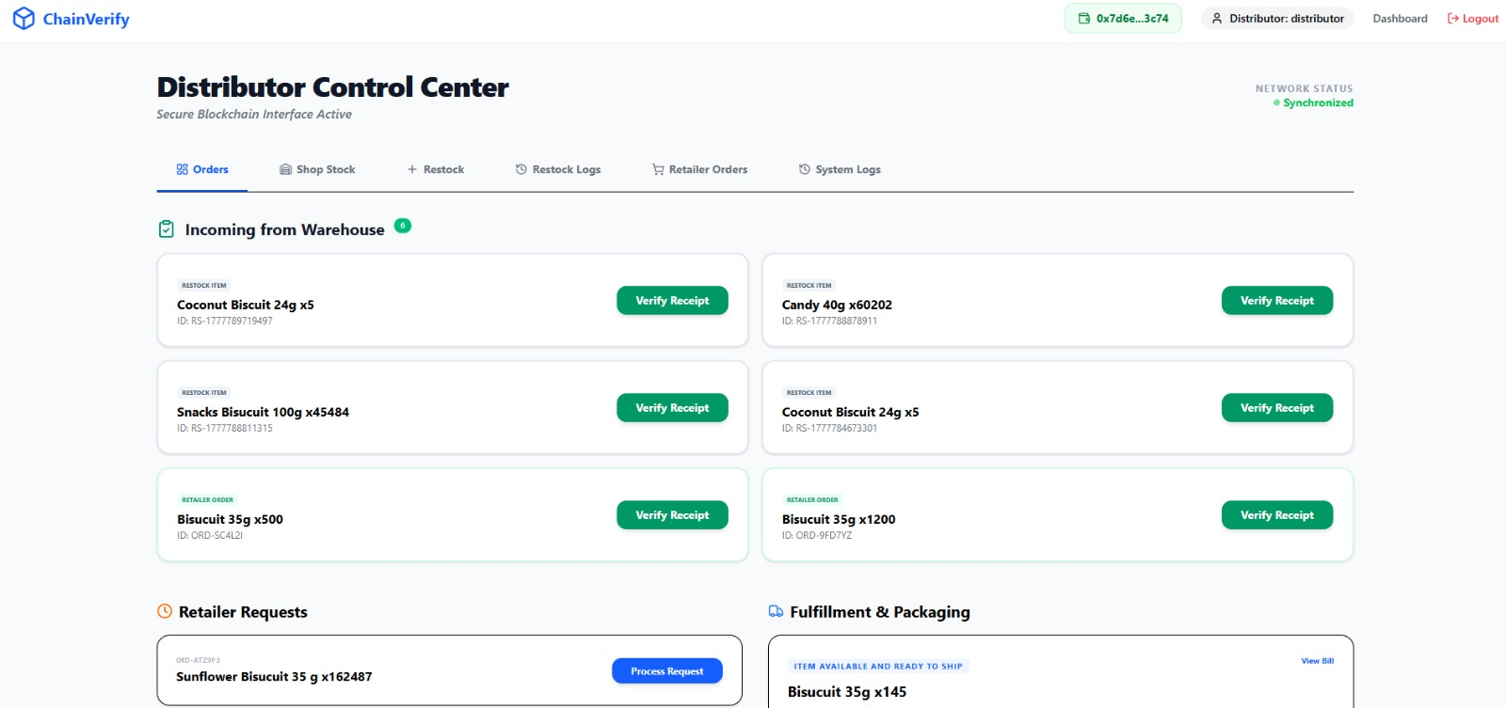

Slide 28
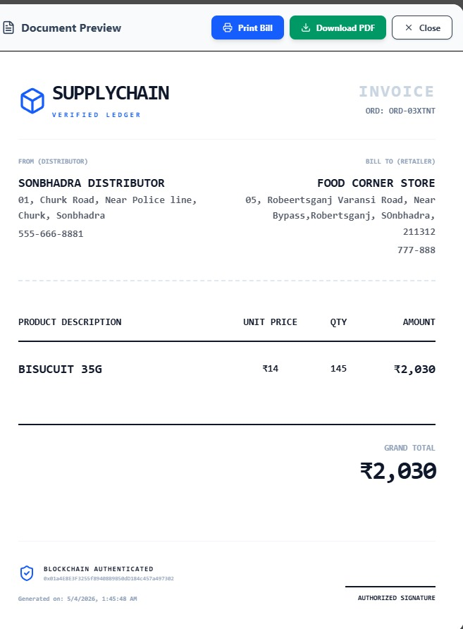

Slide 29
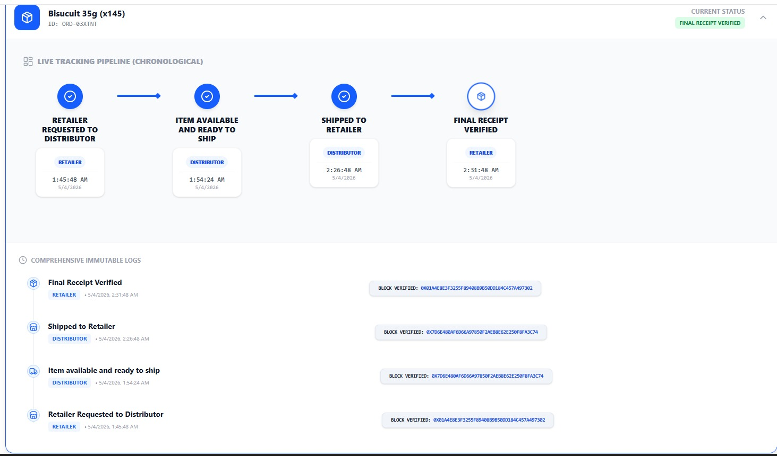

Slide 30
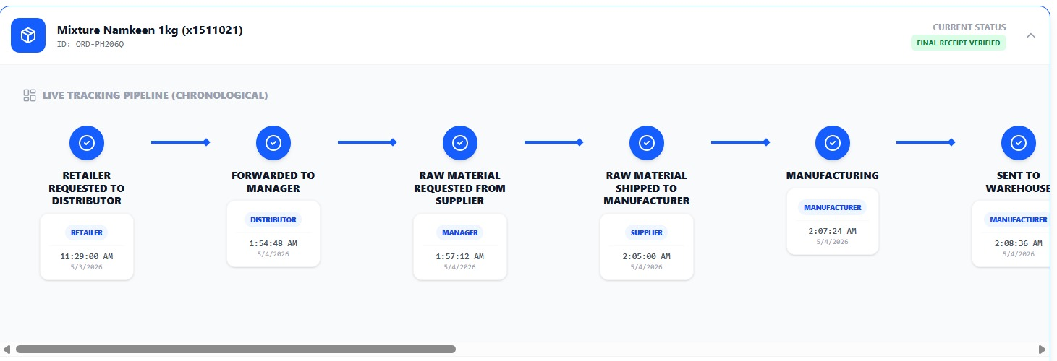
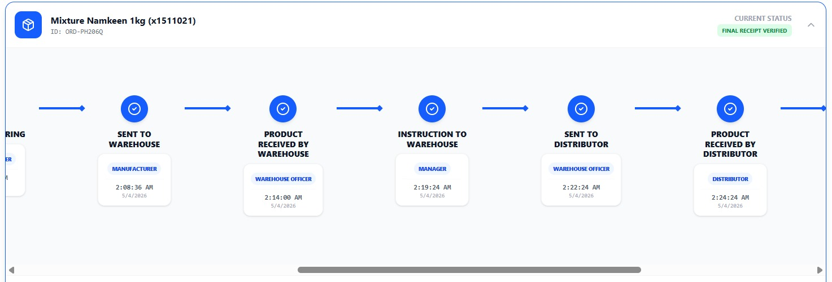
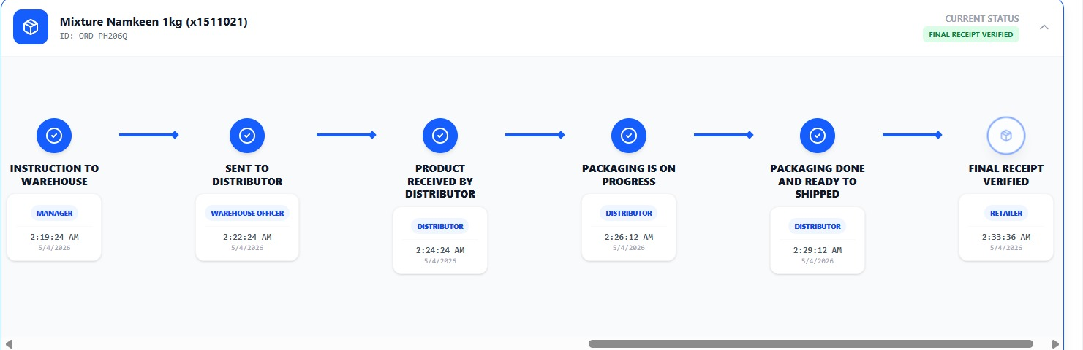

Slide 31
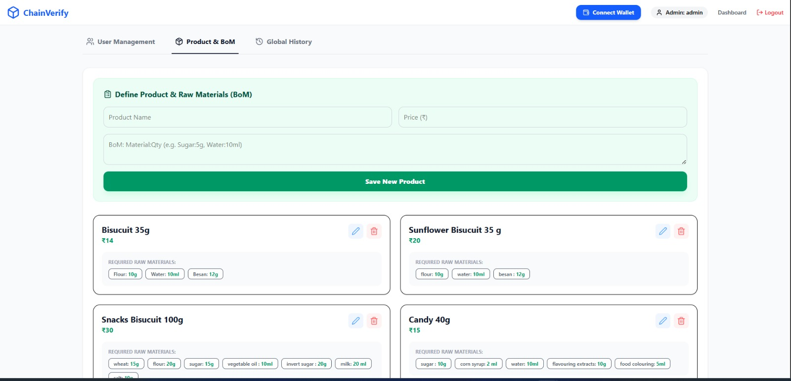
Admin Panel

Slide 32
Reference
Solidity Documentation: https://docs.soliditylang.org/
React Documentation: https://react.dev/
Hardhat Documentation: https://hardhat.org/
MetaMask Developer Docs: https://docs.metamask.io/
Tailwind CSS Documentation: https://tailwindcss.com/
IBM Blockchain. "Blockchain for Supply Chain: Transparency and Traceability." Available at: https://www.ibm.com/blockchain/industries/supply-chain
ResearchGate. (2024). Blockchain Technology for Global Supply Chain Management: A Survey of Applications, Challenges, Opportunities & Implications. IEEE Access, 12,
MDPI. (2024). Improving Supply Chain Management Processes Using Smart Contracts in the Ethereum Network Written in Solidity. Applied Sciences, 14(11), 4738. https://doi.org/10.3076/3417/14/11/4738

